Slide 1
Beginner’s Guide to Documenting APIs
Joanna Bujes and Paul Wallace
TC Camp API Workshop
April 26, 2019

Slide 2
Schedule
Time | Session | Presenter
9:00 | Introduction | Joanna and Paul
9:15 | What’s an interface? | Joanna
9:30 | Syntax conventions | Joanna
9:45 | Break
10:00 | Command line interfaces | Joanna
10:45 | Break
11:00 | Application programming interfaces | Joanna
12:00 | Lunch
1:00 | RESTful APIs | Paul
1:45 | Break
2:00 | Documenting APIs: the reality | Joanna
2:30 | Break
2:45 | Docs as code | Paul
3:30 | Q&A | Joanna and Paul

Slide 3
What is an interface?
Most generally, a means of getting a service without caring how that service is provided.
Buttons in an elevator
A stamped, addressed envelope
A remote control for a given device – TV, DVD player, stereo

Slide 4
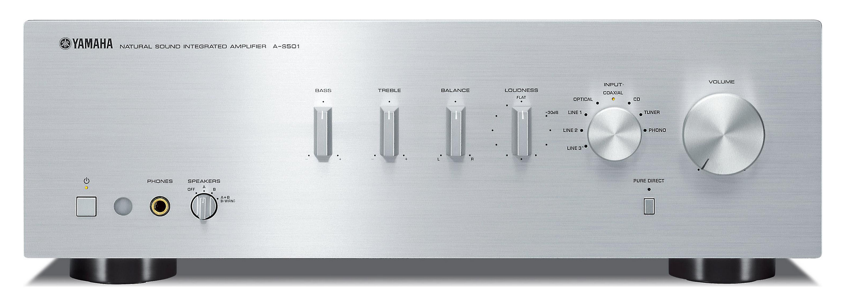
A stereo amplifier:
It takes input from a CD player, a tuner, a record player
It sends output to one or more speakers
You control the inputs, outputs, and sound using the controls shown

Slide 5
If we were to translate the actions of these controls into English sentences:
Set volume to 11
Set treble to 0
Set bass to 2
Set input to CD
Set output to speaker A

Slide 6
The amplifier’s interface
Describing generally how the amplifier can be configured:
SetVolume value
SetTreble value
SetBass value
SetInput cd | phono | tuner | tape
SetOutput A | B | AB
SetAmplifier -v value -t value -b value -in cd | phono | tuner | ta -out A | B | AB
SetAmplifier -v 11 -t -2 b 5 -in phono -out AB

Slide 7
Syntax conventions
Format | Meaning
element <element> | A variable for which you must supply specific information
literal | A value that you must specify exactly as shown
a | b | Select either a or b
[ element ] | An optional element
element… | An element that you can repeat

Slide 8
From syntax to specific command
CreateFile filename …
For example: CreateFile telephone.txt birthdays.txt
RenameFile oldName newname
For example: RenameFile Taxes.pdf Taxes2018.pdf
SetAlarm <time> [<snooze_interval>]
For example: SetAlarm 1600 10

Slide 9
Syntax and meaning
A good command is syntactically correct and results in a realistic/meaningful action.
article adjective noun verb article adjective noun. ← syntax
The blue house kicked the shaggy dog.
The fierce lion pounced on the frightened antelope.
Fierce pounced frightened lion the antelope the frightened on.

Slide 10
Syntax and reality
What information might we want to add to the following syntax diagrams:
SetAmplifier –v value –t value -b value -in cd | phono | tuner | ta –out A | B | AB
SetAlarm <time> [<snooze_interval>]
ChangePassword old new [expiration_date]

Slide 11
Software interface
A way to get the services of a software component without having to know anything about how that is implemented.
Graphical User Interfaces
Command Line Interfaces
Application Programming Interfaces – domain specific
RESTful APIs

Slide 12
Command line interface
A way of interacting with a program by issuing commands in the form of successive lines of text entered in a command shell.
The command might be passed to the Operating System for some action, or it might be passed to an application installed on your machine: the application will interpret and execute the command.
The syntax and meaning of these interfaces needs to be documented.

Slide 13
CLI command syntax
A CLI consists of a set of commands, a set of command options, and optionally constants and environment variables.
Commands are particular to the shell or program and specify actions/verbs.
The parameters you pass to these commands are the elements that the commands need to do their work or elements that the commands act on.
General syntax for a command:
Command parameter1 parameter2 parameter3 …

Slide 14
Shells: user interface to OS
whoami bujes
pwd /Users/bujes/repos/doc
ls
ALSUdragonbook.pdf Simon's analysis prezo.docx
Compilers.docx Static Code Analysis.docx
man <command> Displays help for the command.

Slide 15
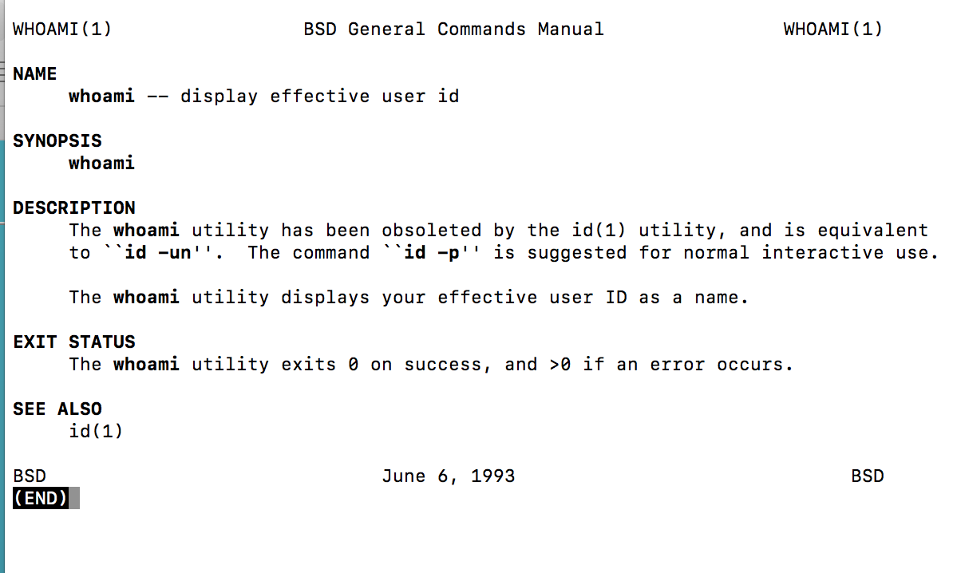
$ man whoami

Slide 16
Documenting a command
Documenting a command requires the following information:
Summary
Syntax
Detailed information about syntax elements: options, parameters, defaults
Description and usage notes
Examples
Error codes
Related material

Slide 17
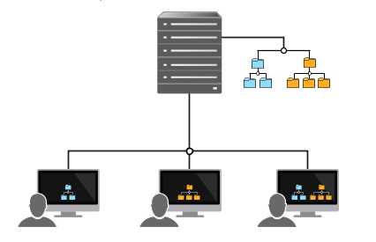
Workspaces and depots

Slide 18
CLI Examples
https://www.perforce.com/manuals/v15.1/cmdref/p4_cachepurge.html
https://www.perforce.com/manuals/v15.1/cmdref/p4_archive.html

Slide 19
CLI exercises
Explain what each command does:
p4 cachepurge –a –D install.txt upgrade.txt
p4 cachepurge –m 100 -D upgrade.txt
Write a command for each description:
The following example shows how you would use the p4 cachepurge command to delete enough content to leave 1000 bytes of free space.
The following example shows what would happen if you deleted all revisions of the file mysource.c, but it does not actually delete the revisions.

Slide 20
From command to description:
p4 cachepurge –a –D install.txt upgrade.txt
This command deletes all revisions of the files install.txt and upgrade.txt.
p4 cachepurge –m 100 –D upgrade.txt
This command deletes 100 revisions of the file upgrade.txt.

Slide 21
From description to command:
The following example shows how you would use the p4 cachepurge command to delete enough content to leave 1000 bytes of free space.
p4 cachepurge –f 1000 –D upgrade.txt
The following example shows what would happen if you deleted all revisions of the file mysource.c, but it does not actually delete the revisions.
p4 cachepurge –n –a –D mysource.c

Slide 22
What we’ve learned
What a command line interface is
What syntax conventions are
How to use syntax to define a command prototype
How to create a command from a prototype
How to describe the action of a command

Slide 23
APIs and libraries
What is a library?
Why do we use libraries?
How do we access code in a library?
What are standard libraries?
What are third-party libraries?

Slide 24
Libraries
A library is a group of functions and declarations created for use by other programs
A library is written in a particular language and can be used by software written in the same language
A library exposes its services through an API
The code that implements the services defined by the API is not visible to the programmer who uses the API

Slide 25
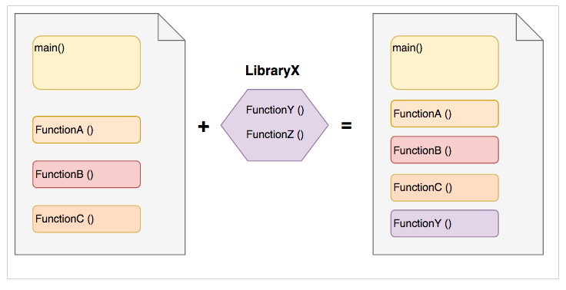
Program Structure

Slide 26
Standard libraries
Standard libraries are shipped with each programming language. They provide common functions and data types that programs use. For example math functions, string manipulation functions, input/output functions, and so on.
#include <stdio.h>
int main () { printf ("Hi there") }
//declaration of printf
int printf(const char *format, ...)

Slide 27
Third-party libraries
Third-party libraries provide functionality that help you use the services of that party.
--An operating system publishes an API that enables your application to run on that operating system
--An application publishes an API to help you access data or services particular to that application
Search for “facebook api” “twitter api” “<your_favorite_app> api” to see how common these APIs are and what they have to offer.

Slide 28
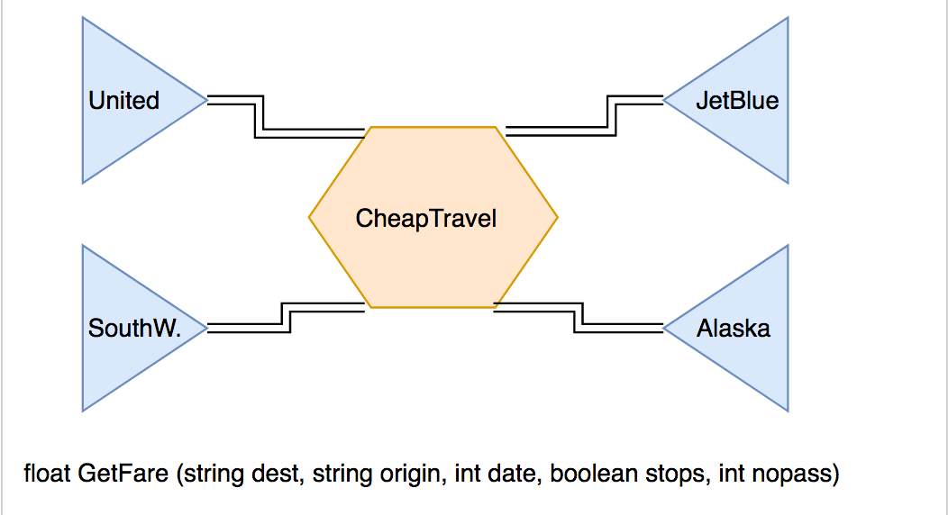
Using third-party APIs

Slide 29
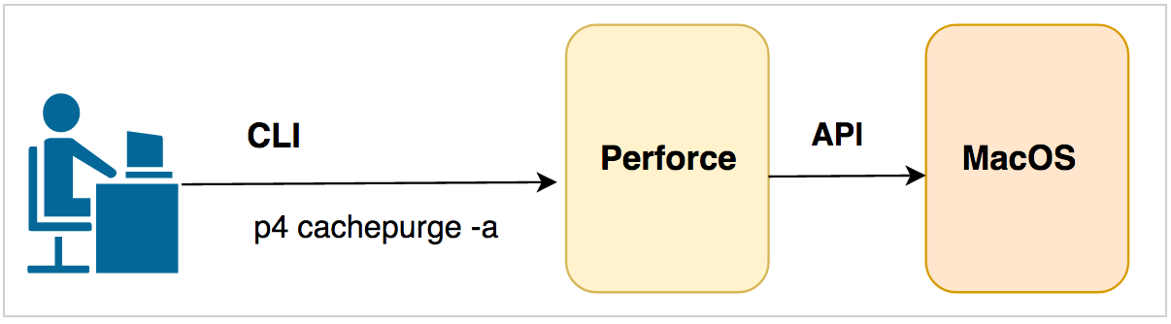
CLI vs API
CLI Command prototype: p4[g-opts]cachepurge-a[-n-R-O][-in][-Sn][-Dfile...] Actual command: P4 cachepurge –a –D install.txt upgrade.txt
API
Declaration: float GetFare (string dest, string origin, int date, boolean stops, int nopass)
Invocation: price = GetFare (“NYC”, “OAK”, 352020, false, 2)

Slide 30
Simple and complex data types
The parameters you pass to commands generally specify data, and that data is typed.
Simple types include integers, floats, strings, and Booleans
Complex types include arrays, and structures composed of simple types
An array is a collection of simple types and may not contain more than one type
A structure may contain a mixture of types

Slide 31
Data type examples: complex data types
struct account { int account_number;
char *first_name;
char *last_name;
float balance;
};

Slide 32
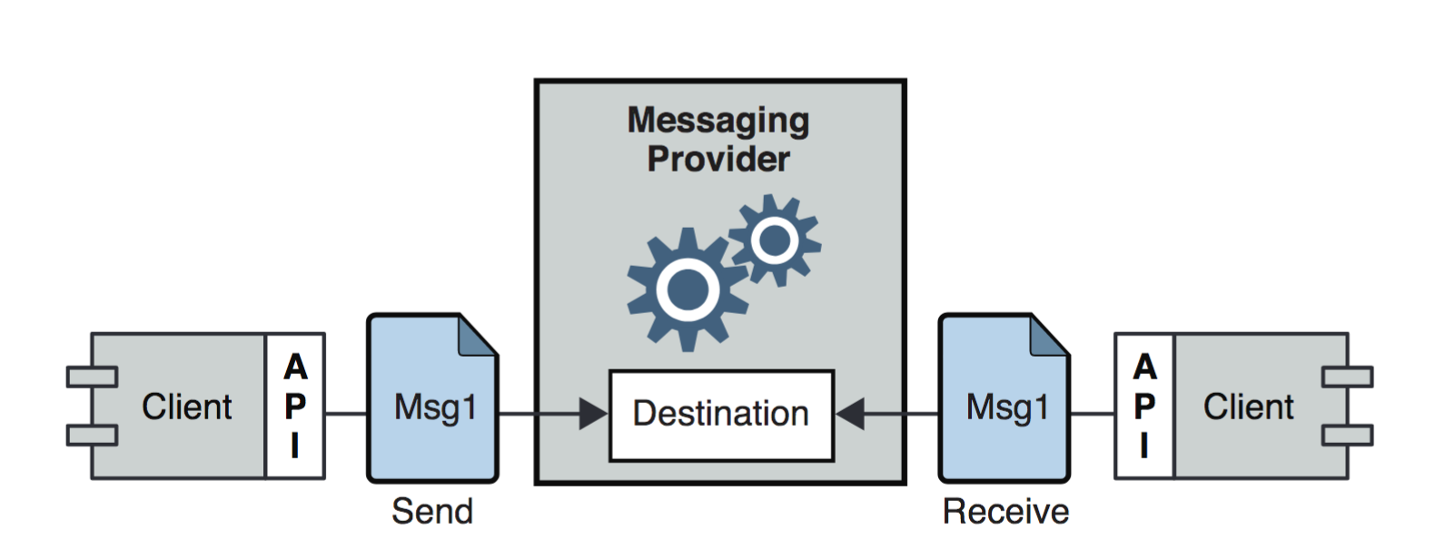
A messaging application
Client application uses API calls to define and send a message.
The message is relayed via destination on a server.
The client uses API calls to connect to the server and retrieve the message.

Slide 33
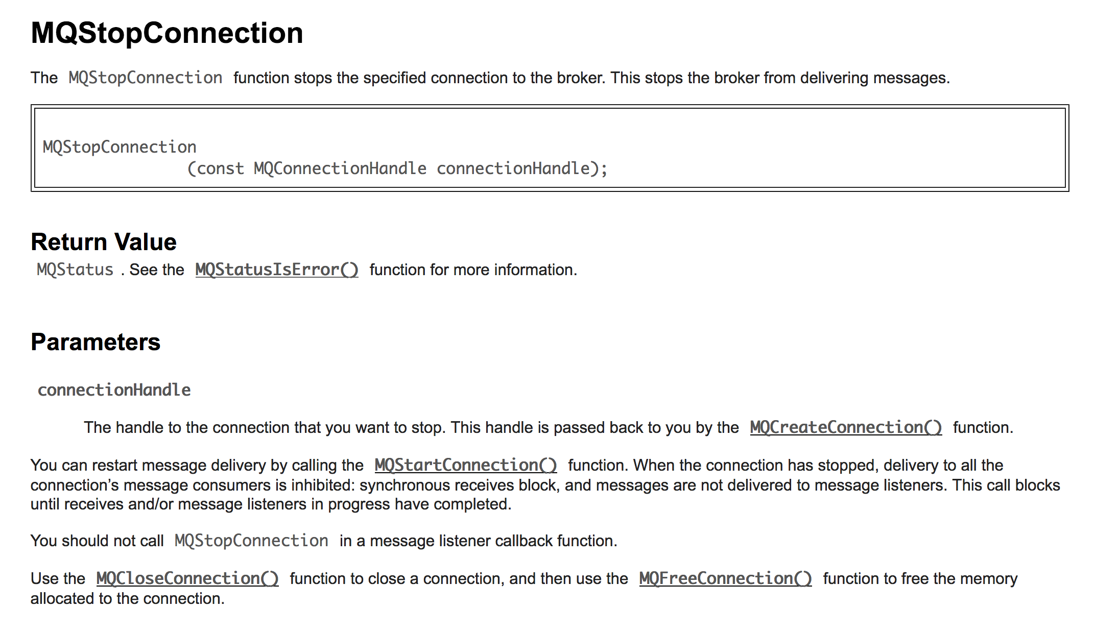

Slide 34
Time for Lunch

Slide 35
How this works in the real world
API documentation commonly includes dozens of functions and many data structures.
These functions and data structures are presented in a reference format, almost always in alphabetical order.
In addition to the reference material, a user also needs to understand the basic use cases for the API and also the basic concepts or standards that are introduced by the API.

Slide 36
Requirements of reference information
Consistency: use consistent formats, terminology, parallel constructions, examples.
Be explicit about agency: end user, developer, administrator, dev ops.
But remember: reference information is not enough. You must also develop procedural and conceptual information
Procedures: how do I use the API to get something done.
Concepts: what basic concepts must I understand to make sense of the procedures and reference information.

Slide 37
Editing and maintaining API documentation
Editing and maintenance tasks are often assigned to beginning writers. You might be asked to do the following:
Proofread or edit existing documentation
Re-organize or cleanup existing documentation (p4 archive)
Correct or expand existing documentation to provide better info
Expand existing documentation if the API/CLI changes

Slide 38
Creating new API documentation
Once you become more experienced, you will be able to document an API from scratch.
Your inputs might consist of the following:
Access to source code
A specification that describes the functions and data structures of the API or the commands of the CLI
White papers or other collateral associated with the API
Research that your do; training you undertake

Slide 39
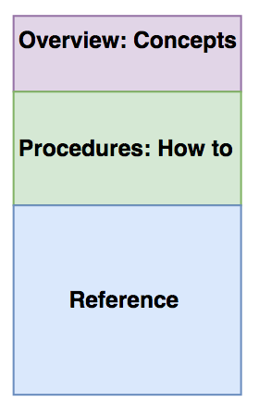
Although your book is meant to be read from front to back; you will be most productive writing it from back to front.

Slide 40
Working backwards
Write the reference section first -- you can be productive before you understand everything -- for a rushed release, it is acceptable to just have the reference
Write the procedural section next to explain how the functions are meant to work together to accomplish a task
Write the conceptual section last to explain those things without which the user could not understand the rest: set context, describe the basic workflow
API documentation is incomplete without these three types of docs.

Slide 41
The maintenance workflow
Developer files a bug describing the change or addition.
You ask for clarification if needed.
You update the doc.
Developer reviews the docs and verifies, or asks for further changes
Update until verified.

Slide 42
Writing new API doc
Read the specs and other collateral.
Look for the user view.
Research basics you don’t understand.
Write an outline of the proposed doc and have dev verify it.
Start writing the reference; get sanity checks along the way.
Write the procedural chapters and the introduction.
Send doc to review.
Incorporate comments.
Publish.

Slide 43
Working with engineers
Engineers tend to be focused on the implementation of the API/CLI
Product managers, support, and sales engineers sometimes have a better understanding of the user view
It is unreasonable to expect the engineer to do your work for you. You are responsible for learning the basics.
Engineers are generally patient and understanding, especially when it’s not three days before a deadline.

