Slide 1
Lockbench progress
Trying different locks on libcds StripedMap, libcds AVL, and Wormhole

Slide 2
StripedMap setup
Vendored libcds (just the headers I need) into third_party/libcds/.
The lock is a template parameter in libcds, so I just pass in my own lock types.
Adapter: include/indexes/striped_map_index.hpp.
Bench: bench/cds_bench.cpp, with --lock std|tas|ttas|cas|ticket.
Wrote a correctness test (bench/cds_test.cpp) that compares against std::map.
All 5 locks passed the correctness test.

Slide 3
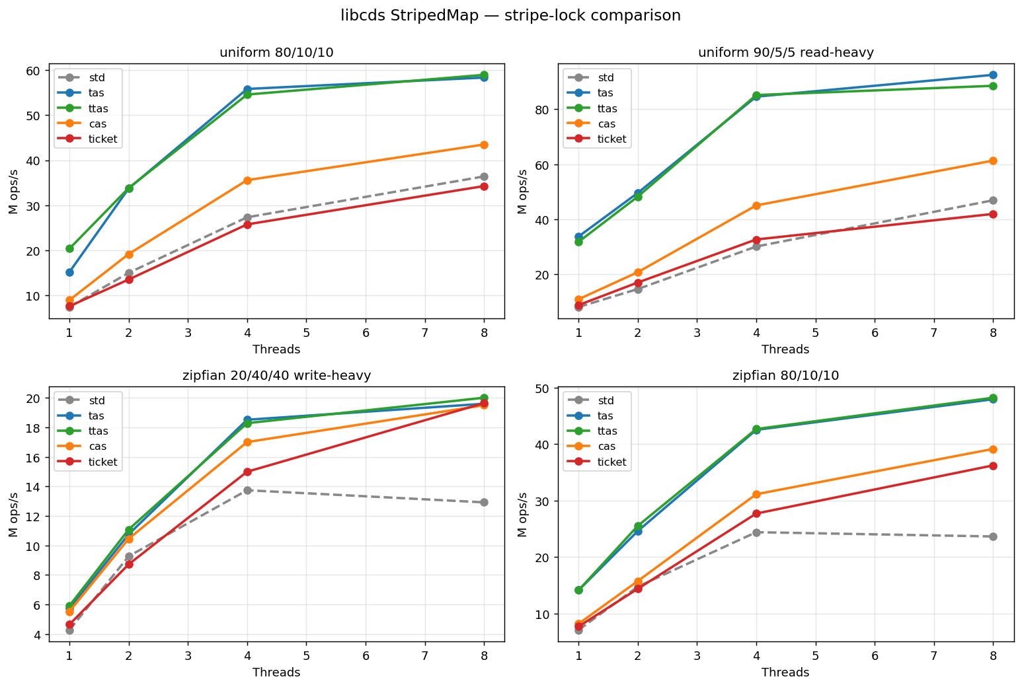
StripedMap throughput
Higher is better. std::mutex is the dashed grey line.

Slide 4
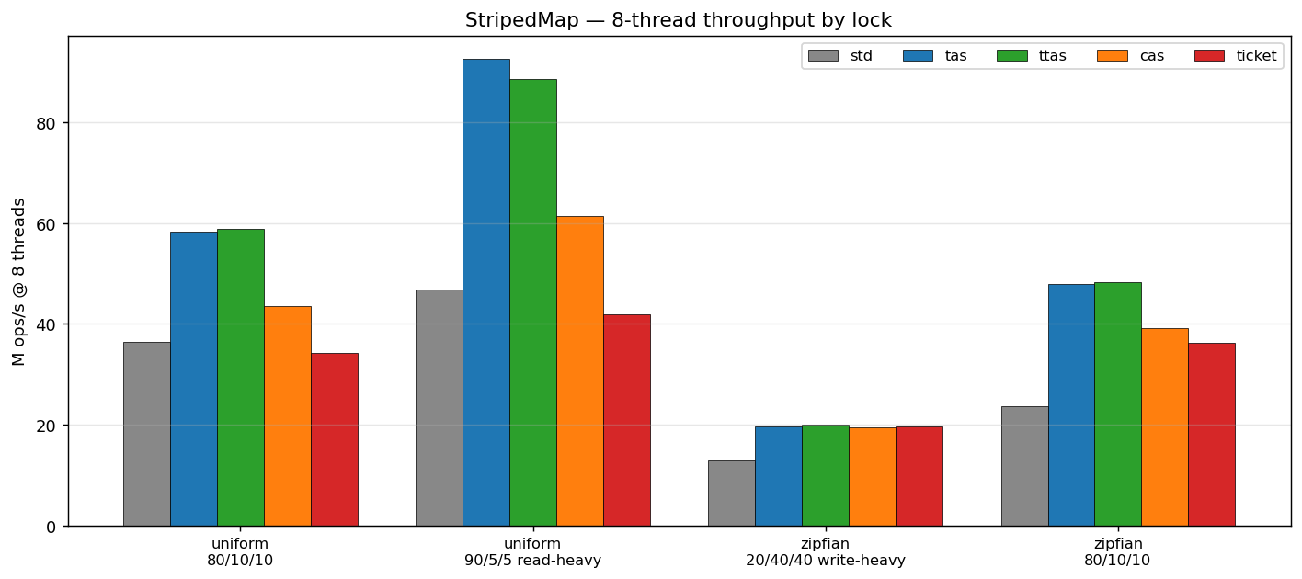
StripedMap at 8 threads

Slide 5
StripedMap — what I noticed
TAS and TTAS are the fastest, especially on read-heavy.
std::mutex is slower than the spinlocks here (Apple Silicon parks the thread).
Ticket lock isn't great on uniform workloads.
On the write-heavy workload everything looks similar — contention dominates.

Slide 6
Bronson AVL setup
Same idea but with libcds's BronsonAVLTreeMap (a tree).
Tree uses one lock per node, plumbed via cds::sync::injecting_monitor<Lock>.
Needed to add a small static lib (cds-rt) for libcds's RCU runtime.
Adapter: include/indexes/avl_tree_index.hpp. Bench: bench/cds_avl_bench.cpp.
Correctness test passed for all 5 locks.

Slide 7
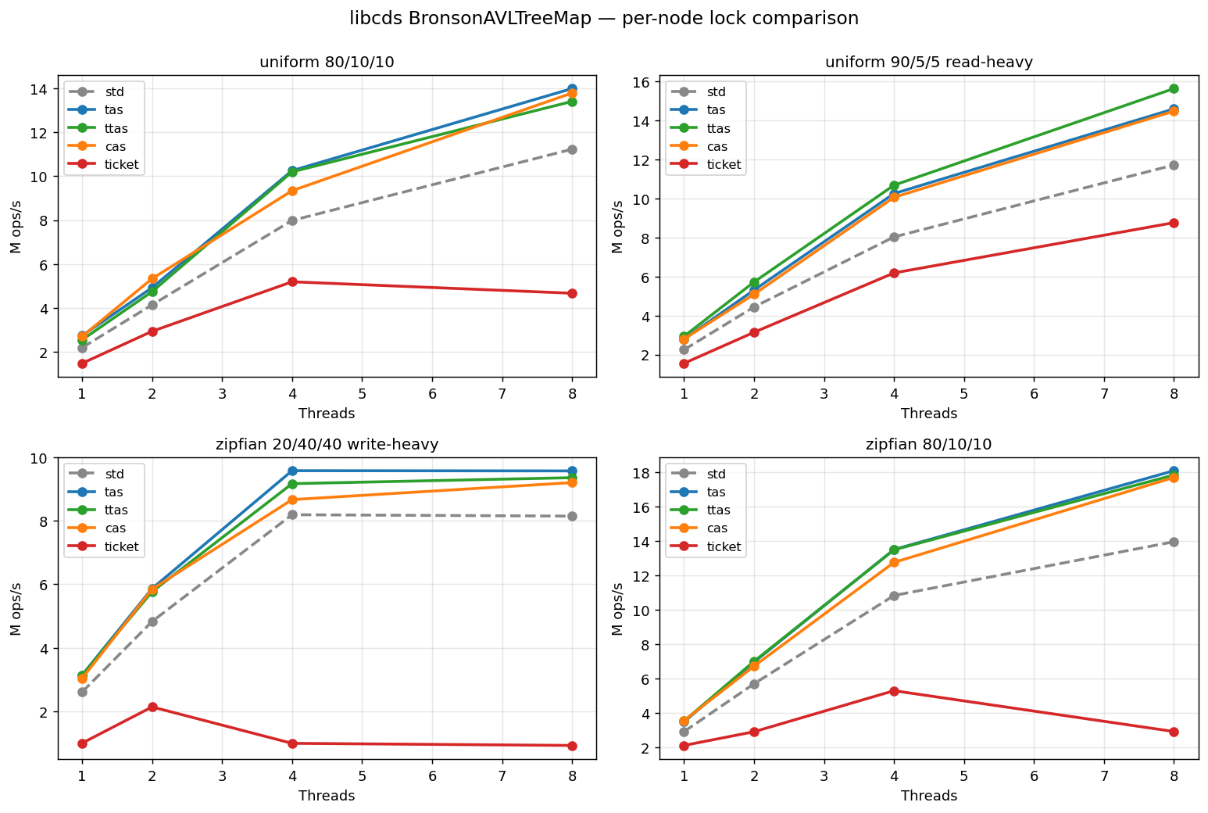
Bronson AVL throughput
Slower than StripedMap overall because tree ops are O(log N).

Slide 8
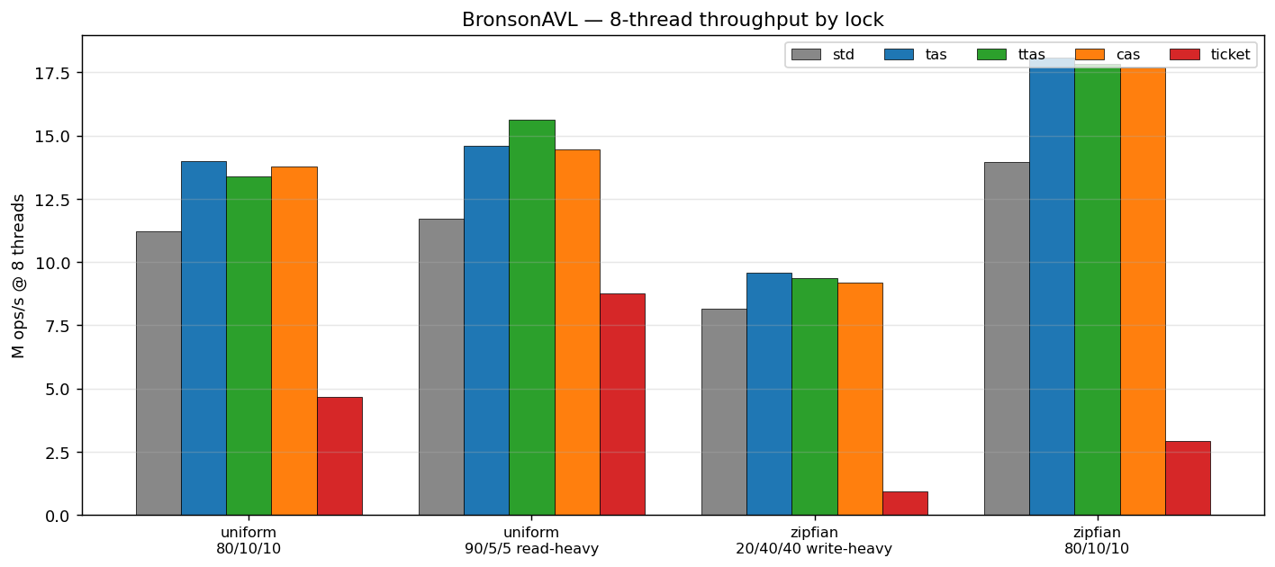
Bronson AVL at 8 threads

Slide 9
Bronson AVL — what I noticed
Ticket lock does really badly here.
I think it's because Bronson's readers do a version-check thing and the ticket lock's FIFO ordering doesn't play well with that.
TAS / TTAS / CAS are all close to each other.
std::mutex is somewhere in the middle.

Slide 10
Wormhole
Concurrent ordered index from Wu et al. (FAST '19).
It's a mix of a trie + hash + linked list.
Three lock sites in the code: leaflock (rwlock), metalock (rwlock), sortlock (small spinlock).
Readers do a try-lock-with-spin then fall back to a version check if the lock isn't free.
Also uses RCU (called QSBR) for reclaiming freed leaves (that's separate from the locks)

Slide 11
Wormhole : plan
Vendored wormhole into third_party/wormhole/.
Wrote a small shim that replaces wormhole's lock structs with one that wraps any of my lock types.
Building one binary per lock (wh_bench_default, wh_bench_rw, wh_bench_tas, ...).
7 variants total: default (wormhole's own lock) + rw, tas, ttas, cas, ticket, occ.
Sweep script will run all 7 the same way as the StripedMap and AVL sweeps.

Slide 12
Wormhole : things to watch out for
Ticket lock can't really do try-lock without messing up the queue, so I'm using an approximation.
OCC currently runs as a write-only lock here (its optimistic-read protocol doesn't fit wormhole's API).
Not touching wormhole's RCU code => that's separate from the locks.

