Slide 1
Index lock evaluation
How lock primitive choice changes throughput inside three concurrent indexes
Cross architecture: AWS Graviton (ARM) and Intel Xeon (x86)
Andrei Pana
Research project review
May 2026

Slide 2
What this project is about
The goal is to see how different lock primitives perform inside three concurrent indexes,
and whether the answer changes when you move from x86 (Intel Xeon) to ARM (AWS Graviton).
The three indexes used:
1. libcds StripedMap. Hash table with N stripes, one lock per stripe.
2. libcds BronsonAVL. Lock based AVL tree with one monitor lock per node.
3. Wormhole (Wu et al., FAST 2019). Hybrid trie plus hash plus linked list.
Lock primitives compared:
StripedMap and BronsonAVL: std::mutex, tas, ttas, cas, ticket.
Wormhole: default (upstream untouched), rw, tas, ttas, cas, occ, occ-opt.
The headline question: does the same lock win across architectures, or does it shift?

Slide 3
Setup
Machine | Architecture | Cores in scope | Notes
AWS Graviton | ARM Neoverse N1 | 8 | Hypervisor pinned vCPU clocks
Intel Xeon (diascld45) | x86_64 | 16 (out of 48) | Capped at 16T to stay on a single socket
Workload tag | Distribution | Reads % | Inserts % | Deletes %
balanced | uniform | 80 | 10 | 10
read heavy | uniform | 90 | 5 | 5
hot key | zipfian | 80 | 10 | 10
write heavy | zipfian | 20 | 40 | 40
Each run is 3 seconds of measurement after 1 second of warmup.
Thread ladder is power of 2 up to the per machine cap (1, 2, 4, 8 on Graviton; 1, 2, 4, 8, 16 on Xeon).
Every plot in this deck shows Graviton in the left panel and Xeon in the right panel for the same workload.
Below each line plot we also show a sorted bar chart at the maximum thread point so the ranking is visible at a glance.

Slide 4
Thread pinning details, Graviton specifics
How --pin works in the harness, and what it actually does on a c6g instance
How --pin is implemented (Linux only, in include/primitives/util.hpp):
set_thread_affinity(thread_id) calls sched_setaffinity with a cpu_set_t containing only that one CPU.
Threads are numbered 0, 1, 2, ..., so thread N gets pinned to logical CPU N.
Pinning is dense and sequential: a 4 thread run uses CPUs 0..3, an 8 thread run uses CPUs 0..7.
What that means on AWS Graviton specifically:
c6g instances run Neoverse N1 cores. Neoverse N1 does NOT support SMT, so one vCPU is one physical core.
The kernel sees CPUs 0..7 on a c6g.2xlarge, and those map 1 to 1 to physical Graviton cores.
AWS Nitro / Graviton does not migrate vCPUs across physical cores at runtime under steady load.
So sched_setaffinity to CPU N effectively pins to physical core N for the duration of the run.
Each pinned thread also gets a hypervisor managed clock that does not vary at runtime, which is one
reason fairness numbers on Graviton are very tight (around 0.98 across all benches).
Honest disclaimer about the data in this deck:
The harness has a --pin flag, but only the standalone cds_sweep.sh passes it. The two sweep scripts
used to produce these slides (wh_compare.sh and run_avl_compare.sh) do NOT pass --pin.
So the Wormhole, BronsonAVL, and StripedMap numbers in this deck are from UNPINNED runs.
On Xeon variance comes from DVFS, not from thread migration.

Slide 5
How we built StripedMap
Adapter at include/indexes/striped_map_index.hpp
Wraps cds::container::StripedMap from libcds.
Hash table with std::list buckets and a fixed array of N stripe locks.
The lock primitive is the template parameter to cds::container::striped_set::striping<Lock>,
so we plug any lockbench primitive (tas_lock, ttas_lock, cas_lock, ticket_lock, std::mutex) at compile time.
We use 65536 stripes. Each operation hashes the key, picks the stripe, and acquires its lock.
Resize policy is load_factor_resizing<4>: when item count divided by buckets exceeds 4,
the map takes ALL stripe locks (scoped_full_lock) and rehashes. We size the initial bucket array
large enough that we do not hit a resize during a benchmark run.
Why it matters: StripedMap is the simplest of the three indexes. There is no traversal,
each operation acquires exactly one lock, so it isolates the cost of a single lock acquire
plus the time to walk the per stripe std::list.

Slide 6
How we built BronsonAVL
Adapter at include/indexes/avl_tree_index.hpp
Wraps cds::container::BronsonAVLTreeMap from libcds. Bronson et al. published this
lock based AVL tree as a balanced concurrent ordered map with optimistic version validated reads.
Tree is balanced. Each node carries a monitor lock that we plug in via cds::sync::injecting_monitor<Lock>.
Reads use a sequence style version counter on each node. Writers take the lock, mutate, then bump the version.
Writes do hand over hand traversal down the tree, locking at most a small constant number of nodes at a time.
Memory reclamation is handled by URCU (cds::urcu::gc<general_buffered>). Worker threads attach to the URCU
manager on first call via a thread_local guard, then detach at thread exit.
Why it matters: the contention surface is much smaller than StripedMap. The hot lock is wherever the
tree is being mutated, which depends on the key access pattern. This is what makes the zipfian
workloads interesting: under a skewed distribution, a small set of nodes carries most writes.

Slide 7
How we built Wormhole, part 1: vendoring and shim design
Adapter at include/indexes/wormhole_index.hpp; shim at third_party/wormhole/wh_lock_shim.{h,cpp}
Wormhole (Wu et al., FAST 2019) is a hybrid trie plus hash plus linked list ordered concurrent index.
It hard codes its own rwlock and spinlock as 4 byte opaque structs in lib.h. For our experiment we need
to swap them with any of our primitives at compile time.
Approach:
1. Vendor wormhole in tree at third_party/wormhole/. The only edits to upstream sources are short
ifdef gated blocks. With WH_LOCK_SHIM unset, the build is upstream wormhole untouched.
2. Add wh_lock_shim.h, which redefines struct rwlock and struct spinlock as 128 byte storage arrays
with extern C function declarations matching upstream signatures (rwlock_lock_read, rwlock_trylock_write_nr, etc.).
3. Add wh_lock_shim.cpp, a C++ TU that picks LockT via WH_LOCK_<NAME> macro, asserts size and alignment,
and provides extern C bodies. Each function placement-news the LockT into the shim storage at init time
and dispatches via small if constexpr templates so the non matching branches are elided.
occ-opt is special: writer side uses the cas lock, but readers walk the leaf without taking the lock at all.
They snapshot a per leaf seqlock counter, read the entries, then validate. On mismatch they retry.

Slide 8
How we built Wormhole, part 2: the alignment bug
Every shim variant SIGSEGV on Xeon during the very first prefill insert
Symptom: wh_test_rw, wh_test_cas, wh_test_tas, wh_test_ttas, wh_test_occ, wh_test_occ-opt all crashed in
wormleaf_insert_hs on Xeon. wh_test_default ran clean. The crash was invisible on Apple Silicon.
Root cause:
wormleaf_shift_inc and wormleaf_shift_dec use _mm256_load_si256 on leaf->ss (AVX2 aligned load).
Aligned loads need the source address to be a multiple of 32 bytes.
With upstream wormhole, leaflock + sortlock take 8 bytes total, so leaf->ss starts at offset 1088 (aligned).
With our shim, leaflock + sortlock take 256 bytes, pushing leaf->ss to offset 1336 (1336 mod 16 = 8).
Aligned SIMD load at a misaligned address gives SIGSEGV on x86. NEON tolerates misalignment, so Mac was fine.
Fix:
_Alignas(32) struct entry13 hs[WH_KPN]; in struct wormleaf, gated on WH_LOCK_SHIM.
This adds 8 bytes of padding before hs[], pulls hs to offset 320 and ss to 1344, both 32 byte aligned.

Slide 9
How we built Wormhole, part 3: bugs in the optimistic reader
Five separate things had to be fixed before wh-occ-opt was correct and fair
1. Uninitialized occ_seq.
slab_alloc_safe returns memory with stale bits. If a fresh leaf came in with an odd seq counter,
readers spun forever waiting for a writer that never existed. Fix: initialize occ_seq to 0 in wormleaf_alloc.
2. Missing seq bumps in writer fast paths.
wormhole_jump_leaf_write and wormhole_split_insert bypass the regular wormleaf_lock_write / unlock_write.
Without explicit bumps the seq would go odd and never come back to even, leaving the leaf in an
apparent "writer in progress" state forever. Fix: bump occ_seq on trylock_write_nr success in those paths.
3. Torn entry13 reads.
entry13 is an 8 byte packed struct (e1: u16 key prefix, e3: u48 compressed pointer).
Stock wormleaf_match_hs reads e1 and e3 as separate field accesses. Without the leaflock, a writer
could clear hs[i].v64 between the two reads. Reader sees e1 == pkey, then reads e3 == 0, derefs NULL,
SIGSEGV. The seqlock validate would catch it, but only after the segfault.
Fix: read entry13 as a single atomic v64 load, unpack e1 and e3 from the same snapshot.
4. kv use after free under optimistic reads.
kvmap_mm_dup frees old kvs immediately on update. An optimistic reader could hold a kv pointer that
gets freed mid-read. Fix: custom kvmap_mm with a no-op free for wh-occ-opt. kvs leak for the run
(~150 MB for a 3 second benchmark, acceptable for measurement). A production implementation would defer free via QSBR.
5. Allocator asymmetry inflated the wh-occ-opt win.
Locked variants paid roughly 10 to 30 ns per op for free(); the no-op free variant did not.
That artificially doubled occ-opt apparent advantage on write heavy zipfian. Fix: WH_FAIR_MM CMake
option that uses the same no-op free MM for ALL variants. Required for an apples to apples comparison.

Slide 10
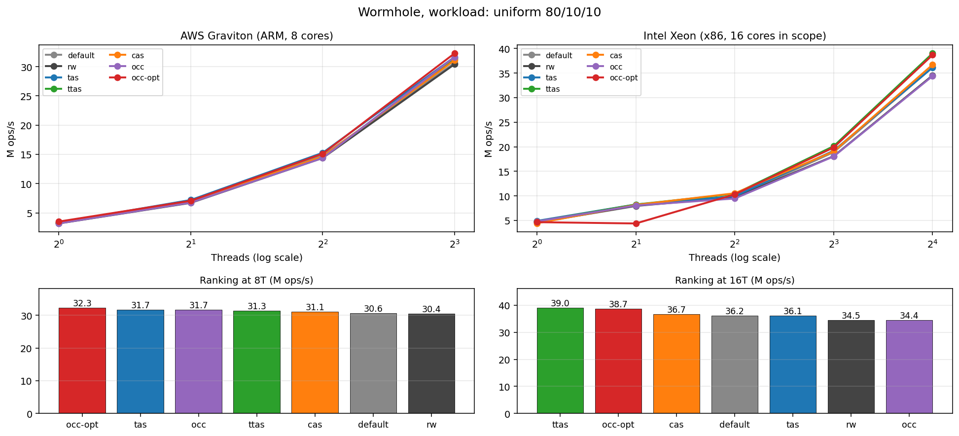
Wormhole, balanced workload (uniform 80 percent reads)
Top: throughput vs threads. Bottom: ranking at the architecture's maximum threads.

Slide 11
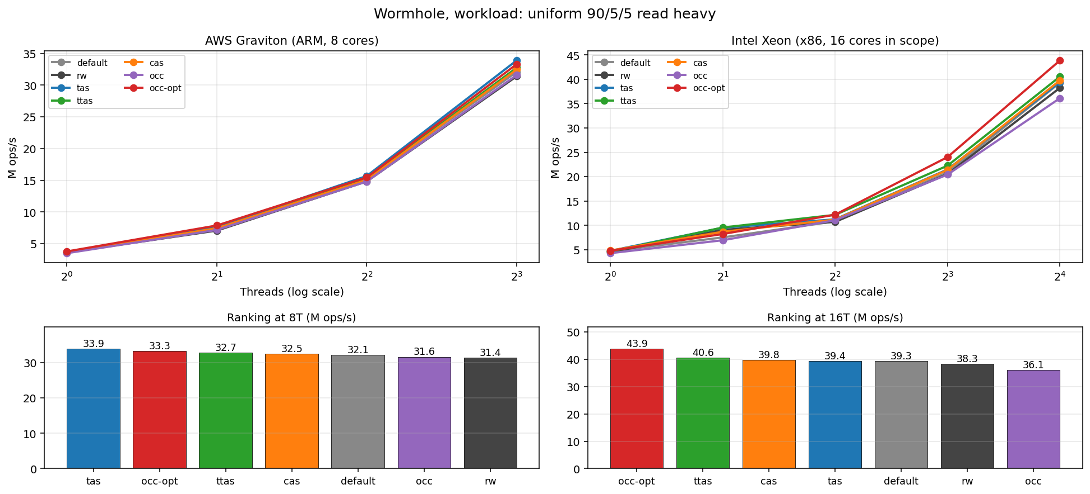
Wormhole, read heavy workload (uniform 90 percent reads)
Where an optimistic reader is expected to win

Slide 12
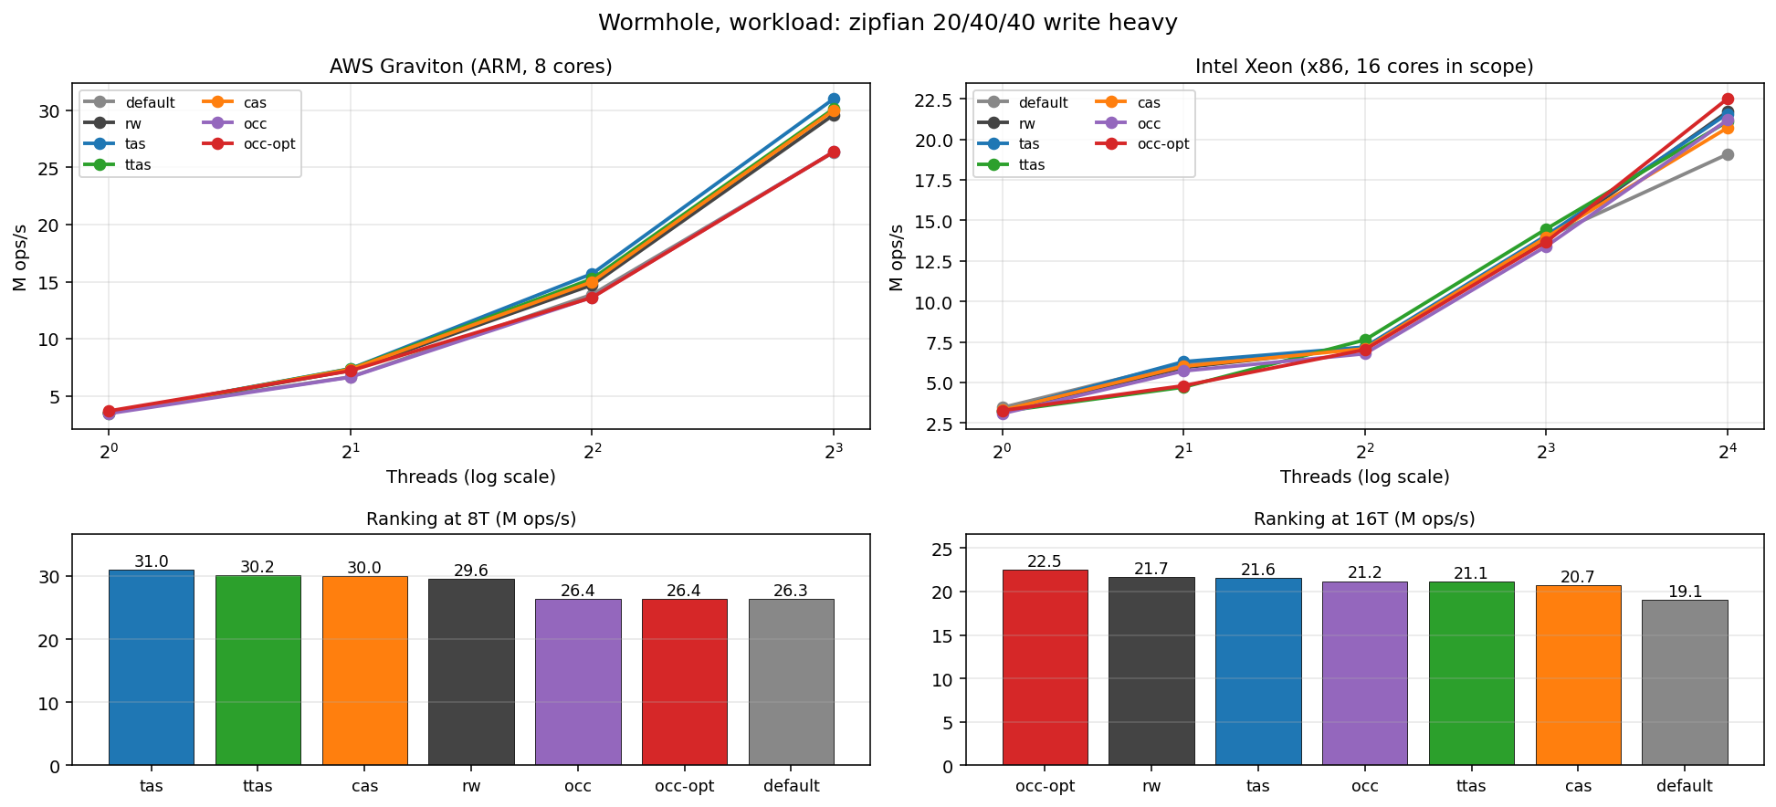
Wormhole, write heavy workload (zipfian 20 percent reads, 40 inserts, 40 deletes)
Hot key contention, where readers cannot escape conflict

Slide 13
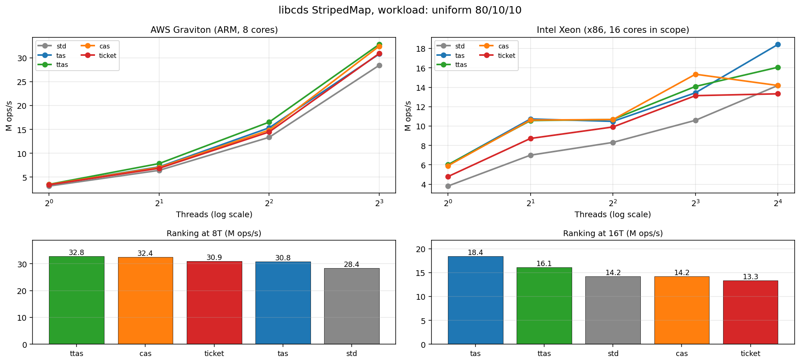
libcds StripedMap, balanced workload (uniform 80 percent reads)
Per stripe lock contention, no traversal

Slide 14
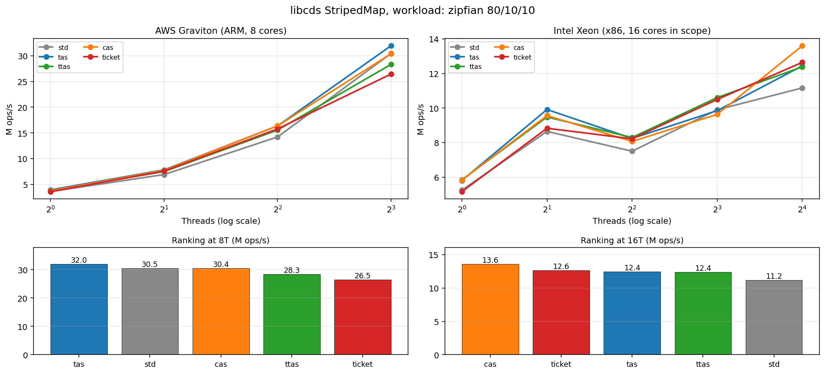
libcds StripedMap, hot key workload (zipfian 80 percent reads)
A few stripes carry most of the traffic

Slide 15
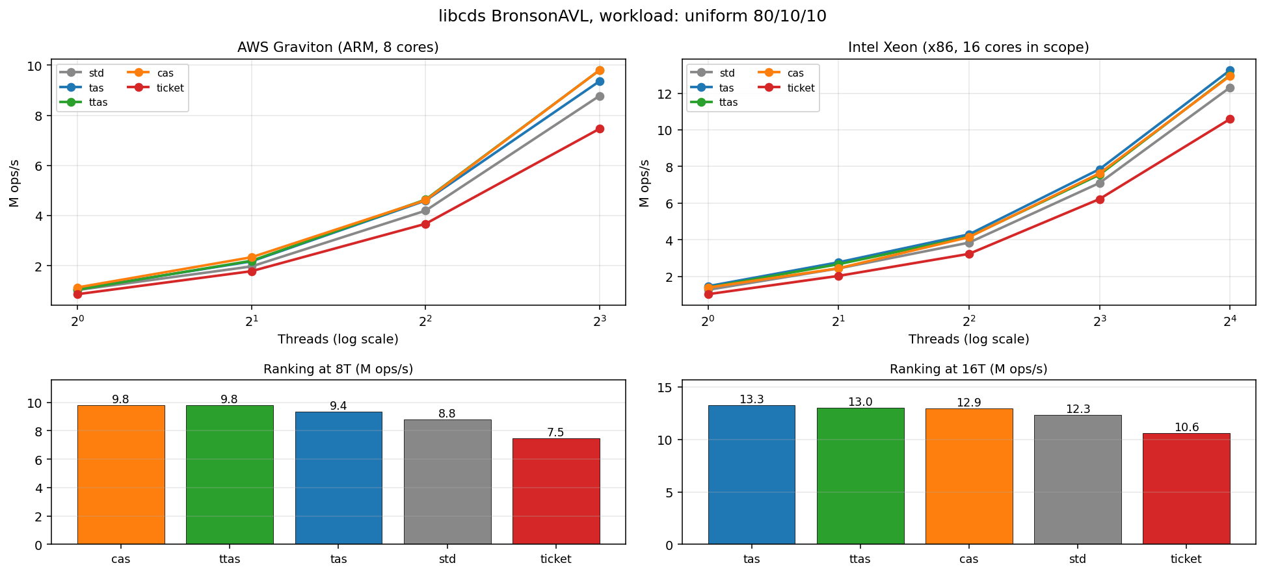
libcds BronsonAVL, balanced workload (uniform 80 percent reads)
Per node monitor lock, much smaller contention surface than StripedMap

Slide 16
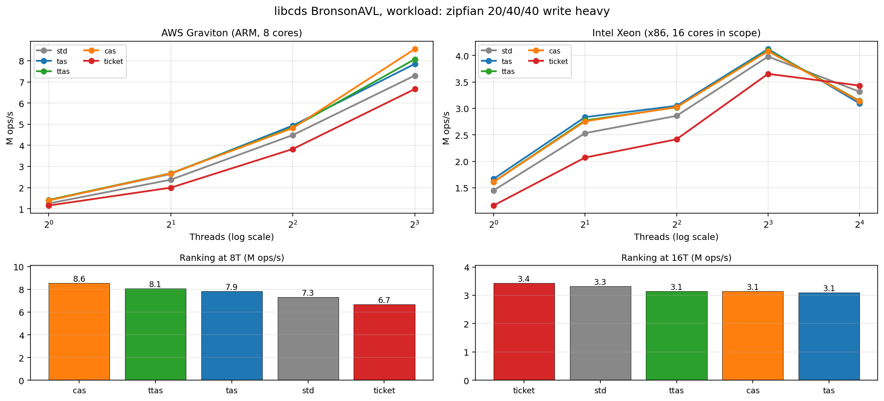
libcds BronsonAVL, write heavy workload
Tree mutations create more lock acquisition per operation

Slide 17
Next steps, part 1: assembly question
Every lock primitive we have evaluated so far (tas, ttas, cas, ticket, rw, occ) is built on
std::atomic. The compiler picks the underlying instruction. On Graviton with -march=native are getting the ARMv8.1 LSE atomics (cas, casal, swp, ldadd). On Xeon we get the lock prefixed instructions (lock cmpxchg, lock xchg, lock xadd).
Things our current set does NOT cover:
On ARM, WFE (Wait For Event) and SEV (Send Event). These let a spinning core enter a low power wait
that wakes when the cache line changes. The Linux kernel arm64 spinlock uses them. Our cpu_relax just
does YIELD which is a hint that is largely a NOP on Neoverse cores.
On ARM, hand picking barrier strength (DMB ISHLD vs DMB ISHST vs DMB ISH SY) instead of letting the
compiler map memory_order_release to whichever DMB it picks.

Slide 18
Next steps, part 2: concrete experiments to run
Add a WFE based spinlock primitive (most promising new direction for ARM).
New file: include/primitives/tas_lock_wfe.hpp and a matching cas_lock_wfe.hpp.
The acquire path: try the atomic, on failure use WFE to wait for any change to the cache line, then retry.
The release path: store, then SEV to wake any waiting cores. Reference: Linux arch/arm64 spinlock.h.
Plug into the Wormhole shim and compare against the YIELD based versions on Graviton.
Hypothesis: at high contention, WFE saves real power and may reduce coherence traffic;
at low contention it is a wash or slightly slower because of the extra SEV.
Smaller items still on the list.
Get sudo on Xeon for one controlled run with setup_cpu.sh, to separate DVFS noise from real lock behaviour.
Add Apple M3 back for the Wormhole comparison (P cores only, capped at 6T to stay homogeneous).
Write up the cross arch lock ranking finding (ttas wins more on Graviton, cas / ticket more on Xeon).

