Slide 1
Cross architecture lock primitive comparison
Three concurrent indexes, five to seven lock variants, two architectures
Andrei Pana
Research project progress review
May 2026

Slide 2
What this project is about
The goal is to see how different lock primitives perform inside concurrent indexes,
and whether the answer changes when you move from x86 (Intel Xeon) to ARM (AWS Graviton).
The three indexes used are:
1. libcds StripedMap. Hash table with N stripes and one lock per stripe.
2. libcds BronsonAVL. Lock based AVL tree with one monitor lock per node.
3. Wormhole (Wu et al., FAST 2019). Hybrid trie plus hash plus linked list.
For Wormhole, we wrote a small shim that lets us swap the rwlock for any of our
primitives at compile time, without touching upstream wormhole call sites.
The headline question: does the same lock win across architectures, or does it shift?

Slide 3
Setup
Two machines, four workloads, common thread ladder up to 8 (Graviton) and 16 (Xeon)
Machine | Architecture | Cores in scope | Notes
AWS Graviton | ARM Neoverse N1 | 8 | Hypervisor pinned vCPU clocks
Intel Xeon (diascld45) | x86_64 | 16 (out of 48) | Capped at 16 to avoid second socket NUMA
Workload tag | Distribution | Reads % | Inserts % | Deletes %
balanced | uniform | 80 | 10 | 10
read heavy | uniform | 90 | 5 | 5
hot key | zipfian | 80 | 10 | 10
write heavy | zipfian | 20 | 40 | 40
Lock variants per index:
StripedMap, BronsonAVL: std, tas, ttas, cas, ticket
Wormhole: default (upstream), rw, tas, ttas, cas, occ, occ-opt
Each run is 3 seconds of measurement after 1 second of warmup. The Graviton
and Xeon panels in every plot below come from the same workload and the same
thread points.

Slide 4
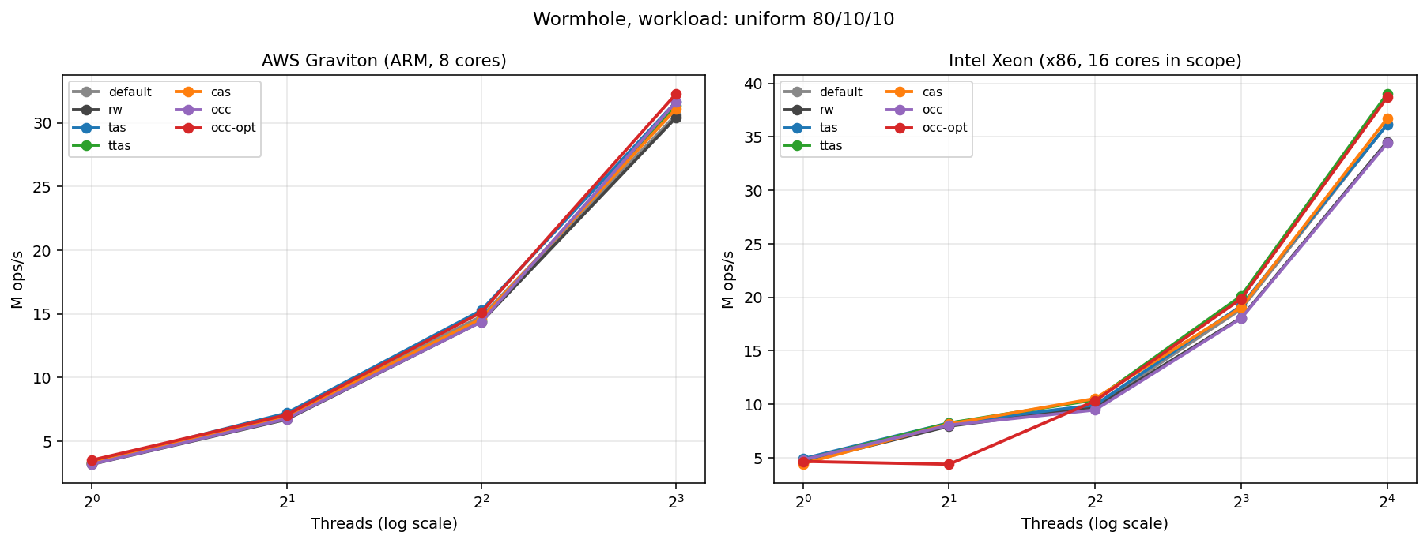
Wormhole, balanced workload (uniform 80 percent reads)
Side by side, same lock colours across both panels
On Graviton at 8T, occ-opt finishes on top (32.3 M ops/s). tas and occ are right behind it.
On Xeon at 16T, ttas wins narrowly (39.0 M) with occ-opt almost tied at 38.7 M.
wh-default (upstream wormhole rwlock) is in the middle of the pack on both machines.

Slide 5
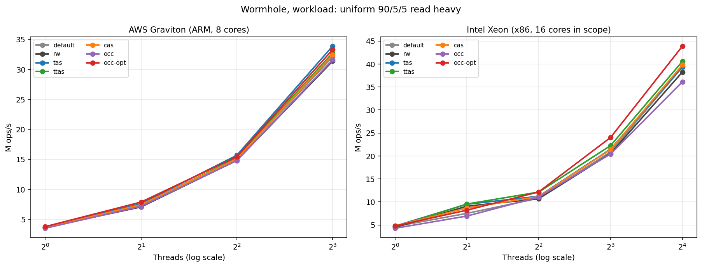
Wormhole, read heavy workload (uniform 90 percent reads)
Where an optimistic reader is expected to win
occ-opt validates against a per leaf seqlock, so readers never take the leaflock at all.
On Xeon the optimistic reader opens a clear gap (43.9 M, vs 40.6 M for ttas at 16T).
On Graviton it is much tighter: tas 33.9 M, occ-opt 33.3 M, ttas 32.7 M, all within 4 percent.
This is the workload where the design choice has the most leverage, especially on x86.

Slide 6
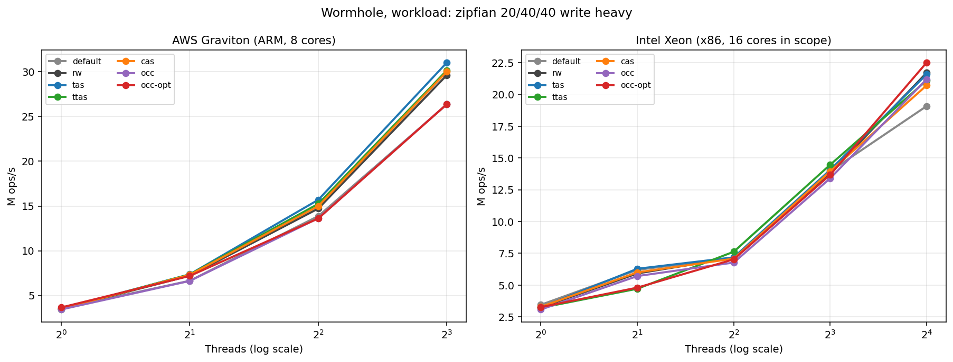
Wormhole, write heavy workload (zipfian 20 percent reads, 40 inserts, 40 deletes)
Hot key contention, where readers cannot escape conflict
On Graviton, tas, ttas and cas pull ahead at 8T (around 30 M).
On Xeon, occ-opt is still on top at 16T (22.5 M) with rw and tas right next to it.
Even on the workload least favourable to the optimistic path, it does not collapse.
That is a good sign for occ-opt being a sensible default for Wormhole.

Slide 7
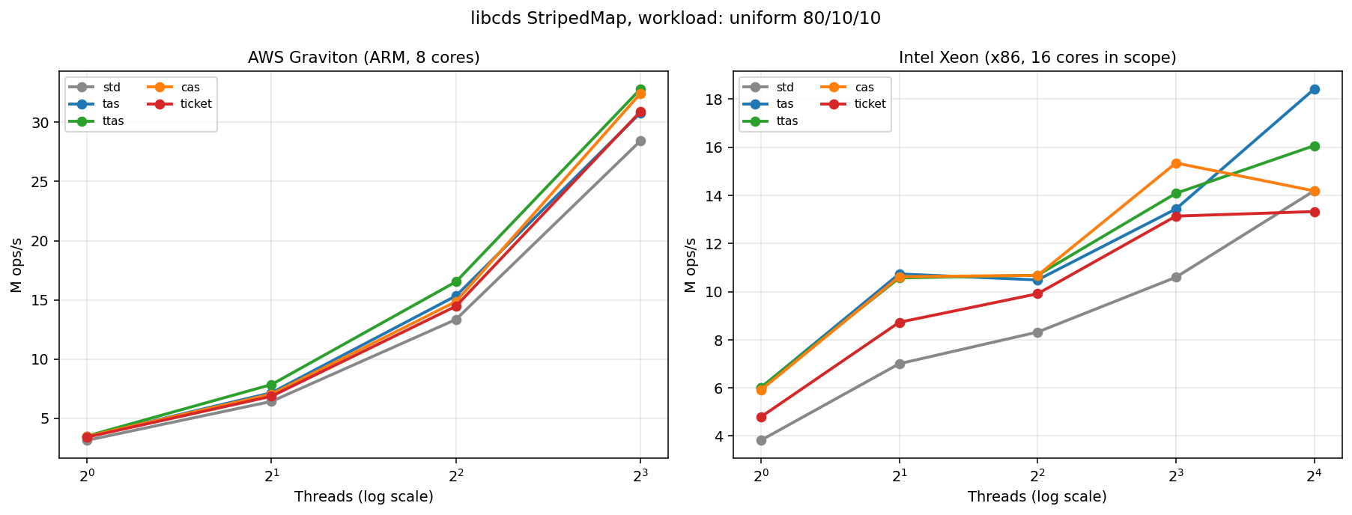
libcds StripedMap, balanced workload (uniform 80 percent reads)
Per stripe lock contention, no traversal
On Graviton, ttas wins at 8T (32.8 M) with cas right behind (32.4 M).
On Xeon, tas takes the lead at 16T (18.4 M) with ttas second (16.1 M).
Xeon throughput is lower because we capped at 16T (out of 48) to stay on a single socket.

Slide 8
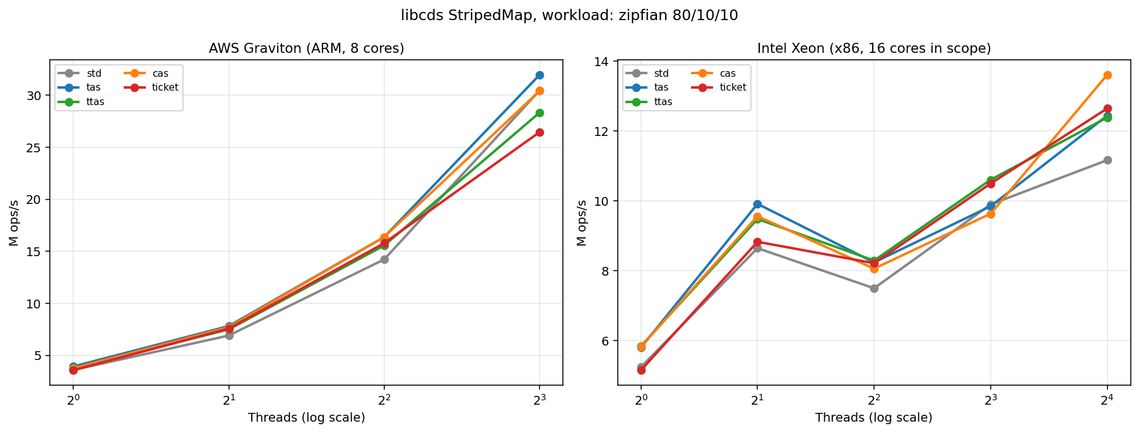
libcds StripedMap, hot key workload (zipfian 80 percent reads)
A few stripes carry most of the traffic
On Graviton at 8T, tas leads (32.0 M), with std::mutex and cas tied just behind.
On Xeon at 16T, cas wins (13.6 M) with ticket and tas close together.
The drop from balanced to hot key on Xeon is large, which matches expectations.

Slide 9
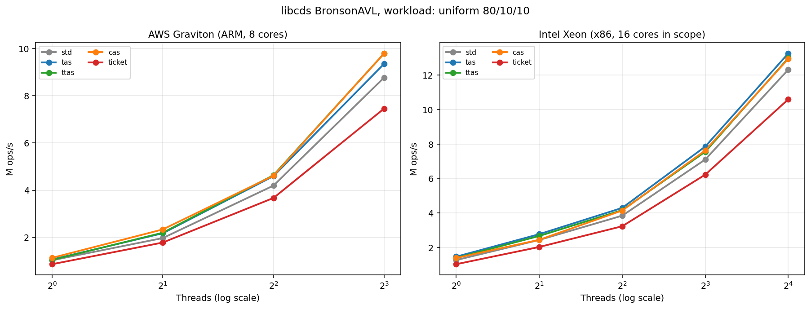
libcds BronsonAVL, balanced workload (uniform 80 percent reads)
Per node monitor lock, much smaller contention surface than StripedMap
On Graviton at 8T, cas and ttas tie at 9.8 M, with tas just behind.
On Xeon at 16T, tas leads (13.3 M), with ttas and cas within a few percent.
BronsonAVL absolute throughput is lower than StripedMap because traversal cost is real.
The relative ordering between locks is broadly stable across the two machines.

Slide 10
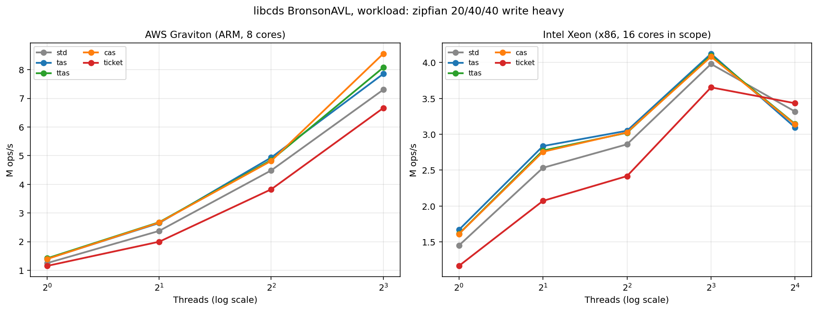
libcds BronsonAVL, write heavy workload
Tree mutations create more lock acquisition per operation
On Graviton, cas takes the lead at 8T (8.6 M) with ttas and tas close behind.
On Xeon, ticket wins at 16T (3.4 M), with std::mutex unusually close.
Different best lock per architecture on this workload, which is exactly the cross arch
story we wanted to surface.

Slide 11
Best lock per (architecture, workload)
Top throughput at each architecture's maximum thread count in scope
Index | Architecture | Max T | Workload | Best lock | Throughput (M ops per s)
Wormhole | graviton | 8 | uniform 80/10/10 | occ-opt | 32.3
Wormhole | graviton | 8 | uniform 90/5/5 read heavy | tas | 33.9
Wormhole | graviton | 8 | zipfian 20/40/40 write heavy | tas | 31.0
Wormhole | graviton | 8 | zipfian 80/10/10 | tas | 39.7
Wormhole | xeon | 16 | uniform 80/10/10 | ttas | 39.0
Wormhole | xeon | 16 | uniform 90/5/5 read heavy | occ-opt | 43.9
Wormhole | xeon | 16 | zipfian 20/40/40 write heavy | occ-opt | 22.5
Wormhole | xeon | 16 | zipfian 80/10/10 | occ-opt | 35.0
StripedMap | graviton | 8 | uniform 80/10/10 | ttas | 32.8
StripedMap | graviton | 8 | uniform 90/5/5 read heavy | ttas | 42.2
StripedMap | graviton | 8 | zipfian 20/40/40 write heavy | cas | 21.0
StripedMap | graviton | 8 | zipfian 80/10/10 | tas | 32.0
StripedMap | xeon | 16 | uniform 80/10/10 | tas | 18.4
StripedMap | xeon | 16 | uniform 90/5/5 read heavy | ticket | 26.0
StripedMap | xeon | 16 | zipfian 20/40/40 write heavy | tas | 6.9
StripedMap | xeon | 16 | zipfian 80/10/10 | cas | 13.6
BronsonAVL | graviton | 8 | uniform 80/10/10 | cas | 9.8
BronsonAVL | graviton | 8 | uniform 90/5/5 read heavy | ttas | 11.0
BronsonAVL | graviton | 8 | zipfian 20/40/40 write heavy | cas | 8.6
BronsonAVL | graviton | 8 | zipfian 80/10/10 | ttas | 13.9
BronsonAVL | xeon | 16 | uniform 80/10/10 | tas | 13.3
BronsonAVL | xeon | 16 | uniform 90/5/5 read heavy | tas | 16.6
BronsonAVL | xeon | 16 | zipfian 20/40/40 write heavy | ticket | 3.4
BronsonAVL | xeon | 16 | zipfian 80/10/10 | tas | 15.2
Quick observations from the table:
Graviton and Xeon do not always agree on the best lock for the same workload.
For Wormhole, occ-opt is the headline winner on read leaning workloads (and on uniform 80/10/10 on Graviton).
For StripedMap and BronsonAVL, tas and ttas dominate. cas and ticket appear more on Xeon than on Graviton.

Slide 12
Wormhole adaptation, what we built
A drop in shim that lets us pick any of our locks at compile time
Wormhole originally hard codes its own rwlock and spinlock. To compare lock primitives,
we replaced both types with a 128 byte storage shim, plus a small extern C dispatch layer
that placement news the chosen lockbench primitive at init time.
Files added:
third_party/wormhole/wh_lock_shim.h (struct definitions, function decls)
third_party/wormhole/wh_lock_shim.cpp (extern C bodies that dispatch to LockT)
Variants now built per CMake target:
default (upstream untouched), rw, tas, ttas, cas, occ, occ-opt
occ-opt is a special variant. The writer side uses the cas lock, but readers walk
the leaf without taking the lock at all. They snapshot a per leaf seqlock counter,
read the entries, then validate. On a mismatch they retry.
One bug worth flagging that took some debugging:
With the shim active, every Wormhole variant crashed on Xeon during the very first
prefill insert. The cause was a 32 byte aligned AVX2 load on leaf->ss. The shim made
the offset of ss inside wormleaf 16 misaligned. The fix was a single _Alignas(32) on
the hs array, which adds 8 bytes of padding and pulls ss to a 32 byte boundary.

Slide 13
Next steps
Add Apple Silicon back to the cross arch comparison, just for Wormhole.
The M3 P core and E core split makes scaling numbers harder to interpret,
so the plan is to limit the comparison to the first 8 P cores only.
Get sudo access on the Xeon for one short controlled run.
With setup_cpu.sh (performance governor and turbo off) we can rerun a small slice and
confirm whether the Xeon variance we currently see is mostly DVFS noise or something deeper.
Add a per arch lock latency micro benchmark.
The current numbers are throughput inside an index. A pure latency view of acquire
and release on each architecture would close the loop, by separating raw atomic cost
from contention behaviour.
Write up a short paper section on the cross architecture lock ranking story.
The fact that ttas wins more often on Graviton while cas and ticket show up more on Xeon
is a nice concrete result to land in writing.

