Slide 1

Effects of Berry Curvature on Thermoelectric Transport
Archisman Panigrahi
UG 4th Year
24th June 2021
Supervisor: Prof. Subroto Mukerjee, Dept. of Physics, IISc

Slide 2
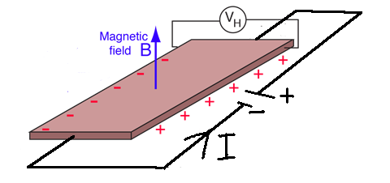
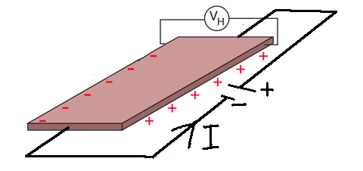
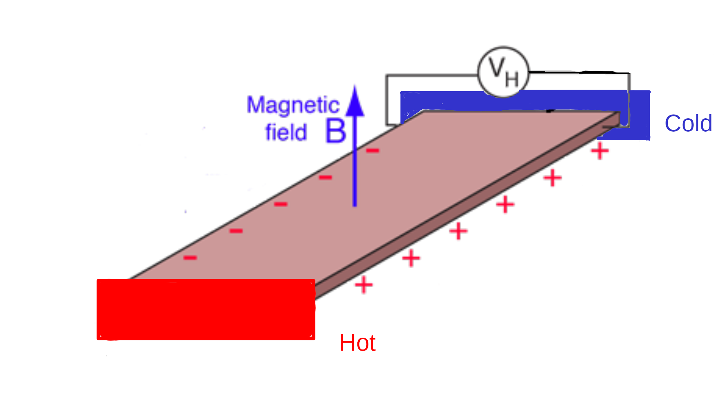
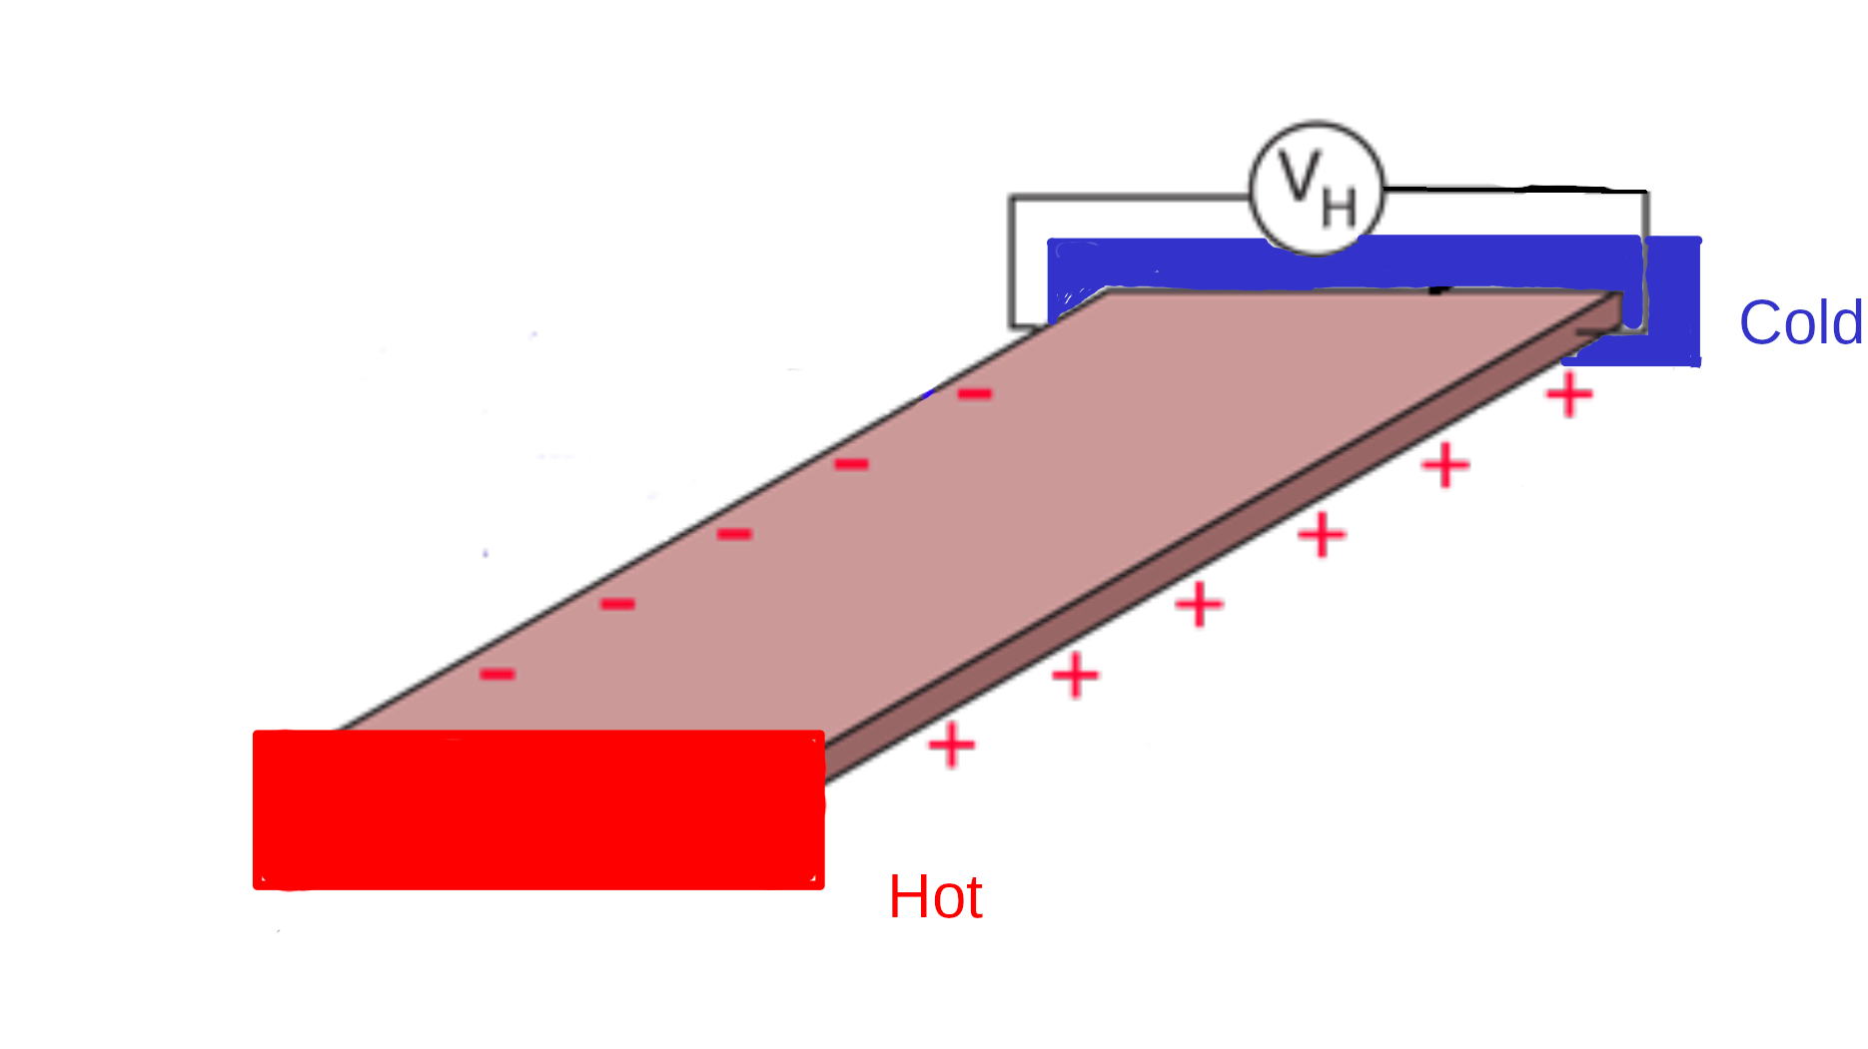
Why is this interesting?
There can be a transverse Hall voltage without a magnetic field
Anomalous Hall Effect
Nernst Effect: Hall like response for a temperature gradient
Electrically insulating temperature reservoirs
Anomalous Nernst Effect

Slide 3
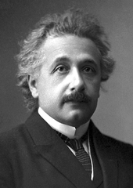
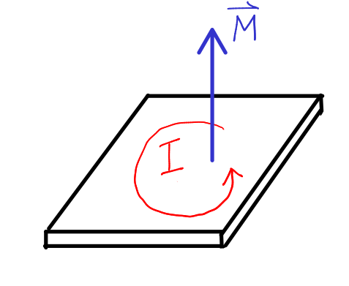
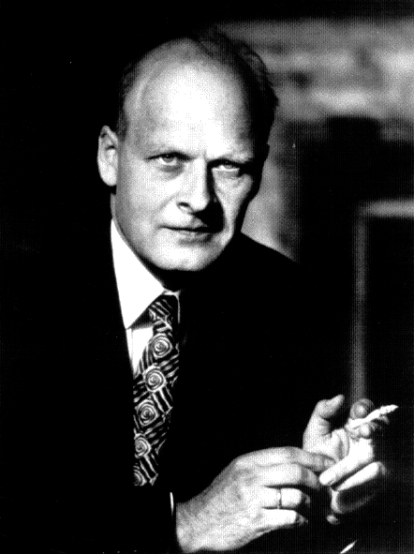
Thermoelectric transport: Einstein and Onsager relations
Einstein relation:
Onsager relation:
N. R. Cooper, B. I. Halperin, and I. M. Ruzin. PRB 55 2344 (1997)

Slide 4
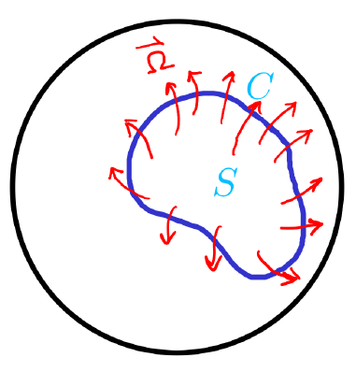
Geometric phase and Berry Curvature
Time dependent Hamiltonian
Space of
Stokes’ theorem:
Like magnetic field, but in parameter space

Slide 5
Berry Curvature in reciprocal space
Block wavefunctions in periodic potential
  Effective Schrodinger equation
Crystal momentum changes with electromagneic field
Time evolution

Slide 6
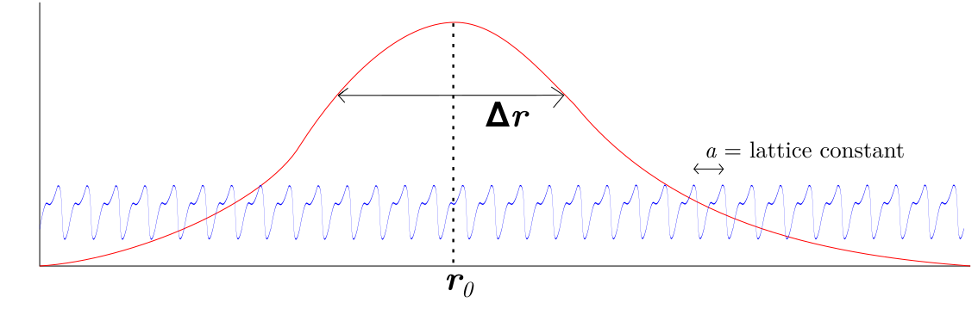
Construction of Bloch wavepacket, and its evolution
  Wavepacket
                Bloch eigenfunction

Slide 7
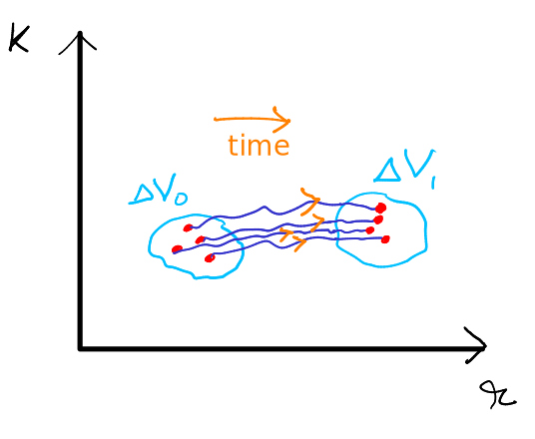
Effects of Berry curvature
Ming-Che Chang and Qian Niu PRL 75, 1348 (1995),
Daniel C. Ralph. arXiv: 2001.04797
The semiclassical equation of velocity is modified
                Decoupled
(2D)
Phase space density is modified
Anomalous velocity
(2D)
is a constant of motion
Di Xiao, Junren Shi, and Qian Niu. PRL 95, 137204 (2005)

Slide 8


Boltzmann Transport framework
        Classical charge and energy currents
        Semiclassical framework
Heat current: From 1st law of thermodynamics,

Slide 9
When do we get a non-zero Berry Curvature?
If inversion symmetry holds
If time reversal symmetry holds
When both hold simultaneously, Berry curvature is identically zero.

Slide 10
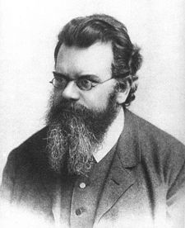
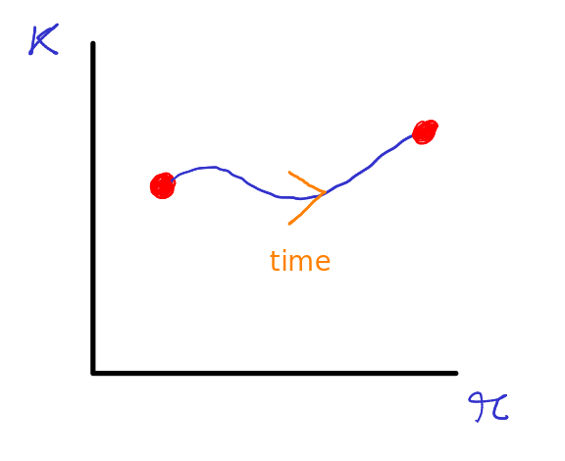
Boltzmann Transport Equation
In equilibrium, is the Fermi distribution.
The external fields are small, and it deviates slightly from
the Fermi distribution
The system tries to attain equilibrium, with a relaxation time
We assume that the more the distribution deviates, the faster it would try to return to equilibrium, relaxation time approximation.

Slide 11
Boltzmann Transport Equation
In steady-state, and homogeneous fields, the equation in becomes,
Why is the perturbation theory valid?
Dimension analysis: this term = the first term, is the cyclotron frequency
This is less than the first term when
If then the critical field is ~ 570 T
Why even consider this term, then??

Slide 12
Boltzmann Transport Equation
In steady-state, and homogeneous fields, the equation in becomes,
Verified that it reduces to results obtained from Drude model
In free electron limit
Einstein and Onsager
Relations are satisfied
The solution, with

Slide 13
Which all terms contribute
2nd order
0, as it should be without any external field
For a filled band,
Chern number, integer
Independent of scattering!!

Slide 14
Which all terms contribute
For a filled band, quantized!!
This is not the (usual) quantum Hall effect
But we have an issue here
Independent of scattering!!

Slide 15
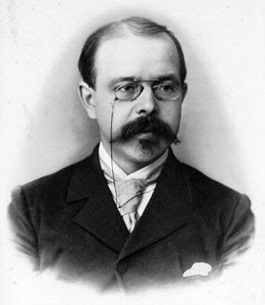
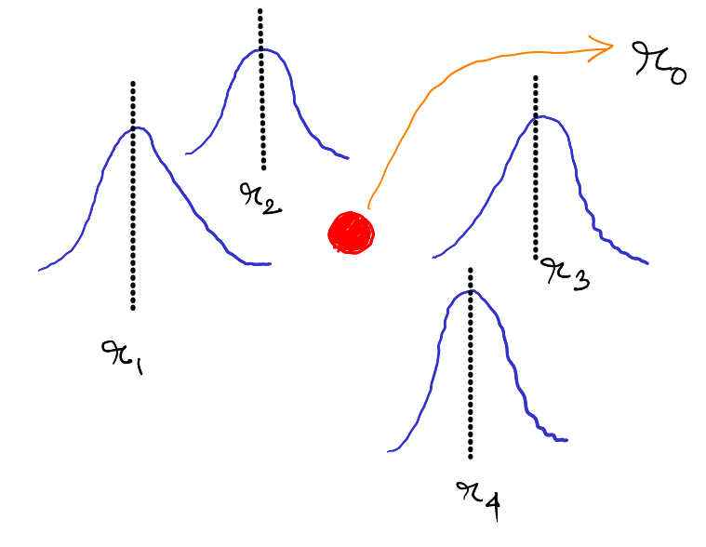
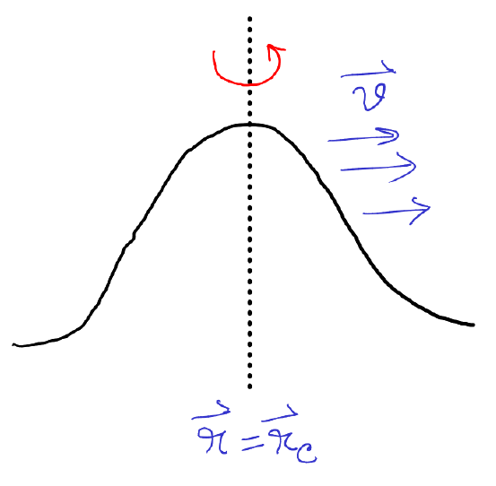
Issue
(Nernst)
Apparently, a temp gradient or
a chemical potential gradient
cannot give rise to anomalous Hall effect
No term like and
☹️
☹️
☹️
What we missed:
The wavepackets are not localized
Circulating magnetization currents
Orbital magnetic moment
Di Xiao, Yugui Yao, Zhong Fang, and Qian Niu. PRL 97, 026603 (2006)

Slide 16
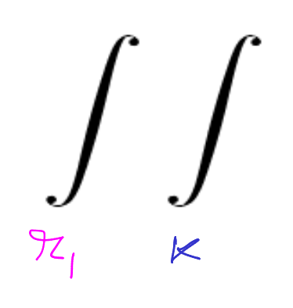
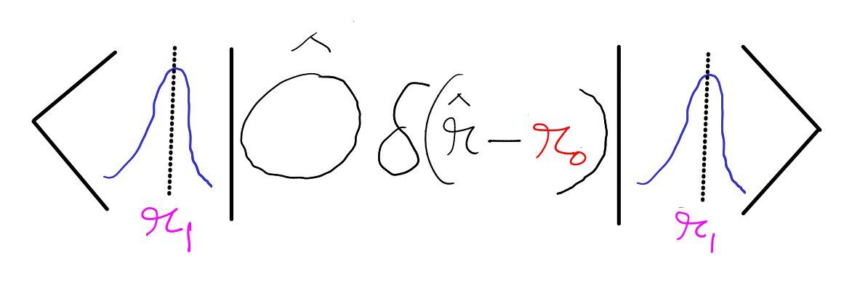
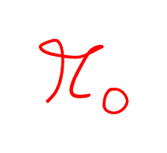
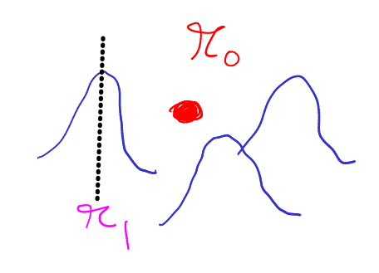
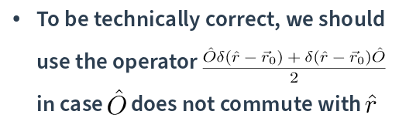
Wavepackets are not localized

Slide 17
To calculate electric current, we use
Similarly, for heat current

Slide 18
Effects of orbital magnetization
Energy eigenvalues are modified
Net magnetization can be obtained from the Free energy
Phase space density correction is important

Slide 19
Transport current
Now we are ready to calculate the transport electric current

Slide 20
How about Onsager relation?
We can define energy magnetization,
Di Xiao, Yugui Yao, Zhong Fang, and Qian Niu.
PRL 97, 026603 (2006)
☹️
N. R. Cooper, B. I. Halperin, and I. M. Ruzin. PRB 55 2344 (1997)

Slide 21
Possible resolution for the Einstein relation to hold

Slide 22
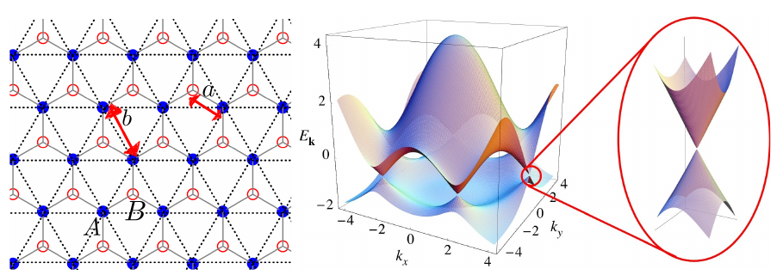
Berry curvature and Chern numbers of some microscopic models
In a two band system with Hamiltonian
Monolayer graphene
Non-zero Berry curvature when there is a finite band gap : growing on BN substrate
However, there is Time Reversal Symmetry, so

Slide 23
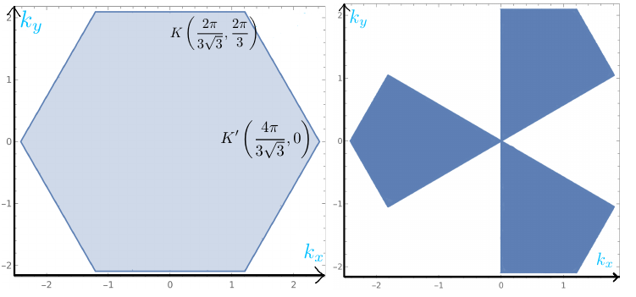
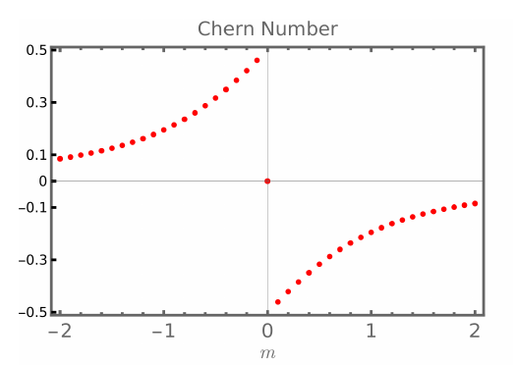
Valley Polarization
Electrons can be made to selectively occupy valleys with circularly polarized light
A. Friedlan and M. M. Dignam PRB 103, 075414 (2021)

Slide 24
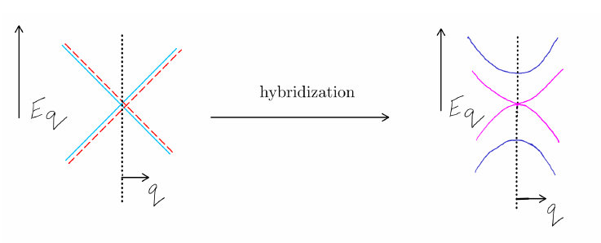
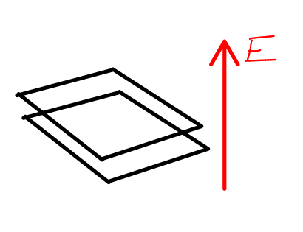
Bilayer Graphene
We can generate a band gap by applying an electric field

Slide 25
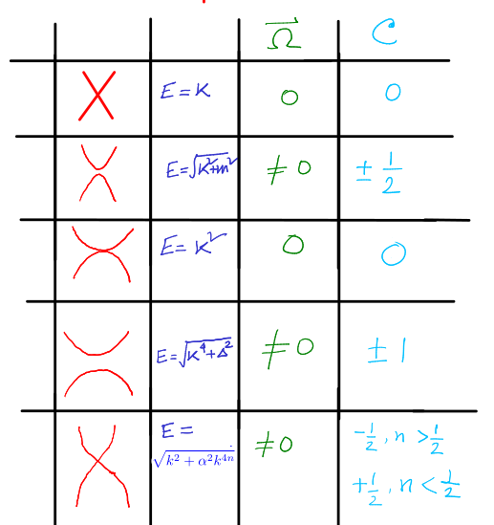
Results for valley Chern number

Slide 26
New results
The condition on the energy magnetization for Einstein relation to hold for anomalous Heat current
Solution of Boltzmann transport equation upto linear order, that captures the effects of Berry curvature in regular Ohmic, regular Hall and regular Nernst effects

Slide 27
Thank you

