Slide 1
Summary of results for Bott index of QAHI quasicrystal

Slide 2
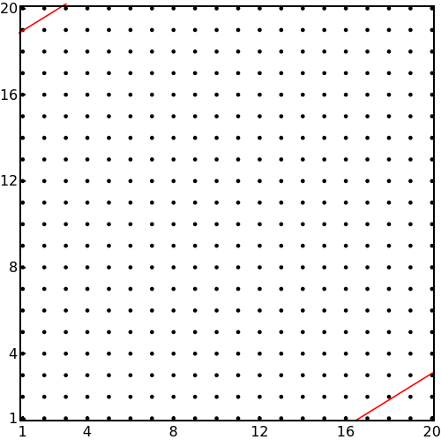
When the quasicrystal is large, the Bott index
is identical to the original system.
The Bott index is when and it
is 0 when
There are no long range hoppings.
(apparent from the arrayplot of the
Hamiltonian).

Slide 3
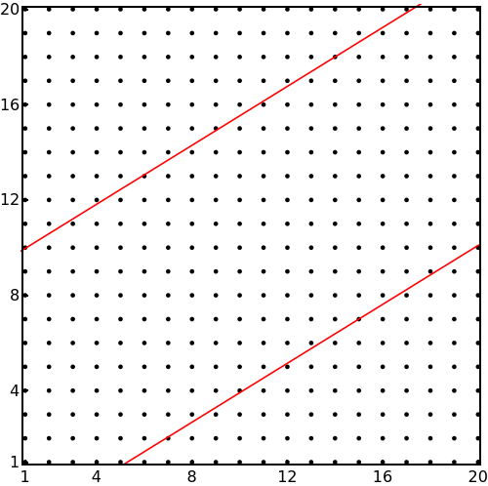
As the number of points in the
quasicrystal is decreased, the
Bott index becomes identically 0
As the quasicrystal becomes smaller,
non local hoppings become noticable
in the Arrayplot of the renormalized
Hamiltonian.

Slide 4
This result is not very generic. In the intermediate regime, there is an oscillation.
For a very large quasycrystal, the Bott index is .
As we keep decreasing the quasicrystal size, first the Bott index becomes 0, then it again becomes over a small region, and it again becomes 0 as the quasicrystal size is made smaller. And it remains 0 afterwards.

