Slide 1
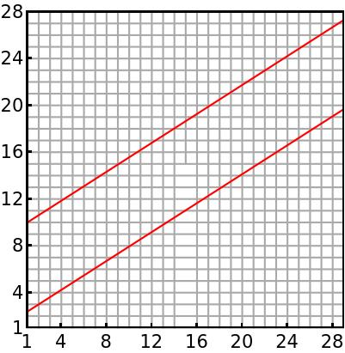
The lattice has a single dislocation core
217 sites in the quasicrystal
The lattice dislocation center is at the 108th site of the quasicrystal – orbitals 215 and 216

Slide 2
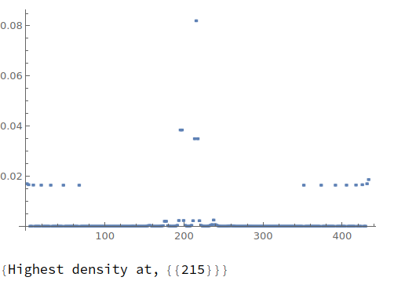
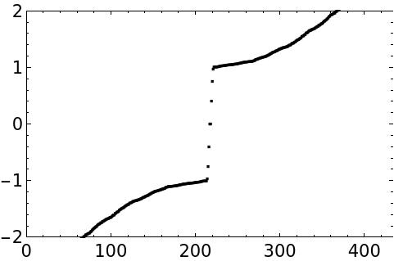
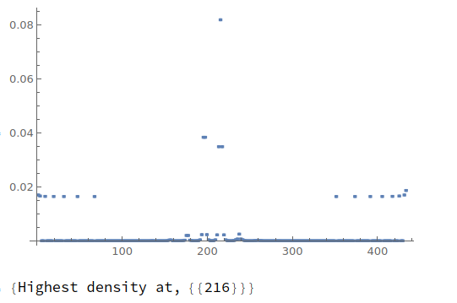
m = -1 (M Phase)
The lattice dislocation center is at the 108th site
of the quasicrystal – orbitals 215 and 216
E=0
Two zero energy dislocation modes

Slide 3
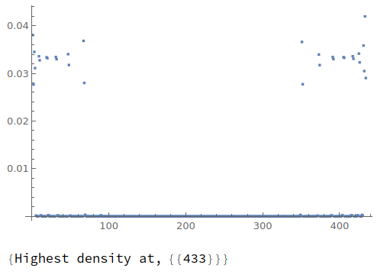
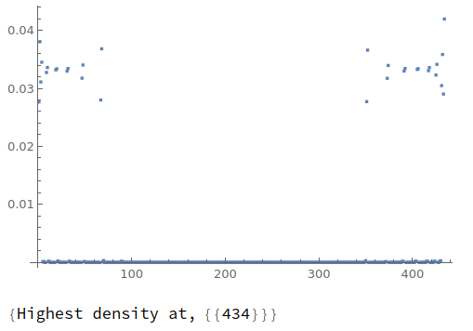
m = -1 (M Phase)
E= ±0.404
Edge like modes

Slide 4
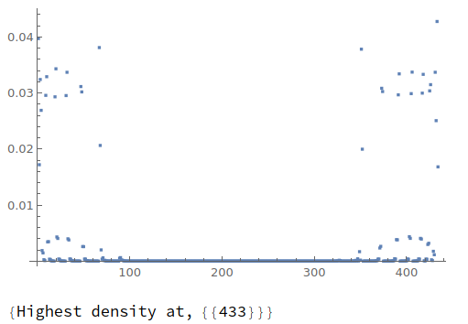
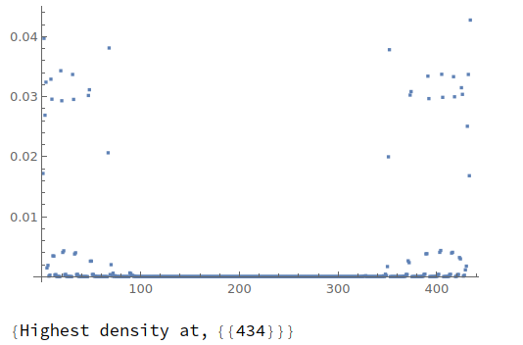
m = -1 (M Phase)
E= ±0.752
Edge like modes

Slide 5
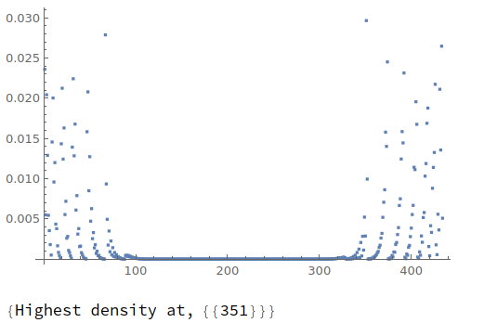
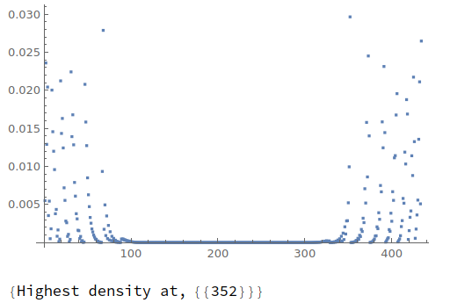
m = -1 (M Phase)
E= ±0.969
Edge like modes

Slide 6
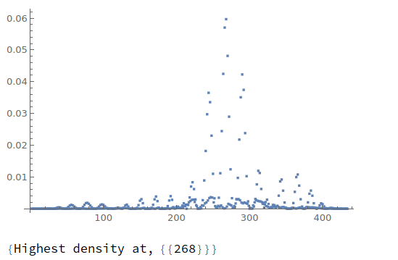
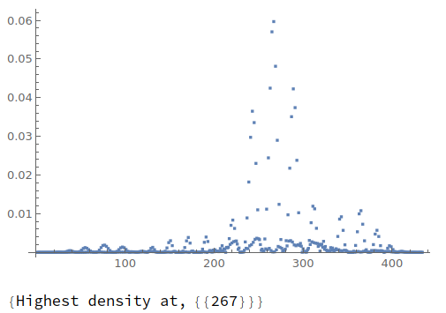
m = -1 (M Phase)
E= ±1.007
All other modes reside in the bulk

Slide 7
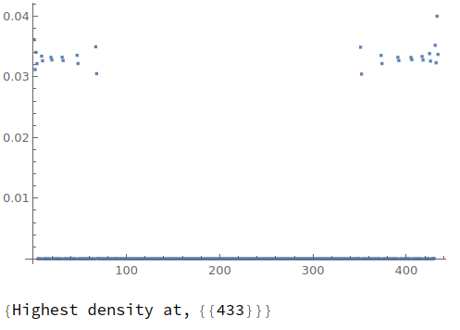

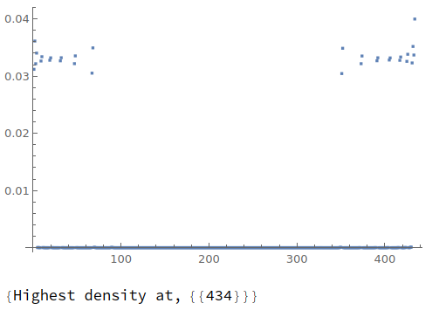
m = +1 (Γ Phase)
E=±0.205
Edge like modes

Slide 8
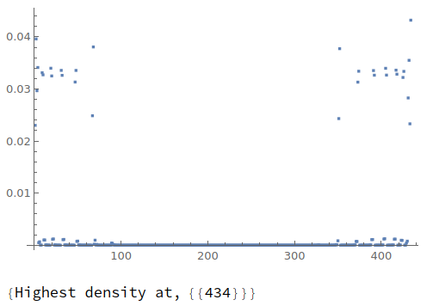
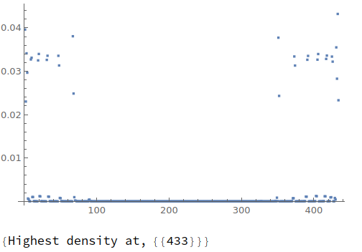
m = +1 (Γ Phase)
E=±0.590
Edge like modes

Slide 9
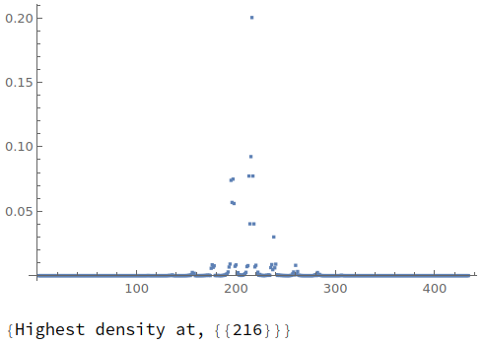
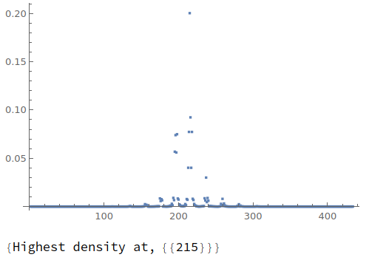
m = +1 (Γ Phase)
E=±0.804
Dislocation modes

Slide 10
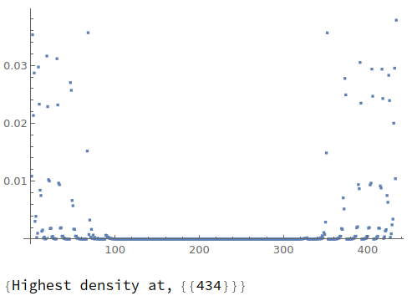
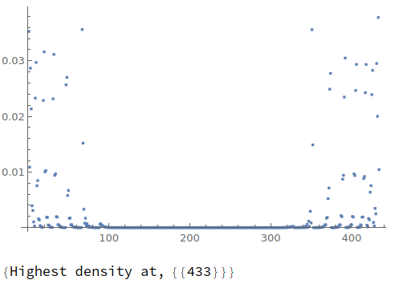
m = +1 (Γ Phase)
E=±0.881
Edge like modes

Slide 11
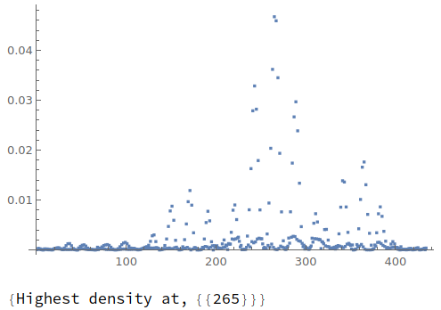
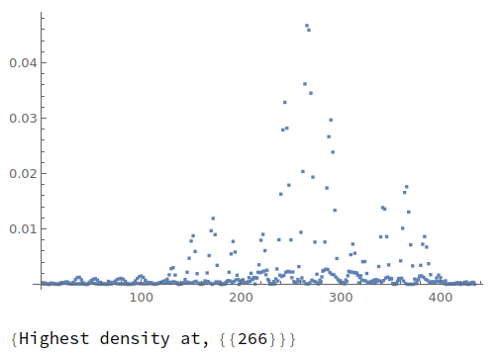
m = +1 (Γ Phase)
E=±1.007
The rest are bulk modes

