Slide 1

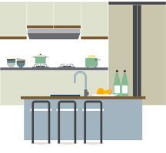
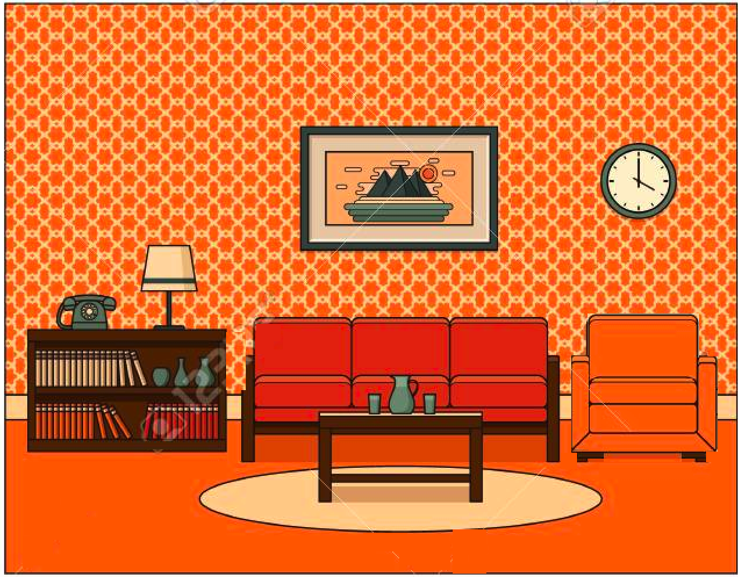
9
7
8
Bedroom
Kitchen
1
3
4
5
6
2
Living Room

