Slide 1


Rent A Bike by Ankit Pangasa

Slide 2
Functional Requirements
See the two wheelers available nearby.
Rent a bike from the center/nearest location using mobile App.
Charging on ride time, distance travelled and the duration
View the Trip details.
Pay via Credit card (auto debited or manually paid)
Notifications - SMS, Mail and Mobile push.

Slide 3
NFR
Built for scale
Highly available and Resilient
Built as a platform which other app developers can also reuse (expose APIs and SDKs)
Concurrent

Slide 4
Assumptions
User can specify radius to search for.
User are static while searching for nearby rental area.
New Centers added will take some time to update.
Reservation will have a reservation time of 10 minutes until booked.

Slide 5
Estimates
Monthly Active Users = 0.5 Million
Daily Active Users = 50,000
Average Queries per user: 4 queries
QPS = (50000*4)/(24*60*60) = 3 queries/seconds
Peak Search QPS = 2 * QPS = 6 queries/seconds
New Booking creation (25% conversion from search) = 0.25 * 3 = 3 booking/4 seconds
Total bookings per day = 0.4 * 60 * 60 * 24 = 65000 booking/day
Data entry per booking = 8*2 + 8 + 8 + 4 + 8 + 8 + 8 * 2 + 4 = 72 bytes
Total data per day = 72 * 65000 = 5MB/day
Data storage for 5 years = 9GB
25%** expansion per year = 27GB
**Since the system is still picking up in the market, we can assume that data storage requirement will increase by 25% per year

Slide 6
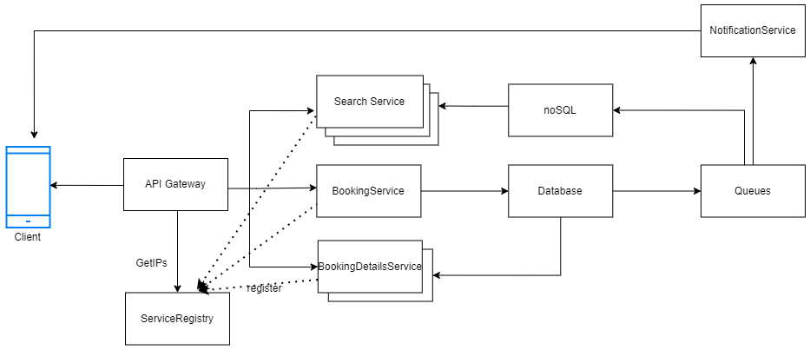
Design Overview

Slide 7
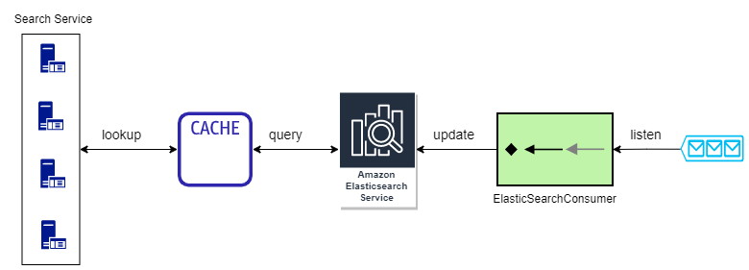
Search Service

Slide 8
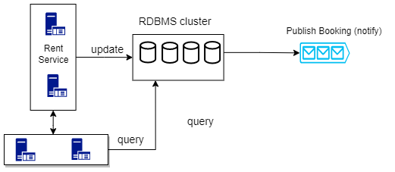
Rental Service
Payment service

Slide 9
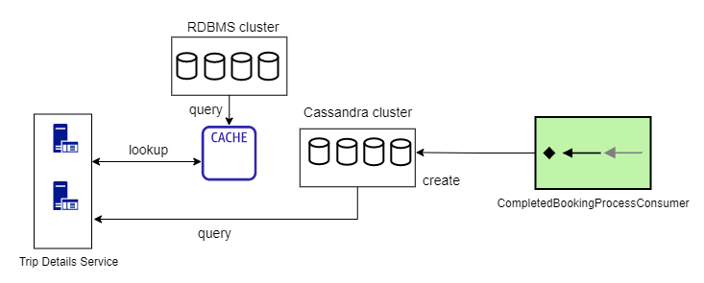
Booking Details Service

Slide 10
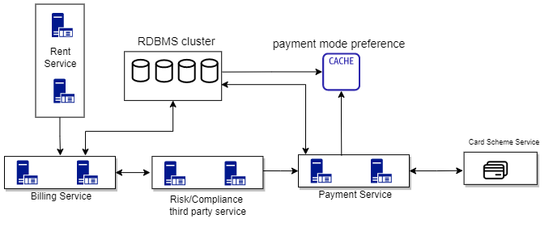
Billing and Payment Service

Slide 11
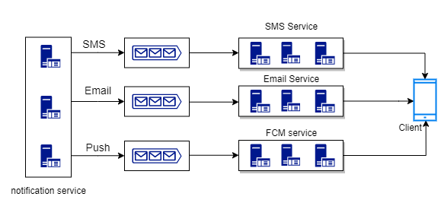
Notification Service

Slide 12
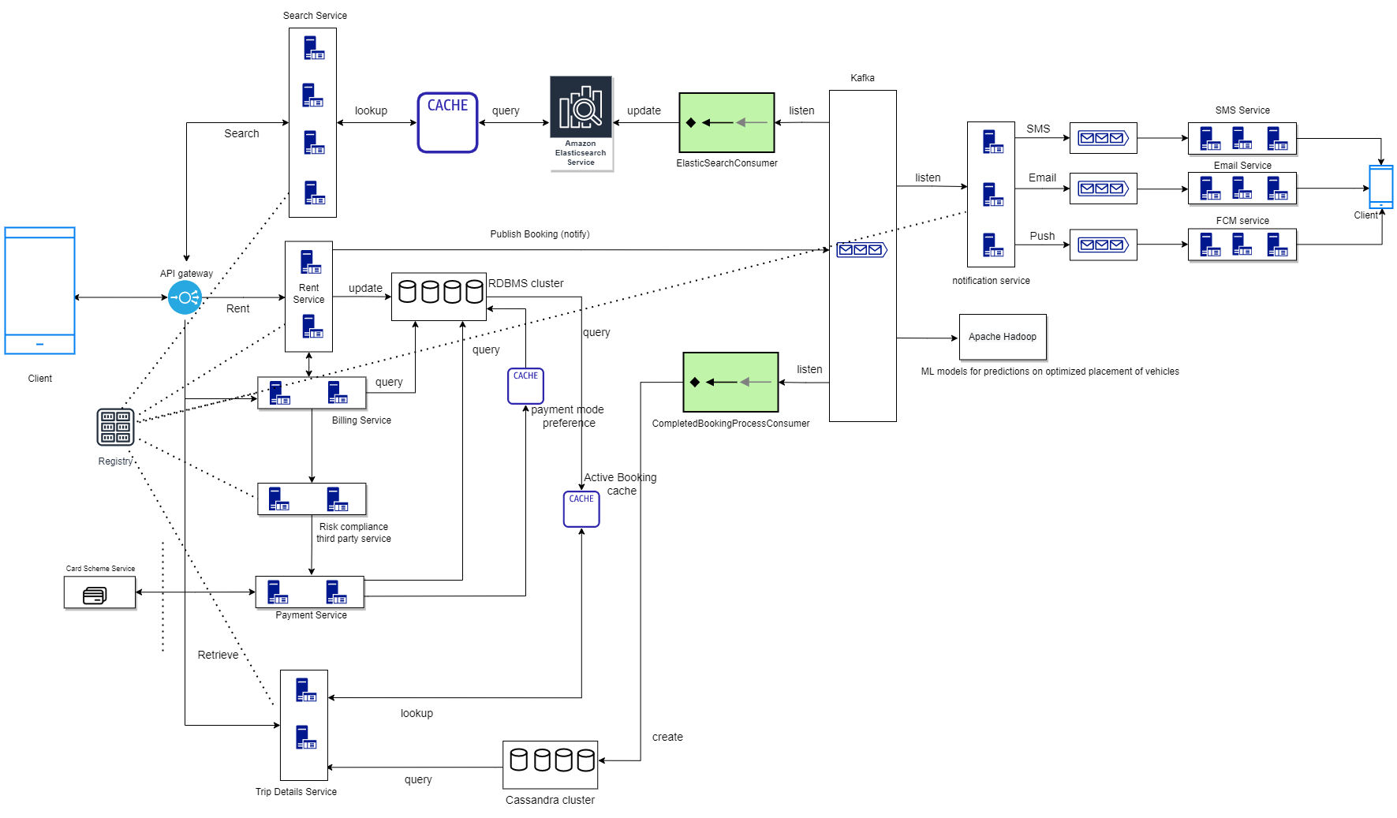
Overall System

Slide 13
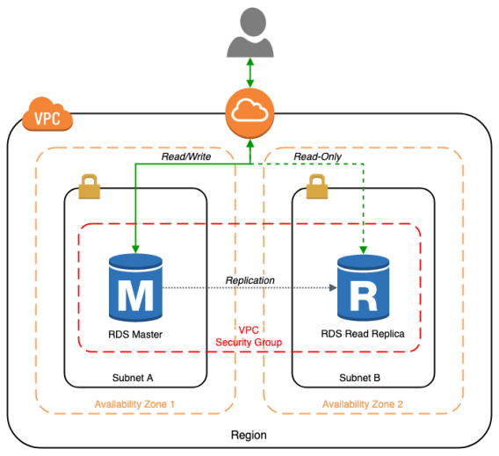
Fault Tolerance

Slide 14
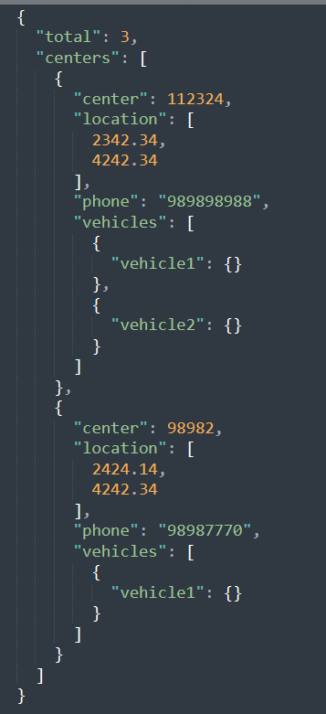
API Endpoints
GET /v1/vehicles/search
Search nearby vehicles listed by centres
Request Parameter | Description | ValueType
latitude | User’s latitude | decimal
longitude | User’s longitute | decimal
distance | Maximum distance to look around. | Integer
dateTimeFrom | Booking required from | double
dateTimeTo | Booking required until | double
Response
Notes:
{
"total": 3,
"centers": [
{
"center": 112324,
"location": [
2342.34,
4242.34
],
"phone": "989898988",
"vehicles": [
{
"vehicle1": {}
},
{
"vehicle2": {}
}
]
},
{
"center": 98982,
"location": [
2424.14,
4242.34
],
"phone": "98987770",
"vehicles": [
{
"vehicle1": {}
}
]
}
]
}

Slide 15
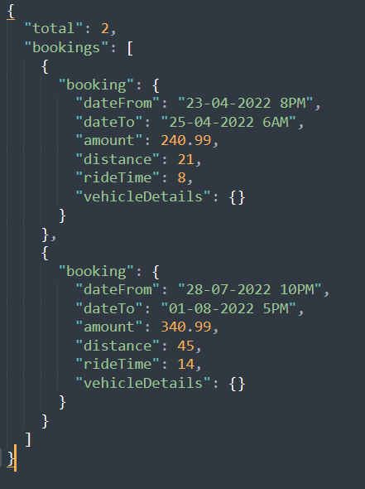
API Endpoints
GET /v1/bookings/
Get bookings of the user
Request Parameter | Description | ValueType
active | Only active or all bookings | bool
Response
Notes:
{
"total": 2,
"bookings": [
{
"booking": {
"dateFrom": "23-04-2022 8PM",
"dateTo": "25-04-2022 6AM",
"amount": 240.99,
"distance": 21,
"rideTime": 8,
"vehicleDetails": {}
}
},
{
"booking": {
"dateFrom": "28-07-2022 10PM",
"dateTo": "01-08-2022 5PM",
"amount": 340.99,
"distance": 45,
"rideTime": 14,
"vehicleDetails": {}
}
}
]
}

Slide 16
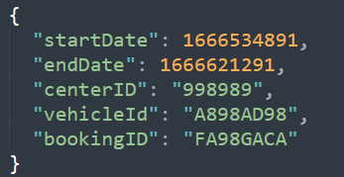
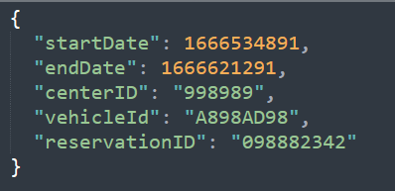
API Endpoints
POST /v1/bookings/
Make a booking
Response
Request Body
Notes:
{
"total": 2,
"bookings": [
{
"booking": {
"dateFrom": "23-04-2022 8PM",
"dateTo": "25-04-2022 6AM",
"amount": 240.99,
"distance": 21,
"rideTime": 8,
"vehicleDetails": {}
}
},
{
"booking": {
"dateFrom": "28-07-2022 10PM",
"dateTo": "01-08-2022 5PM",
"amount": 340.99,
"distance": 45,
"rideTime": 14,
"vehicleDetails": {}
}
}
]
}

Slide 17
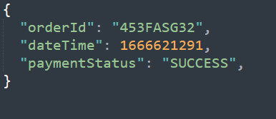
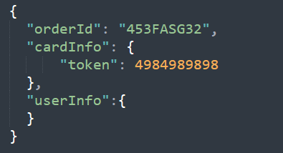
API Endpoints
POST /v1/payments
Make a payment
Response
Request Body
Notes:
{
"total": 2,
"bookings": [
{
"booking": {
"dateFrom": "23-04-2022 8PM",
"dateTo": "25-04-2022 6AM",
"amount": 240.99,
"distance": 21,
"rideTime": 8,
"vehicleDetails": {}
}
},
{
"booking": {
"dateFrom": "28-07-2022 10PM",
"dateTo": "01-08-2022 5PM",
"amount": 340.99,
"distance": 45,
"rideTime": 14,
"vehicleDetails": {}
}
}
]
}

Slide 18
Class Diagram

Slide 19
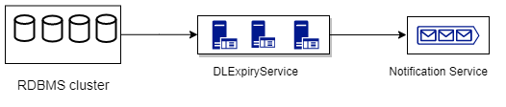
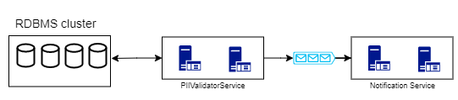
Hack-a-thon Ideas
Service to notify users about PII expiries like Driving License
Service to let users preview in-app vehicle documents.
Prediction for best placement of vehicles in nearby centres

Slide 20
Possible Extensions for future
Expansion to other cities and countries
Support for different variety of 2 wheelers:
Vehicle Names
Vehicle Description: Vehicle year, Vehicle mileage, Vehicle Average
Vehicle Images
Vehicle Ratings and Comments
Four wheelers
Other Payment Systems like Cash, UPI, Wallets
Promotional offerings based on user’s booking patterns

