Slide 1
Fundamentals Of Machine Learning
Abinaya sundari Panneerselvam

Slide 2
Problem
1)Which fuel that produce high heat content with reasonable cost?
2)Which fuel that produce least sulfur and ash content?
3)What is the future scope of fossil fuel?
4)Which fuel gives more profit?

Slide 3
Data Description
Data is collected from PUDL- The Public Utility Data Liberation Project (EIA Form 923 (2001-2021)
Data set has 608,565 rows of 30 variables
fuel_type_code_pudl
fuel_received_units
fuel_mmbtu_per_unit
sulfur_content_pct
ash_content_pct
fuel_cost_per_mmbtu

Slide 4
Analysis
- The Method I used Kmean Algorithm,
First, I choose variables which is required for my analysis then I prepared the data.
Second, I use two methods wss and silhouette to find optimal K (center).

Slide 5
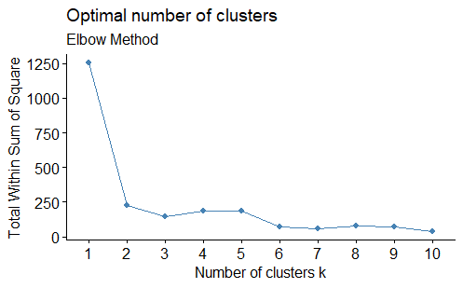
Finding Optimal K (WSS)
K (WSS) – 2

Slide 6
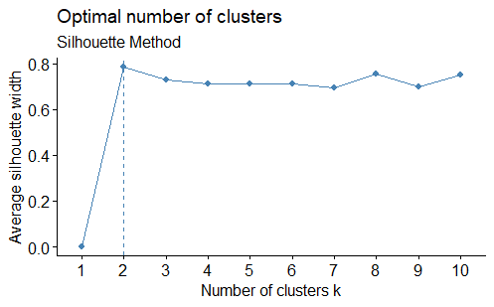
Silhouette
K=2,
- K-means clustering with 2 clusters of sizes 3300, 5831

Slide 7
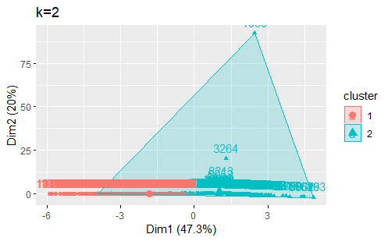
Cluster

Slide 8
Result
Cluster 1: Coal,
Cluster 2: Gas, Oil.

Slide 9
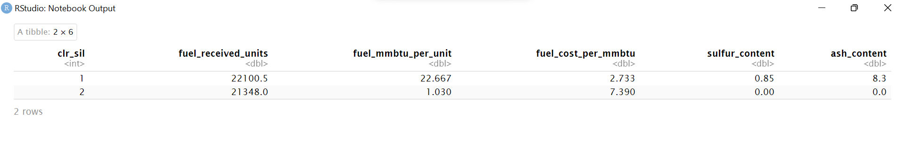
Summary
Cluster 1, with fossil fuel coal produce high heat content in turn produce electricity with reasonable cost thus maximizing profit.
Cluster 2, with gas and oil, does not radiate either sulfur or ash while heating the fuel to produce electricity.
According to cluster 2, In the future gas and oil will play important role in the production of electricity. Although, the coal is the cheapest and efficient fuel, but it will emit more co2 when heating it will cause global warming. So, in future use of coal will get reduced, but use of oil and gas will grow rapidly.
Cluster 1- maximum profit

Slide 10
Thank You

