Slide 1
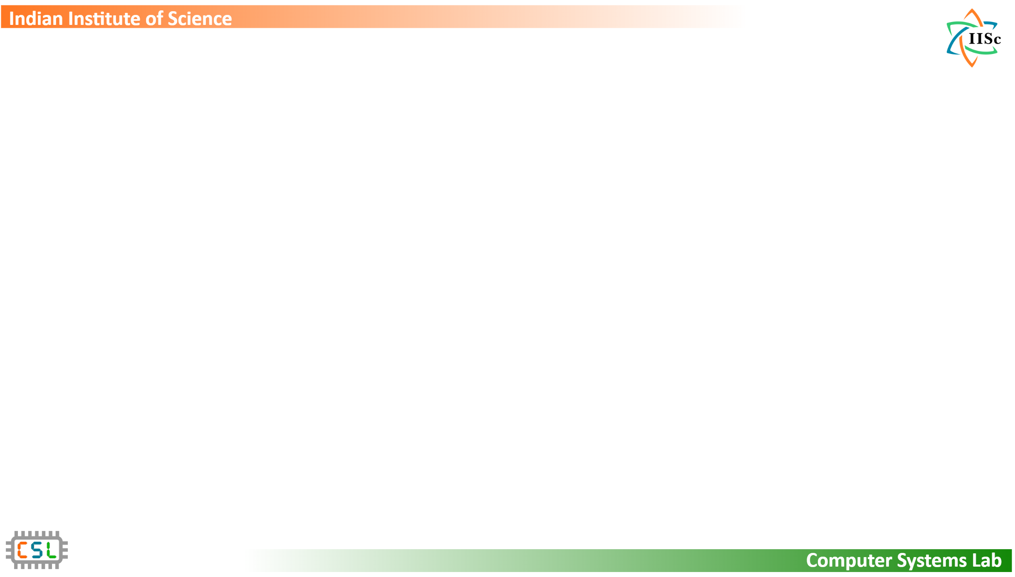
Trident: Harnessing Architectural Resources for All Page Sizes on x86 Processors
Ashish Panwar, Venkat Sri Sai Ram, Arkaprava Basu
Department of Computer Science and Automation
Indian Institute of Science
Notes:
Hi everyone, I am Ashish Panwar and today I am excited to talk about Trident -- a system that achieves high performance by using all page sizes on x86 systems.

Slide 2
Executive summary
Increasing memory footprint challenges virtual memory
Multiple large page sizes in modern hardware
Inadequate support from system software!
Profitability analysis of 1GB pages
Double-digit performance gain over 2MB pages
Trident/Trident^{pv}
Leveraging multiple large page sizes transparently and efficiently
Virtualizing memory management for 1GB pages
Notes:
In this talk, we are going to discuss large pages that are essential for dealing with the virtual memory's address translation overheads.
x86 systems today support multiple large page sizes (namely 2MB and 1GB).
While 2MB pages are used quite extensively today, we find that the hardware resources of 1GB pages are under-utilized due to inadequate software enablement.
In our paper, we first show that 1GB pages have significant potential to improve performance. and there is no good reason why we should not be using them more often.
We have built Trident in Linux -- a system that uses all page sizes, transparently and efficiently. We will also take a look at a variant of Trident that optimizes large page management in virtualized systems.

Slide 3





Virtual memory under duress
M
L
XL
Increasing memory consumption
XS
S
Deep hierarchy of page tables (e.g., 5 levels in x86)
Fundamental limitations on TLB growth
address translation wall
Notes:
This is the age of big data and the memory demand of applications is continuously increasing.
On large memory systems that host these workloads, TLB misses are quite common which makes address translation a performance problem. This is because TLB misses are resolved by traversing multi-level page tables that reside in memory. The growth in memory capacity is also leading to deeper page tables (e.g., 5 levels) that further adds to these overheads.
In addition, we have fundamental limitations on how large TLBs can be -- because the size of TLB is directly related to the lookup latency and energy consumption.
Combined together, these factors lead to a phenomenon that we refer to as the "address translation wall" where the memory management unit spends a significant fraction of CPU cycles in translating virtual addresses into physical addresses.

Slide 4

Architectural mitigation of address translation wall
Large pages = higher TLB coverage
Fewer TLB misses
Faster page table walks
Multiple large page sizes on x86 (2MB, 1GB)
Notes:
We can deal with the address translation wall with large pages that
essentially increase the coverage of TLB -- as a result of which we not only get fewer TLB misses -- but also shorter and faster page table walks.
If we look at micro-architecural trends, since their inception about a decade ago, resource allocation for 1GB pages has been increasing in the hardware. For example, 1GB pages had a 4-entry L1 TLB in Sandy Bridge which has grown to 8 in recent Ice Lake processors.
In the L2 TLB, the number of 1GB page entries has increased from 0 in Sandy Bridge to 1024 in Ice Lake. In fact, in Ice Lake processors, 1GB and 2MB pages have the same number of entries. It is therefore quite clear that micro-architects see a huge potential in 1GB pages.

Slide 5
System software support for large pages
Multiple ways to deploy large pages
Static allocation (e.g., hugetlbfs)
Application directed (e.g., mmap and other syscalls)
Application transparent (e.g., Linux’s THP)
 | relink / recompile | prior reservation of physical memory | fine-grained memory management | supported large page size(s)
hugetlbfs | Yes | Yes | No | 2MB, 1GB
syscalls | Yes | Yes | No | 2MB, 1GB
THP | No | No | Yes | 2MB
Linux supports only 2MB large pages transparently!
Notes:
A software ecosystem can use large pages in various ways.
For example, Linux provides 3 methods:
Option 1 - is a static approach where you relink your application against a librabry to allocate large pages from a reserved pool of memory
Option 2 - is to directly request large pages via mmap family of system calls
and Option 3 is an application transparent mechanism where large pages are handled by the kernel itself without involving users and admins. A popular example of this is transparent huge pages or the THP support of Linux.
The first two of these methods have some usability issues. Recompilation is problematic for legacy applications -- and memory reservation is problematic for overcommitment in shared infrastructures such as the cloud. In addition, large pages allocated via these methods aren't meant to be broken into smaller pages or to be swapped out of memory. So they preclude fine-grained memory management.
The third alternative is quite attractive and offers all the desired features. This is y THP is quite popular. Unfortunately, it supports only 2MB pages on x86 today.
So on one hand, we see that hardware is devoting more and more resources to 1GB pages--and on the other hand we find that the software ecosystem has been under-utilizing these resources.

Slide 6



Why are 1GB pages ignored?
Major contributions
Lack of evidence on profitability
1
Analysis of 1GB pages
Complexity of managing GB-sized pages
2
Trident/Trident^{pv}
TLB thrashing?
3
Performance evaluation
Notes:
At this point, it is natural to ask y is it so? We hypothize 3 reasons for this:
1. There is a lack of evidence on how useful 1GB pages are to real-world applications.
and without a clear evidence, software community has little motivation to improve the
support for 1GB pages. No. 2 is the fact that software management becomes challenging as the page size increases. and No. 3 is the concern about potential TLB thrashing -- because historically 1GB pages had only a few TLB entries. Therefore, applications with extremely poor locality may create a situation where the MMU spends most of its time in replacing TLB entries. We look at all these aspects and try to address them in our paper.
First, we analyze 1GB pages and show that they are extremely valuable for performance. Second, we design and implement Trident to embrace 1GB pages transparently. and Third, with evaluation on a real-system, we look for any evidence of TLB thrashing.

Slide 7
Profitability analysis of 1GB pages
Platform:
Dual-socket Intel Skylake server
18 cores, 192GB DDR4 (per socket)
10-120GB memory footprint
Linux kernel v4.17.3, KVM
 | L1 dTLB | L2 TLB | TLB reach
4KB | 64 | 1536 | 6MB
2MB | 32 | 1536 | 3GB
1GB | 4 | 16 | 16GB
%
20%
20%
%
22%
85%
%
%
6%
10%
13%
12%
27%
12%
%
Performance improvement over 4KB pages
Notes:
We analyze the profitability of 1GB pages over 2MB pages by allocating them via the static allocation method of Linux -- that is hugetlbfs.
We analyzed several large-memory applications including key-value stores, machine learning and HPC workloads on a real Skylake machine that has 192GB memory and 18 cores per socket. The system provides TLB coverage of 6MB, and 3GB with 4KB and 2MB pages, and of 16GB with 1GB pages.
The graph shows how much performance 2MB and 1GB pages improve over the baseline 4KB pages. The numbers on top of the bars show the difference between 1GB and 2MB pages. The difference as we can see is quite substantial -- as high as 27% in case of Btree.
We do the same analysis for virtualized systems as well where the cost of a TLB miss is much higher because they use two levels of page-tables for address translation. The graph on the right shows that 1GB pages can be even more valuable under virtualization where the difference between 1GB and 2MB pages is as high as 85% in case of canneal.
Overall, these experiments demonstrate the value of 1GB pages over what we get with 2MB pages.

Slide 8
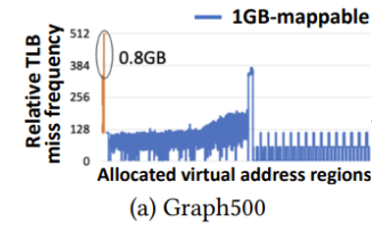
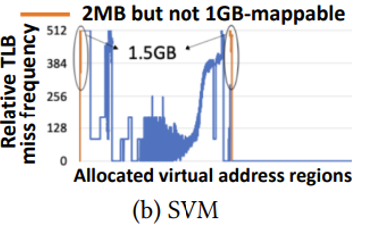

How to utilize 1GB pages?
Linux THP is tuned for a single large page size (2MB on x86)
Substitute 2MB THP with 1GB THP?
essential to leverage all large page sizes!
Notes:
Now that we know that 1GB pages have significant potential -- the question is -- how do we use them? One option is to simply replace 2MB THP with 1GB THP -- in the existing Linux implementation?
Unfortunately, this is not the best idea. The reason is that some virtual address regions cannot be mapped with 1GB pages because they are not big enough or not aligned at 1GB boundary.
And in some cases, such regions contribute to a lot of TLB misses.
For example, these graphs show the address spaces of two applications graph500 and SVM. The x-axis shows the virtual address space and y-axis shows the relative TLB miss frequency of each 2MB region.
The regions colored orange cannot be mapped with 1GB pages because they are not big enough. But their TLB miss frequency is the highest in the whole address space. If we were to replace 2MB THP with 1GB THP, these orange regions will have be mapped with 4KB pages which would not be ideal for performance.
What this means is that we should use all large page sizes not just the largest -- even if they provide higher tlb coverga.

Slide 9



Trident: Transparent use of all large page sizes
1
Eager large page allocation
2
Opportunistic large page promotion
3
Smart compaction
https://github.com/csl-iisc/Trident-MICRO21-artifact
Notes:
To realize this systematically, we build Trident in Linux.
Trident is basically a set of 3 enhancements over Linux where the first two components deal with extending THP to a more hierarchichal strucutre for supporting mutiple large page sizes. We introduce the 3rd component to deal with physical memory fragmentation more efficiently, especially for 1GB pages. Lets look at these components one by one.

Slide 10


Trident: Transparent use of all large page sizes
1
Eager large page allocation
page fault
allocate 1GB page
high allocation latency
allocate 2MB page
asynchronous page-zeroing
allocate 4KB page
Notes:
The first one is eager large page allocation where we try to achieve best possible TLB coverage by allocating 1GB pages at the time of page-fault, followed by 2MB and 4KB page allocation, if required.
While this is good for performance for obvious reasons, one potential problem arises due to the fact that we need to zero-fill a page before it can be allocated to a process. This is a security requirement because otherwise an application's data can leak to other entities.
Zero-filling a 1GB page can take 100s of milli-seconds that adds to the latency of page-fault. We avoid this latency by asynchronously zero-filling 1GB pages in the background. This way, they can be allocated much faster.

Slide 11



Trident: Transparent use of all large page sizes
2
Opportunistic large page promotion
virtual address space
1GB mappings
promotion to 1GB
promotion to 2MB
2MB mappings
4KB mappings
promotion to 1GB
Notes:
The 2nd component is opportunistic promotion of memory regions to large pages.
While we try to allocate 1GB pages eagerly, some address regions may have to mapped
with 2MB or 4KB pages either because either the region was not big enough or we could not obtain a 1GB page frame due to fragmentation.
We take care of these situations by promoting regios to large pages in the background. Similar to allocation, here also we first try to promote smaller mappings to 1GB pages or to 2MB pages if 1GB page frame is not available.
if required , We do this multiple times so that 1GB pages can be utilized to their maxmimum effect.

Slide 12
Physical memory compaction in Linux: An introduction
allocated
free
source
target
Notes:
Before we discuss our 3rd component smart compaction, lets take a quick overview of how Linux compacts physical memory to allocate large pages.
Linux maintains two pointers namely "source" and "target" -- the source points to a range of page frames that it wants to free and "target" points to a block where the source block’s data can be copied.
The source pointer moves from left to right -- while the target pointer moves from right to left.

Slide 13


Memory compaction in Linux is inefficient
better alternatives
source block
(occupancy=3)
occupancy=2
occupancy=1
occupancy=1
unmovable pages (e.g., kernel objects)
source block
unnecessary data movement
Notes:
We find that this sequential approach is inefficient -- because it
disregards how the physical page frames are allocated. For example, in the picture shown here, Linux would select the left most memory block as the source which would require migrating 3 page frames. At this point, there are 3 better alternatives that require less data movement. The second problem comes from unmovable pages (e.g., Linux cannot migrate kernel objects such page-tables, and DMA buffers).
Linux's approach of compaction also disregards the placement of unmovable data and it can select a memory block as the source even if the block contains unmovable pages.
In the example shown here, Linux would migrate the 1st page out the source block. the 2nd page is already free. It is only when the source pointer reaches page-3, that Linux realizes that this block cannot be freed completely. It would then skip this whole block and move to the next block. Both these scenarios are examples of unnecesary data movement -- and it becomes really problematic with 1GB pages where the amount of data movement can be quite high.

Slide 14
Trident: Transparent use of all large page sizes
3
Smart compaction
Greedy selection of source and target blocks
least occupancy,
no unmovable page frame
highest occupancy,
at least 1 free page frame
target
source
occupancy=3
unmovable=1
occupancy=3
unmovable=0
occupancy=3
unmovable=1
occupancy=2
unmovable=0
occupancy=3
unmovable=1
occupancy=1
unmovable=0
occupancy=2
unmovable=0
occupancy=1
unmovable=0
metadata scan
Notes:
Tridet is more prudent in its approach. What we do is -- we maintain two counters for each 1GB block -- one counter captures the occupancy of the block and the other counts how many unmovable pages frames are present within that block.
When we want to compact memory, we simply scan this metadata to greedily select the source and target blocks. The source block is the one with least occupancy and no unmovable data, and the target is the one that is most populated but has at least 1 free page.
This way, we copy minimum amount of data possible at the moment.

Slide 15
Trident: Performance evaluation
%
%
%
%
%
%
%
Performance improvement over Linux THP
Notes:
Now lets c how Trident performs and specially how different components of Trident perform. We compare 3 variants of Trident with THP. 1 is Trident-1GBonly -- where we don't use 2MB pages. 2nd is Trident-NC where we use both 1GB and 2MB pages but don't use smart compaction and the 3rd is where all components are used.
Clearly, using only 1GB is not the best option. We discussed SVM earlier where we saw that some of its addresses that have high tlb misses can't be mapped with 1GB pages. Using only 1GB pages degrades performance in such cases. In the absence of fragmentation, Trident and Trident-NC perform similarly because compaction isnt required. We get better performance when we use 2MB pages in tandem with 1GB pages.

Slide 16
Trident: Performance evaluation
%
%
%
%
%
%
%
%
Performance improvement over Linux THP
Notes:
We also study the same configurations under fragmentation. The second graph shows that Trident is able to sustain the benfits of 1GB pages even when memory is fragmented. The graph also shows that all the components of Trident contribute in its performance.
We also saw that the number of CPU cycles that are spent in page-table walks consistently goes down with Trident and there was no evidence of TLB thrashing on our system.
Also note that our system provides only 16GB of TLB coverage with 1GB pages. On IceLake, we expect that Trident will perform even better./

Slide 17



Trident^{pv}: Virtualizing Trident
Two layers of memory management
Twice the work!
Data movement is the dominating kernel activity
Large page promotion
Memory compaction
Virtualize memory management for large pages
Copy-less page migration
Notes:
Next we discuss how we can optimize Trident further for virtualized systems.
Based on the discussion so far, it is clear that data movement is the dominating kernel
activity in the management of large pages either during large page promotion or while compacting memory.
For virtualized systems, we observe that we can mimic data movement with copy-less page migration which can ultimately be used to lower the cost of promotion and compaction

Slide 18
Traditional vs. copy-less page migration
gVA
v1 v2
gVA
v1 v2
g1
g2
g3
g4
g5
g1
g1
g2
g3
g2
g3
g4
g5
gPA
g5
gPA
g1
g2
g3
g5
h1
h2
h3
h4
h5
h1
h2
h3
h5
hPA
h1
h2
h3
h5
hPA
h2
h3
h4
Traditional page migration
Copy-less page migration
Notes:
The example shown here is how traditional page migration works.
We have two virtual pages v1 and v2 that are mapped to non-contiguous page frames g3 and g5. If the guest OS wants to re-map them to two contiguous page frames (for example, g1 and g2), it would first unmap v1 and v2, then copy g3 to g1 and then copy g5 to g3 and finally establish a new mapping that is contiguous.
In a virtualized setting, we observe that we can mimic the effect of guest page migration without copying any data.
The example on the right shows how copy-less page migration works.
We have v1 and v2 mapping to g3 and g5 (similar to the example on the left). To map them to contiguous page-frames g1 and g2, we first unmap v1 and v2, then we exchange the page table mappings of g1 and g3 in the host physical address space. This will have the same effect as if the data of g3 has been copied to g1. Next, we can do the same for g2 and g5 -- which is equivalent to copying g5's content to g2. Finally establish a new mapping from v1,v2 to g1,g2. This way, we made v1 and v2 contiguous in the guest physical address space with simply manipulating page-table pointers.

Slide 19

Trident^{pv}: Leveraging copy-less page migration
1
2
Large page promotion
Memory compaction
migrate g3 to g1 & g5 to g2
g1
g2
g3
g4
g5
Guest OS
Too many VM exits!
[(g2,g5),
(g1, g3)]
(g1,g3)
(g2,g5)
Batching hypercalls
Hypervisor
h1
h2
h3
h4
h5
Notes:
In tridentpv, we use this idea to optimize both promotion and compaction.
For this, we replace data copy operations with hypercalls from guest Linux to KVM.
For example, we issue a hypercall with parameters (g1,g3) to mimic data copy from g3 to g1. and similarly the next hypercall with parameters (g2, g5).
However, if we replace all data copy operations with hypercalls, it creates a performance problem because hypercalls are expensive. It involves VM exits and each one of them can take 100 of microseconds.
We can optimize this by batching multiple requests into a single hypercall -- and that is possible because whenever we compact or promote pages, we essentially do a lot of data movement together -- so batching works really well. In the best case, we can promote a 1GB page out of 2MB pages with just a single hypercall.

Slide 20
Trident^{pv}: Performance evaluation
1GB page promotion latency
Copy-based | 600ms
Trident^{pv} (without batching) | 30ms
Trident^{pv} (with batching) | 0.5ms
Notes:
This experiment measures the time the guest OS spends in promoting a 1GB page out of 2MB pages.
The effectiveness of our approach is quite visible here: while copy-based promotion takes about 600ms, TridentPV reduces it to only 30ms without batching and further to only 0.5ms with batching.

Slide 21
Trident^{pv}: Performance evaluation
%
%
%
%
%
%
%
%
%
%
SVM Memcached GUPS
Btree Canneal
SVM Memcached GUPS
Btree Canneal
Performance improvement over Linux/KVM THP
Notes:
Finally, we evaluate tridentpv in both fragmented and non-fragmented settings under virtualization. The results show that TridentPV comfortably beats our baseline THP systems in terms of performance,
In a non-fragmented system, it improves performance by as much as 47% for canneal. Under fragmentatio, the improvement is as high as 24% for GUPS.

Slide 22
Key take-aways
Hardware resources for 1GB pages are under-utilized
Trident
Leveraging 1GB pages transparently
Exploiting synergy of all large page sizes
Trident^{pv}
Copy-less page migration
Faster promotion and compaction for large pages
Notes:
That completes our discussion of Trident. In this talk, we looked at how the micro-architectural resources of 1GB pages have been under-utilized, even though they have been commercially available for a decade.
We analyzed 1GB pages to investigate their profitability and built Trident in Linux to exploit the synergy of all page sizes.
We further optimized large page management for virtualized systems with copy-less page migration.
Trident comfortably outperforms Existing state-of-the-art THP solutions that only focus on 2MB large pages.

Slide 23

Contact us
Checkout Trident
https://github.com/csl-iisc/Trident-MICRO21-artifact
Ashish Panwar (ashishpanwar@iisc.ac.in)
Venkat Sri Sai Ram (sirvisettis@iisc.ac.in)
Arkaprava Basu (arkapravab@iisc.ac.in)
Computer Systems Lab @ CSA, IISc
https://csl.csa.iisc.ac.in/
This presentation and recording belong to the authors. No distribution is allowed without the authors' permission.
Notes:
Trident is open-source and we encourage you to give it a try.
For more details, please refer to the full paper or reach out to us.

Slide 24
Contact us
Venkat Sri Sai Ram (sirvisettis@iisc.ac.in)
Ashish Panwar (ashishpanwar@iisc.ac.in)
Arkaprava Basu (arkapravab@iisc.ac.in)
Computer Systems Lab @ CSA, IISc
https://csl.csa.iisc.ac.in/
This presentation and recording belong to the authors. No distribution is allowed without the authors' permission.

