Slide 1



Making Huge Pages Actually Useful
Ashish Panwar^{1,2}, Aravinda Prasad¹, K. Gopinath¹
¹Indian Institute of Science (IISc), Bangalore
²NetApp Inc.
Architectural Support for Programming Languages and Operating Systems (ASPLOS)-2018

Slide 2
Virtual-to-physical address translation
TLB miss overheads are (very) expensive
Even more expensive in virtualized systems
Resolving a TLB miss takes up to 4 memory accesses on native*
Up to 24 on virtual (nested page tables)*
Experimental Setup:
8 core Xeon Ivy-Bridge Server
24GB memory
* On x86 based systems.

Slide 3
Efficient address translation with huge pages
Map large regions in TLB entries ➔ Less TLB misses
Supported by hardware for nearly two decades
Considerable performance benefits (under ideal conditions)

Slide 4
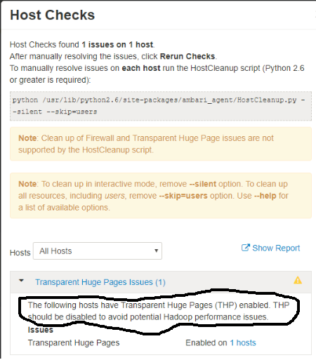
Tales from the field

Slide 5
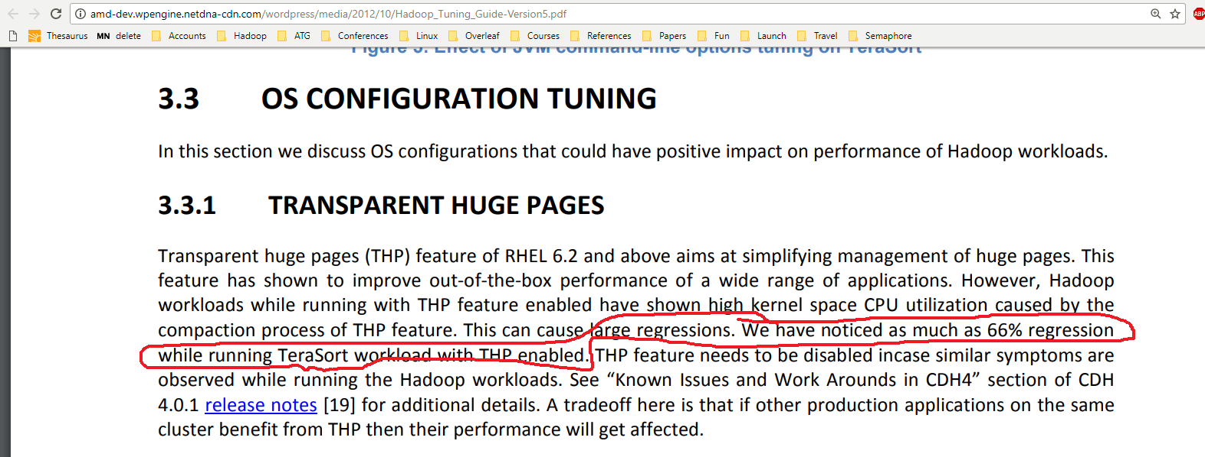
Tales from the field

Slide 6
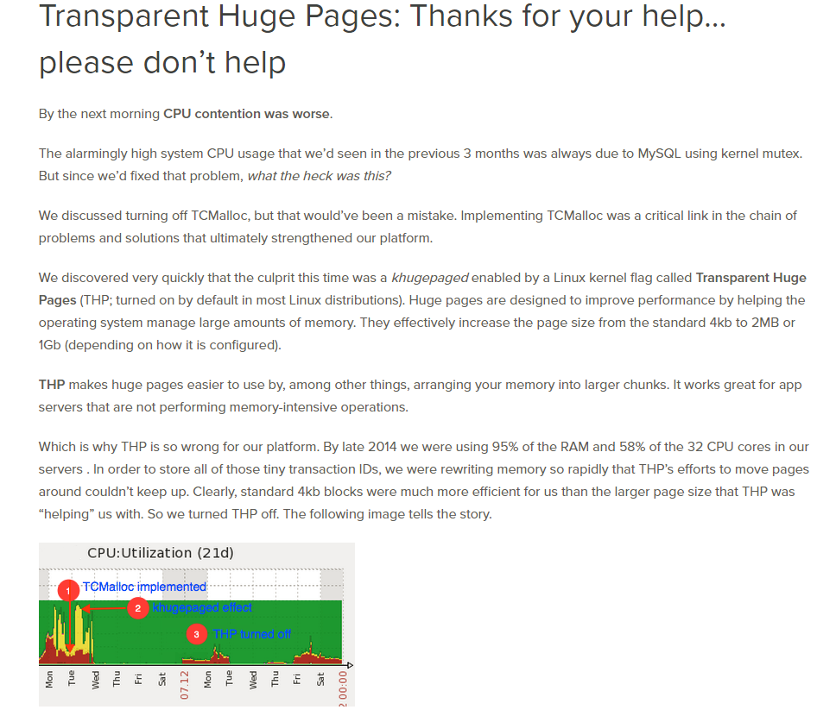
Tales from the field

Slide 7
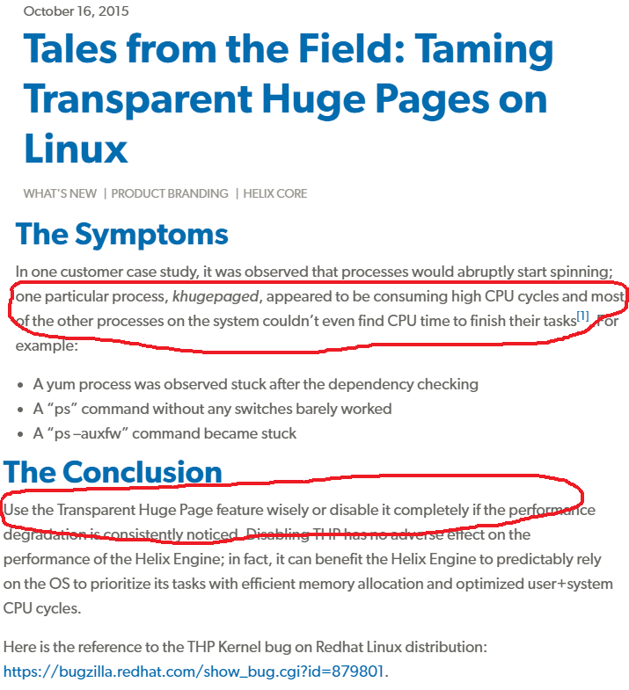
Tales from the field

Slide 8
Why aren’t huge pages effective (yet)?
Must be mapped contiguously
Difficult to allocate because of fragmentation as the system ages
Defragmentation can become a bottleneck, if not done properly
Memory compaction (migrate pages to restore contiguity)
free
allocated

Slide 9
Why aren’t huge pages effective (yet)?
Must be mapped contiguously
Difficult to allocate because of fragmentation as the system ages
Defragmentation can become a bottleneck, if not done properly
Memory compaction (migrate pages to restore contiguity)
before
free
compaction
allocated
after

Slide 10
Why aren’t huge pages effective (yet)?
Must be mapped contiguously
Difficult to allocate because of fragmentation as the system ages
Defragmentation can become a bottleneck, if not done properly
Memory compaction (migrate pages to restore contiguity)
before
free
compaction
allocated
after
Problem: Not all pages can be moved!

Slide 11
Why aren’t huge pages effective (yet)?
Must be mapped contiguously
Difficult to allocate because of fragmentation as the system ages
Defragmentation can become a bottleneck, if not done properly
Memory compaction (migrate pages to restore contiguity)
free
allocated
unmovable

Slide 12
Why aren’t huge pages effective (yet)?
Must be mapped contiguously
Difficult to allocate because of fragmentation as the system ages
Defragmentation can become a bottleneck, if not done properly
Memory compaction (migrate pages to restore contiguity)
before
free
compaction
allocated
unmovable
after
cannot allocate 4 contiguous pages

Slide 13
What are unmovable pages?
Movability requires reference management of every object
User space – page tables [pa = PTE(va)]
Kernel space – directly mapped [pa = va + PAGE_OFFSET*]
Direct mapping makes kernel pages unmovable
Tradeoff between simplicity vs flexibility
Large contiguous allocations are (generally) prohibited
Inevitable with huge pages

Slide 14
Fragmentation mitigation in Linux
Anti-fragmentation
Aims to prevent fragmentation occurrence
Partitions physical memory between kernel and user (at pageblock granularity)
Clusters alike allocations together (to minimize pollution)

Slide 15
Fragmentation mitigation in Linux
Anti-fragmentation
Aims to prevent fragmentation occurrence
Partitions physical memory between kernel and user (at pageblock granularity)
Clusters alike allocations together (to minimize pollution)
2. Memory compaction
Compact regions that are not polluted by the kernel (colored green)

Slide 16
Problem (1/3): Fragmentation-via-pollution
need pages? steal from movable
Unmovable
Movable
unmovable
movable
free

Slide 17
Problem (1/3): Fragmentation-via-pollution
Unmovable
Movable
unmovable
movable
free

Slide 18
Problem (1/3): Fragmentation-via-pollution
Hybrid pageblock (treated as unmovable by the Linux kernel)
Unmovable
Movable
unmovable
movable
free

Slide 19
Problem (1/3): Fragmentation-via-pollution
Unmovable
Movable
unmovable
movable
free

Slide 20
Problem (1/3): Fragmentation-via-pollution
Unmovable
Movable
need pages? steal from unmovable
unmovable
movable
free

Slide 21
Problem (1/3): Fragmentation-via-pollution
Unmovable
Movable
unmovable
movable
free

Slide 22
Problem (1/3): Fragmentation-via-pollution
Unmovable
Movable
unmovable
movable
free

Slide 23
Problem (1/3): Fragmentation-via-pollution
Unmovable
Movable
unmovable
movable
free

Slide 24
Problem (1/3): Fragmentation-via-pollution
Unmovable
Movable
unmovable
movable
free

Slide 25
Problem (1/3): Fragmentation-via-pollution
Unmovable
Movable
unmovable
movable
free

Slide 26
Problem (1/3): Fragmentation-via-pollution
Unmovable
Movable
unmovable
movable
free
Eventually majority of pageblocks become hybrid
Can lead to permanent fragmentation
Why? Because hybrid pageblocks remain hidden from the allocator

Slide 27
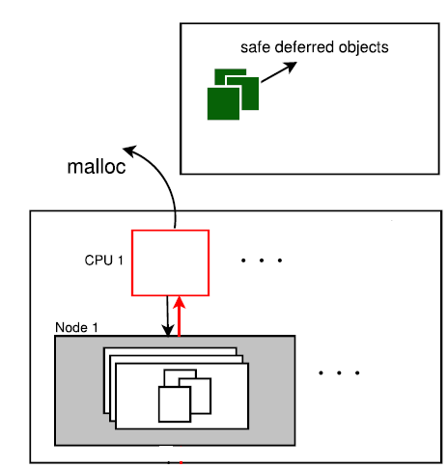
Problem (2/3): High slab churns
Many subsystems use Read-Copy-Update(RCU)
synchronization mechanism
Every update operation creates a new copy
of the object
RCU
Slab Allocator
Old (deferred) objects are reclaimed sometime
after a safe (grace) period

Slide 28
Problem (2/3): High slab churns
Extended lifetime of kernel (unmovable) objects
High rate of pollution
RCU
Slab Allocator
Buddy Allocator
Unmovable
alloc/free
Movable

Slide 29
Problem (2/3): High slab churns
Extended lifetime of kernel (unmovable) objects
High rate of pollution
RCU
Slab Allocator
Buddy Allocator
Unmovable
alloc/free
Movable

Slide 30
Problem (2/3): High slab churns
Extended lifetime of kernel (unmovable) objects
High rate of pollution
Why? Deferred objects remain invisible to the
slab allocator until reclaimed by RCU
RCU
Slab Allocator
Buddy Allocator
Unmovable
alloc/free
Movable

Slide 31
Problem (3/3): LIU migration
LIU (Latency-inducing unsuccessful) migration
migrate
Hybrid Pageblock
(unknown to the Linux kernel)

Slide 32
Problem (3/3): LIU migration
LIU (Latency-inducing unsuccessful) migration
migrate
Hybrid Pageblock
(unknown to the Linux kernel)

Slide 33
Problem (3/3): LIU migration
LIU (Latency-inducing unsuccessful) migration
oops!
Hybrid Pageblock
(unknown to the Linux kernel)

Slide 34
Problem (3/3): LIU migration
LIU (Latency-inducing unsuccessful) migration
oops!
Hybrid Pageblock
(unknown to the Linux kernel)
wasted effort

Slide 35
Problem (3/3): LIU migration
LIU (Latency-inducing unsuccessful) migration
oops!
Hybrid Pageblock
(unknown to the Linux kernel)
wasted effort
High memory traffic, TLB shootdowns
Particularly harmful for page-fault intensive workloads
Why? Because hybrid pageblocks remain hidden during compaction

Slide 36
Implications
Huge page allocation failures
High (and variable) latency
Virtualization can exacerbate performance issues
Both Guest and Host OSs may perform unnecessary work
Large memory large problems
High (kernel mode) CPU utilization
Performance isolation
Workload: milc (SPEC CPU2006)

Slide 37
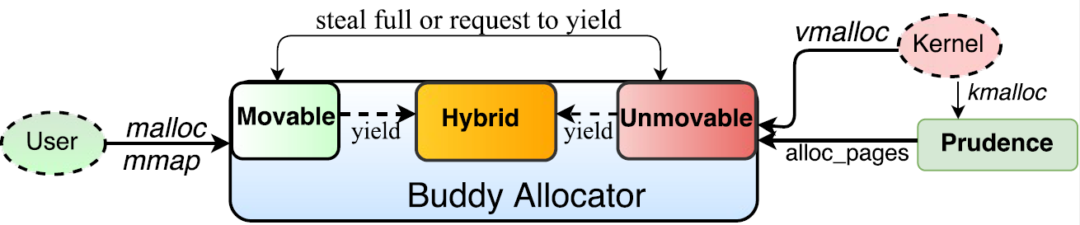
Illuminator
Manages hybrid pageblocks explicitly
Mitigates fragmentation-via-pollution
Eliminates LIU migration
Reduces slab churns with Prudence [1]

Slide 38
Preventing unnecessary fragmentation
Unmovable
Hybrid
Movable
unmovable
movable
free

Slide 39
Preventing unnecessary fragmentation
Unmovable
Hybrid
Movable
unmovable
movable
free

Slide 40
Preventing unnecessary fragmentation
Unmovable
Hybrid
Movable
unmovable
movable
free
Existing hybrid pageblocks are utilized to prevent pollution
Produces less than 10% hybrid pageblocks compared to Linux

Slide 41
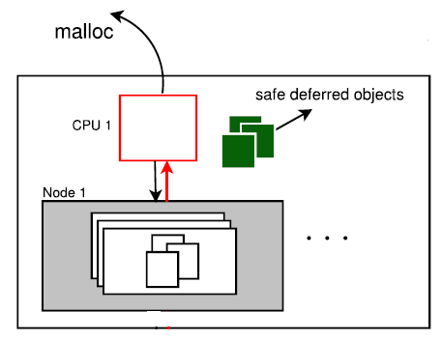
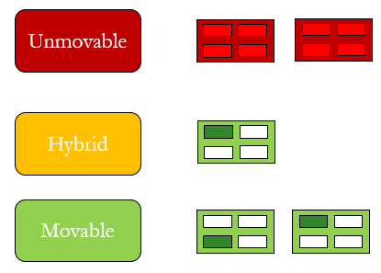
Illuminator
Slab
Allocator
Buddy
Allocator
alloc/free

Slide 42
Eliminating LIU migration
Skip hybrid pageblocks during compaction
migrate
Hybrid Pageblock
(known to Illuminator)

Slide 43
Eliminating LIU migration
Skip hybrid pageblocks during compaction
migrate
Hybrid Pageblock
(known to Illuminator)

Slide 44
Eliminating LIU migration
Skip hybrid pageblocks during compaction
migrate
Hybrid Pageblock
(known to Illuminator)

Slide 45
Eliminating LIU migration
Skip hybrid pageblocks during compaction
Hybrid Pageblock
(known to Illuminator)
successful

Slide 46
Eliminating LIU migration
Skip hybrid pageblocks during compaction
Hybrid Pageblock
(known to Illuminator)
successful
Reduces the cost of compaction by up to 99%

Slide 47
Experimental Framework
Hardware
8 core Xeon Ivy-Bridge server
8GB and 24GB physical memory (workload dependent)
Page sizes: Base-4KB, Huge-2MB
Software
HPC, scientific computing and a database server
SPEC CPU2006, PARSEC, NAS Parallel Benchmarks
Linux kernel 4.5
Ubuntu OS
KVM hypervisor

Slide 48
Results(1/4): Performance

Slide 49
Results(2/4): Latency
Setup:
MySql server benchmarked with sysbench tool
32 million rows, 8 threads performing read operation
10 iterations. Graph shows the max latency from each iteration.

Slide 50
Results(3/4): Performance isolation
Workloads executed (one-by-one) alongside milc

Slide 51
Results(4/4): Illuminator and virtualization
120 130
KVM hypervisor
Guest – 8 GB memory, 8 vCPUs
Legend denotes the layer at which Illuminator was applied

Slide 52
Conclusions
Huge pages not useful without effective OS support
Explicit kernel support needed to handle physical memory fragmentation
Current solutions suffer from poor decision making in critical code paths
Virtualization can exacerbate the impact of poor fragmentation mitigation
Illuminator: A simple solution to make huge pages actually useful!
https://github.com/apanwariisc/Illuminator

Slide 53
Thank You!

