Slide 1
Towards Practical Page Placement for a Green Memory Manager
17 December, 2015
Ashish Panwar, K. Gopinath
Department of Computer Science and Automation
Indian Institute of Science
Bangalore, India

Slide 2
Agenda
Motivation
Background
Challenges
Design and Implementation
Results
Conclusion and Future Work

Slide 3
Motivation
Memory consumes significant power in some situations (sometimes upto 40%).
Proportion of memory power consumption increases in idle states.
Software hardware cooperative power management (CPU and other subsystems) makes it even more critical.
However, such cooperation for memory power optimization is still missing in traditional systems despite continuous hardware support.

Slide 4
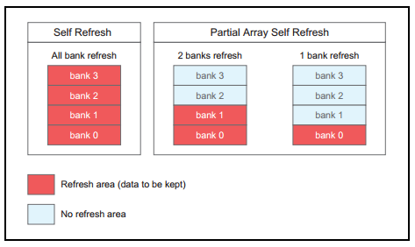
Hardware Support
Partial Array Self-Refresh:
Memory banks can be turned off to save power.
Requires operating system support to avoid data loss.
Fig 1. Overview of Partial Array Self Refresh ^{[1]}
Power State | Relative Power Consumption
Read/Write | 100 %
Active-Idle | 63 %
Self-Refresh | 7 %
Deep-Power-Down | < 1%
Power state transition of memory banks is typically transparent to software.
Table 1. Relative Power Consumption of different power states ^{[1]}

Slide 5
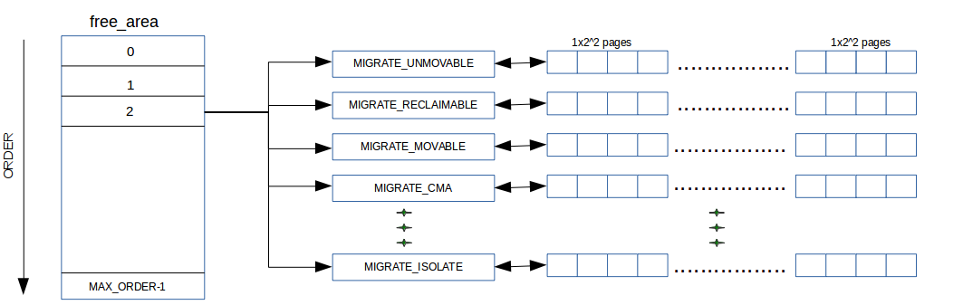
Linux Page Allocator
Fig 2. Layout of Linux Binary Buddy Allocator
Memory is divided in multiple zones.
Each memory zone gets its own buddy allocator.

Slide 6
Role of a Memory Manager
Restrict page allocations to a subset of memory banks.
Perform migration (or compaction) in order to limit the number of in-use memory banks in long run (should be kept to minimum as migration itself will burn some power).
Linux page allocator performs poorly for both requiremets !

Slide 7
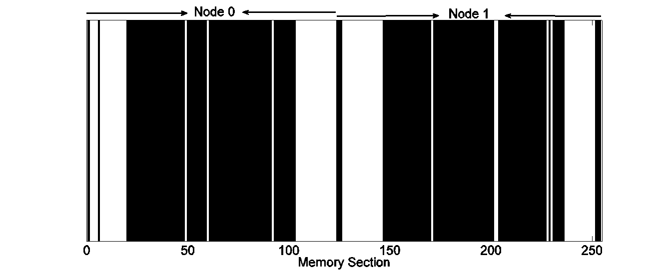
Behavior of Linux Page Allocator
(a). All memory sections are in-use for even < 10 % memory usage on Node 1.
(b). Sections colored black (172/256) can not be freed because of the presence of
kernel (unmovable) pages.
Fig 3. Impact of arbitrary page allocation of Linux kernel
Arbitrary page allocation causes -
Memory references to spread over almost all memory banks (even during low workloads).
A large proportion of memory banks to become unmovable due to the presence of kernel pages.

Slide 8
Challenge
Working sets are complex, large and rapidly changing on modern hardware.
Actual memory references are typically transparent to operating systems.
Fig 4. Working set (10ms sample) of facesim with different thread count.

Slide 9
Challenge
Idle periods are hard to achieve as the number of cores grow large.
Processing such information in a running system is a processor (and hence power) hungry activity.
Fig 5. Working set (10ms sample) of swaptions with different thread count.

Slide 10
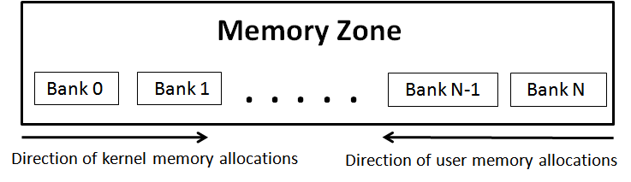
Array based Bank-Buddy Allocator
Manages free pages of each memory bank individually.
Allocation from one end of the array.
Different directions for kernel and user memory allocations.
Migrate when there is an opportunity.
Fig 6. Array based Bank-Buddy Allocator

Slide 11
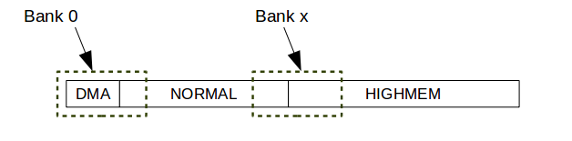
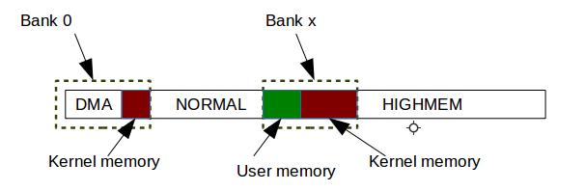
When a bank crosses zone boundary
There are at-most two such possibilities in a system.
Always keep memory banks that cross zone boundary in-use.

Slide 12
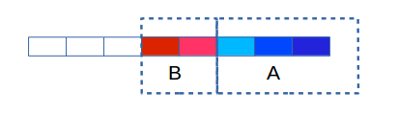
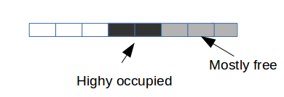
Analyzing Array based Bank-Buddy Allocator
Cost of Page Allocation : O(n), where n is the number of memory banks spanned by the zone.
Unnecessary migration overhead.
If A exits first -

Slide 13
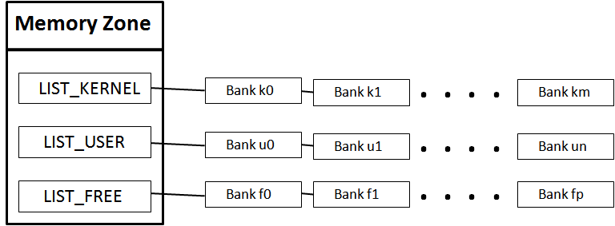
List based Bank-Buddy Allocator
Fig 7. Layout of memory banks in List based Bank-Buddy Allocator
Helps in reducing migration overhead but the cost of memory allocation is still high i.e., O(n) in the worst case.

Slide 14
Issues with per Bank Buddy Allocators
104 bytes per order free lists on x86_64.
1144 bytes for free_area per memory zone.
Impact: Size of memory management structures (and hence the kernel image) grows significantly.
MICRO-OPTIMIZATION MACRO SIDE-EFFECTS (mainly due to inefficient cache behavior).

Slide 15
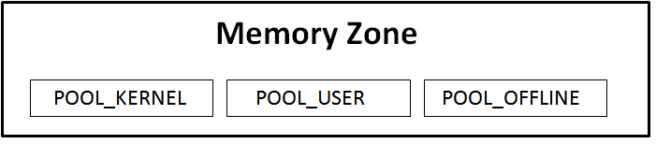
Adaptive-Buddy Allocator
Merge all banks belonging to same list (from list based design) together to form memory pools.
Provides better runtime performance compared to earlier designs.
Capacity on demand can be met by adding (or removing) banks to (or from) allocation pools.
Fig 8. Layout of memory pools in Adaptive-Buddy
Page Allocation : O(1)
Page Free : O(1)

Slide 16
Size of mm data structures

Slide 17
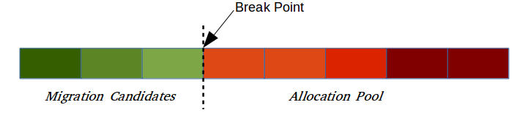
Page Migration
Sort banks in descending order based on the number of free pages.
Identify candidate banks for migration (break point).
Isolate candidate banks from allocation pool (to avoid copying more than once).
Migrate in the sorted order.

Slide 18
Results
(a). Unmovable memory sections (colored black) with Buddy allocator
(b). Unmovable memory sections (colored black) with Adaptive-Buddy allocator
Fig 9. Kernel memory footprint (sections colored black) with different allocators

Slide 19
Results
(a). Free vs Offlined memory without page migration
(b). Free vs Offlined memory with page migration
(c). Offlined vs migrated Memory
Fig 10. Behavior of Adaptive-Buddy regarding power management

Slide 20
Results
Workloads –
Light : Memory footprint varying between 10%-50%.
Medium : Memory footprint varying between 30%-80%.
Workload | 32 GB |  |  | 4 GB
 | Max | Average Offline Memory(%) |  | Max | Average Offline Memory(%)
 |  | Optimal | Adaptive-Buddy |  | Optimal | Adaptive-Buddy
Light | 81 | 69 | 59.5 | 64 | 55 | 48
Medium | 56 | 57 | 45.7 | 45 | 35 | 26
Table 2. Percentage of offline memory on different systems and workloads along with comparison with a hypothetical optimal solution in the average case.

Slide 21
Performance Evaluation
PARSEC Benchmark Suite
Application | User Time (seconds) |  | System Time (ms)
 | Buddy | Adaptive-Buddy | Buddy | Adaptive-Buddy
bodytrack | 290 | 290 | 864 | 672
blackscholes | 352 | 352 | 3885 | 3915
canneal | 297 | 299 | 7380 | 7412
dedup | 56 | 55 | 27843 | 28363
facesim | 1051 | 1058 | 9610 | 9836
freqmine | 987 | 981 | 2360 | 2382
streamcluster | 1052 | 1094 | 12319 | 12614
swaptions | 666 | 639 | 13373 | 12228
vips | 273 | 272 | 4478 | 3848
x264 | 211 | 211 | 1603 | 1787
Table 3. Comparison between the execution time with different allocators for PARSEC applications

Slide 22
Performance Evaluation
AIM9 Microbenchmark Suite
Test | Description | Operations per Second |  | Difference
 |  | Buddy | Adaptive-Buddy
creat-clo | File creations & closes | 151816 | 149883 | -1.30%
page_test | System allocations & pages | 552330 | 559781 | +1.35%
break_test | System memory allocations | 3716713 | 3949383 | +6.26%
exec_test | Program loads | 1396 | 1390 | -0.43%
fork_test | Task creations | 3260 | 3193 | -2.05%
shared_memory | Shared memory operations | 1054128 | 1053623 | -0.05%
tcp_test | TCP/IP messages | 202990 | 202461 | -0.26%
udp_test | UDP/IP datagrams | 458661 | 449836 | -1.93%
Table 4. Comparison between the execution time with different allocators for PARSEC applications

Slide 23
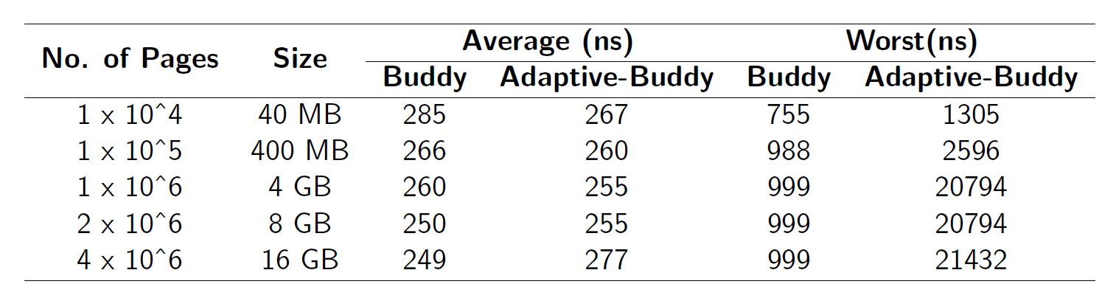
Performance Evaluation
A Synthetic Benchmark:
Created for testing the page allocation performance for a large number of successive requests to build memory pressure.
C program for page allocation and systemtap for timing measurement.
Table 5. Comparison between the average and worst case allocation time of different allocators
Worst case behavior of Adaptive-Buddy can be improved by using a kernel thread for moving pages of a
memory bank from one pool to another but that solution also has many downsides !

Slide 24
Future Work
Integrating and testing Adaptive-Buddy on a real hardware.
Evaluating Adaptive-Buddy in virtualized environments (for capacity on demand).
A power friendly buffer cache ?

Slide 25
References
https://lwn.net/Articles/478049/
Linux Memory Power Management [S. Bhat 2013].
Linux VM Infrastructure to support Memory Power Management [A. Garg 2011].
Jantz, Michael R. and Strickland, Carl and Kumar, Karthik and Dimitrov, Martin and Doshi, ``A Framework for Application Guidance in Virtual Memory Systems'', VEE 2013.
David, Howard and Fallin, Chris and Gorbatov, Eugene and Hanebutte, Ulf R. and Mutlu, Onur, ``Memory Power Management via Dynamic Voltage/Frequency Scaling'', ICAC 2011.
Huang, Hai and Shin, Kang G. and Lefurgy, Charles and Keller, Tom, ``Improving Energy Efficiency by Making DRAM Less Randomly Accessed'', ISPLED 2005.
Huang, Hai and Pillai, Padmanabhan and Shin, Kang G., ``Design and implementation of power-aware virtual memory'', ATEC 2003.
Hai Huang, Kang G. Shin, Charles Lefurgy, Karthick Rajamani, Tom Keller, Eric Van Hensbergen, and Freeman Rawson, "Cooperative Software-Hardware Power Management for Main Memory", published in Lecture Notes in Computer Science, Power-Aware Computer Systems: 4th International Workshop, PACS 2004, Volume 3471, December, 2005, pages 61-77.

Slide 26
Thank You !

