Slide 1
Available bandwidth measurement as simple as running wget
Demetres Antoniades, Manos Athanatos,
Antonis Papadogiannakis, Evangelos P. Markatos
Institute of Computer Science
Foundation for Reasearch and Technology Hellas
Constantine Dovrolis
College of Computing
Georgia Institute of Technology

Slide 2

Roadmap
Introduction
Measurement methodology
The abget tool
Validation results
Available bandwidth variability
Conclusions

Slide 3
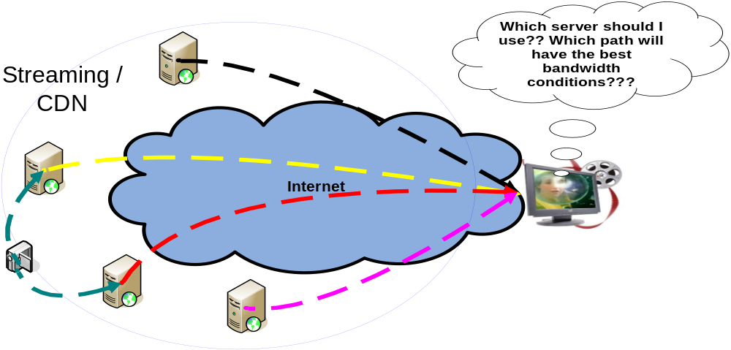
Why to measure available bandwidth?
Numerous applications:
  Streaming media, Content Distribution Networks, overlay networks, QoS verification, congestion control
We need to measure the available bandwidth in many Internet paths

Slide 4
Definitions
Capacity:
  The maximum possible IP-layer end-to-end throughput
  Limited by the narrow link
  Independent of cross traffic load
Available Bandwidth (avail-bw):
  The idle (non-utilized) part of path’s capacity
  Limited by the tight link
  Dynamically varying metric
C₁ C₂ C₃
Source
Sink
Narrow link
Tight link

Slide 5
Existing measurement tools
 | Cooperative | Non-cooperative
Capacity | Pathrate | SProbe
Available bandwidth | TOPP, Pathload, Spruce, PathChirp, IGI/PTR | abget
Current avail-bw tools require cooperation of both ends
Most end points do not cooperate
Existing tools are based on UDP/ICMP protocols which are often blocked or rate limited

Slide 6
Introducing abget
abget runs in single-end mode
It uses any TCP-based server as sender, which cooperates indirectly
abget uses only TCP packets and appears as a normal client
It estimates the variation range of the avail-bw from any server to an instrumented client within a user defined time period

Slide 7
Measurement methodology
The sender transmits packet streams at a certain rate
We don’t control the sender, so we have to enforce it to do so
We analyze the received packets interarrivals to decide whether the probing rate is higher or lower than avail-bw
We use an iterative algorithm to estimate the avail-bw

Slide 8
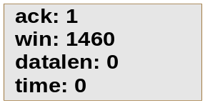
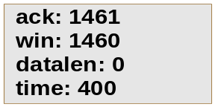
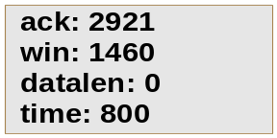


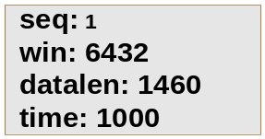
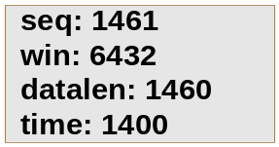

Make a server cooperative (1/2)
We force the TCP server to send packets periodically at a given rate R by
  limiting the advertised window to one MSS size
  acknowledge one MSS with each ACK and
  generate paced ‘fake’ ACKs with period T=MSS/R
The server is forced to send one MSS upon receiving each ACK
abget client
Server

Slide 9
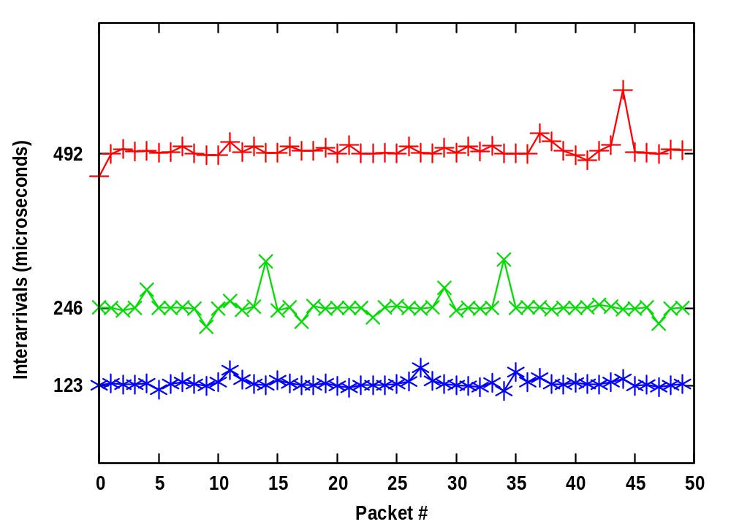
Make a server cooperative (2/2)
Segment interarrivals at an instrumented server, passively monitored with tcpdump, for three different ACK generation periods
The server transmits most segments very close to the desired rate

Slide 10
Analyze packet interarrivals
We estimate the relative OWDs from the interarrivals of the received segments:
d(i): the relative OWD of packet i
t(i): the interarrival between packets i and i-1 at receiver
T: the constant interarrival between packets i and i-1 at the sender
d(i) = d(i-1) + t(i) - T
Starting the recursion with d(1)=0 we reconstruct the OWD time series
If the OWDs increase, then the probing rate is higher than the avail-bw

Slide 11
The abget algorithm
abget uses an iterative algorithm based on linear probing
The user specifies the probing range [R_{min}, R_{max}] and the estimation resolution w
For each probing rate, it sends N packet streams
Based on majority counting, abget classifies each rate as higher (I) or lower (N) than the avail-bw, or not clear (G)
Finally, it reports a variation range [low bound, high bound] for the avail-bw
N
N
N
G
G
I
I
I
Rmin
Rmin + w
low
bound
high
bound
Rmax - w
Rmax
Probing rates

Slide 12

Measurement duration and overhead
Reducing the measurement duration leads to faster estimation and lower overhead
Increasing the measurement duration leads to better accuracy
In abget the measurement duration, overhead, and accuracy can be controlled by the user
Tool’s parameters:
  Probing range [R_{min}, R_{max}]
  Estimation resolution w
  Number of streams N
  Stream length (packets) K
  Idle time between successive streams T_{i}

Slide 13
Validation results
Validation in a local testbed
Validation in a passively monitored operational network path
abget parameters:
N=5 streams per probing rate
K=50 packets
w=5 Mbps estimation resolution
probing range R_{min}=0 Mbps and R_{max}=100 Mbps
T_{i}=500 msec idle time
Measurement duration about 50 seconds

Slide 14
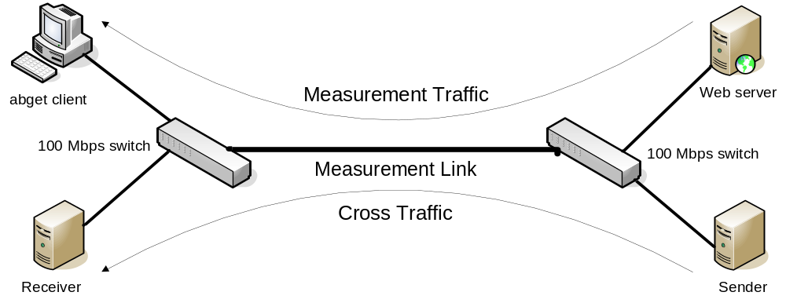
Validation in a local testbed

Slide 15
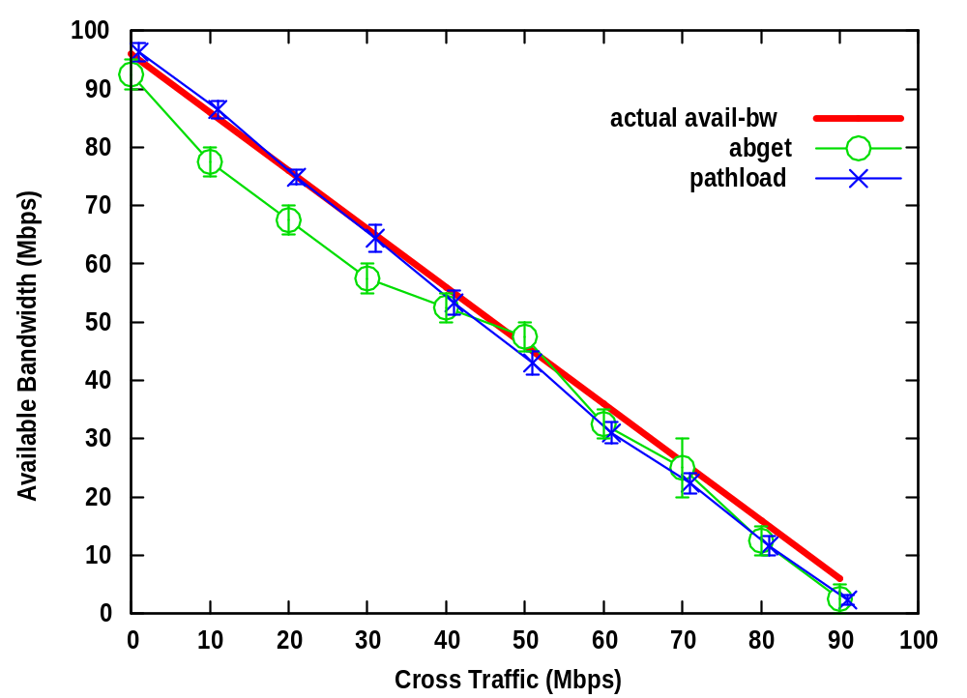
UDP cross traffic
abget produces accurate estimates, compared to actual avail-bw

Slide 16
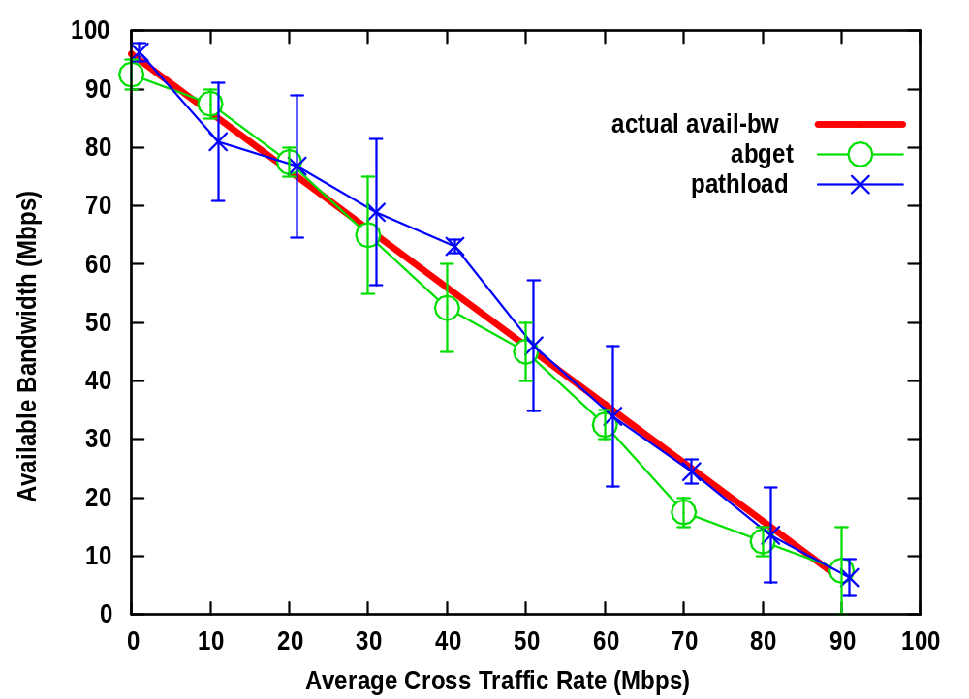
Trace driven cross traffic
Realistic traffic by ‘replaying’ a packet trace at different rates

Slide 17
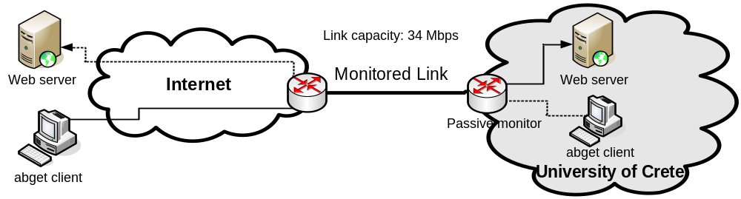
Validation in an operational path (1/2)

Slide 18
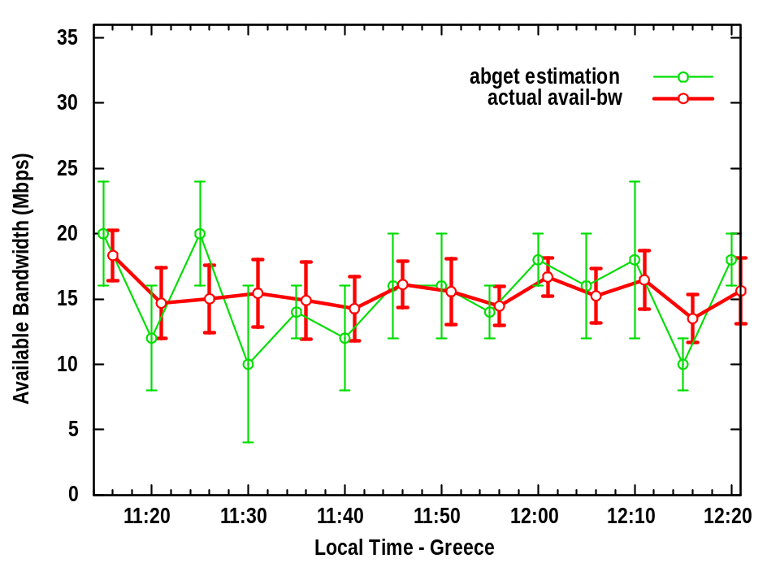
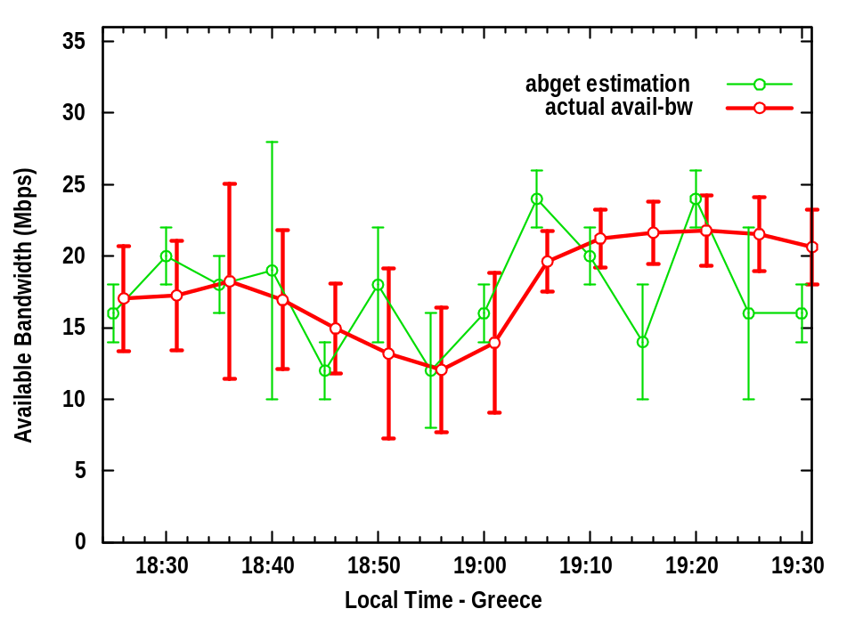
Validation in an operational path (2/2)
avail-bw from www.nytimes.com to UoC client
avail-bw from UoC web server to Gatech client
We passively measured the actual avail-bw variation at the tight link
abget central estimates are, for the most part, within the actual variation range

Slide 19
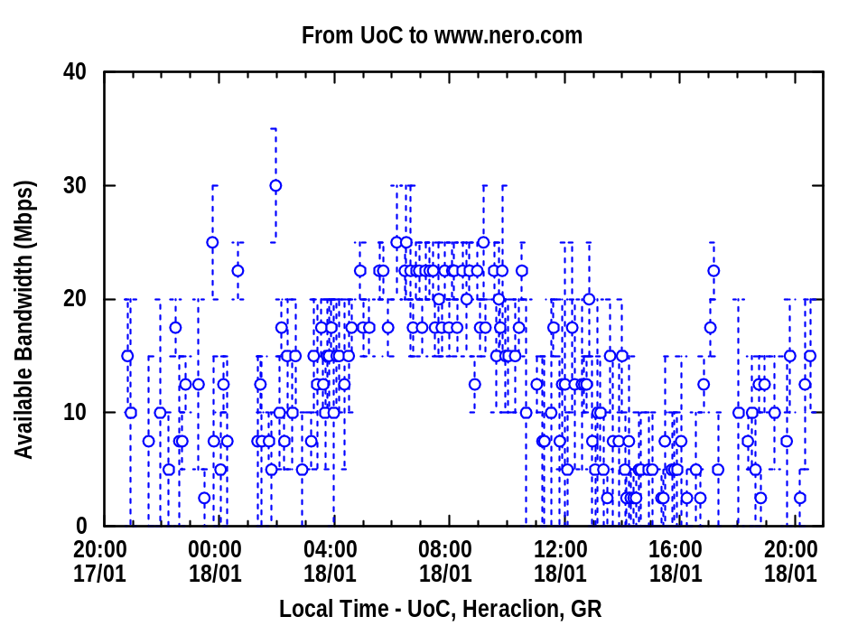
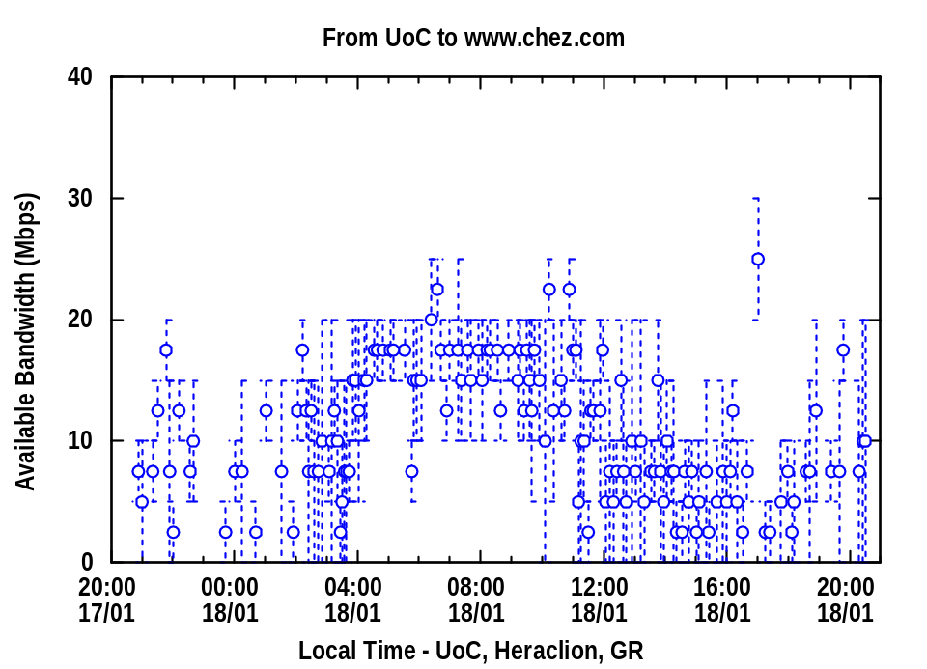
Available bandwidth variability (1/2)
Both paths show the same diurnal pattern, maximum avail-bw in the early morning hours and minimum in afternoon and evening
Wider variation range when avail-bw is lower

Slide 20
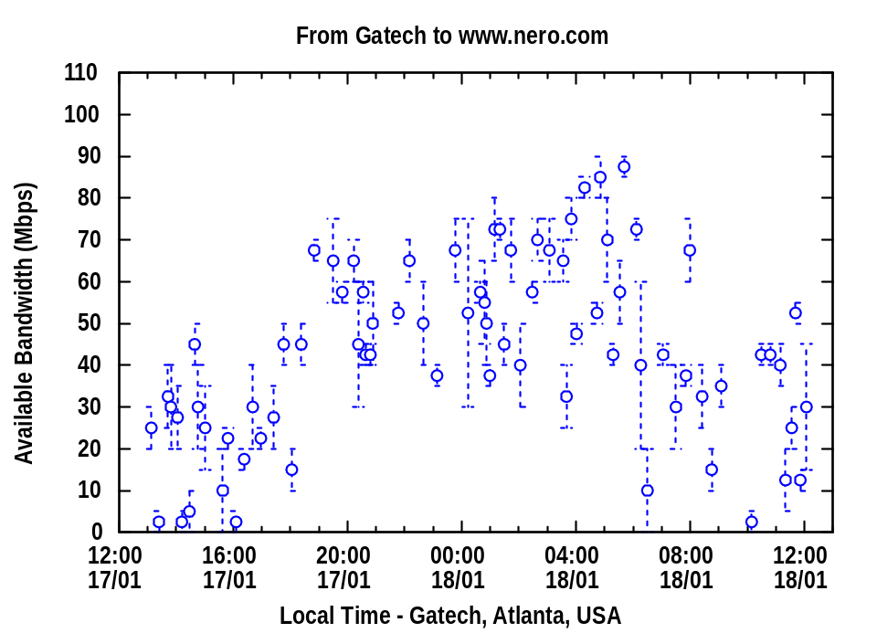
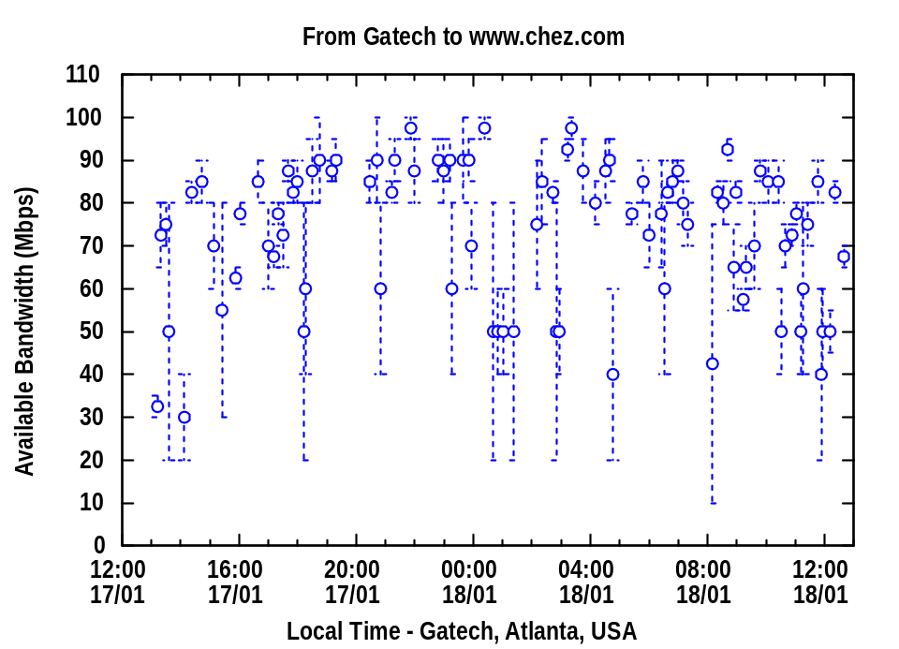
Available bandwidth variability (2/2)
The left path seems to go through diurnal variations, with lower avail-bw during the morning and afternoon hours
The right path does not show diurnal variations and has significantly higher avail-bw
Wide variation range is expected when tight link carries just a few flows

Slide 21
Conclusions
A novel methodology for ‘single-end’ avail-bw measurements
abget estimates the variation range of the avail-bw from any server to our computer within a user-defined period
The tool was validated using realistic traffic
We already extended the tool for upstream measurements
Future work includes extensive wide-area measurements
Focused on the variability and predictability of the avail-bw in different time scales

Slide 22

Thanks!
Any questions?
?

Slide 23
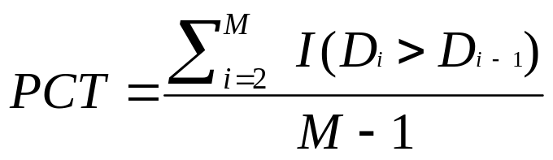
Pairwise comparison test (PCT)
The PCT measures the fraction of consecutive OWD pairs that are increasing
where I(X) is one if X holds and zero otherwise
0 ≤ PCT ≤ 1
If the trend is increasing, PCT approaches 1
If the OWDs are independent, PCT expected close to 0.5
We used the pathload thresholds for trend detection

Slide 24
Robustness to reverse path traffic (1/2)
We assume that ACKs are not significantly dispersed at the reverse path
L_{D} : the size of a data segment (typically 1500B)
L_{A} : the size of the corresponding ACK (typically 40B)
If avail-bw in the reverse path in less than L_{D}/L_{A} (typically about 40) times the avail-bw in the forward path, ACKs will not arrive periodically at the server
Only few paths have such high degree of asymmetry

Slide 25
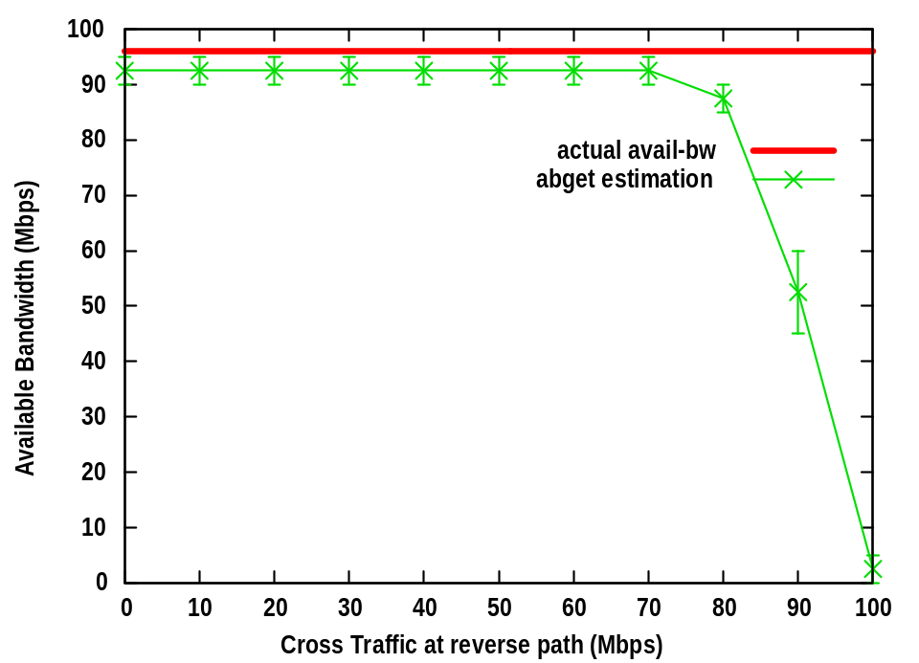
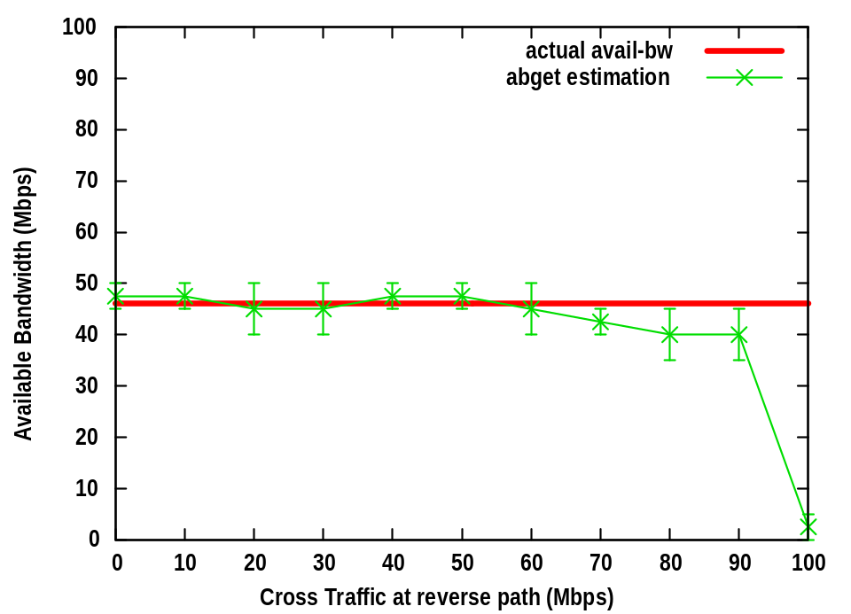
Robustness to reverse path traffic (2/2)
estimations with no traffic at the forward path
estimations with 50Mbps traffic at the forward path
UDP cross traffic was generated at the reverse path
abget starts to underestimate avail-bw when reverse path traffic is very close to link’s capacity

