Slide 1

Technical Report on Ambiguity in NLP
Training a Transformer for Hindi Ambiguity Detection
By :-
Aparajita Sah (202300556)
B. Tech CSE (Data Science)
Text Analytics and NLP | 2026
Under the supervision of :
Mr. Sital Sharma
AI&DS
SMIT, SMU

Slide 2

AMBIGUITY IN NLP - HINDI LANGUAGE
CONTENTS
SL.no | TITLE | Slide no.
1. | Project Overview | 1
2. | Ambiguity in Hindi NLP - Types & Examples | 2
3. | Types of Ambiguity | 3-4
5. | BERT Transformer | 5
6. | Transformer Training Configuration | 6
7. | Web Interface | 7-8
2
ii
Department of AI&DS
Sikkim Manipal Institute of Technology, SMU
Notes:
QoS aware Named Data Wireless Sensor Network

Slide 3
AMBIGUITY IN NLP - HINDI LANGUAGE
Project Overview
What is the Hindi Ambiguity Resolution System?
An end-to-end NLP system that detects and resolves ambiguity in Hindi language.
Given any ambiguous Hindi word, sentence, or idiom, the system generates two distinct interpretations (literal vs. figurative, or two equally valid meanings).
Works in both Hindi (Devanagari) script and Hinglish (Romanized Hindi).
Dual-Track Architecture
Track A - Rule-Based Engine: JavaScript + Fuzzy Matching, 60 curated entries, instant GPU-free inference.
Track B - 2B Parameter Transformer: PyTorch + LLaMA/Mistral architecture, deep generative interpretation.
Coverage
60 ambiguous Hindi entries across 6 ambiguity categories.
Hinglish Normalizer: 100+ Roman to Devanagari mappings for script-agnostic input.
Web Interface: HTML5 + CSS3 + Vanilla JS, self-contained single-file UI.
Department of AI&DS
Sikkim Manipal Institute of Technology, SMU
Notes:
QoS aware Named Data Wireless Sensor Network

Slide 4
AMBIGUITY IN NLP - HINDI LANGUAGE
Ambiguity in Hindi NLP
Why Hindi is Uniquely Ambiguous
Hindi allows the same surface form to carry radically different meanings with no additional syntactic markers.
Existing NLP tools either ignore this ambiguity or collapse it into a single dominant meaning.
Core Examples of Hindi Ambiguity
कल (kal) - Yesterday / Tomorrow | सोना (sona) - To sleep / Gold
आम (aam) - Mango / Common/Ordinary | दिल टूट गया - Literal heartbreak / Emotional heartbreak
बैंक गया (bank gaya) - Went to bank institution / Sat by riverbank
Six Categories Covered
1. Lexical 2. Syntactic 3. Semantic 4. Pragmatic 5. Idiomatic 6. Referential
Department of AI&DS
Sikkim Manipal Institute of Technology, SMU

Slide 5
AMBIGUITY IN NLP - HINDI LANGUAGE
Types of Ambiguity - Details
Lexical Ambiguity
Single word with multiple unrelated meanings (polysemy / homonymy).
Example: 'वो आम खाता है' - आम = mango OR common; 'काम' = work OR desire (Sanskritic).
b) Syntactic / Structural Ambiguity
Same sentence parsed into multiple valid grammatical structures.
Example: 'राम और श्याम की बहन आई' - [Ram + Shyam's sister came] OR [Ram and Shyam's shared sister came].
c) Semantic Ambiguity
Compositional meaning differs from intended meaning. E.g. 'उसकी आँखें बोलती हैं' - eyes literally speak vs. eyes are expressive.
Department of AI&DS
Sikkim Manipal Institute of Technology, SMU

Slide 6
AMBIGUITY IN NLP - HINDI LANGUAGE
Types of Ambiguity - Details
d) Pragmatic Ambiguity
Speaker intent differs from literal meaning. Relies on Grice's Maxims of quality, quantity, relevance, and manner.
e) Referential / Anaphoric Ambiguity
Hindi's pro-drop and 'वो' (he/she) increase referential ambiguity. E.g. 'राम ने श्याम को मारा और वो चला गया' - who left?
f) Idiomatic Ambiguity
When a phrase can be interpreted both literally and figuratively (e.g., “haath khade kar diye” = raised hands / gave up).
Department of AI&DS
Sikkim Manipal Institute of Technology, SMU

Slide 7
AMBIGUITY IN NLP - HINDI LANGUAGE
BERT Transformer
Architecture Overview:
Encoder-only Transformer based on BERT architecture, implemented in PyTorch.
~110M (BERT-base) to ~340M (BERT-large) parameters. Produces contextual embeddings and can classify or rank multiple interpretations.
Key Components:
Position Encoding: Learned positional embeddings – captures token order within fixed sequence length.
Attention: Multi-Head Self-Attention – fully bidirectional context understanding.
Feed-Forward: GELU activation layers – smoother and more effective than ReLU.
Normalization: Layer Norm with post-normalization – stabilizes training.
Tokenization: Word Piece tokenizer with special tokens: [CLS], [SEP], [MASK].
Structured Output Format:
Input: 'सोना' → [CLS] sentence [SEP] → Output via classification head or embeddings for multiple meanings/interpretations
Department of AI&DS
Sikkim Manipal Institute of Technology, SMU

Slide 8
AMBIGUITY IN NLP - HINDI LANGUAGE
Transformer Training Configuration
Training Hyperparameters:
Learning Rate: 5e-3 (raised from 2e-4 - critical for only 30 training sentences)
LR Schedule: OneCycleLR (warmup + annealing for fast convergence on tiny dataset)
Epochs: 200 | Label Smoothing: 0.1 (reduces overconfidence on small data)
Mixed Precision: torch.cuda.amp FP16 for GPU memory efficiency.
Memory Optimization:
Gradient Checkpointing: Enabled (trades compute for memory on 2B model).
Model Initialization: torch.device('meta') to avoid 8GB CPU RAM spike.
Then: to_empty(device='cuda') to materialize weights directly on GPU.
Tokenizer Fix:
Modified encode() to auto-expand vocabulary for unseen tokens at training time, eliminating <UNK> flood.
Department of AI&DS
Sikkim Manipal Institute of Technology, SMU

Slide 9
AMBIGUITY IN NLP - HINDI LANGUAGE
Web Interface
Normalization Pipeline (100+ mappings):
Direct phonetic: 'ka' → 'क', 'kha' → 'ख', 'ga' → 'ग'
Common words: 'dil' → 'दिल', 'pyar' → 'प्यार', 'ghar' → 'घर'
English bridges: 'heartbreak', 'gold' → corresponding Hindi entries
Fuzzy fallback: word-overlap on transliterated form if no exact match
Web Interface:
Single self-contained HTML5 file. No external library dependencies.
Accepts Hindi (Devanagari) OR Hinglish (Roman) input interchangeably.
Displays both interpretations side-by-side with Hindi + English explanations.
Department of AI&DS
Sikkim Manipal Institute of Technology, SMU

Slide 10
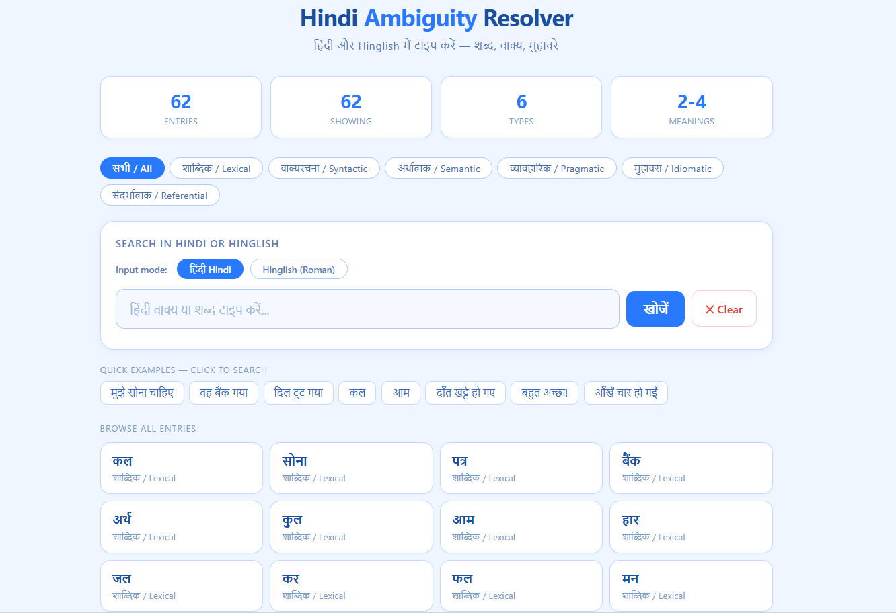
AMBIGUITY IN NLP - HINDI LANGUAGE
Web Interface
Fig 1: User Interface of the Model
Department of AI&DS
Sikkim Manipal Institute of Technology, SMU

