Slide 1
Coop Project Presentation
Fall 2024 Coop @ Drug Discovery Group
Abigail Parakoyi

Slide 2


Drug Discovery Group @ United States Veteran Assistance Department
Notes:
Multi-ancestry
Brief explanation of the data we have access to and why its significant
What about our data is different from others
Access to MVP that has a higher percentage of non Europeans and wanted to leverage this to discover genes otherwise overlooked in other datasets.
We have GWAS data from a wide variety of soruces and the data is formatted in diff ways and needs to be harmonized

Slide 3
Multi-Ancestry Project
Leverage the MVP Genetically Inferred ancestry (GIA) dataset to glean gene-trait insights.
Essential in broadening our understanding of gene-trait relationships across ancestries.
Higher percentage of non-European decent GWAS files compared to other datasets.
These GWAS files are from a wide variety of dataset banks, leading to various formatting options.
Notes:
Multi-ancestry
Brief explanation of the data we have access to and why its significant
What about our data is different from others
Access to MVP that has a higher percentage of non Europeans and wanted to leverage this to discover genes otherwise overlooked in other datasets.
We have GWAS data from a wide variety of soruces and the data is formatted in diff ways and needs to be harmonized

Slide 4
The Dataset
GIA : Genetically Inferred Ancestry
Population of US Veterans
Categorized by Phecodes, System, and ancestral groups (AMR, AFR, EUR, EAS, PAN)
For this study we are excluding the analysis of EAS and PAN ancestral group

Slide 5
How can we harmonize our data & extract insights from it?

Slide 6
Project Timeline
QC Script & Data Harmonization
Analysis
Next Steps
Notes:
Change to arrow flow chart
Check whether implementation is the right word or should I change to harmonization

Slide 7
Project Timeline
01
QC Script
Create quality check(QC) and
standardization script
02
Data Implementation
Implement QC script on Genetically
Inferred Ancestry (GIA) data
03
Analysis
Run MR and further analyze MR results
04
Next Steps
Next steps for downstream analysis
Notes:
Change to arrow flow chart
Check whether implementation is the right word or should I change to harmonization

Slide 8
01 QC Script & Data Harmonization

Slide 9



Why?
Initial Problem
Need for QC and standardization of GWAS files for MR analysis as our pipeline is growing and there is a need for infrastructure and standardization.
Solution
A script to QC and standardize GWAS summary statistic files.
Final Product
One QCd and standardized GWAS sum stats txt file.
Notes:
Currently, we lacked a standardized approach for processing GWAS summary statistics files from different groups, performing quality control (QC), and preparing them for analysis in the MR pipeline.
Develop a script capable of handling GWAS summary statistics files in various formats, performing quality control, and standardizing them for use in the MR pipeline.

Slide 10


Data Processing Pipeline
YAML Config
File
QC Script
Post-Qc GWAS Summary Stats Files
Pre-QC GWAS Summary Stats Files
Notes:
Ask if I should indulde a snippet of the yaml and a pre and post QC GWAS file.

Slide 11
In Depth View of the QC Script
Basic Check and Standardization Check and standardize variant IDs (SNIPID or rsID), CHR, POS, EA, and NEA. Run sanity check on statistics.
01
Lift Over build Check and convert file from build 37 to build 38.
02
Statistical Checks Further statistical checks and conversion.
03
Harmonization Harmonize the data based on reference files.
04
GWASLab preprint: He, Y., Koido, M., Shimmori, Y., Kamatani, Y. (2023). GWASLab: a Python package for processing and visualizing GWAS summary statistics. Preprint at Jxiv, 2023-5. https://doi.org/10.51094/jxiv.370
Notes:
Basic Check - checking if in CHR:POS:NEA:EA oriantaion, Identify autosomal chr and standardize, Convert position to int, checking for NA in EA/NEA columns, checking for A/C/T/G base pair, convert all columns to Upppercase. Ensure all statistical columns are within specified ranges.
Lift over – checks if document is in build 38 if so pass, if not convert to build 38. This uses API calls hence the need to run this outside of KDI.
Statistical Checks - Check and convert OR to BETA, Check and convert mlog10P to P, Check and or create minor allele frequency (MAF) column
Harmonization - Align NEA alleles to REF in the reference sequence, Assign Rsid according to REF/ALT, CHR, POS if it is not present already, Flip alleles based upon reference sequence flipping variant rate, Run Qc file against VCF file for specific ancestry, Check for palindromic SNPs , Check for indistinguishable indels we simply check for these but make no changes

Slide 12
QC Script & Data Implementation Benchmarks
QC Script
Runtime ~ 20 min/script
Output Files:
Post-QC GIA Data
~ 10 days of QC runtime on all GIA data files
Total of 3.1 TB of data
MR Analysis
Sent over to Kai to run MR Analysis through Eristwo
GWAS QC output file
Log file
Pre and post QQ plot of data
Output Files:
GWAS QC output/file
Log file/file

Slide 13
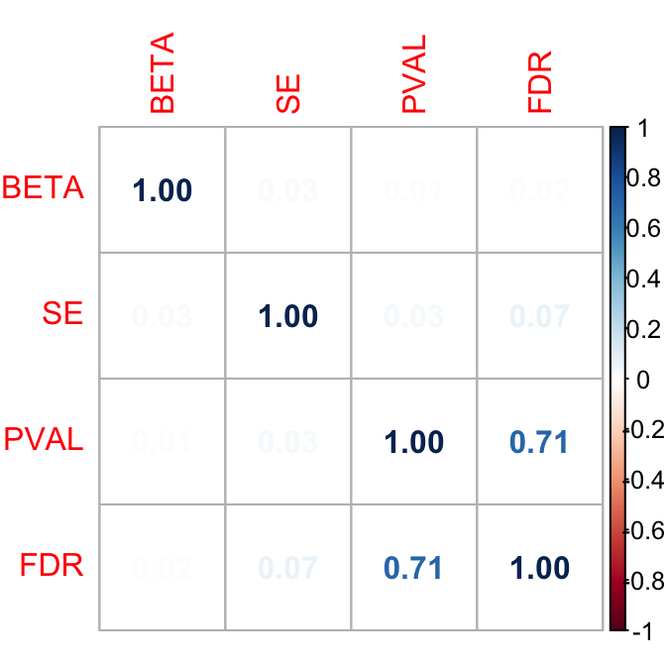
Checking Reliability of QC Script
Comparing MR results of Atrial fibrillation phenotype pre and post QC to ensure reliability of QC script.
100% match rate between pre and post QC MR statistical results meaning QC script is reliable.

Slide 14
02 Analysis

Slide 15
Overarching Question
What are the differences between the ancestry groups we are studying based on predicted gene expression & protein levels across phenotypes?
Notes:
What are the differences between the ancestry groups we are studying?
Regarding they’re gene expression levels on various phenotypes

Slide 16
Data Analysis Pipeline
Combine Ancestry MR results
Create significance code for each gene/population based on threshold
Determine counts of significant genes/population
Compare Beta of significant genes/population/dataset
Determine counts of significant genes/population/dataset
Notes:
Ask if I should indulde a snippet of the yaml and a pre and post QC GWAS file.

Slide 17
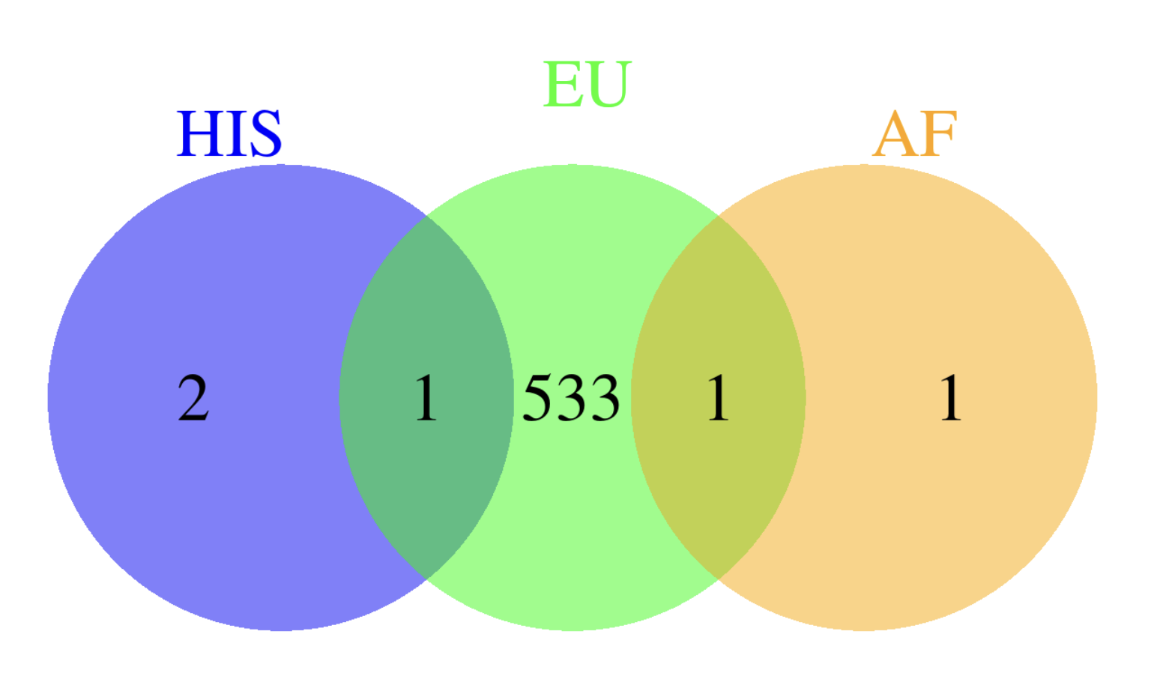
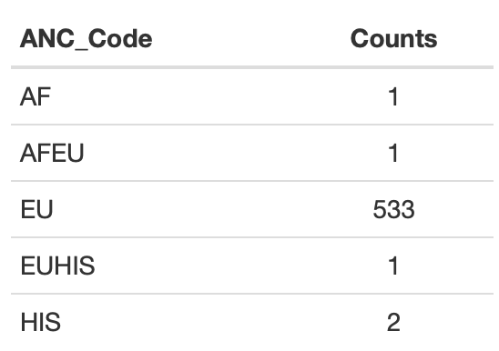
Determining Significant Genes Present in each Population
Atrial fibrillation

Slide 18
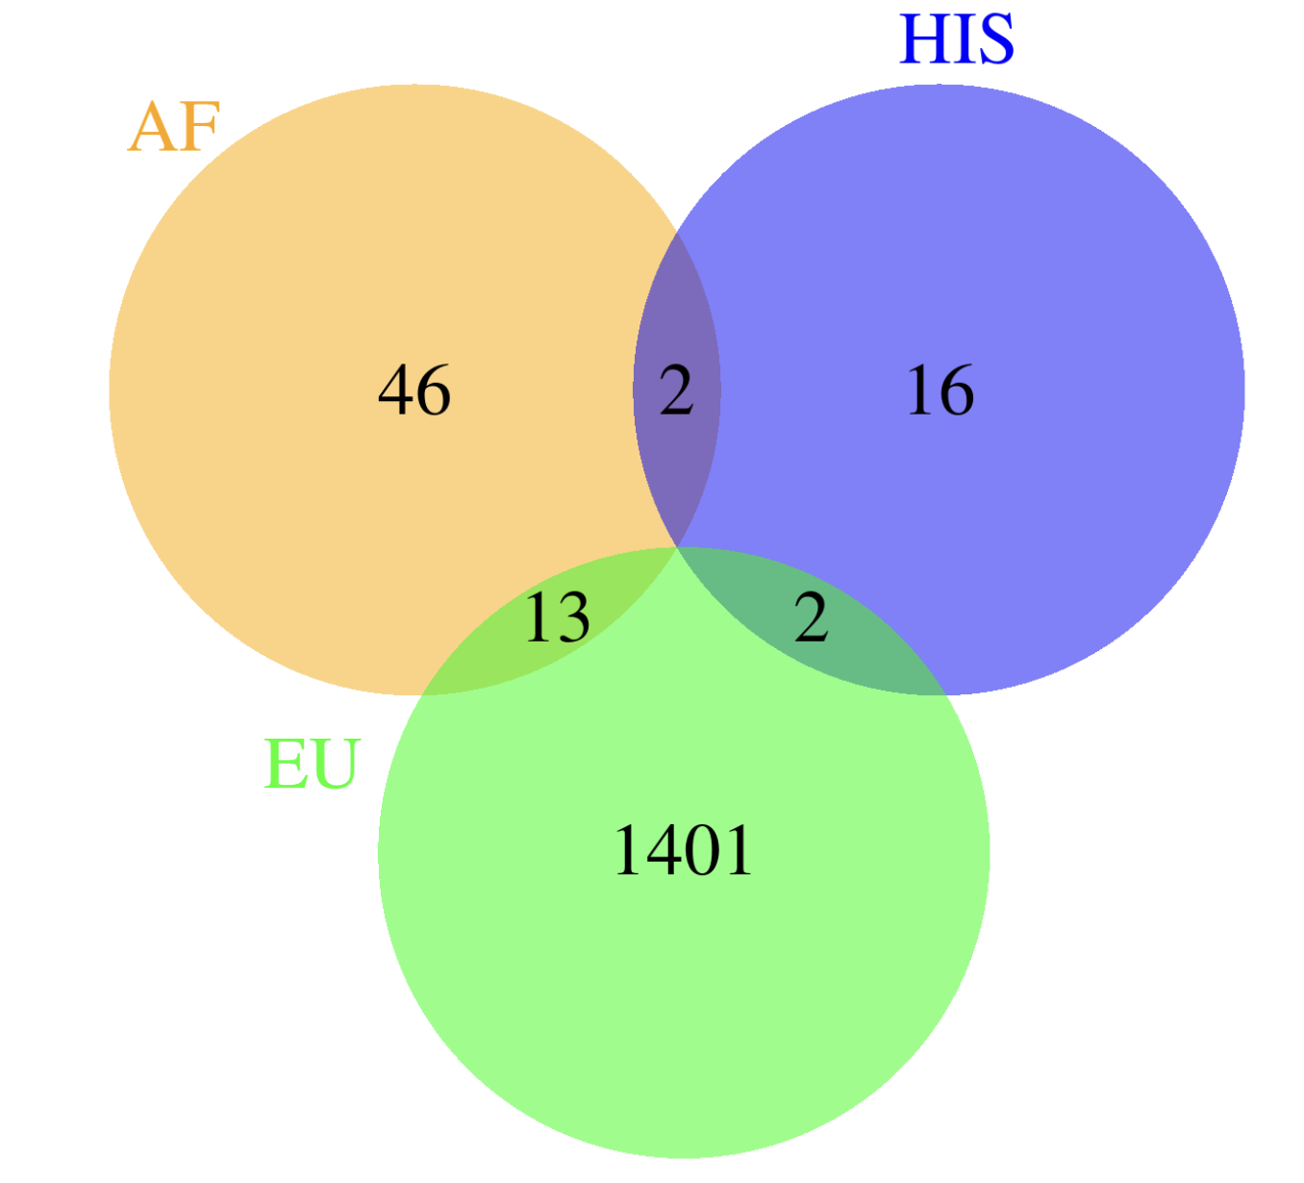
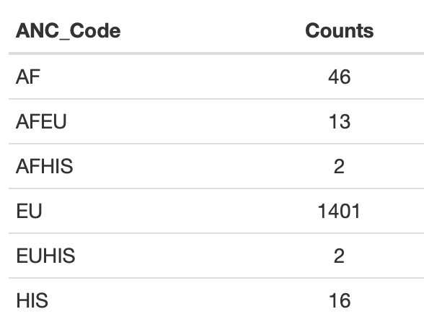
Determining Significant Genes Present in each Population
Type 2 Diabetes

Slide 19
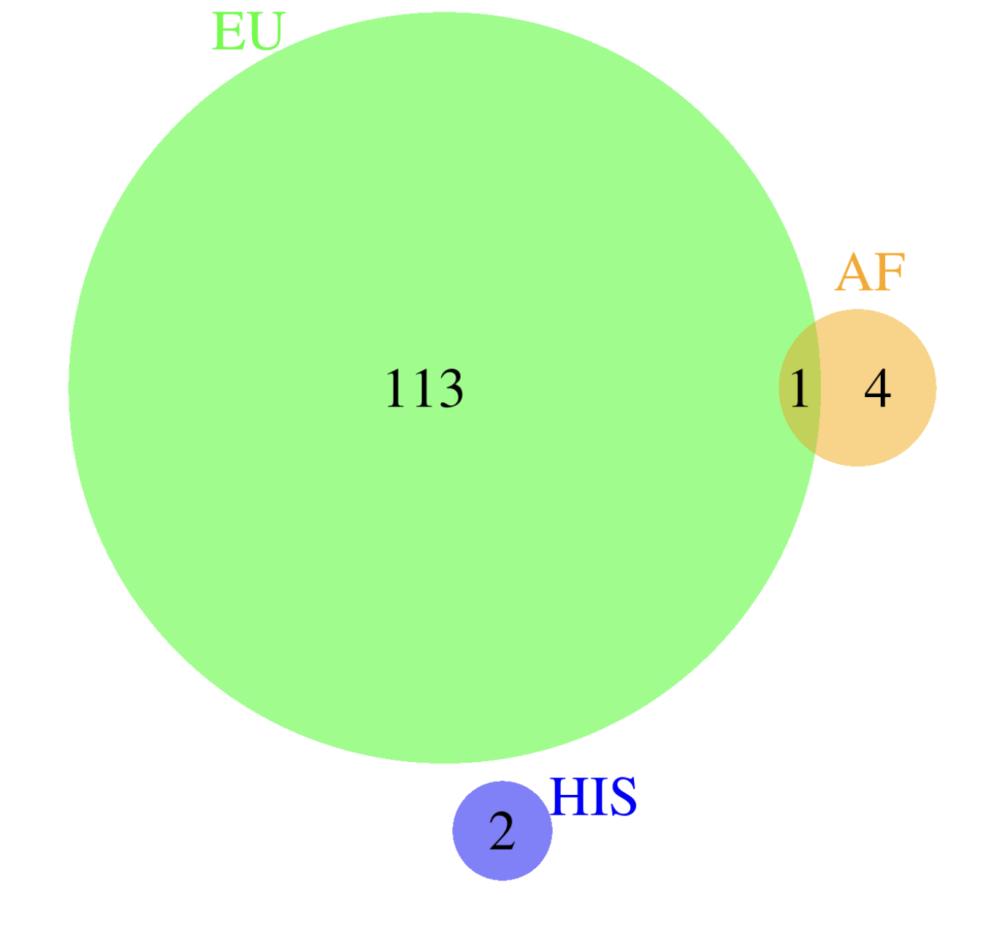
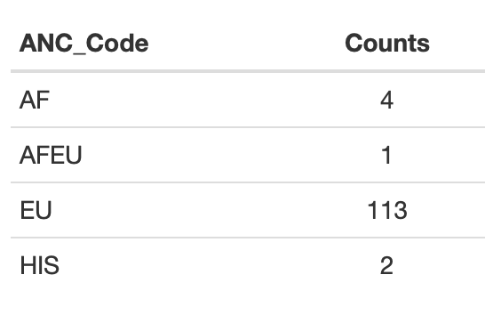
Determining Significant Genes Present in each Population
Acute Dermatitis

Slide 20
Determine Number of significant genes for each population per dataset
Type 2 Diabetes
Acute Dermatitis
Atrial fibrillation

Slide 21
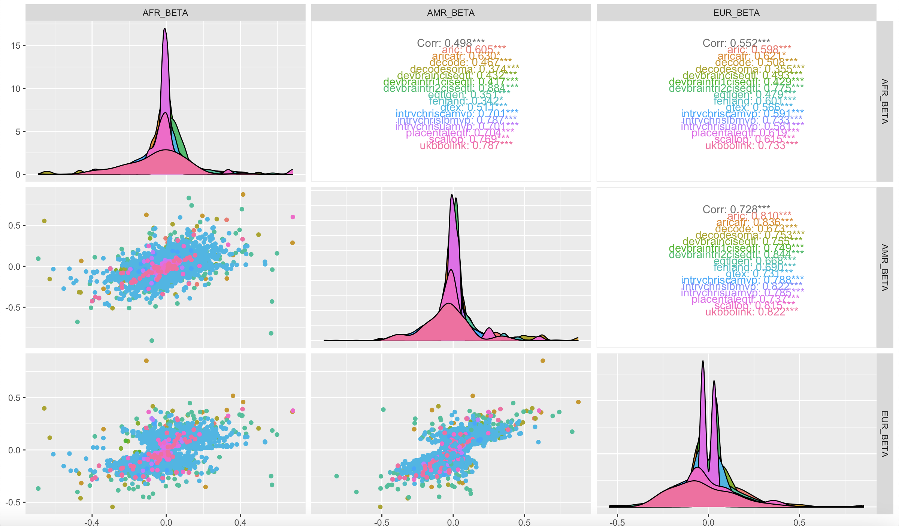
Type 2 Diabetes significant genes beta comparison in each population across datasets

Slide 22
03 Next Steps

Slide 23
Next Steps
Further analyze the data in terms of the Hispanic cohort
Continue analysis on the other phenotypes besides the three mentioned in the presentation
Run gene enrichment on genes of interest

Slide 24
Acknowledgments
Brian Ferolito
Alex Pereira
Entire Drug Discovery Group
MVP
Alex Susienka (Northeastern Co – op Advisor)
Questions?

Slide 25
MR
Aid in establishing causal effects of risk factors on diseases.
Reduced risk of being manipulated by confounding or reverse causal effects.
MR is based on three assumptions:
The genetic variant is associated with risk factors
The genetic variant is not associated with confounders
The genetic variant influences the outcome through risk factors

