Slide 1
Capstone Project
ElecKart
Market Mix Modelling
Group Members: AJAY KUMAR YEDLA AKANSHA PARASHAR
PHANI BHUSHANA RAO K

Slide 2
Business & Data Understanding
Data preparation &
Exploratory Data Analysis
Features Engineering
Model Building & KPI
Recommendation

Slide 3
Objective
To develop a market mix model for 3 product sub-categories
Camera accessory, Gaming accessory and Home Audio to observe the actual impact of different marketing levers over sale of one year (July 2015 -June 2016) and recommend the optimal budget allocation for different marketing levers for the next year.

Slide 4
Our Understanding of the Scope
ElecKart is an e-commerce firm dealing mainly with electronic products
Gather e-commerce domain knowledge
1
Understand the given dataset and questions that can be answered
2
Cleaning and prepare the data; with 3 category-wise data sets creation
3
Derived variable creation and grouping by weeks
4
EDA
5
Uni and bi -variate analysis
6
Multi-variate analysis; using different modeling techniques
7
Choose the best model for each segment
8

Slide 5
Basic understanding of given data
# of units sold
Delivery days and SLA
Categories/sub categories
Vertical
Procurement SLA
Item type = Luxury/Mass-Market
Product
Marketing Channel Investments
Customer sentiment
Discounts
Adstock
Promotion
Price
gmv
Product mrp
Pin-code
Order Payment Type
Week of the year – seasonality
Holiday / Events; isHoliday
Place

Slide 6
Data Cleaning and Preparation of consumer Electronics
ConsumerElectronics
Removing all the rows having NA and duplicate values.
Checking unique values
Converting date column’s data type to DATE
Filtering out data which does not fall within the timelines of this analysis – 1st July 2015 – 30th June 2016.
Creating weeks from the ‘order_id’ data.
Converting order_id and order_item_id into proper numeric format - from scientific notation.
Removing rows with negative product MRP; gmv and units.
Removing rows where (product_mrp*unit) < gmv.
Removing rows with negative deliverybdays and deliverycdays; assuming “\N” means no delay.
Rarely SLA/procurement SLA for any delivery will be more than 2 months (60 days); hence filtering out these value .
Computing discount % for each transaction.
Computing gvm/unit.
Computing ItemType – categorizing items into Luxury (priced more the 80 %tile) and Mass Market.
Removing Columns which will not be used in analysis.
Storing the total gmv proportion for each of the 3 categories wrt the total gvm for all items
Filtering and keeping only the 3 required categories.

Slide 7
Data Cleaning Preparation of Media data
Media data and other information.xlsx
Loading all the 4 spreadsheets
Special Sale Calendar –
Splitting the event name and date; also converting the date in proper format.
Creating event start and end date.
Producing a dataframe – having all dates possible within the timeframe of analysis and corresponding event names (if any).
Merging this with consumer data – produced earlier.
Monthly NPS Score –
Transposing the columns into rows.
Cleaning the naming issues wrt months.
Populating the same monthly scores to each day of the month.
Convert it to weekly basis.
Merging this with consumer data – produced earlier.
Media Investment –
Distributing the monthly investing data for each channel into daily investment – proportionate to “days in that month”.
Converting it on weekly basis.
Extracting category-wise investment – proportionately to gvm of each of the 3 category wrt the total gvm.
Creating 3 category-wise dataframes - Merging this with consumer data – produced earlier.
Converging CR(10000000) to Total Investment, TV, Digital, Sponsorship, Content-Marketing, Online-Marketing, Affiliates, SEM, Radio, Other attributes.
Any item having gmv/unit more at 80%tile is assumed to be Luxury else Mass-market.
Please note: At the end of this analysis we are producing 3 category wise clean .csv .files

Slide 8
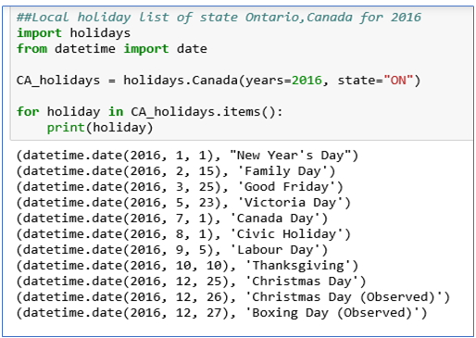
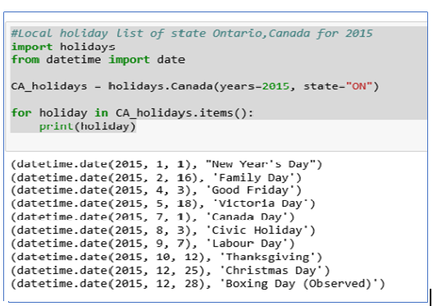
Local Factors
Local factors impacts: Ontario local holidays are considered along with other holidays for said FY(July-15 to June-16).

Slide 9
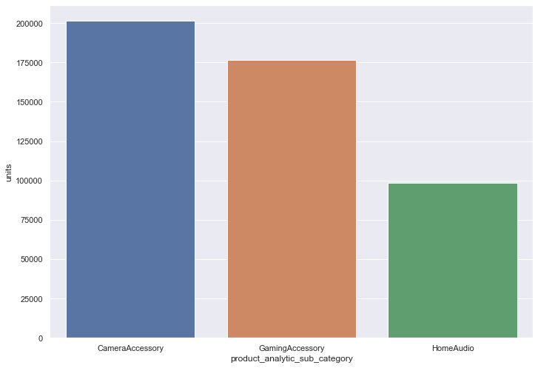
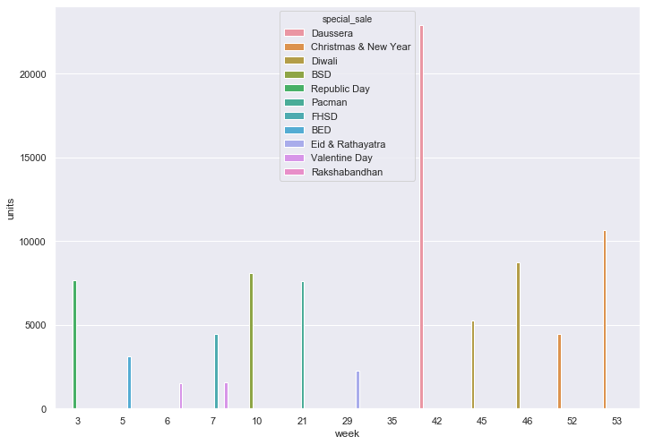
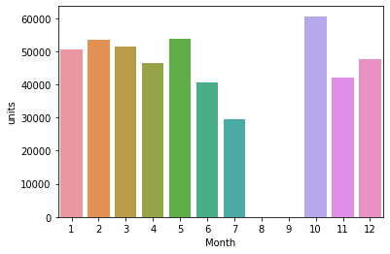
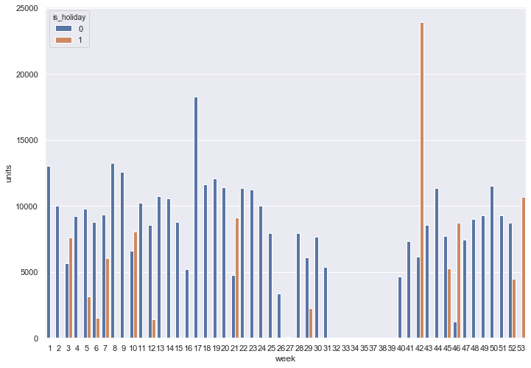
Bar charts and Graphs of master dataframe
Units sold
Special day sales
Monthly GMV
Weekly holiday sales

Slide 10
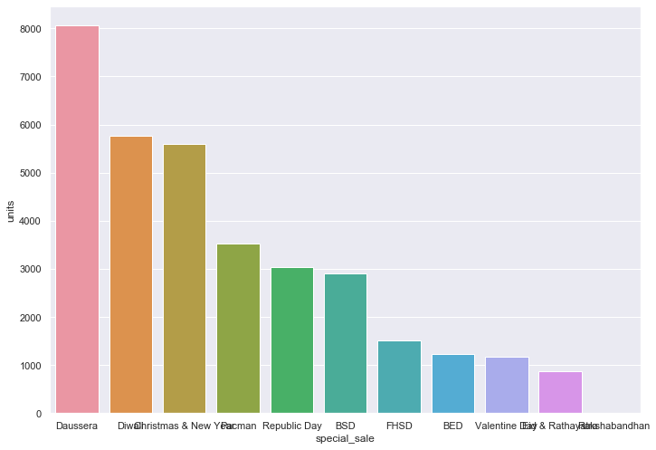
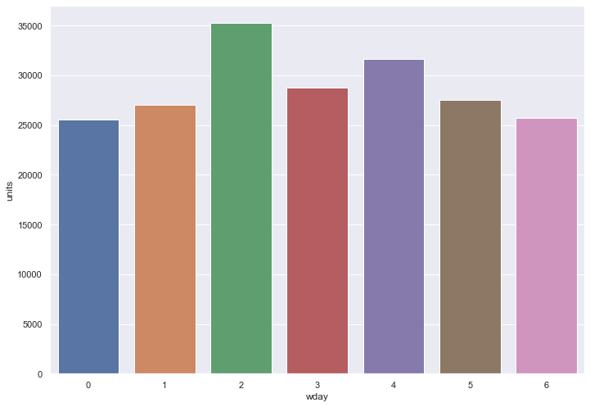
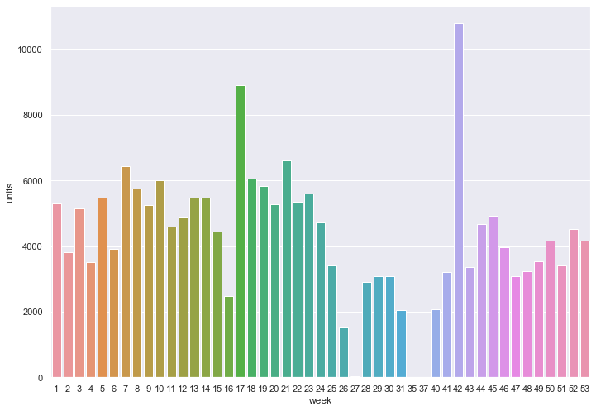
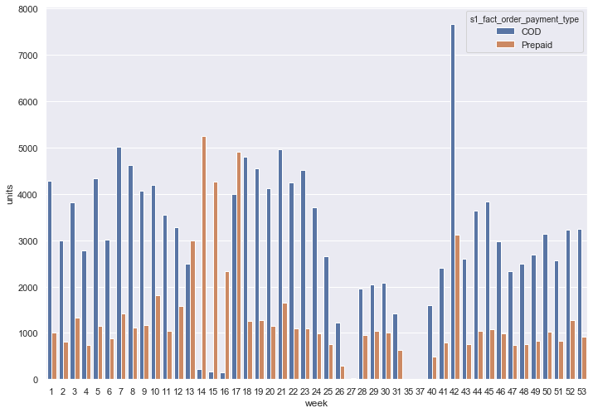
EDA (Camera Accessory)
Weekday
sales
Special holiday sales
Weekly sales
Weekly payment types

Slide 11
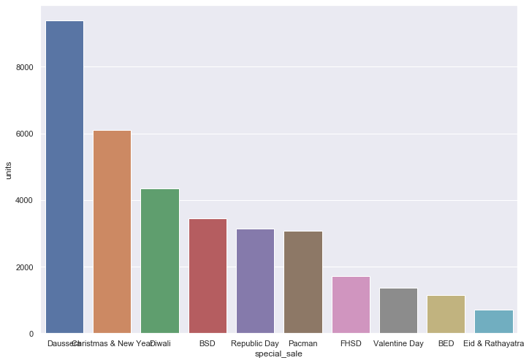
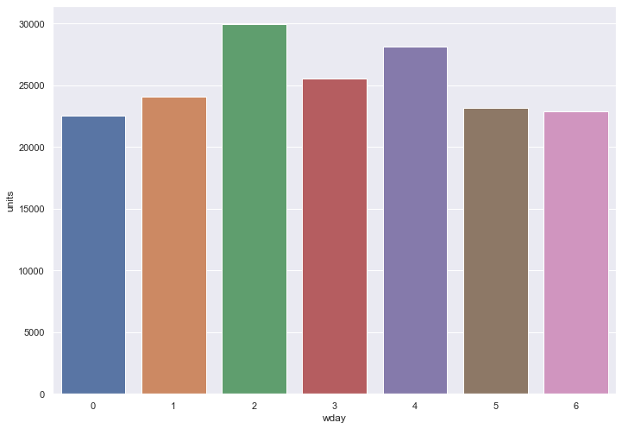
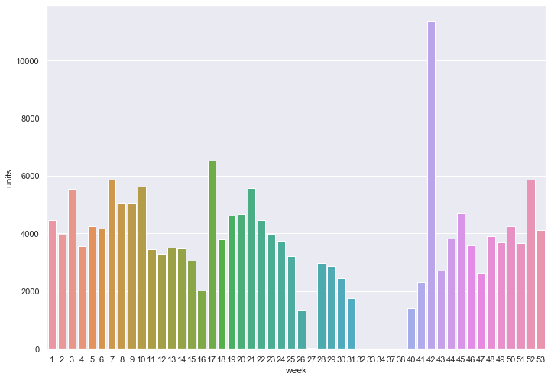
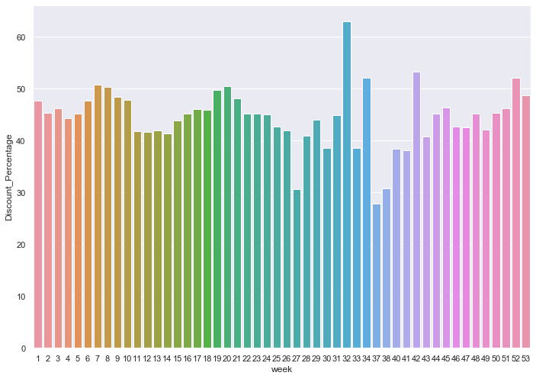
EDA (Gaming Accessory)
Special holiday sales
Weekday
sales
Weekly sales
Weekly discount %

Slide 12
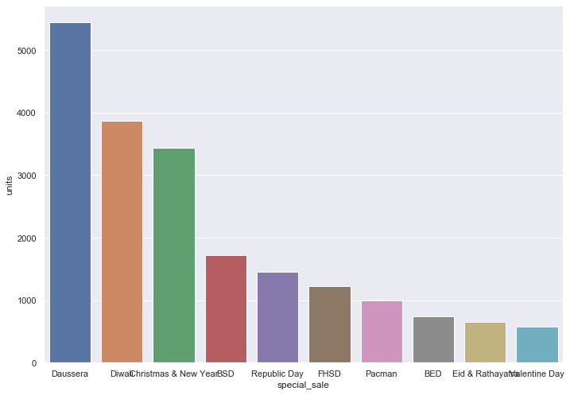
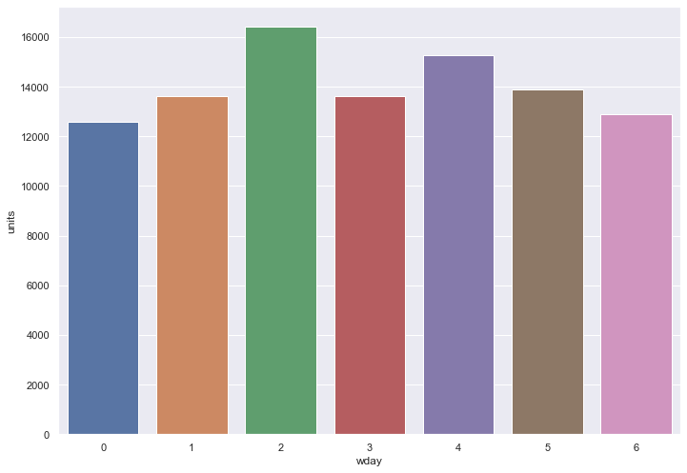
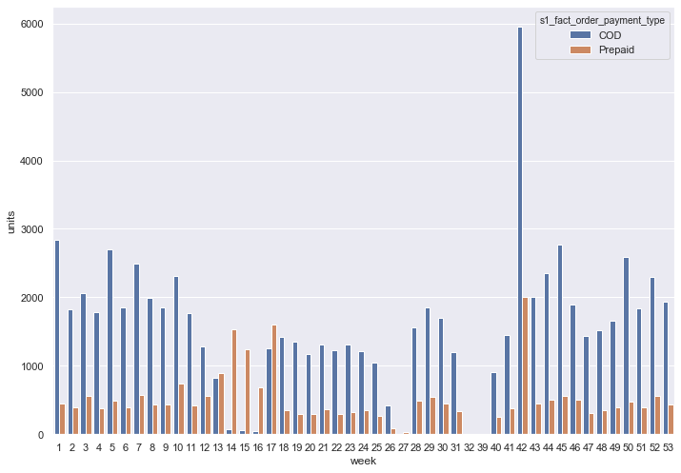
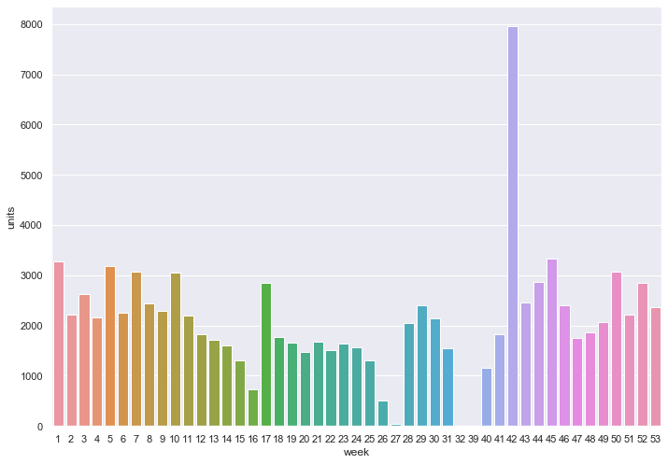
EDA (Home Audio)
Weekday
sales
Special holiday sales
Weekly payment types
Weekly sales

Slide 13
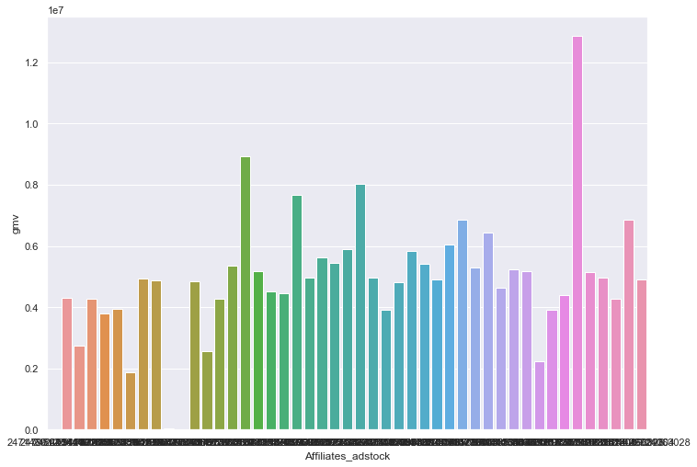
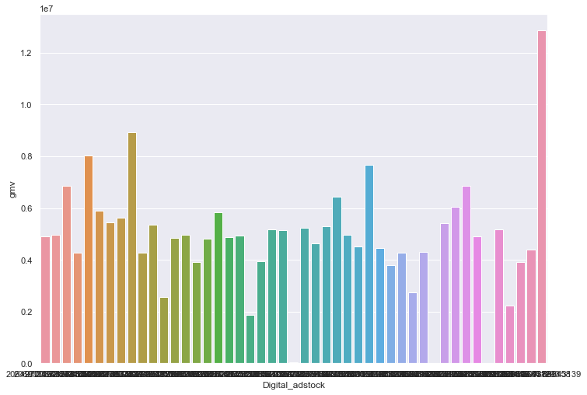
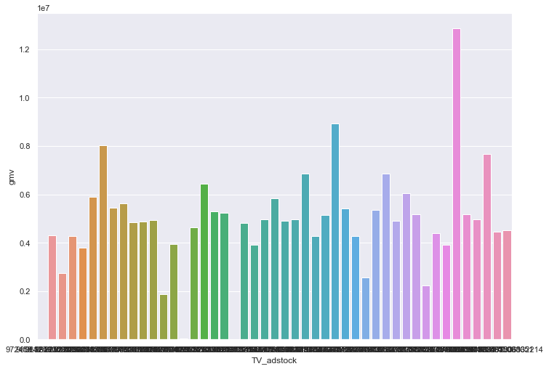
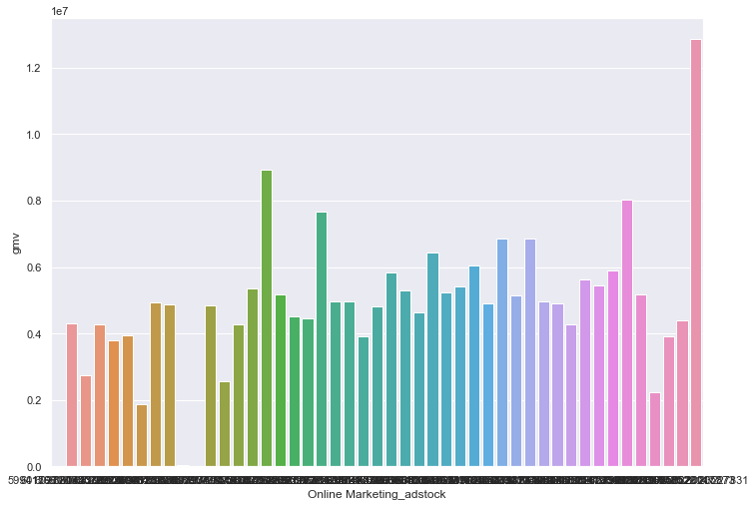
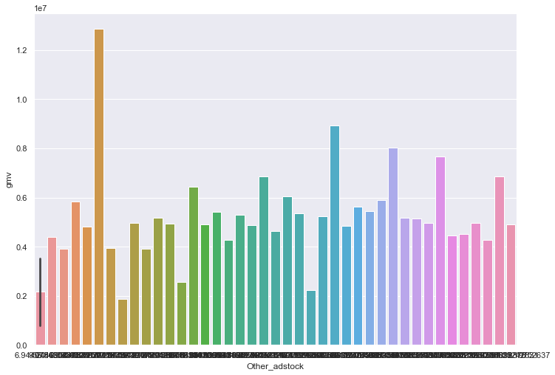
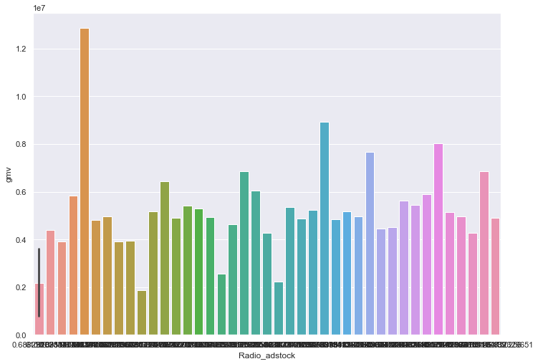
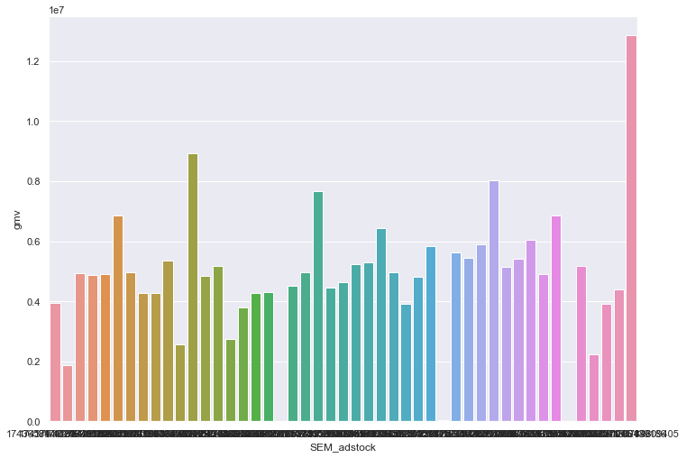
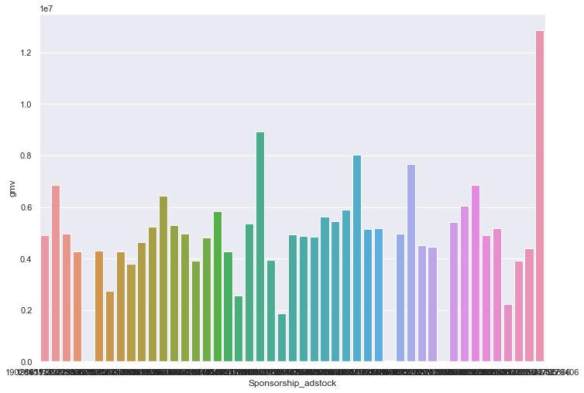
Adstock
Affiliates
Digital
TV
Online Marketing
Other
Radio
SEM
Sponsorship

Slide 14
Derived KPIs & Modeling
List of derived KPIs and advance KPIs is as follows:
KPIs | Advance KPIs
Discount Percentage | Ad-stock of 3 categories
GMV per unit | Moving average of last 3 weeks (gmv per unit, DP)
Total GMV | Lag variables (gmv per unit, DP) for 3 weeks
Average GMV | Promotion Type
Units | Holiday Week
Delivery Status | Delivery Status
Item Type
Delivery on Time

Slide 15
Model Dashboard
r-square prediction values (without cross validation)
Model/Category | Camera Accessory | Gaming Accessory | Home Audio
Linear | 0.89 | 0.86 | 0.78
Multiplicative | 0.92 | 0.70 | 0.86
Koyck | 0.86 | 0.87 | 0.75
Distributed Lag | 0.86 | 0.86 | 0.76
r-square prediction values (with cross validation)
Model/Category | Camera Accessory | Gaming Accessory | Home Audio
Linear | 0.91 | 0.89 | 0.80
Multiplicative | 0.88 | 0.72 | 0.92
Koyck | 0.91 | 0.89 | 0.84
Distributed Lag | 0.91 | 0.89 | 0.84

Slide 16
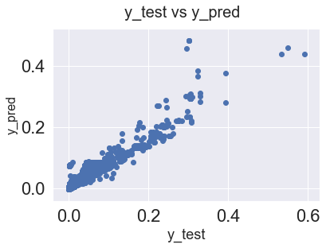
Camera Accessories – Recommendations
After analyzing 4 different models, its observed that Koyck model is best suited for Camera Accessories.
Its has least mean square error (0.007) and have high result in Cross -Validation (0.91) as compare to other three models.
product_mrp is the strongest variable having a good impact on the GMV.
Other common factor which affect the model is delivery_on_time, Content Marketing etc.

Slide 17
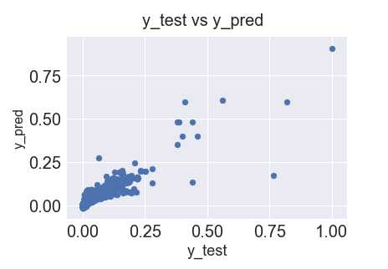
Gaming Accessories – Recommendations
After analyzing 3 different models, its observed that Koyck model is best suited for Gaming Accessories.
For Gaming Accessories, RMSE is 0.0071 for Koyck which is the least mean square error as compared to others.
Also product_mrp is the strongest variable having a good impact on the GMV.
Other common factor which affect the model is delivery_on_time, Content Marketing etc

Slide 18
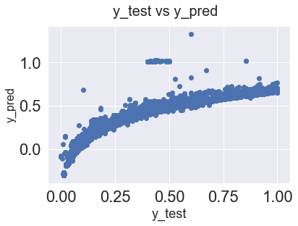
Home Audio – Recommendations
After building and analyzing 3 different models, it is observed that Multiplicative model is best suited for the category of Home Audio.
R2 scores of Koyck and Distributed lag models are almost the same but better results are achieved after performing cross validation.
product_mrp is the strongest variable having a good impact on the GMV.
gmv_lag_1_per and gmv_lag_2_per are also proving to be good for GMV.
GMV increases with a little bit of tweaking in the product_mrp.

