Slide 1

THINKING IN DIGITAL SYSTEMS
CHAPTER 16

Slide 2
Topics
Systems Thinking in Board Games
An Exercise in Simple Instructions
Game Analysis: Apple Picker

Slide 3
Systems Thinking in Board Games
Some board game rules are explicit
  "Do not pass Go. Do not collect $200."
Other board game rules are implicit
  A players will not just place the dice on the values that she would prefer to have.
  The dice must stay on the table and must land completely flat on a side to be considered a valid roll. Otherwise, they are rerolled.
  Dice are generally not thrown at other players...or eaten.

Slide 4
Systems Thinking in Digital Games
When developing digital games, all rules must be explicit!
And, digital instructions must be simple.

Slide 5
An Exercise in Simple Instructions
Making a Peanut Butter and Jelly Sandwich
  Each person in the class will take the next 10 minutes to write explicit instructions for making a PB&J sandwich
  Your available equipment includes:
    A jar of peanut butter
    A jar of jelly
    A loaf of sliced bread in a bag
    A butter knife
  Remember to make your instructions as explicit as possible
  Don't make any assumptions about knowledge
  You have 10 minutes...

Slide 6
An Exercise in Simple Instructions
Time's up!
Turn in your instructions
The instructor(s) will now each choose a sheet of instructions at random
  And will follow them to make a PB&J sandwich

Slide 7
An Exercise in Simple Instructions
How did it go?

Slide 8
What This Means to Digital Programming
Human Understanding
Unity Dev Environment
Code Libraries: UnityEngine
Programming Language: C#
Computer Understanding

Slide 9
The Key to Computer Programming…
Breaking Complex Problems
into Simpler Problems

Slide 10
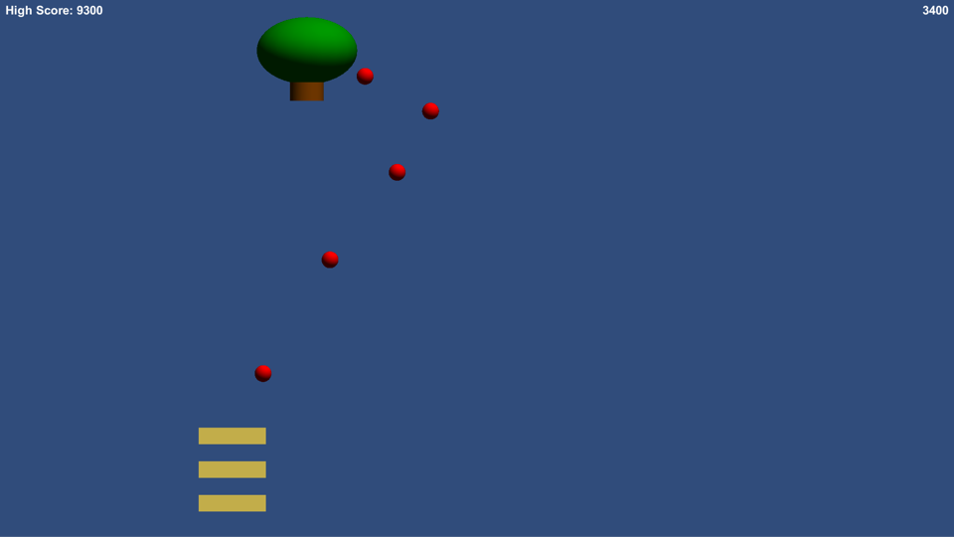
Game Analysis
Apple Picker

Slide 11
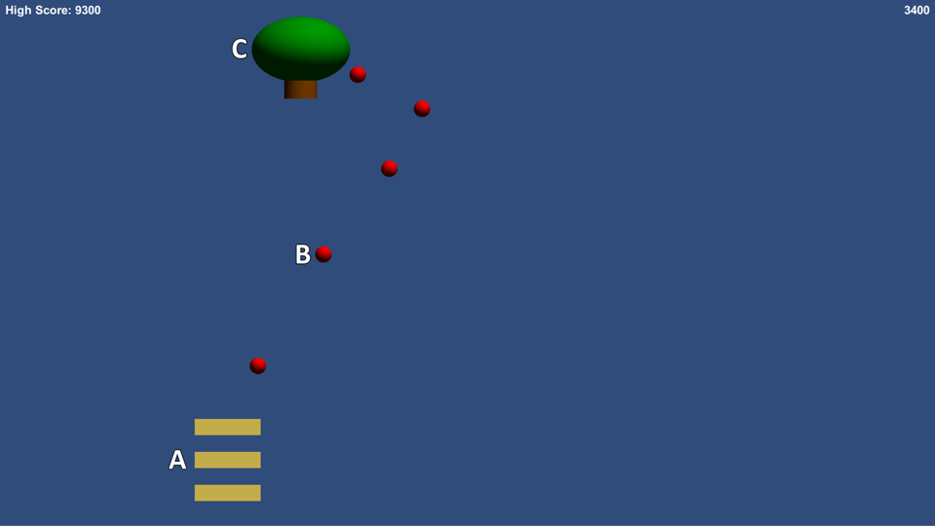
Apple Picker
Based on the classic Activision game Kaboom!
  Player controls 3 Baskets (A) and tries to catch Apples (B) that are dropped by the AppleTree (C)

Slide 12
ApplePicker GameObject Action Lists
Basket Actions
Apple Actions
AppleTree Actions
Move left and right following the player's mouse.
Move left and right randomly.
Fall down.
If any basket collides with an Apple, catch the Apple
If an Apple hits the ground, it disappears and causes other Apples to disappear.
Drop and Apple every 0.5 seconds.
These can be parsed into flowcharts

Slide 13
FRAMES IN COMPUTER GAMES
"Frame" comes from film
  Describes a single image in a strip of film
  Film was originally 16fps (frames per second), then 24fps
Television
  Describes a single pass of the electron gun
    (actually, two passes that are interlaced)
  30fps
    (60 fields per second)
Computer Games
  Describes a single refresh of the screen
  Also describes all the calculation involved in that refresh

Slide 14
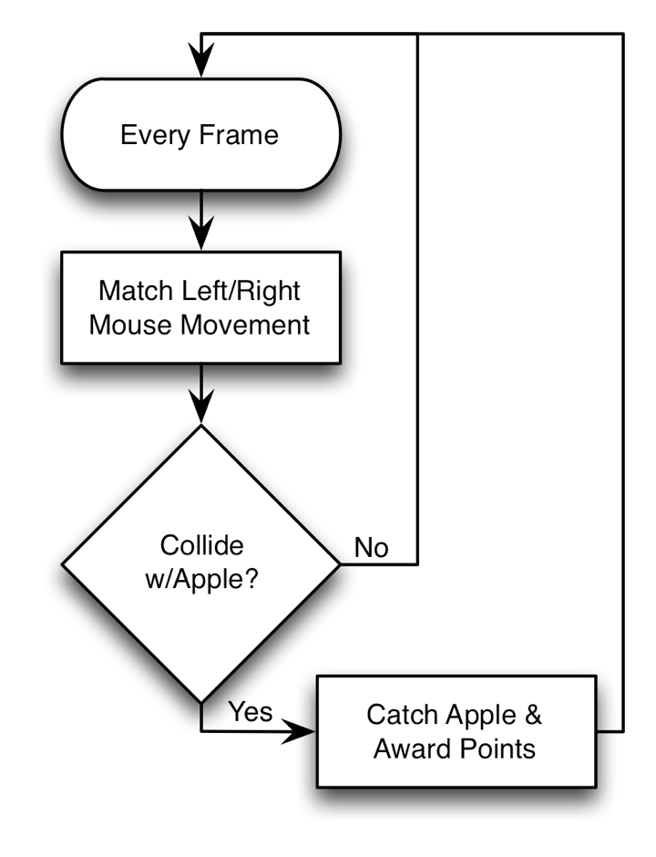
ApplePicker Flowcharts: Basket

Slide 15
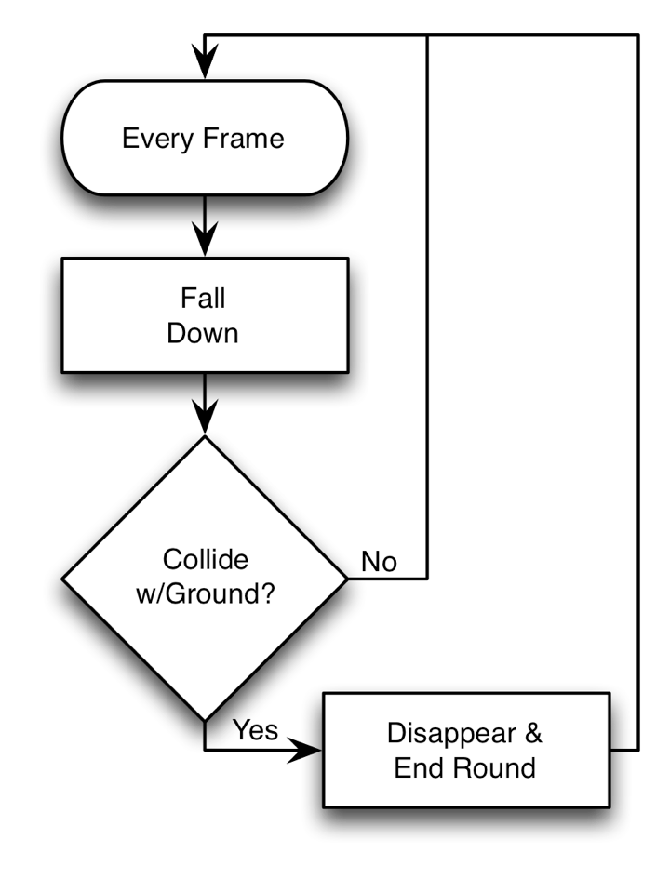
ApplePicker Flowcharts: Apple

Slide 16
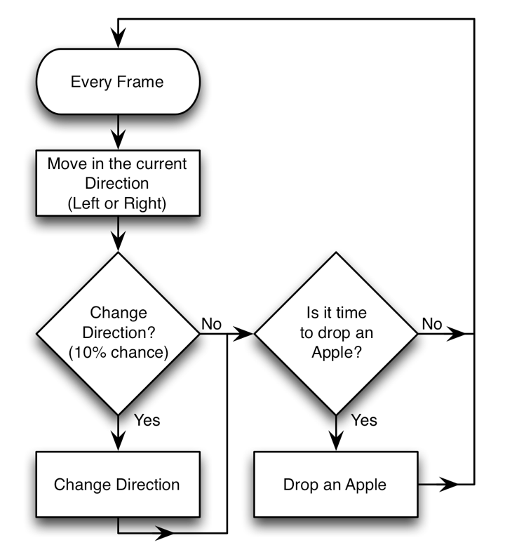
ApplePicker Flowcharts: AppleTree

Slide 17
Chapter 16 – Summary
Board games have both explicit and implicit rules
All rules for digital games must be explicit
Computers only understand very simple, explicit instructions
Programming languages (like C#) help us express these simple instructions to the computer
Complex behavior can be broken down into much simpler instructions

