Slide 1

INTRODUCING OUR LANGUAGE: C#
CHAPTER 18

Slide 2
Topics
The Features of C#
  C# is a Compiled Language
  C# is Managed Code
  C# is Strongly Typed
  C# is Function Based
  C# is Object-Oriented
Reading and Understanding C# Syntax

Slide 3
Understanding the Features of C#
C# is a Compiled Language
  Computer chips only understand machine language
    000000 00001 00010 00110 00000 100000
    This is what punch cards were
  Authoring languages were created to be an intermediary language between humans and computers
  Two kinds of authoring languages:
    Interpreted
    Compiled

Slide 4
Understanding the Features of C#
Interpreted Languages
  e.g., JavaScript, PHP, and Python
  Two-Step Process
    Programmer writes the code
    An interpreter converts the code into machine language in real-time
  Benefits
    Portability: Can run on any kind of computer as long as there's an interpreter
  Detriments
    Lack of Speed: The processing power used to interpret the code is not spent on the game itself
    Lack of Efficiency: Because the code can run on any computer, it's not optimized for any specific computer

Slide 5
Understanding the Features of C#
Compiled Languages
  e.g., C#, Basic, Java, C++
  Three-Step Process
    Programmer writes the code
    Programmer uses a compiler to convert the code into machine language
    Computer executes the code
  Benefits
    Speed: Computer spends more processor power on the game itself
    Efficiency: Code is optimized for a specific processor architecture
  Detriments
    Lack of Portability: Compiled for only one kind of machine
    Extra Compilation Step

Slide 6
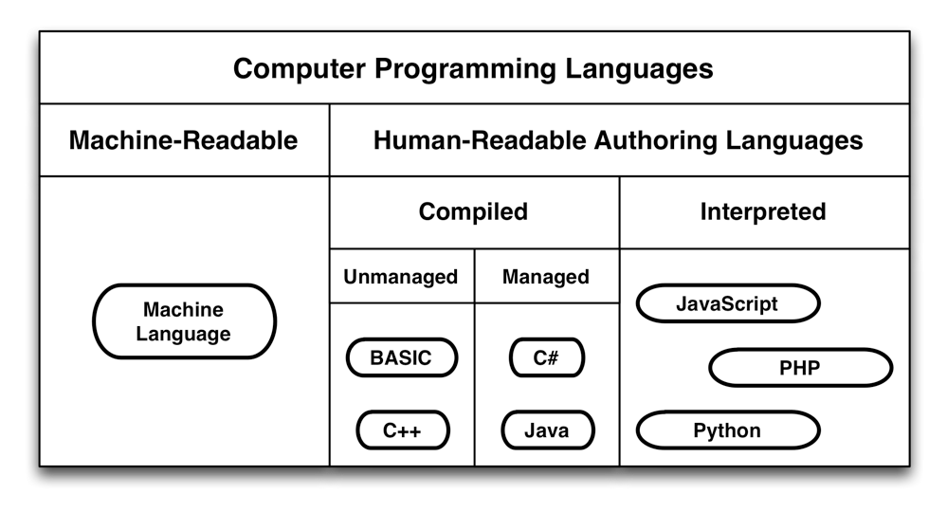
Understanding the Features of C#
Hierarchy of Computer Languages

Slide 7
Understanding the Features of C#
C# is Managed Code
  Computers have a limited amount of Random Access Memory (RAM)
  Older compiled languages like BASIC and C++ require the programmer to manually allocate and deallocate RAM
  In managed code, allocation and deallocation are handled automatically
  This makes it less likely that you will accidentally claim all of the memory
    Doing so is known as a "memory leak"

Slide 8
VARIABLES IN COMPUTER LANGUAGES
A variable is a name that can hold a value
This concept is borrowed from algrbra
  x = 5
  x + 2 = ?
Variables in computer languages can hold much more than just simple numbers
  Numbers
  Words, sentences, paragraphs, novels…
  Images, sounds, 3D models, animations…
  Functions and methods
  Classes and GameObjects

Slide 9
Understanding the Features of C#
C# is Strongly Typed
  In a non-strongly typed language, a variable can hold any kind of data
    The same variable could hold a number one moment and an animation the next
  A strongly typed language restricts the type of data that can be held by any variable
    int x = 5; – An int x can only hold an integer number
    float y = 3.4f; – A float y can only hold a floating point number
  Strong typing allows accurate syntax checking
    The compiler can check your code for correctness
  Strong typing also allows robust code-completion
    The code editor can guess what you want to type and auto-complete

Slide 10
Understanding the Features of C#
C# is Function Based
  Computer programs used to be just a series of commands
  This was like giving driving directions to someone
    From school, head north on Vermont
    Head west on I-10 for about 7.5 miles (about 12Km)
    At the intersection with I-405, take the 405 south for 2mi (3.2Km)
    Take the exit for Venice Blvd.
    Turn right onto Sawtelle Blvd.
    My place is just north of Venice on Sawtelle.
  Functional languages allow the encapsulation of commands
    "If you see a store on the way, please BuySomeMilk()."
    The BuySomeMilk() function encapsulates the many actions involved in finding and purchasing milk.

Slide 11
Understanding the Features of C#
C# is Object-Oriented
  Functions and data used to be separate
  Object-oriented programming introduced classes
  Classes combine functions and data into a single object
    Variables in classes are called fields
    Functions in classes are called methods
  This enables things like a flock of birds where each bird thinks for itself…
    …rather than being controlled by a single, monolithic program
  Object-orientation also allows class inheritance
    A subclass can inherit the fields and methods of its superclass
    e.g., a Dog would inherit all the fields and methods of its superclass Mammal, which would in turn inherit from Animal

Slide 12
Reading and Understanding C# Syntax
All languages have syntax:
The dog barked at the squirrel.
At the squirrel the dog barked.
The dog at the squirrel. barked
barked The dog at the squirrel.
[Subject] [verb] [object].
[Object] [subject] [verb].
[Subject] [object]. [verb]
[verb] [Subject] [object].
Only one of these sentences is correct
  Only one follows the rules of syntax of the English language
The other sentences have syntax errors

Slide 13
Reading and Understanding C# Syntax
C# statements also have syntax rules
  int x = 5;
    Declares a variable named x of the type int
      If a statement starts with a type, the second word of the statement becomes a new variable of that type
    Defines the value of x to be 5
      The = is used to assign values to variables
    All C# statements end with a semicolon ( ; )
      A semicolon is used because the period is already used in decimal numbers

Slide 14
Reading and Understanding C# Syntax
C# statements also have syntax rules
  int x = 5;
  int y = x * ( 3 + x );
    Declares a variable named y of the type int
    Adds 3 + x for a value of 8 (because x = 5)
      Just as in algebra, order of operations follows parentheses first
    Multiplies x * 8 for a value of 40 (5 * 8 = 40)
    Defines the value of y to be 40
    Ends with a semicolon ( ; )

Slide 15
Reading and Understanding C# Syntax
C# statements also have syntax rules
  string greeting = "Hello World!";
    Declares a variable named greeting of the type string
      strings can hold a series of characters like a word or novel
    Defines the value of greeting to be "Hello World!"
      Anything between double quotes is a string literal, a value to be assigned to a string variable
    Ends with a semicolon ( ; )

Slide 16
Reading and Understanding C# Syntax
C# statements also have syntax rules
  string greeting = "Hello World!";
  print( greeting );
    Calls the function print()
      When a function is called, it executes its actions
    Passes the argument greeting into the function print()
      Some functions take arguments: data that changes how the function acts
      The print() function will print the string greeting to the Console pane in Unity
      The Console pane will display "Hello World!"
    Ends with a semicolon ( ; )

Slide 17
Chapter 18 – Summary
You learned important features of C#
  C# is a Compiled Language
  C# is Managed Code
  C# is Strongly Typed
  C# is Function Based
  C# is Object-Oriented
You learned to read and understand some C#
In the next chapter, you'll write your first Unity C# program

