Slide 1
Language Translation with the Magic of Sequences
Cesar Duarte
Neural Network
SKKU/Spring 2017

Slide 2
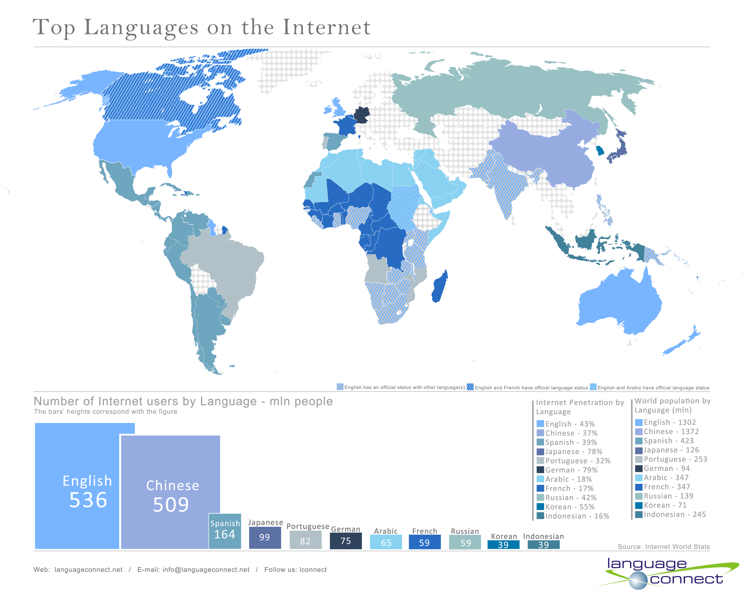
How many languages are there?
6909 living languages, 94% of the world speaks roughly 6% of them

Slide 3
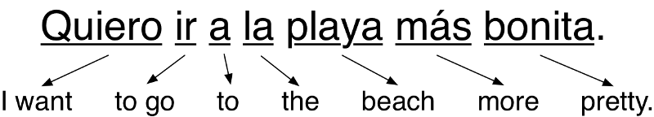
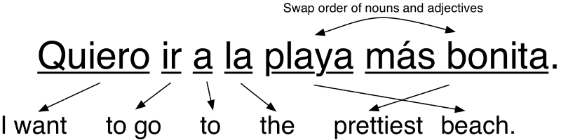
Making Computers Translate
The simplest approach is replace every word in a sentence
Easy, right?! But naïve, ignores grammar and context, maybe swap the order of the nouns....

Slide 4
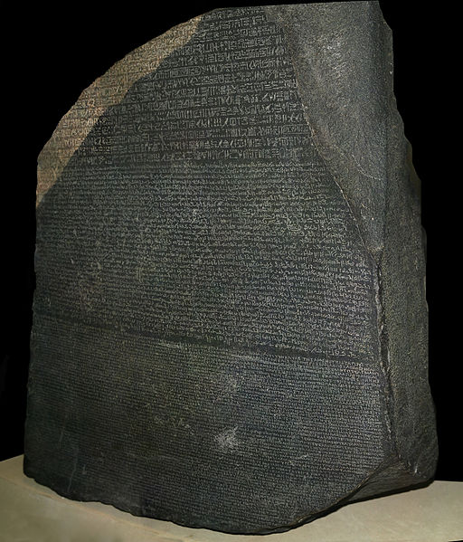
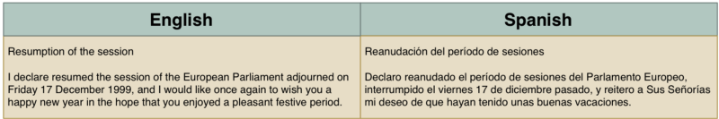
Statistics-Based Translation
That was the base of the earliest machine translation systems
Developed during the Cold War, Georgetown IBM experiment 1954 - 6 grammar rules and 250 lexical items IBM 701 mainframe, 60 Russian sentences
Statistics-based translation system, double translated texts – parallel corpora
Rosetta Stone – three languages – Ancient Egyptian, hieroglyphic and Demotic and Ancient Greek.

Slide 5
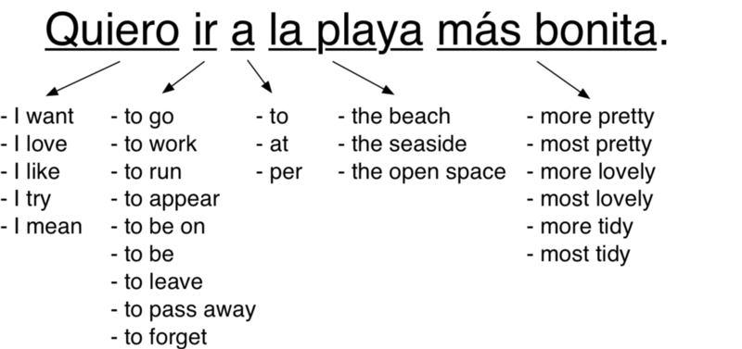
Probabilities and Stats
The idea behind is use statistical translation, to generate thousands of possible translations ranking them by likelihood of being correct
The first step is to break the data into sentences
Find different translations for each chunk
I want | to go | to | the prettiest | beach. +++​
I try | to leave | per | the most lovely | open space. ---

Slide 6
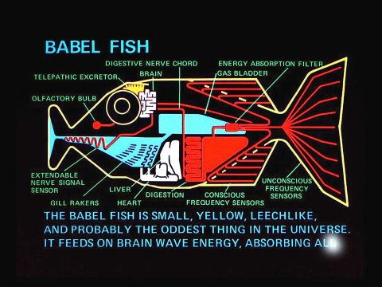
Statistical Machine and Ruled-Based Translation
Franz Josef Och improved the idea behind Statistical Machine Translation, giving birth the Google Translate in the early 2000s
"Every time I fire a linguist, the performance of our speech recognition system goes up."
-Frederick Jelinek - A Pioneer at speech recognition
The Hitchhiker's Guide to the Galaxy" features a Babel Fish, which you can insert into your ear in order to understand what aliens are saying

Slide 7
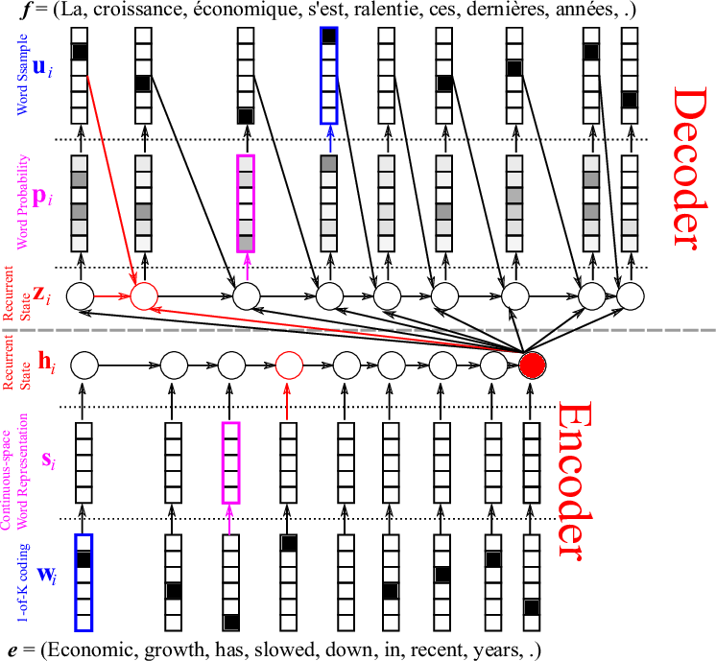
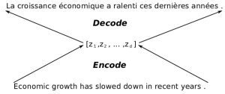
Recurrent Neural Networks
In 2014 KyungHyun Cho's team breakthrough
A deep learning model that translate two languages without human intervention, Recurrent Neural Networks and encodings

Slide 8
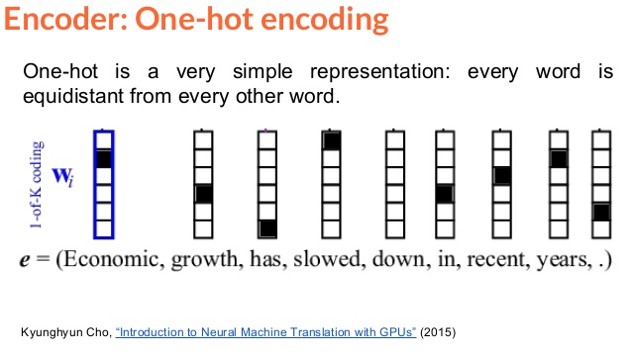
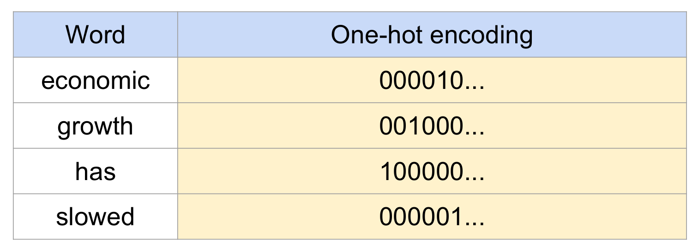
One-hot Encoding

Slide 9
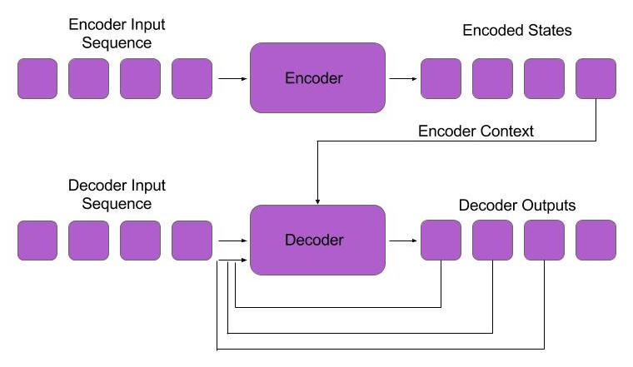
Sequence-to-Sequence(seq2seq)
Maximize the log probability of the output sequence conditioned on the input sequence

Slide 10
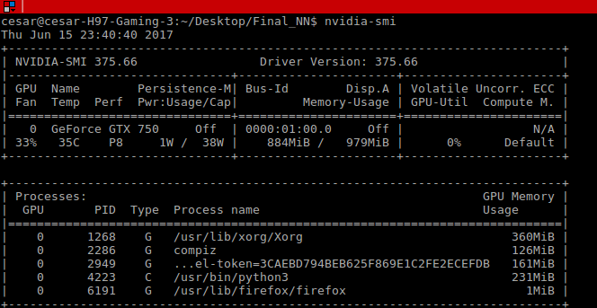
Training
Tensorflow 1.1.0 GPU
Python 3/Jupyter Notebook
GeForce GTX 750 – Memory 1024 MB

Slide 11
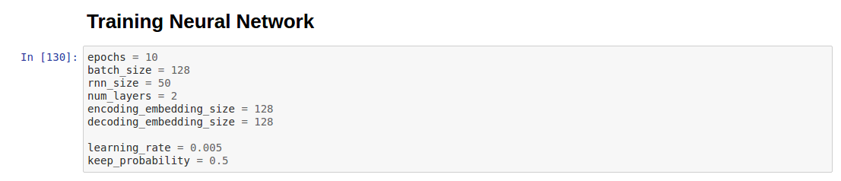
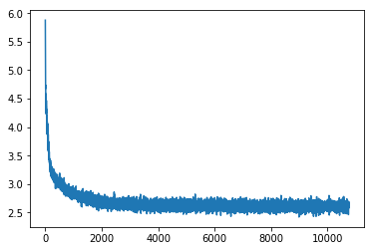
System Tuning
Tuning parameters is more an art than a Science
Epoch 9 Batch 1073/1077 - Train Accuracy: 0.978, Validation Accuracy: 0.950, Loss: 2.579

Slide 12
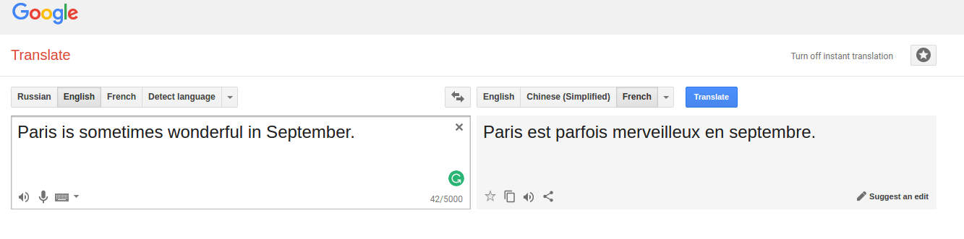
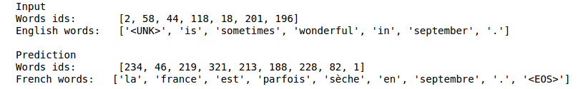
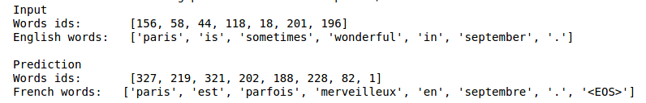
Results
Paris is sometimes wonderful in september
paris is sometimes wonderful in september

Slide 13
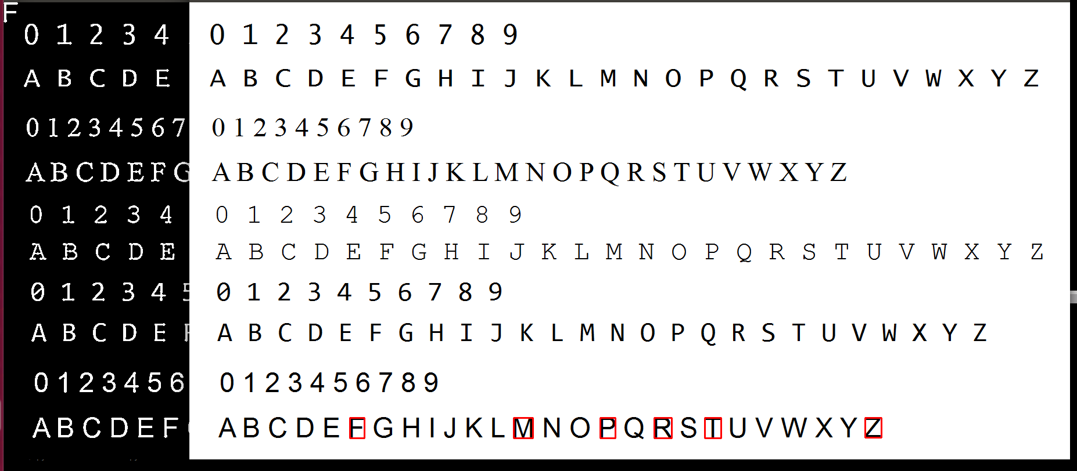
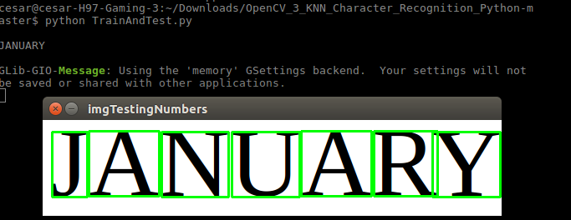
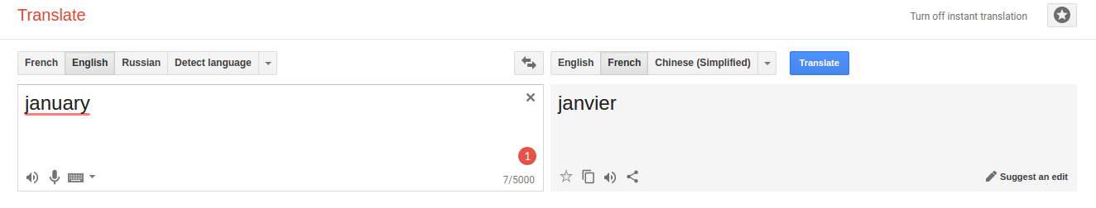
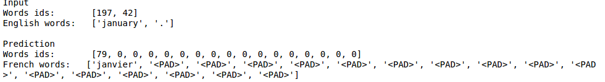
3-Nearest Neighbors
Character recognition
Generate a string and translate string

Slide 14
Limitations
Sentence length, poor performance for long sentences (attention mechanism)
GPU card doesn't have enough memory for long sentences
Language complexity, handle differently depending of the difference of structural between languages

Slide 15
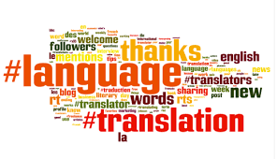
Q&A
Thanks for the attention/Gracias por la atención/注目してくれてありがとう/Grato pela atenção/Merci pour l'attention/관심을 가져 주셔서 감사합니다/感谢您的关注/Спасибо за внимание

