Slide 1
DXC Digital Explorer Solution Template
Guidelines and templates for offline collection of solution information for DXC Digital Explorer

Slide 2
Change Log
Change | Date | Contributor
Initial Version | Nov 2018 | David Stevens
Updated for Technical Excellence 2020 (client testimonials) | August 2019 | David Stevens
Reworked layout | April 2020 | David Stevens

Slide 3
Contents
Overview
Template

Slide 4
Overview

Slide 5
Overview
The Solutions module within DXC Digital Explorer provides the means to capture, store, discover and reuse solutions; either in full or in part.
A Solution within Digital Explorer can represent various types of Solution Architecture models; ranging from Reference Architectures, Customer Implementations, Partner Capabilities, DXC Offerings, Internal enabling Capabilities, Demos and prototypes from DXC Labs
The solution module is supported by a clearly defined and well structured metamodel; aligned with the Opengroup Archimate standards.
The metamodel is further enriched with the alignment to the DXC architectural canvas; presenting a clear and concise representation of any solution model on a single page.

Slide 6
Purpose
Storing our solutions within Digital Explorer unlocks additional business value from a number of channels
Through the analyse of customer requirements within the Digital Explorer Workspaces module or the development of a customer roadmap within the Digital Explorer Roadmaps module; existing solutions can be discovered, reused and referenced with customers.
Through direct reuse and copying within the Digital Explorer Solutions module; allow other users to clone and specialize an existing solution to met their customer needs.

Slide 7
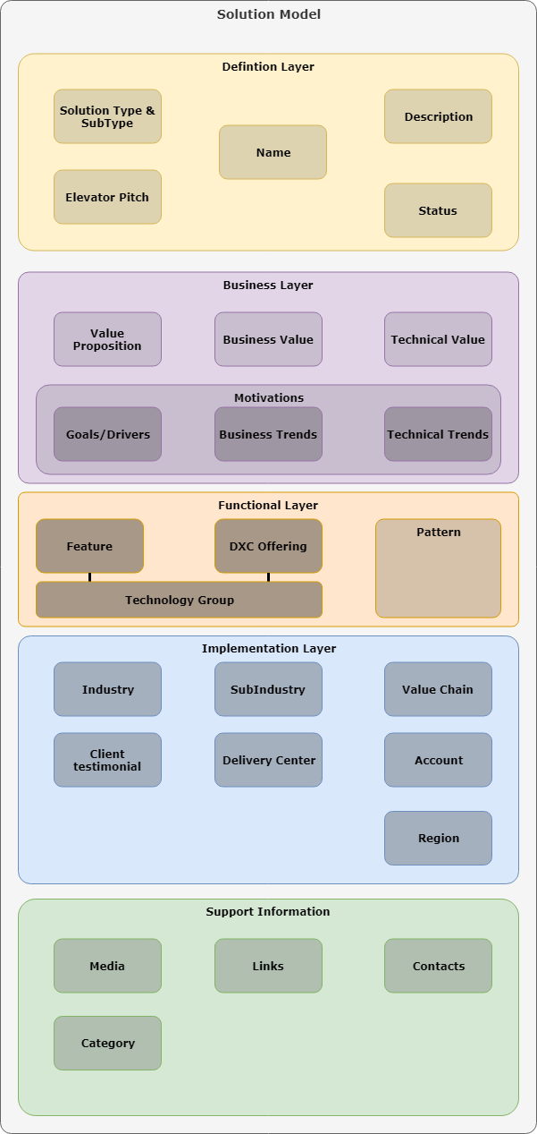
Solution MetaModel
The Solution Metamodel breaks the solution into 5 keys areas
General Definition
Business Layer
Functional Layer
Implementation Layer
Supporting Information
Detailed information on the metamodel can be found on the public GitHub repository for Digital Explorer here

Slide 8
DXC Architecture Canvas
Strategy Key strategic themes which have an overall influence on the technical design and implementation of the solution.
System Management & Operations Defines the people, processes and tools required to deliver and manage part or the complete IT system.
Security
Provides the validation and protection of IT systems from unauthenticated access, theft or physical damage
User Experience
The connection of the physical world to the digital environment; capabilities such as Internet of Things and 3D printing and bridging the gap between physical and digital environments.
Transactional Core
Business processes provided as a consumer service; can be used to provide the end-2-end business process or used in combination with one or more services or processes.
Foundational Core
Core capabilities provided to support the overall functionality of the solution.
Infrastructure
Capabilities to deliver an infrastructure service, from Server hardware, operating systems, virtualization and cloud computing.

Slide 9



Submitting Content into Digital Explorer
There are a number of channels to submit content into Digital Explorer
DXC Digital Explorer
GitHub Solution Reader
Automated Sync.
GitHub
Solution Entry Forms
PowerPoint Template (this file)
Manual Entry

Slide 10
Templates

Slide 11
Solution Overview Definition
Solution Name * |  | Status | Demo/Concept/Prototype/Pilot/Production**
Elevator Pitch * how would you tweet about your solution? Max 240 characters
Description * Max 5000 characters
Solution Type * | DXC Offering Family/ DXC Reference Architecture / Partner (Alliance, Solution, Pioneer) / DXC Client Solution**
* Required
** Delete as appropriate

Slide 12
Solution Overview Business Value
Value Proposition What does it solve? Max 5000 characters
Business Value Max 5000 characters
Technical Value Max 5000 characters

Slide 13
Solution Overview Motivations and Trends
General Business Motivations (Optional)
Business Motivation | Description
Related Industry Trends https://digitalexplorer.dxc.com/de/
Trend | Trend | Trend | Trend | Trend
The upload into Digital Explorer will extract matches from the descriptive text provided on slides 9 & 10; Use this table to ensure key trends are explicitly associated with the solution

Slide 14
Solution Overview Capabilities & Offerings
Capability Name | Description | DXC Canvas Group (see slide
Sub Offering Name

Slide 15
Solution Overview Implementation Information
Associated Industries*
Industry (Level 1) | Sub Industry (Level 2) | Business Area (Level 3) | Business Function (Level 4)
Associated Accounts
Account Name
* Aligns with DXC Corporate taxonomy
** Level 1 information required, Levels 2-4 optional

Slide 16
Solution Overview Delivery Information (Optional)
Associated Delivery Centres
Delivery Centre Name
Client Testimonial Quote from client or account leadership team
Referenceable? Default is no

Slide 17
Solution Overview Contacts
Contact Name | Contact Email | Role
 |  | Examples: Solution Owner Architect UX Lead Tester

Slide 18
Solution Overview Supporting media and links
Name and Description | Type | URL
 | Examples: Solution Overview video demo Sandbox demo
Please attach any supporting media, videos, docs, images (files or links)

