Slide 1
Identify Clusters in Plant Dataset
UNSUPERVISED LEARNING

Slide 2
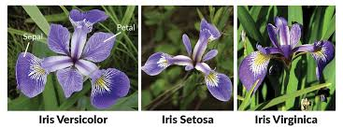
Research Overview
Identifying the number of clusters in Iris dataset
We are going to perform unsupervised learning to determine distinct clusters
Based on the results, we can
develop an app to identify the type
of plant based on plant features

Slide 3
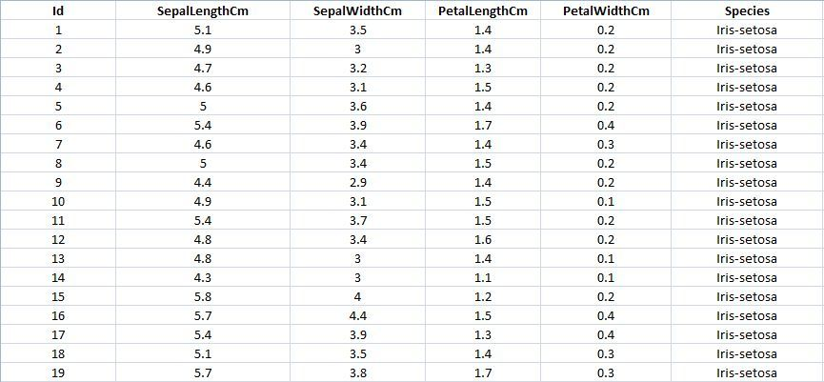
Data Overview
Dataset for analysis consists a sample of 150 records for plant features
Plant Features
  Sepal Length & Width
  Petal Length & Width

Slide 4
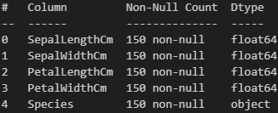
Data Cleaning
Dropping ID column as it doesn’t provide any useful information
No missing values were found in the data

Slide 5
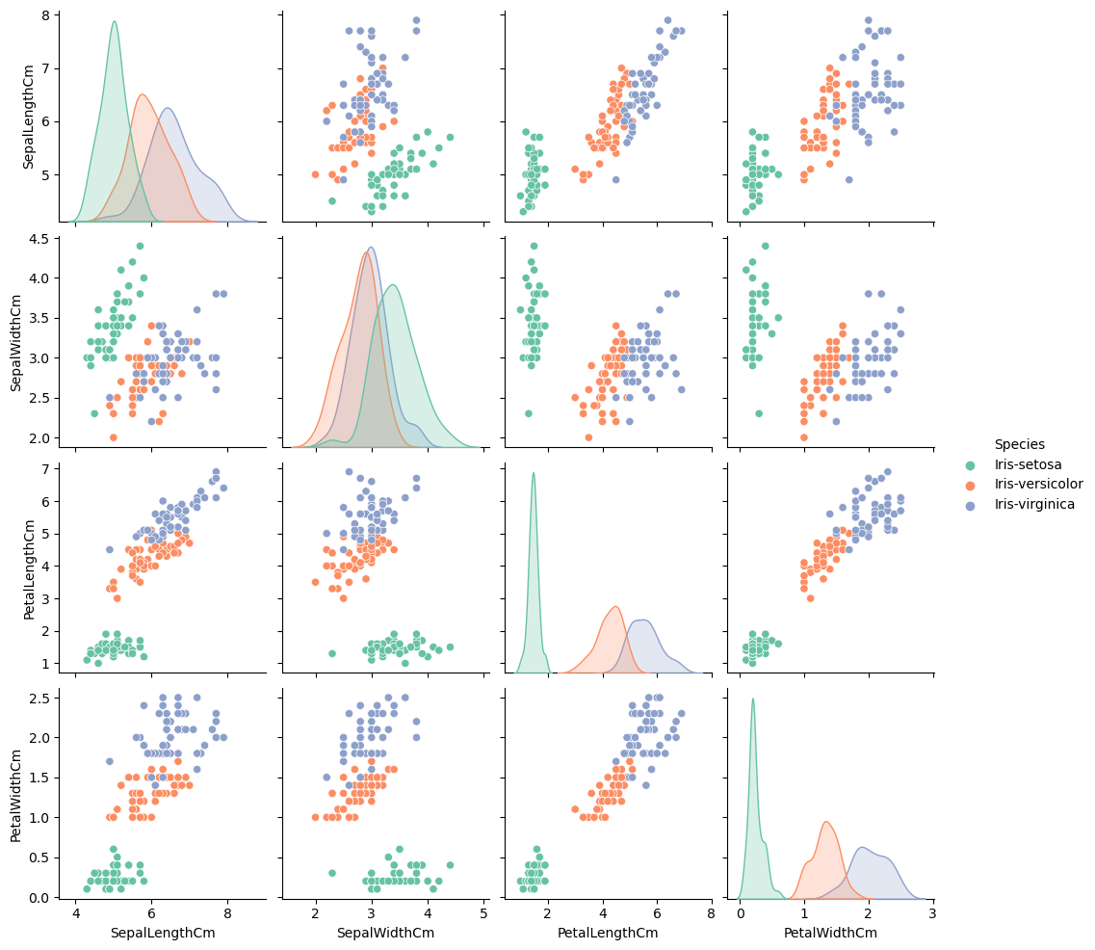
Data Exploration

Slide 6
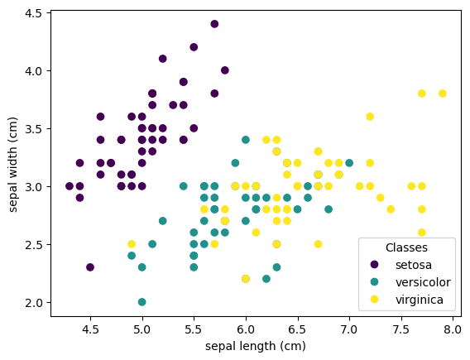
Data Exploration

Slide 7
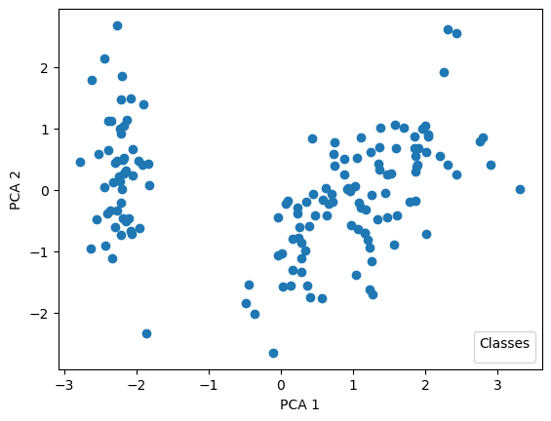
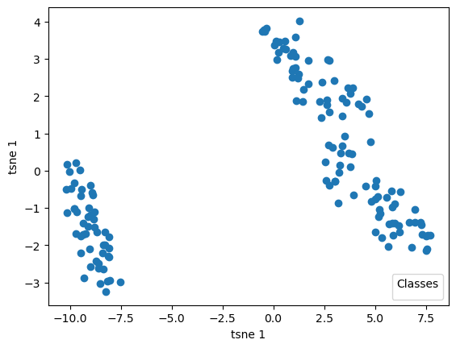
Dimensionality Reduction
Principal Component Analysis
t-sne Analysis

Slide 8
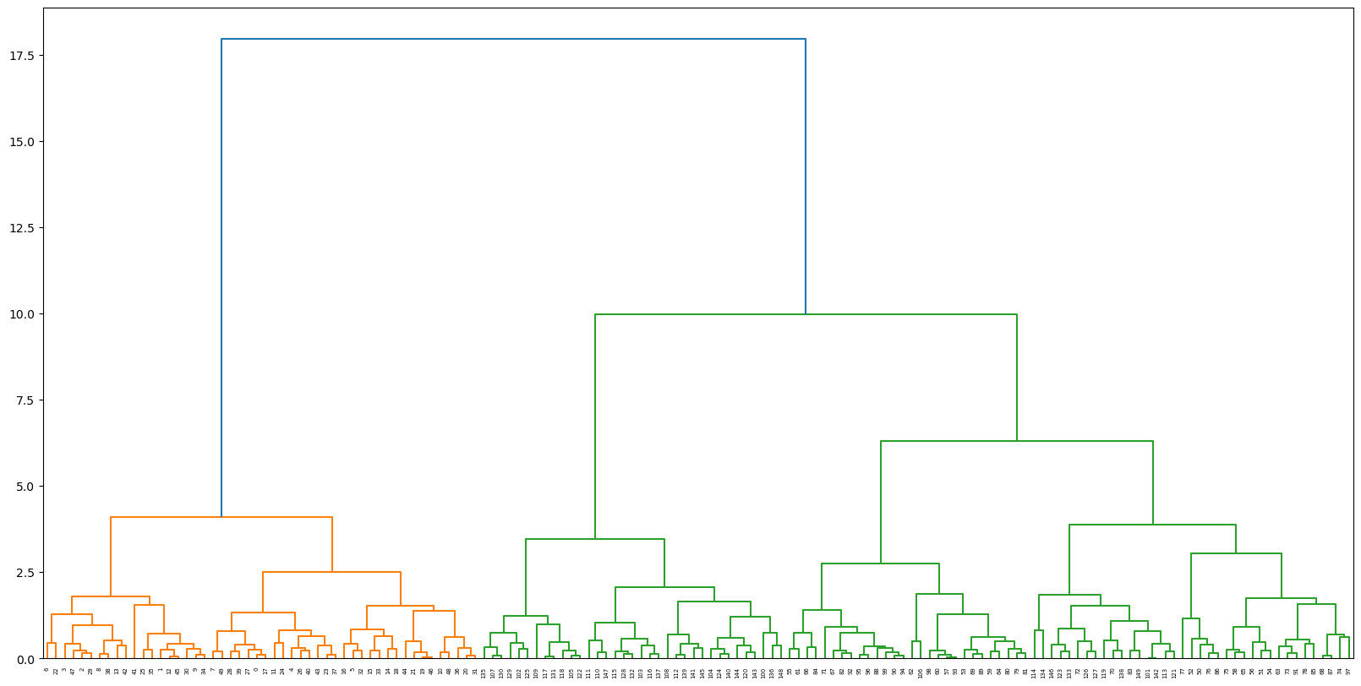
Unsupervised Learning – Agg. Clustering
Agglomerative clustering technique is used to identify the clusters
Dendogram showed there are 3 clusters in the data
For evaluation the result of the model, we used Silhouette Score
Achieved Silhouette score of 0.63

Slide 9
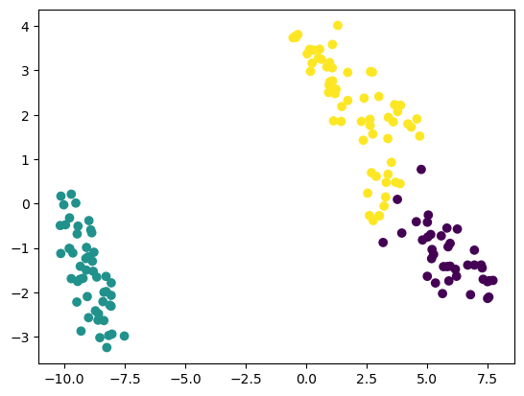
Unsupervised Learning – K Means
K means clustering technique is used to identify the clusters
For evaluation the result of the model, we used Silhouette Score
Achieved Silhouette score of 0.66

Slide 10
Conclusion & Future Work
The insights gained from dimensionality reduction and clustering is that there are 3 cluster
Based on model evaluation metric of Silhouette Score, K Means had higher score of 0.66 as compared to Hierarchy/Agglomerative clustering
Given this research, it is evident that we can identify plant species based on plant features and can form clusters
An app that takes input of plant features and tells end user the type of plant is viable product based on this research
Shortcoming would be that if there were more features except sepal and petal lengths and widths, for ex – color of plant, climate it needs, plant height etc

