Slide 1
Average Test Scores
FEMALE vs Male

Slide 2

Research Overview
Does the student performance varies based on Gender? If it does, by how much?
We are going to perform statistical test to determine if there is a difference based on gender
Based on the results, we can
determine if we need to make
academic improvements or not

Slide 3
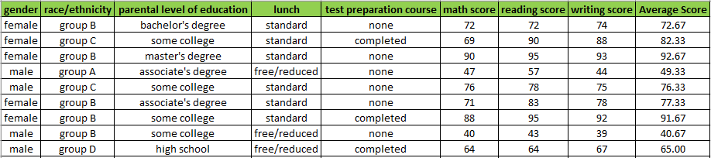
Data Overview
Dataset for Analysis consists a sample of 1000 records for test scores
Gender Distribution
Female : 518 Records
Male : 484 Records

Slide 4
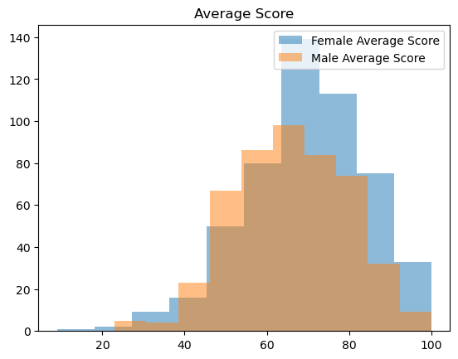
Statistical Analysis
We performed T test to determine does the Average Test Score varies based on gender
Also, using confidence interval, we can quantify on average by how much the score varies

Slide 5
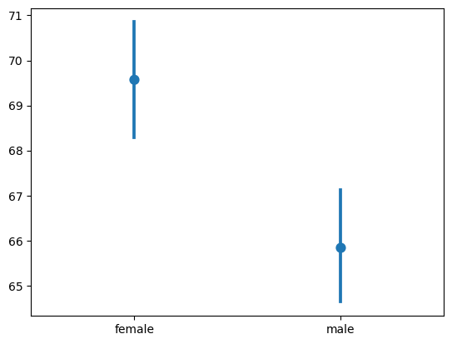
Summary
Based on the analysis we determined the there is a significant difference between the test scores of Female vs Male
With 99% confidence, average score of female are on average between 6.03 and 1.43 higher than male average score
Average Test Scores – Female vs Male

Slide 6
Conclusion
Extra attention can be provided on male students for them to improve their scores
Faculties can try to find reasons behind why male students are performing lesser than female students.

