Slide 1
“Data Visualization Project”
Trade & Business
Guidance From:
>> Ashish Anand sir
>> Prachuryya Kaushik sir
>> Soumya ma’am
Name: Akshay Vitthal Parit
Roll No: 224161013

Slide 2
All Datasets Overview
1) Startups Funding >> 'Sr No', 'Date', 'Startup Name', 'Industry Vertical', 'City Location', 'Investors Name', 'InvestmentnType', 'Amount', 'Month'
2) Bangalore >> 'area_type', 'availability', 'location', 'size', 'total_sqft', 'bath', 'balcony', 'price', 'Per_sqft'
3) Delhi >> 'Area', 'BHK', 'Bathroom', 'Furnishing', 'Locality', 'Parking', 'Price', 'Status', 'Transaction', 'Type', 'Per_Sqft'
4) Credit Card Uses >> 'index', 'City', 'Date', 'Card Type', 'Exp Type', 'Gender', 'Amount', 'DayOfWeek', 'Month', 'Year'

Slide 3
Let’s gets started with Startup Funding Dataset and gradually inter-connects the dots with other datasets..

Slide 4
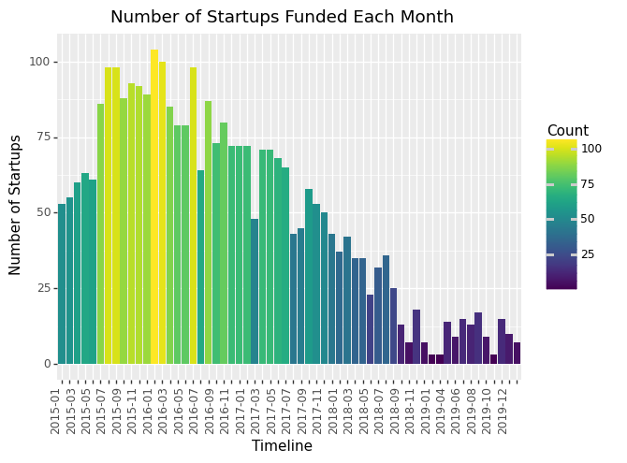
From 2016 onwards, the no of startups reduced continuously. Reasons for this downfall are…. i) GST and demonetization. ii) Consolidation. iii) Funding slowdown.

Slide 5
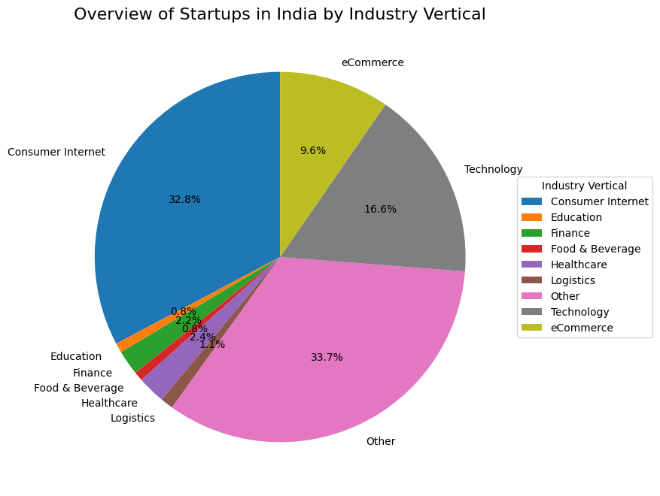
* Most of the startups are software company related (Industry vertical-->Consumer Internet,Technology & eCommerce)

Slide 6
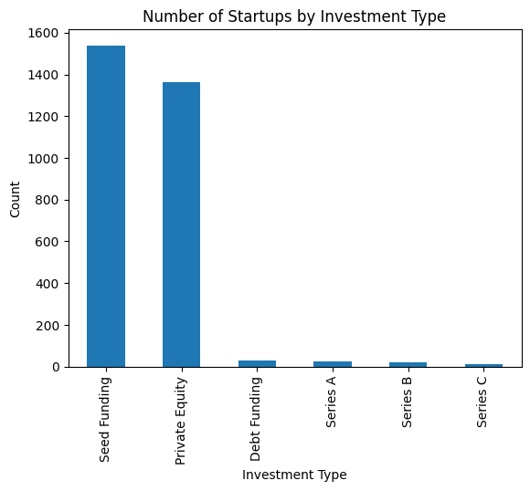
* Most of the startups in India has started with investment type as a Private Equity or Seed Funding. Sir Ratan Tata started 25 startups which is maximum by an individual person

Slide 7
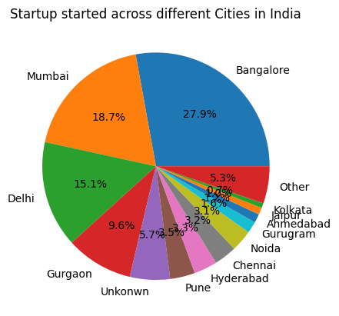
*Most of the startups are started in Major cities like Bangalore, Mumbai, Delhi etc.

Slide 8
Connecting Startup dataset with Real Estate dataset
As we have seen, more no. of startups are started in major cities of India like BANGALORE, DELHI & MUMBAI….
Need lots of Employees…
In order to provide accommodation to employees, plotting is needed….
We will see Real Estate data in Bangalore & Delhi..

Slide 9
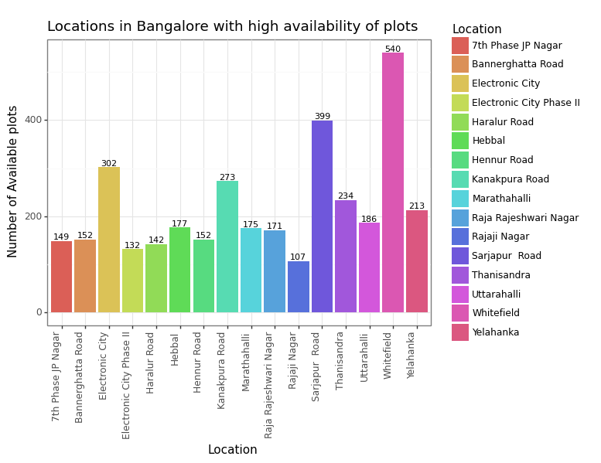

Slide 10
Why????
What is the main reason behind more plottings in
Whitefield, Electronic city, Sarjapur road, Kanakpura road and
Thanisandra road?
Answer--->
“Growing IT Parks near these locations”
* International Tech Park commonly known as ITPL is a tech park located in Whitefield, Bangalore. It is the oldest & largest IT/ Tech Park in Bangalore started in 1992.
* Electronics City is one of the largest electronic industrial parks in India spread over 332 acres of area.There are over 200 IT companies housed in the Electronics City. Some of these companies include General Electric, Biocon, Bosch, Tech Mahindra, Wipro Technologies and TCS.
* Sarjapur Road is surrounded by many renowned IT Parks and Tech hubs. The IT boom in adjacent neighbourhoods of Electronic City and Whitefield acted as a catalyst for Sarjapur Road to top-listed property markets of Bangalore.
* Thanisandra Road is becoming attractive because of its proximity to Manyata Tech Park & from kanakpur road, it is straightforward to get to the employment hubs of Sarjapur Road and Electronic City.

Slide 11
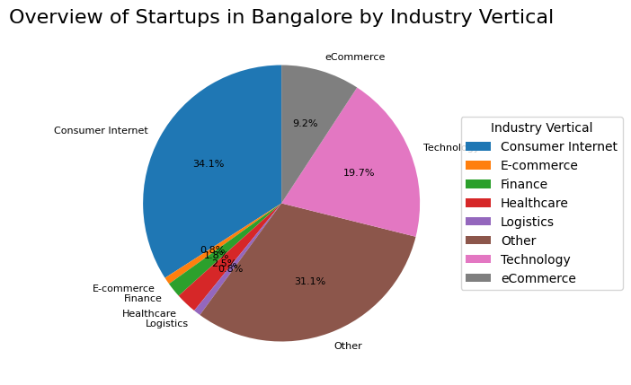
Connecting with Startups in Bangalore…
In Bangalore, around 65% of startups are software/IT related. Therefore majority of plottings found near IT park areas.

Slide 12
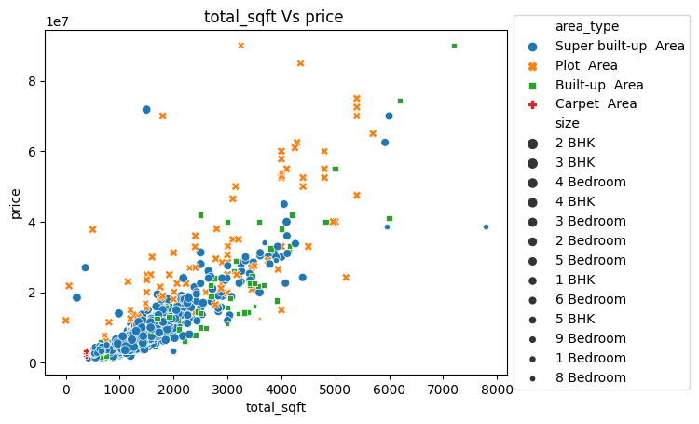
price Vs total_sqft in 5 locations with area type and size

Slide 13
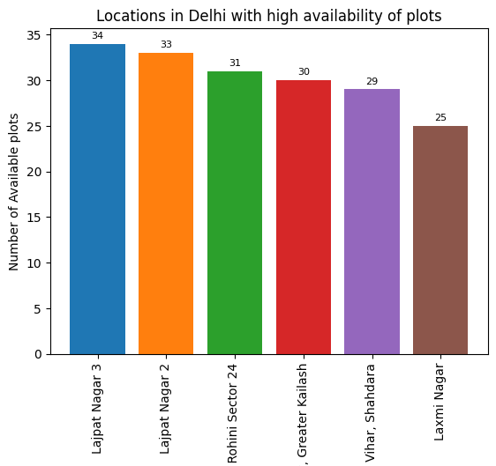
Similar to Bangalore, Delhi is also following same trend…
Lajpat nagar and Greater Kailash are near to IT hub present in Delhi
And also well connected by roads.

Slide 14
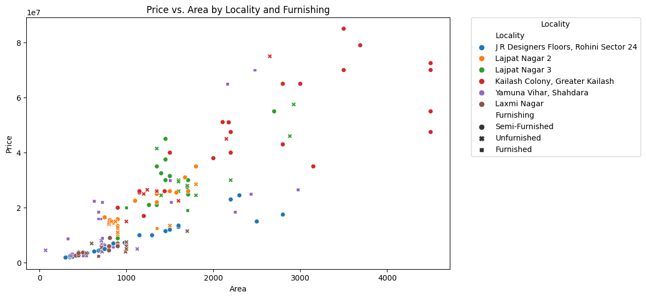
Area Vs Price in localities of Delhi with high availability of plots

Slide 15
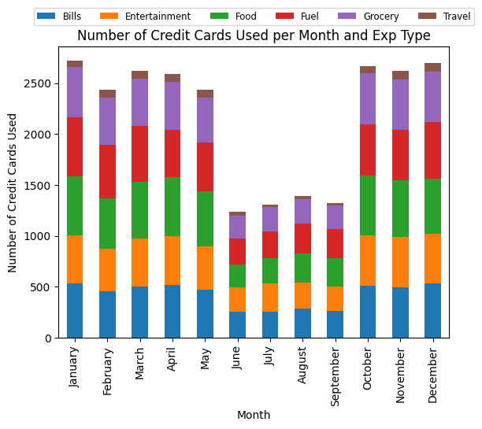
Now, We have left with Credit Card Uses dataset…Also we have to interconnect this dataset with Startup & Real Estate…

Slide 16
What is the reason behind the drastic fall in Credit Card uses in Rainy season ???
I was also thinking, this is because of rainy season but…It is not actual reason.
Actually,
We had been provided with 3 years Credit Card uses data, but it is not of all 36 months…And this is why we are getting less credit card uses for some months.
Oct 2013
Dec 2013
Jan 2014
Dec 2014
Jan 2015
May 2015

Slide 17
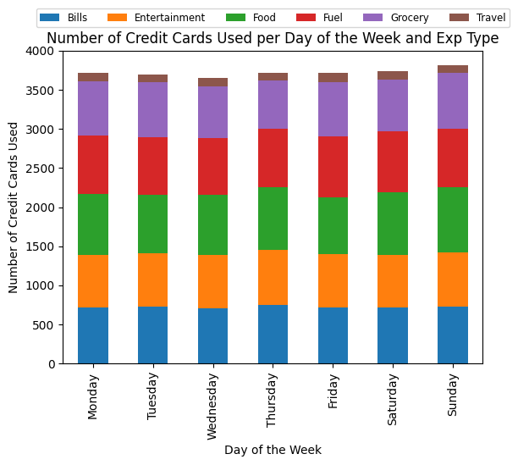
If we look carefully, then we will see that, there is a Slight increase in credit card uses on holidays.

Slide 18
Expectation
As we have seen,
Most of the startups are started in major cities in India → Plotting in these cities is also got increased to accommodate employees..
Now,
It is quite obvious that Credit Card uses in these cities should be more, isn't it?

Slide 19
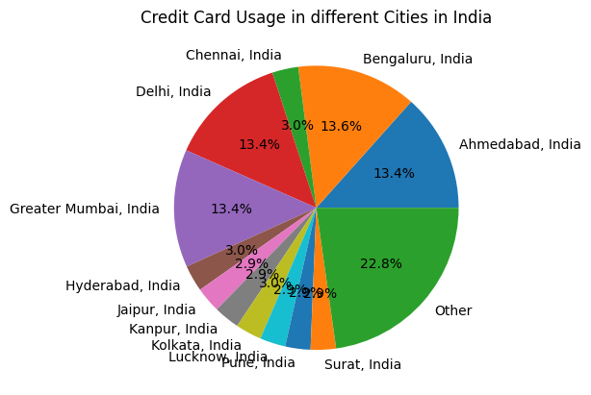
As we can clearly see,
more than 50% of credit cards are used in 4 cities in India.

Slide 20
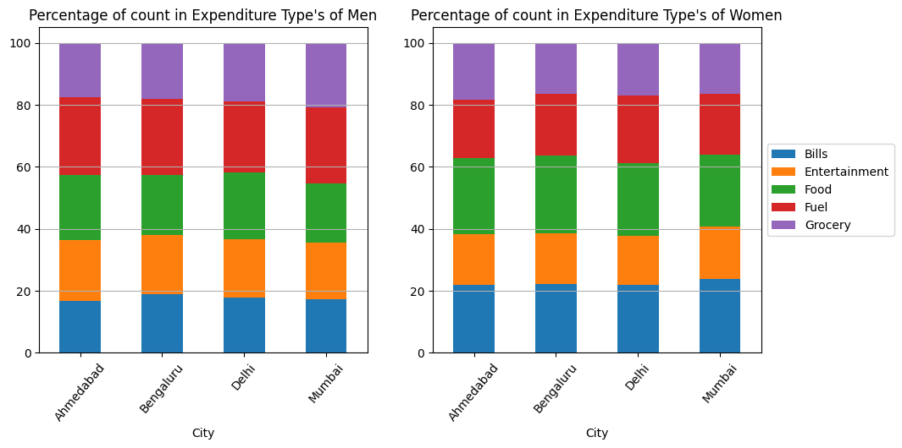
Now, we will focus more on top 4 credit card using cities in India
We can clearly see that,
In these 4 cities, Males are mostly spending money on Fuel while Females
spent their money on paying Bills and ordering Food..

Slide 21
Credit Card Uses
Interconnecting with Startup..!!
Let, I want to invest in startup and I have less money to invest…→ I can’t invest in Logistic or Tech related companies, as they require huge amount to invest.
As we have seen, mostly people are spending money on food & fuel…
I can invest my money in food or fuel related startups so that I will get more returns…
Interconnecting with Real Estate..!!
In Bangalore and Delhi
Startups increased Also Credit cards uses is also more
---> There is a high chance of use of Credit cards to purchase plots…!!

Slide 22
Conclusion
1) I have given with 4 datasets (Bangalore, Delhi, Credit Card Uses & Startup Fundings) & the only possible way to combine & compare these datasets is using common attribute "location
2) I have found, how increase in startups affects to increase in plotting in cities like Bangalore and Delhi.
3) Startups increase > plotting areas increases > Credit cards uses more to take plots
4) Use of credit cards increased mostly for food and fuel > Its better to invest in startups related to food and fuel.
5) I have used the ggplot, group by and visualizing multidimensional plot concepts taught in class.

Slide 23
Thank you

