Slide 1
ActiveMQ 5.15.2 on Azure
Evandro de Paula

Slide 2
Agenda
ActiveMQ 5.15.2 – Installation on Windows
ActiveMQ Persistence Tier – Configuring Azure SQL as ActiveMQ Persistence Tier
ActiveMQ HADR – Master/Slave
ActiveMQ on Azure Scale Sets
.NET Support
KahaDB vs LevelDB
FAQ
Troubleshooting

Slide 3
ActiveMQ 5.15.2
Installation on Windows

Slide 4
Software Acquisition & Pre-Req
Install JRE 8u162
http://www.oracle.com/technetwork/java/javase/downloads/jre8-downloads-2133155.html
DO NOT install JRE or JDK 9.0.4, it will lead to the following error:
Error creating bean with name 'org.apache.activemq.xbean.XBeanBrokerService#0' defined in class path resource [activemq.xml]: Invocation of init method failed; nested exception is java.lang.NoClassDefFoundError: javax/xml/bind/DatatypeConverter | org.apache.activemq.xbean.XBeanBrokerFactory | WrapperSimpleAppMain
ActiveMQ 5.15.2
http://activemq.apache.org/activemq-5152-release.html
Install Microsoft JDBC Driver 6.0 for SQL Server
https://docs.microsoft.com/en-us/sql/connect/jdbc/download-microsoft-jdbc-driver-for-sql-server

Slide 5
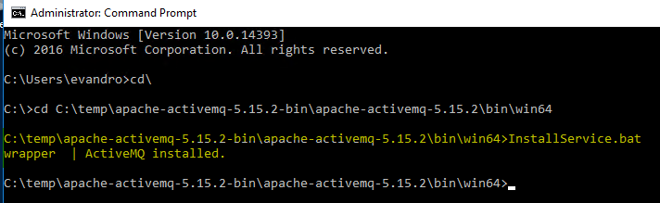
ActiveMQ Installation
Open a Command Prompt as Administrator
Check if JVM is x64 by running java -d64 –version
The navigate to the appropriate folder:
x64 = ..\bin\win64
X86 = ..\bin\win32
Run InstallService.bat
An Access Denied error will occur if the Command Prompt was not opened as Administrator

Slide 6
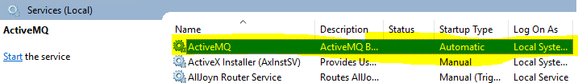
ActiveMQ as a Service
Open services.msc
Start the ActiveMQ service

Slide 7
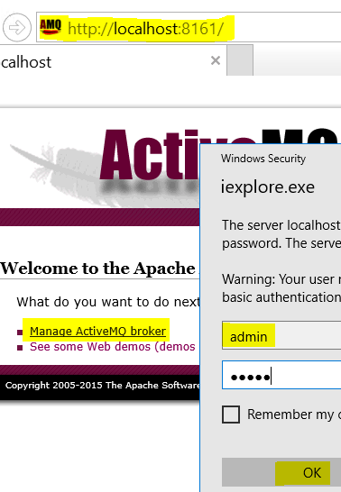
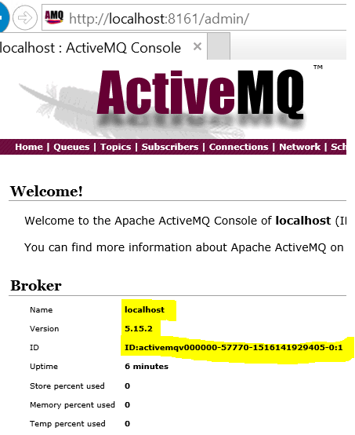
ActiveMQ Management Portal
Open a browser and navigate to http://localhost:8161/
User = admin
Password = admin

Slide 8
ActiveMQ Persistence Tier
Configuring Azure SQL as Persistence Tier

Slide 9
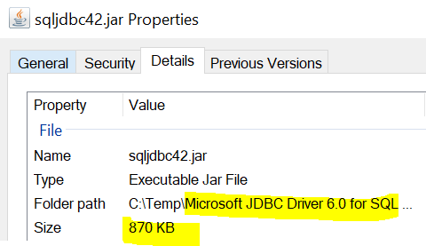
Install Mirosoft JDBC Driver 6.0 for SQL Server
Copy Mirosoft JDBC Driver 6.0 for SQL Server file sqljdbc42.jar for JRE8 to \apache-activemq-5.15.2\lib\optional directory

Slide 10
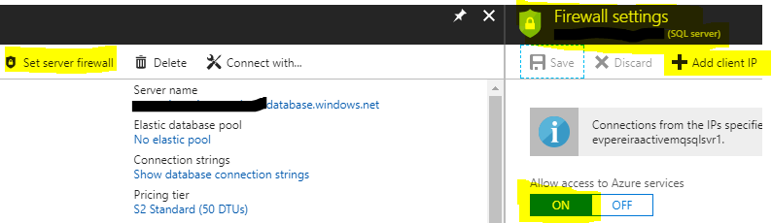
Configure Azure SQL Firewall
Add ActiveMQ machine IP address to the Azure SQL Firewall

Slide 11
Configure Azure SQL as ActiveMQ Persistence Tier
Add below configuration to ActiveMQ configuration file activemq.xml under \apache-activemq-5.15.2\conf directory
Restart the ActiveMQ service
…
<broker xmlns="http://activemq.apache.org/schema/core" brokerName="localhost" dataDirectory="${activemq.data}" persistent="true">
...
<bean id="mssql-ds" class="org.apache.commons.dbcp2.BasicDataSource" destroy-method="close">
<property name="driverClassName" value="com.microsoft.sqlserver.jdbc.SQLServerDriver"/>
<property name="url" value="jdbc:sqlserver://[server name].database.windows.net:1433;database=[database name];"/>
<property name="username" value=“[user]"/>
<property name="password" value="[password]"/>
<property name="poolPreparedStatements" value="true"/>
</bean>
...
<persistenceAdapter>
<!-- <kahaDB directory="${activemq.data}/kahadb"/> -->
<jdbcPersistenceAdapter createTablesOnStartup="false" dataDirectory="${activemq.data}/sql" dataSource="#mssql-ds">
<adapter><transact-jdbc-adapter/></adapter>
</jdbcPersistenceAdapter>
</persistenceAdapter>
...

Slide 12
Verifying Success on Logs(i)
Go to C:\Platform\apache-activemq-5.15.2\data directory and open file activemq.log, you should see:
2018-01-17 09:24:57,887 | INFO | Refreshing org.apache.activemq.xbean.XBeanBrokerFactory$1@76447478: startup date [Wed Jan 17 09:24:57 PST 2018]; root of context hierarchy | org.apache.activemq.xbean.XBeanBrokerFactory$1 | WrapperSimpleAppMain
2018-01-17 09:24:59,314 | INFO | Using Persistence Adapter: JDBCPersistenceAdapter(org.apache.commons.dbcp2.BasicDataSource@bd22cb0) | org.apache.activemq.broker.BrokerService | WrapperSimpleAppMain
2018-01-17 09:25:00,373 | INFO | Database lock driver override not found for : [microsoft_jdbc_driver_6_0_for_sql_server]. Will use default implementation. | org.apache.activemq.store.jdbc.JDBCPersistenceAdapter | WrapperSimpleAppMain
2018-01-17 09:25:00,379 | INFO | Attempting to acquire the exclusive lock to become the Master broker | org.apache.activemq.store.jdbc.DefaultDatabaseLocker | WrapperSimpleAppMain
2018-01-17 09:25:00,424 | INFO | Becoming the master on dataSource: org.apache.commons.dbcp2.BasicDataSource@bd22cb0 | org.apache.activemq.store.jdbc.DefaultDatabaseLocker | WrapperSimpleAppMain
2018-01-17 09:25:00,431 | INFO | PListStore:[C:\Platform\apache-activemq-5.15.2\bin\win64\..\..\data\localhost\tmp_storage] started | org.apache.activemq.store.kahadb.plist.PListStoreImpl | WrapperSimpleAppMain
2018-01-17 09:25:00,800 | INFO | Apache ActiveMQ 5.15.2 (localhost, ID:[your installation id]) is starting | org.apache.activemq.broker.BrokerService | WrapperSimpleAppMain
2018-01-17 09:25:01,032 | INFO | Listening for connections at: tcp://[machine name]:61616?maximumConnections=1000&wireFormat.maxFrameSize=104857600 | org.apache.activemq.transport.TransportServerThreadSupport | WrapperSimpleAppMain
2018-01-17 09:25:01,036 | INFO | Connector openwire started | org.apache.activemq.broker.TransportConnector | WrapperSimpleAppMain
2018-01-17 09:25:01,040 | INFO | Listening for connections at: amqp://[machine name]:5672?maximumConnections=1000&wireFormat.maxFrameSize=104857600 | org.apache.activemq.transport.TransportServerThreadSupport | WrapperSimpleAppMain
2018-01-17 09:25:01,044 | INFO | Connector amqp started | org.apache.activemq.broker.TransportConnector | WrapperSimpleAppMain

Slide 13
Verifying Success on Logs(ii)
2018-01-17 09:25:01,048 | INFO | Listening for connections at: stomp://[machine name]:61613?maximumConnections=1000&wireFormat.maxFrameSize=104857600 | org.apache.activemq.transport.TransportServerThreadSupport | WrapperSimpleAppMain
2018-01-17 09:25:01,052 | INFO | Connector stomp started | org.apache.activemq.broker.TransportConnector | WrapperSimpleAppMain
2018-01-17 09:25:01,060 | INFO | Listening for connections at: mqtt://[machine name]:1883?maximumConnections=1000&wireFormat.maxFrameSize=104857600 | org.apache.activemq.transport.TransportServerThreadSupport | WrapperSimpleAppMain
2018-01-17 09:25:01,064 | INFO | Connector mqtt started | org.apache.activemq.broker.TransportConnector | WrapperSimpleAppMain
2018-01-17 09:25:01,205 | WARN | ServletContext@o.e.j.s.ServletContextHandler@78a71293{/,null,STARTING} has uncovered http methods for path: / | org.eclipse.jetty.security.SecurityHandler | WrapperSimpleAppMain
2018-01-17 09:25:01,285 | INFO | Listening for connections at ws://[machine name]:61614?maximumConnections=1000&wireFormat.maxFrameSize=104857600 | org.apache.activemq.transport.ws.WSTransportServer | WrapperSimpleAppMain
2018-01-17 09:25:01,290 | INFO | Connector ws started | org.apache.activemq.broker.TransportConnector | WrapperSimpleAppMain
2018-01-17 09:25:01,292 | INFO | Apache ActiveMQ 5.15.2 (localhost, ID:[your installation id]) started | org.apache.activemq.broker.BrokerService | WrapperSimpleAppMain
2018-01-17 09:25:01,293 | INFO | For help or more information please see: http://activemq.apache.org | org.apache.activemq.broker.BrokerService | WrapperSimpleAppMain
2018-01-17 09:25:02,695 | INFO | No Spring WebApplicationInitializer types detected on classpath | /admin | WrapperSimpleAppMain
2018-01-17 09:25:02,972 | INFO | ActiveMQ WebConsole available at http://0.0.0.0:8161/ | org.apache.activemq.web.WebConsoleStarter | WrapperSimpleAppMain
2018-01-17 09:25:02,973 | INFO | ActiveMQ Jolokia REST API available at http://0.0.0.0:8161/api/jolokia/ | org.apache.activemq.web.WebConsoleStarter | WrapperSimpleAppMain
2018-01-17 09:25:03,095 | INFO | Initializing Spring FrameworkServlet 'dispatcher' | /admin | WrapperSimpleAppMain
2018-01-17 09:25:03,418 | INFO | No Spring WebApplicationInitializer types detected on classpath | /api | WrapperSimpleAppMain
2018-01-17 09:25:03,769 | INFO | jolokia-agent: Using policy access restrictor classpath:/jolokia-access.xml | /api | WrapperSimpleAppMain

Slide 14
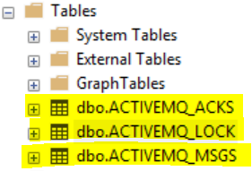
ActiveMQ Tables on Azure SQL
Connect to Azure SQL using your preferred tool (e.g. SSMS)
Verify that the table below have been created

Slide 15
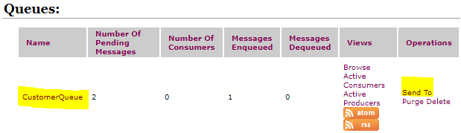
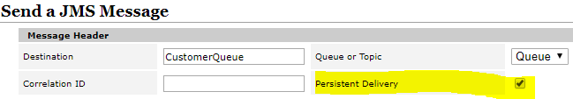

Testing
Create a sample queue through the ActiveMQ management portal and click Send To
Make sure the Persistent Delivery option is checked
Execute the query below and you should see the messages:
SELECT * FROM [dbo].[ACTIVEMQ_MSGS]

Slide 16
ActiveMQ HADR
Master/Slave

Slide 17
HADR (Master/Slave)
There are 3 types of Master/Slave configurations:
Shared file system (e.g. SAN) → KahaDB
Replicated LevelDB
JDBC + DBMS (e.g. Oracle, MySQL, PostgreSQL and SQL Server)
More details available at http://activemq.apache.org/masterslave.html

Slide 18
HADR (Master/Slave) - JDBC
JDBC + DBMS
Documentation states support to MySQL, PostgreSQL, Oracle, SQL Server
More details available at http://activemq.apache.org/jdbc-master-slave.html
Cannot use the high performance journal → therefore, it is relatively slower
Only 1 broker will be up and running giving a point in time (due to exclusive lock on table ACTIVEMQ_LOCK)
Scale set + AzureSQL
Messages are fully available for all brokers sharing the Azure SQL
A slave broker will automatically become master once the master is down
Scale set load balancer need to have its health probes configured
Much higher latency < 125ms for the same 1KB payload
I observed < 10ms latency for the same payload when using KahaDB

Slide 19
HADR (Master/Slave) - KahaDB
KahaDB + Zookeeper
Provides very fast replication system
More details available at http://activemq.apache.org/kahadb-master-slave.html

Slide 20
ActiveMQ on Azure Scale Sets
Configuring Azure Load Balancer and Firewall

Slide 21
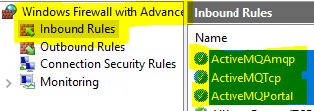
Firewall Inbound Rules
Configure the Firewall to allow traffic on default ports:
8161 – ActiveMQ Management Portal
61616 – ActiveMQ TCP
5672 – ActiveMQ AMQP
RDP into the VMs in the Scale Set and create inbound rules to allow traffic on the ports above:
Use the following script to get Scale Set RDP information:
https://github.com/evandropaula/Azure/blob/master/ScaleSets/PS/Get-ResourceGroupScaleSetsRDPInfo.ps1

Slide 22
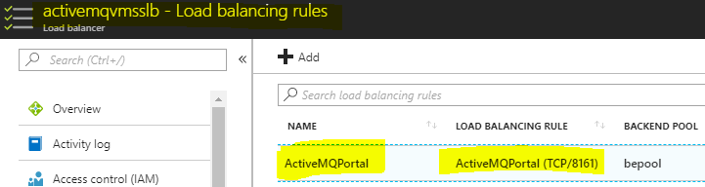
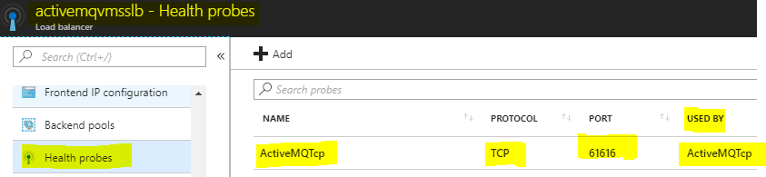
Scale Set Load Balancing Rules & Probes
After deploying the Scale Set and installing Active MQ 5.15.2, the Load Balancer need to be configured for default ports 8161, 61616 and 5672:
Add Health Probes for the ports using Azure Portal;
Add Load Balancing Rule to the Load Balancer to map port 8161, a helper PS script is available at:
https://github.com/evandropaula/Azure/blob/master/LoadBalancer/PS/Add-ActiveMQManagementPortalRule.ps1
Link the load balancer rules to their respective probes in the Azure Portal;

Slide 23
ActiveMQ .NET Support

Slide 24
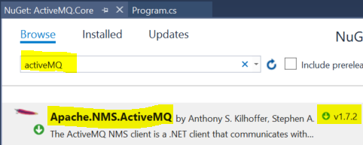
ActiveMQ .NET Support
Search for a Nuget package Apache.NMS.ActiveMQ
Connection is through:
activemq: tcp://activemqhost:61616

Slide 25
ActiveMQ Persistence Tier Performance
KahaDb vs LevelDB

Slide 26
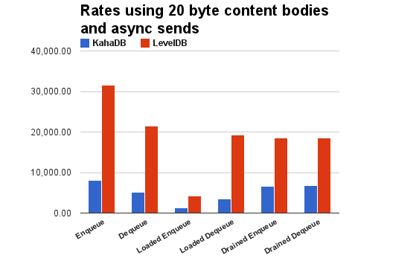
KahaDB vs LevelDB
A benchmark was run comparing KahaDB to LevelDB performance:
More details available at https://github.com/apache/activemq/tree/master/activemq-leveldb-store

Slide 27
FAQ

Slide 28
Can I run ActiveMQ on Azure SQL?
Run extensive test before you jump on it, here is why:
ActiveMQ codebase does not apply retry policy for database communication (e.g. polly), making it more vulnerable for transient errors when running against cloud database
ActiveMQ Repo is available at http://activemq.apache.org/source.html
Polly is available at https://github.com/aws/aws-sdk-java/tree/master/aws-java-sdk-polly
Azure SQL is not explicitly called out on ActiveMQ Persistent page
http://activemq.apache.org/source.html
Also, note messages are stored on a image type column on table ACTIVEMQ_MSGS in SQL Server, which is deprecated
https://docs.microsoft.com/en-us/sql/database-engine/deprecated-database-engine-features-in-sql-server-2016
Reference for .NET:
https://docs.microsoft.com/en-us/azure/sql-database/sql-database-connectivity-issues
Classes with evidence that there is no transient issues handling | Method
\activemq\activemq-jdbc-store\src\main\java\org\apache\activemq\store\jdbc\JDBCMessageStore.java | addMessage() removeMessage()
\activemq\activemq-jdbc-store\src\main\java\org\apache\activemq\store\jdbc\adapter\DefaultJDBCAdapter.java | doAddMessage() doRemoveMessage()

Slide 29
Can I run ActiveMQ on an Scale Set to achieve HADR through Master/Slave?
Yes, ideally a Scale Set with 2 nodes maximum, since there is only one master node at any given time
Make sure the heath probes are appropriate configure for all ports (e.g. 8161, etc.)

Slide 30
Troubleshooting

Slide 31
Logs
Logs are available on file activemq.log under \apache-activemq-5.15.2\data directory

Slide 32
Azure SQL Setup Error – Missing SQL Provider
SQL Server provider is not available due to wrong package org.apache.commons.dbcp.BasicDataSource instead of org.apache.commons.dbcp2.BasicDataSource, more details on thread below:
http://activemq.2283324.n4.nabble.com/ActiveMQ-JDBC-persistence-with-MSSql-td4701883.html
2018-01-17 00:59:17,126 | ERROR | Failed to load: class path resource [activemq.xml], reason: Line 83 in XML document from class path resource [activemq.xml] is invalid; nested exception is org.xml.sax.SAXParseException; lineNumber: 83; columnNumber: 95; cvc-complex-type.2.4.a: Invalid content was found starting with element '{"http://activemq.apache.org/schema/core":journaledJDBC}'. One of '{"http://activemq.apache.org/schema/core":jdbcPersistenceAdapter, "http://activemq.apache.org/schema/core":journalPersistenceAdapter, "http://activemq.apache.org/schema/core":kahaDB, "http://activemq.apache.org/schema/core":levelDB, "http://activemq.apache.org/schema/core":mKahaDB, "http://activemq.apache.org/schema/core":memoryPersistenceAdapter, "http://activemq.apache.org/schema/core":replicatedLevelDB, WC[##other:"http://activemq.apache.org/schema/core"]}' is expected. | org.apache.activemq.xbean.XBeanBrokerFactory | WrapperSimpleAppMain

Slide 33
Azure SQL Setup Error – maxActive
2018-01-17 01:19:41,472 | ERROR | Failed to load: class path resource [activemq.xml], reason: Error creating bean with name 'mssql-ds' defined in class path resource [activemq.xml]: Error setting property values; nested exception is org.springframework.beans.NotWritablePropertyException: Invalid property 'maxActive' of bean class [org.apache.commons.dbcp2.BasicDataSource]: Bean property 'maxActive' is not writable or has an invalid setter method. Does the parameter type of the setter match the return type of the getter? | org.apache.activemq.xbean.XBeanBrokerFactory | WrapperSimpleAppMain

