Slide 1
AI CUSTOMER RETENTION
& Decision Intelligence Platform
From 31 GB of Raw Data to a Production Decision Engine
Amey Parmarthi | ML Engineering Bootcamp Capstone
GitHub: github.com/aparmarthi/ai-customer-retention-mlops
Live API: ai-customer-retention-mlops.onrender.com/docs

Slide 2
The Business Problem
Every Subscription Business Faces Three Questions
?
Who will churn?
Ranked probability score for every subscriber
!
Who should we target?
Hybrid policy: budget-bounded top-K or ROI-optimal threshold
$
What's the financial impact?
Simulated net ROI under configurable cost assumptions
Model Probability --> Decision Policy --> Financial Outcome
AI Customer Retention Platform | Amey Parmarthi

Slide 3
The Data: 31 GB of Real KKBox Subscriptions
31 GB
~1M
1.24%
40
Raw Data Size
Subscribers
Churn Rate
Features Built
Property | Value
Raw data size | ~31 GB (4 tables)
Users | ~1 million subscribers
Time range | Jan 2015 -- Feb 2017
Tables | Members, Transactions, User Logs, Labels
Processed model table | 193,205 rows, ~40 features
Validation churn rate | 1.24% (severe class imbalance)
The full 31 GB was processed end-to-end -- not sampled, not approximated.
AI Customer Retention Platform | Amey Parmarthi

Slide 4
8-Step Reproducible ETL Pipeline
01
CSV to Parquet (3.4x compression)
02
Build user-month spine
DuckDB streaming
DuckDB SQL
03
Aggregate transactions
04
Aggregate user logs
DuckDB 2-stage
DuckDB 2-stage
05
Join all to model_table (118 MB)
06
Create sample data for CI
pandas
pandas
07
Derive recency/tenure/frequency
08
Create SageMaker subset
DuckDB
pandas
Why DuckDB? pandas would OOM on 29 GB user_logs.csv. DuckDB streams it with 4 GB RAM.
AI Customer Retention Platform | Amey Parmarthi

Slide 5
Time-Based Holdout (Not Random Split)
Random Split
Time-Based Holdout
ROC-AUC: 0.9875
PR-AUC: 0.8771
Churn rate: ~6%
Leaks temporal patterns
ROC-AUC: 0.9660
PR-AUC: 0.5392
Churn rate: 1.24%
Matches production conditions
Why time-based? Train on everything up to Jan 31, 2017. Validate on Feb 2017 (the future the model has never seen). This is how it works in production: you train on history and predict tomorrow. The lower time-based numbers are more honest.
AI Customer Retention Platform | Amey Parmarthi

Slide 6
12 Architectures Benchmarked
# | Model | PR-AUC | ROC-AUC | Train Time
1 | LightGBM (Champion) | 0.8887 | 0.9894 | ~3 min
2 | XGBoost | 0.8771 | 0.9875 | ~2 min
3 | CatBoost | 0.8737 | 0.9865 | ~3.7 min
4 | FT-Transformer | 0.8214 | 0.9824 | ~23 min
5 | Random Forest | 0.7935 | 0.9782 | ~5 min
6 | NODE | 0.7719 | 0.9737 | ~11 min
7 | TabNet | 0.5233 | 0.9085 | ~32 min
Also evaluated: Logistic Regression, Decision Tree, FLAML AutoML, Ensemble (12 total)
Why PR-AUC as primary metric? With 1.24% churn, ROC-AUC looks great (0.96+) even when the model wastes outreach budget. PR-AUC directly measures how well churners are concentrated at the top of the ranked list.
AI Customer Retention Platform | Amey Parmarthi

Slide 7
Champion: LightGBM + FLAML AutoML
0.9660
0.5392
43.5x
$17.7K
ROC-AUC
PR-AUC
Lift vs Base
Net ROI
FLAML independently confirmed LightGBM as the best architecture
Key Metrics
Key FLAML Discoveries
Precision @ top-10K: 18.0% (3x vs churn rate)
Recall @ top-10K: 75.0%
ROI-optimal: $17,666 (1,478 users targeted)
Train time: ~3 minutes
Inference: <10ms per record
num_leaves = 1,212 (vs manual 64)
Much deeper trees generalize better
reg_alpha = 0.56
Stronger L1 regularization
learning_rate = 0.036 (146 iterations)
AI Customer Retention Platform | Amey Parmarthi

Slide 8
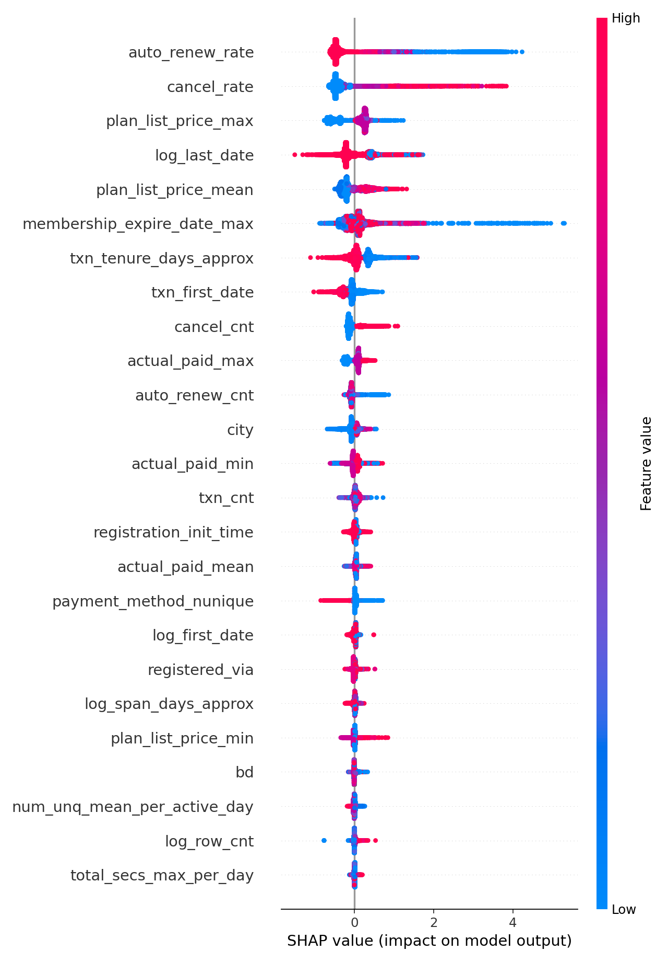
Top Churn Drivers -- Fully Explainable (SHAP)
Rank | Feature | Business Signal
1 | auto_renew_rate | Auto-renewal opt-in
2 | cancel_rate | Historical cancellations
3 | plan_list_price_max | Price sensitivity
4 | log_last_date | Recency of activity
5 | membership_expire_date_max | Subscription horizon
SHAP confirms the model learned causally plausible signals -- not spurious correlations. Every prediction is decomposable into per-feature contributions, enabling stakeholders to understand and trust the model's decisions.
AI Customer Retention Platform | Amey Parmarthi

Slide 9
Two Decision Policies -- Not Just Predictions
Policy 1: Ops-Friendly Top-K
Policy 2: ROI-Optimal Threshold
Target the top 10,000 highest-risk subscribers each month
Precision: 18% | Recall: 75%
Fixed budget, no threshold tuning needed
Target subscribers above probability 0.68
Precision: 70.6% | Contacts: 1,478
Net ROI: $17,666
Net ROI = (TP x save_rate x churn_cost) - (N_targeted x intervention_cost)
Scenario | Cost/Contact | Save Rate | Net Result
Low-cost outreach | $0.50 | 12% | ~$12,200
Incentive offers | $10.00 | 20% | Cost-sensitive
ROI-optimal threshold | $5.00 | 20% | $17,666
AI Customer Retention Platform | Amey Parmarthi

Slide 10
Full Experiment Governance (MLflow)
All 12 model runs tracked in MLflow experiment: kkbox_churn
Parameters
Split policy, feature version, all hyperparameters (auto-flattened)
Metrics
ROC-AUC, PR-AUC, F1, Precision@K, Recall@K
Artifacts
model.pkl, scored validation set, threshold sweep, SHAP plots
Key design: Atomic artifact bundles (every metric traces to exact data) | Split method audit trail | Standardized naming across all 12 experiments
AI Customer Retention Platform | Amey Parmarthi

Slide 11
Production API: FastAPI + Docker
Endpoint | Method | Purpose
/health | GET | Model status, artifact paths
/predict | POST | Single-record churn + threshold
/predict_batch | POST | Batch scoring (JSON/CSV) + top-K
Production Features
Pydantic validation
Two serving policies
Feature alignment
Structured logging
Prediction logging
16 pytest tests
docker compose up --build
API: localhost:8000/docs | Dashboard: localhost:8501
Live now: ai-customer-retention-mlops.onrender.com/docs
AI Customer Retention Platform | Amey Parmarthi

Slide 12
Stakeholder-Facing Dashboard (Streamlit)
[Insert: Screenshot of Streamlit app]
Single Prediction
Enter user features, get churn probability + action label
Batch Scoring
Upload CSV, score all users, download results with ranks
ROI Simulator
Adjust cost assumptions with sliders, see real-time ROI impact
The ROI Simulator lets non-technical stakeholders explore trade-offs without touching the model
AI Customer Retention Platform | Amey Parmarthi

Slide 13
Docker + GitHub Actions CI/CD
Docker Image (~400 MB)
CI/CD Pipeline (GitHub Actions)
python:3.11-slim base
Serving-only deps (requirements-serve.txt)
Non-root appuser (security)
HEALTHCHECK for orchestrators
Model artifacts frozen in image
1. TEST
pytest test_api.py (16 tests)
2. BUILD
Docker build + push to ECR
3. DEPLOY
ECS Fargate rolling deploy
git push main --> tests pass --> image built --> deployed --> ALB health check: /health
AI Customer Retention Platform | Amey Parmarthi

Slide 14
Cloud Training Validation (AWS SageMaker)
Local (Champion)
SageMaker (Validation)
ROC-AUC: 0.9660
PR-AUC: 0.5392
Purpose: Rapid iteration, 12 experiments
Cost: Free (local hardware)
ROC-AUC: 0.9484
PR-AUC: 0.4707
Purpose: Cloud workflow proof
Cost: Pay-per-minute EC2
One controlled job demonstrated:
S3 data ingestion (train channel)
Script Mode execution (train.py)
Artifact packaging (model.tar.gz --> S3)
Model Registry integration (versioned, approval-gated)
AI Customer Retention Platform | Amey Parmarthi

Slide 15
All-AWS Production Architecture
Data
Training
Serving
Monitoring
KKBox DB (31 GB)
DuckDB 8-step ETL
S3 Bucket
SageMaker LightGBM
MLflow Tracking
Model Registry
ECS Fargate (Docker)
FastAPI
ALB Load Balancer
CloudWatch Metrics
Latency / Errors / Drift
SNS Alerts
-->
-->
-->
CI/CD: GitHub Actions --> pytest --> Docker build --> ECR push --> ECS deploy
Estimated cost: ~$26/month at low-to-moderate inference volume
AI Customer Retention Platform | Amey Parmarthi

Slide 16
Monitoring & Model Care
Layer | What | How | Alert Threshold
Infrastructure | Latency, errors, memory | CloudWatch + ALB | p95 > 500ms
Model | Prediction drift | KS-test monthly | Mean shift > 2 std
Business | Precision@K, ROI | Actuals join (30-day lag) | ROC-AUC < 0.90
Retraining Triggers
Trigger | Condition | Response
Scheduled | Monthly | Full pipeline: pull --> train --> evaluate --> deploy
Performance | ROC-AUC < 0.90 | Emergency retrain within 48 hours
Drift | >3 features drifting (KS p<0.01) | Investigate, retrain if metrics degrade
Rollback: Every Docker image tagged with git SHA. ECS keeps previous task definitions. Rollback time: < 5 minutes.
AI Customer Retention Platform | Amey Parmarthi

Slide 17
From 1M Users to 1B
Scale | Users | Raw Data | Compute | Change Required
Current | 1M | 31 GB | DuckDB (local) | None
10x | 10M | 310 GB | DuckDB (local) | None
100x | 100M | 3 TB | Spark SQL | Swap engine
1000x | 1B | 31 TB | BigQuery/Spark | Swap engine
The architecture doesn't require redesign -- only swapping the execution engine.
The 2-stage aggregation pattern, Parquet format, and LightGBM all scale linearly. DuckDB handles 31 GB on a laptop today. Spark handles 31 TB in the cloud tomorrow. Same SQL, same feature logic.
AI Customer Retention Platform | Amey Parmarthi

Slide 18
Full-Stack ML Engineering Competencies
Data Engineering
Model Development
8-step pipeline, 31 GB DuckDB, Parquet storage
12 architectures, FLAML AutoML, time-based eval
MLOps
Evaluation
MLflow tracking, SageMaker validation, Model Registry
PR-AUC, threshold sweep, ROI simulation
Explainability
API Engineering
SHAP analysis, business signal mapping
FastAPI + Pydantic, two policies, 16 tests
Containerization
CI/CD
Docker slim, HEALTHCHECK, docker-compose
GitHub Actions: test --> build --> deploy
Cloud
Business Translation
SageMaker + Model Registry, ECS Fargate arch
ROI framework, cost scenarios, A/B design
AI Customer Retention Platform | Amey Parmarthi

Slide 19
LIVE DEMO
API (Swagger UI)
Dashboard (Streamlit)
1. Click POST /predict --> Try it out
2. Paste a feature record
3. See churn probability + action label
Tab 1: Single prediction with JSON
Tab 2: Upload CSV for batch scoring
Tab 3: ROI simulator with sliders
ai-customer-retention-mlops.onrender.com/docs
github.com/aparmarthi/ai-customer-retention-mlops
docker compose up --build
API: localhost:8000/docs | Dashboard: localhost:8501

Slide 20
KEY TAKEAWAYS
01
Deployment is harder than training
The model was done in Step 4. Steps 5-12 are everything else.
02
The right metric changes everything
Switching to PR-AUC under 1.24% imbalance changed which models looked good.
03
ML models don't make decisions -- policies do
A churn probability is useless without a targeting policy.
04
Scale decisions should be lazy
DuckDB handles 31 GB on a laptop. Choose the simplest tool that works today.
05
Build the infrastructure yourself
FastAPI + Docker + CI/CD from scratch forces understanding of every layer.
Thank You

