Slide 1
AtmoSync: Micro-Climate Analytics
Data Analytics Group - 5
By
Mameeth C
Aparna V
Malavika M
Lucky Aswal

Slide 2
Problem statements & use cases
Traditional supply chain analytics rely on standard transit times and macro-weather forecasts. They fail to track how real-time, hyper-local micro-climate shifts (e.g., sudden humidity spikes inside a specific shipping container) degrade agricultural commodities before they reach the market
USECASES:
A commodities trader at Infotact monitors the AtmoSync dashboard. The streaming pipeline detects that Container A's internal temperature has drifted, increasing the spoilage rate of the avocados inside.
The dashboard instantly calculates "Spoilage Arbitrage" and alerts the trader to reroute the shipment to a closer, secondary market—securing a premium price before the goods degrade below quality thresholds.

Slide 3
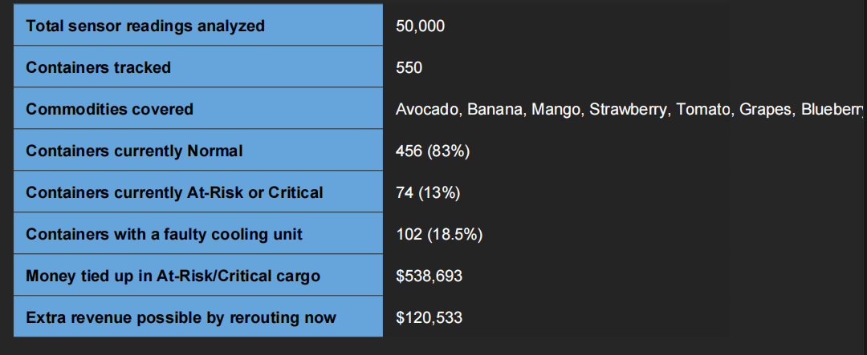
OverView
This report explains, in plain language, what the sensor data from 550 shipping containers (50,000 individual readings) tells us about cargo quality, spoilage risk, and money-saving reroute opportunities.

Slide 4
Step 1
1. Overall Fleet Health: What Shape Is the Cargo In?
Out of 550 containers currently being tracked, most cargo is travelling safely. But a meaningful slice needs attention right now:
456 containers (83%) are Normal — temperature and humidity are staying inside the safe range for that commodity.
20 containers are on Watch — starting to drift, worth keeping an eye on.
23 containers are At-Risk — quality has dropped enough that rerouting to a closer market is recommended.
51 containers are Critical — spoilage is advanced; an emergency discount sale is recommended before the cargo becomes worthless.

Slide 5
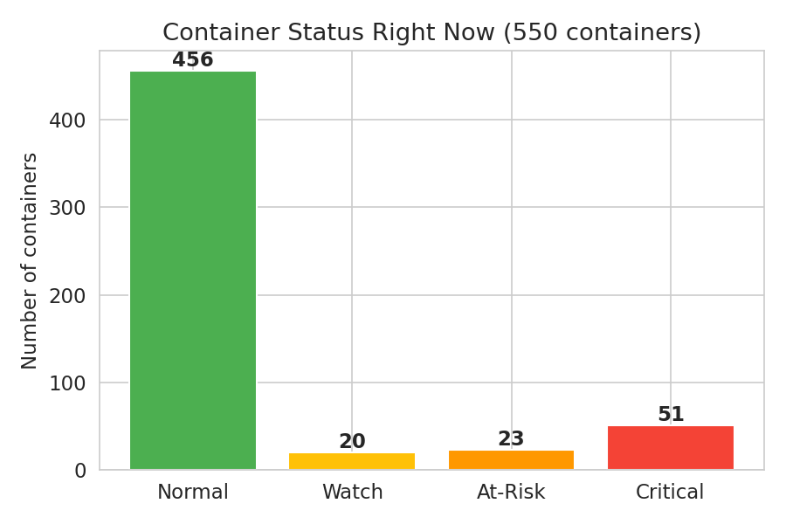
Bar Chat
Snapshot of every container's current status, based on its most recent sensor reading
In plain terms: about 1 in 8 containers currently need a business decision — either reroute them to a
nearer market or sell the goods off quickly at a discount before they spoil completely.

Slide 6
Step 2
2. What's Actually Causing the Spoilage?
We checked which sensor readings actually predict cargo quality dropping. Temperature turned out to be by far the biggest factor.
Temperature drift has a very strong negative relationship with quality (correlation of -0.84). The more a container's temperature strays outside the ideal band for that commodity, the faster the cargo's quality score
Low humidity also hurts quality, but less strongly (correlation of -0.61). Dry air speeds up spoilage, especially for delicate fruit like strawberries and grapes.
Vibration/rough handling showed almost no relationship with quality in this data (correlation close to 0) — meaning bumpy transport alone isn't what's spoiling this cargo; it's the climate control.

Slide 7
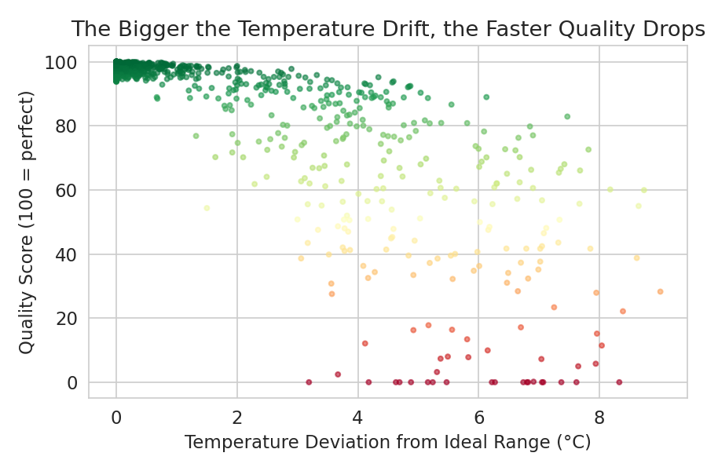
Scatter Chart
Each dot is one sensor reading. The further right (bigger temperature drift), the lower the quality score — the pattern is clear and consistent.
In plain terms: if you want to stop spoilage, the single most effective thing to fix is keeping temperature
inside the ideal band. That matters more than smoothing out humidity or avoiding bumps in the road.

Slide 8
Step 3
3. The Real Culprit: Faulty Cooling Units
We tagged which containers had a cooling unit that started failing partway through the trip. The difference in outcome is dramatic: Containers with a working cooling unit finished their trip with an average quality score of 96.6 / 100.
Containers with a faulty cooling unit finished with an average quality score of just 40.5 / 100 — well into spoiled territory.
Faulty units let the average temperature drift 1.99°C outside the safe range, versus only 0.03°C for healthy units.
102 of the 550 containers (18.5%) developed a cooling fault during transit.

Slide 9
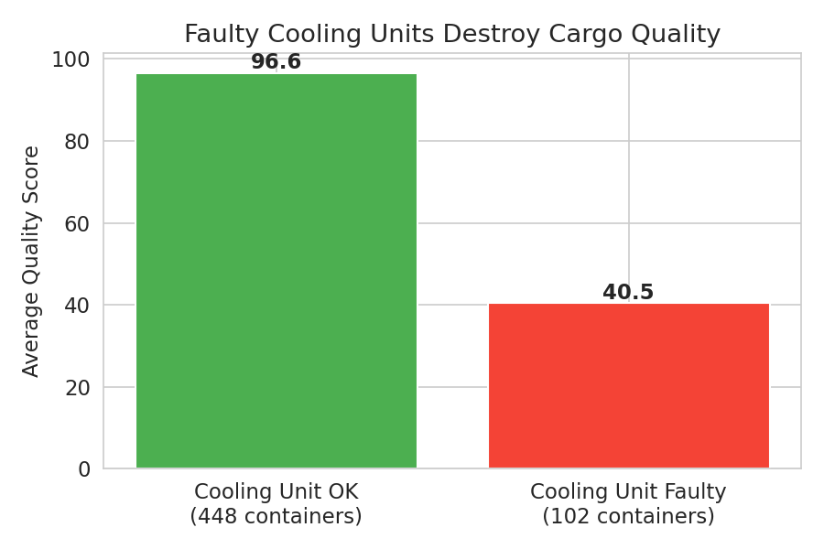
Bar chart
Average final quality score, containers with working vs. faulty cooling units.
In plain terms: a single mechanical fault (cooling unit failure) is responsible for almost all the serious
spoilage cases in this data. Catching a failing cooling unit early — before temperature drifts too far — is the
highest-value alert the dashboard can send.

Slide 10
Step 4
4. Which Commodities Are Most Vulnerable?
Some produce spoils faster than others when conditions aren't perfect, because their safe temperature/humidity windows are narrower.
Strawberries hold up worst — average quality score of only 76.8. They need a very tight 0-2°C range.
Grapes (81.2) and Blueberries (85.2) are also sensitive.
Tomatoes are the most forgiving — average quality score of 93.2 — they tolerate a wider temperature band.

Slide 11
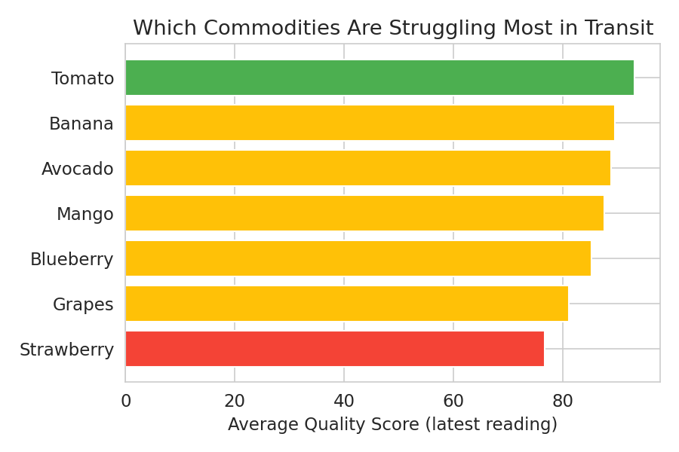
Bar chart
Average quality score by commodity type, across all 550 containers.
In plain terms: if resources are limited, prioritize the highest-precision cooling monitoring for strawberries,
grapes, and blueberries — they have the least room for error.

Slide 12
Step 5
5. The Money Question: Is Rerouting Worth It?
For every container, we compared the value of pushing on to the original (primary) market versus rerouting now to a closer (secondary) market at a slightly lower price per kg.
Across the 74 containers currently At-Risk or Critical, $538,693 worth of cargo (at primary-market pricing) is exposed to further spoilage.
If all 74 were rerouted to their secondary market right now, the combined realized value would be $659,226.
That's a combined gain of $120,533 — because arriving sooner (shorter distance) locks in a higher surviving quality, even though the secondary market's base price per kg is lower.
Only 59 of 550 containers overall currently show a positive arbitrage opportunity — meaning most cargo is still better off completing its original route. Rerouting is a targeted decision, not a blanket policy.

Slide 13
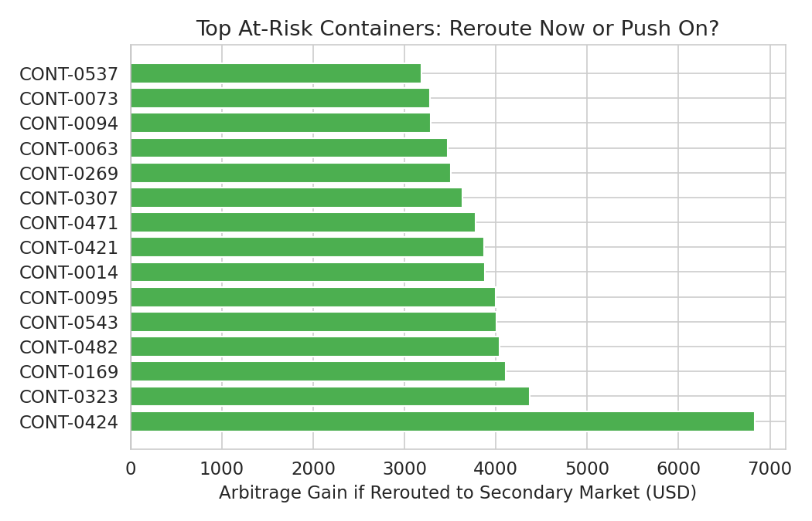
Bar Chart
Top 15 At-Risk/Critical containers ranked by how much extra money rerouting would earn (green = reroute is profitable, red = better to continue to primary market despite the risk status).
In plain terms: spoilage arbitrage isn't automatic — it only pays off once a container's quality has dropped far enough that the shorter trip to a nearby market preserves more value than the higher price at the original destination. The dashboard's job is to flag that crossover point for each container individually

Slide 14
Step 6
6. What This Means for the Dashboard
Priority alert: flag any container where temperature deviation starts climbing (even 1-2°C) — this is the earliest warning sign of a failing cooling unit, well before quality visibly drops.
Watch list: containers carrying strawberries, grapes, or blueberries deserve tighter alert thresholds than tomatoes or bananas.
Reroute recommendation: only surface a reroute suggestion when arbitrage_gain_usd is positive — don't reroute every At-Risk container by default, since 15 of the top 15 At-Risk/Critical containers still
show mixed results (see Figure 5).
Vibration: deprioritize vibration-based alerts for spoilage purposes — this data shows it isn't a meaningful driver of quality loss compared to temperature and humidity.

Slide 15
Tools we use
Python (Pandas,Numpy,Matplotlib seaborn)
Excel
Power BI

Slide 16
THANK YOU!!!

