Slide 1
Class Diagrams and Sequence Diagrams

Slide 2
Employee
Employee
Classes
Objects
Attributes
Operations
Name: Nirmala
Department: Defence
Title: Minister
✓
- Name:
- Department:
- Title:
✓
✓
Employee
+ Get Employee Name
+ Get Employee Department()
+ Get Employee Title ()
Name: Sushma
Department: External Affairs
Title: Minister
✓

Slide 3
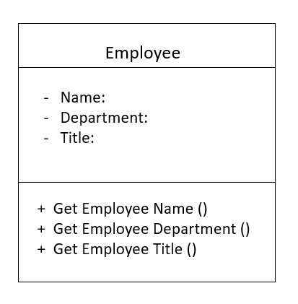
Employee
- nameOfTheEmployee:
- departmentOfTheEmployee:
- titleOfTheEmployee:
- employeeId
string
string
string
int [1..200] = 1
+ getEmployeeName () :
+ getEmployeeDepartment () :
+ getEmployeeTitle () :
+ getEmployeeId () :
string
string
string
int
ClassName
visibility attributeName : Type [multiplicity] = DefaultValue {property string}
visibility operationName {parameterName : Type} : ReturnType {property string}

Slide 4


Slide 5


What do I want to grow?
Food items!
Food items with vitamin content, nutrients and caloric equivalent!
I need a plan!
For gardening and then for growing.
I need to control the environment.
A heater, cooler and light?
And to measure them…temperature sensor?
Data is power.
Crop database!
I still need people
A Plan Maker
A Nutritionist

Slide 6
EnvironmentController
PlanAnalyst
Part of
Part of
Part of
relation
PlanMetrics
Heater
Cooler
Light

Slide 7

PlanAnalyst
EnvironmentController
Analyzes
PlanMetrics
Heater
Cooler
Light

Slide 8
FoodItem
Tomato
is a
is in
is in
VitaminContent
Nutrients

Slide 9
FoodItem
Tomato
VitaminContent
Nutrients

Slide 10
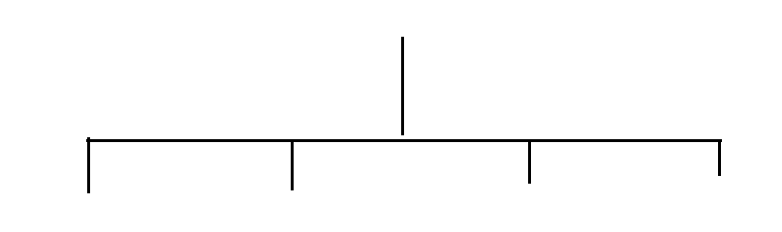
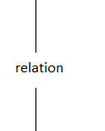
Relation between Classes
Association
Generalization
Aggregation
Composition
Someway related
Is a
Part of
Physically contains

Slide 11
Nutritionist
CropDatabase
contributor
infoSource
assistant
infoSource
lead
PlanAnalyst
Association end names
Association Directionality
userContributor

Slide 12
Employee
Crop
- nameOfTheEmployee:
- departmentOfTheEmployee:
- titleOfTheEmployee:
- employeeId
string
string
string
int [1..200] = 1
+ scientificName:
# yield:
- nutrientValue:
+ getEmployeeName () :
+ getEmployeeDepartment () :
+ getEmployeeTitle () :
+ getEmployeeId () :
string
string
string
int
Friendship mechanism:
To permit a class to distinguish certain privileged classes that are given the rights to see the class’s protected and private parts.
Public (+) Visible to any element that can see the class
Protected (#) Visible to other elements within the class and to subclass
Private (-) Visible to other elements within the class
Public (+) Accessible to all clients
Protected (#) Accessible only to the subclasses, friends or the class itself
Private (-) Accessible only to the class itself or its friends

Slide 13
Nutritionist
CropDatabase
contributor
-
+
infoSource
+
assistant
+
infoSource
+
lead
PlanAnalyst
userContributor
-
Public (+) Accessible to all clients
Protected (#) Accessible only to the subclasses, friends or the class itself
Private (-) Accessible only to the class itself or its friends

Slide 14
FoodItem
1 Exactly one
* Unlimited number (zero or more)
0..* Zero or more
1..* One or more
0..1 Zero through one
3..7 Three through seven
1
1
1..23
1
VitaminContent
CaloricEquivalent

Slide 15
PlanAnalyst
EnvironmentController
+staff
1..3
Multiplicity
*
*
*
+lead
0..1
1..3
Analyzes
1..*
1
1
*
PlanMetrics
Heater
Cooler
Light

Slide 16
Constraints
Plan
{system quantity = 0-7}
{incomplete, disjoint}
EnvironmentController
GrowingPlan
GardeningPlan
1..7
1..7
1..7
{xor}
1
1
*
{incomplete}
Heater
Cooler
Light
Complete
Incomplete
Disjoint
Overlapping
FruitGrowingPlan
{restart time >= (shutdown time + 5 minutes}}

Slide 17


Crop
Item
Set
+ scientificName:
# yield:
- nutrientValue:
«bind»
<Item -> GardeningPlan>
scientificName: retrieve from the crop database
PlanSet
Notes and Template Classes

Slide 18
: GardeningPlan
: Environmental
Controller
: Heater
: Cooler
setClimate()
getTemperature()
heat()
cool()
log()
destroy()
✗

Slide 19

: Object1
: Object2
Synchronous
Asynchronous
>
Return
Lost
●
Sequence Diagrams
Found
●
Destroy
✗

Slide 20
: GardeningPlan
: Environmental
Controller
: Heater
: Cooler
loop
getTemperature()
setClimate()
heat()
cool()
log()
destroy()
✗

Slide 21
“ The one and only place that a system is conceived is in the mind of the designer”

Slide 22
Electronics Circuit diagrams
Architecture Diagrams
Music Notes
Chemistry Symbols
Software Systems ???
UML (Unified Modelling Language)

Slide 23
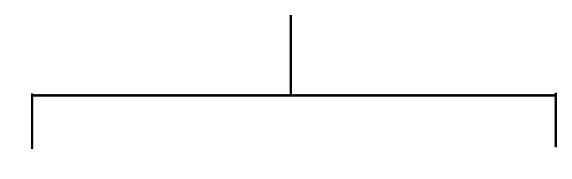

UML Diagrams
Structure Diagrams
Behavior Diagrams
Package Diagram
Class Diagram
Component Diagram
Deployment Diagram
Object Diagram
Composite Diagram
Use Case Diagram
Activity Diagram
State Machine Diagram
✓
Interaction Diagrams
✓
Sequence Diagram
Communication Diagram
Interaction Overview Diagram
Timing Diagram

Slide 24
Sources
Object-Oriented Analysis And Design With Applications - Grady Booch | Robert A. Marksimchuk | Michael W. Engle | Bobbi J. Young | Jim Conallen | Kelli A. Houston

