Slide 1
Weekly Report
24/01/2024
Aparna B G
BS-MS Student
School of Data Science

Slide 2
HAR using Wi-Fi Signals
TOPIC : Human Activity Recognition using Wi-Fi Signals
Improve the activity classification performance

Slide 3
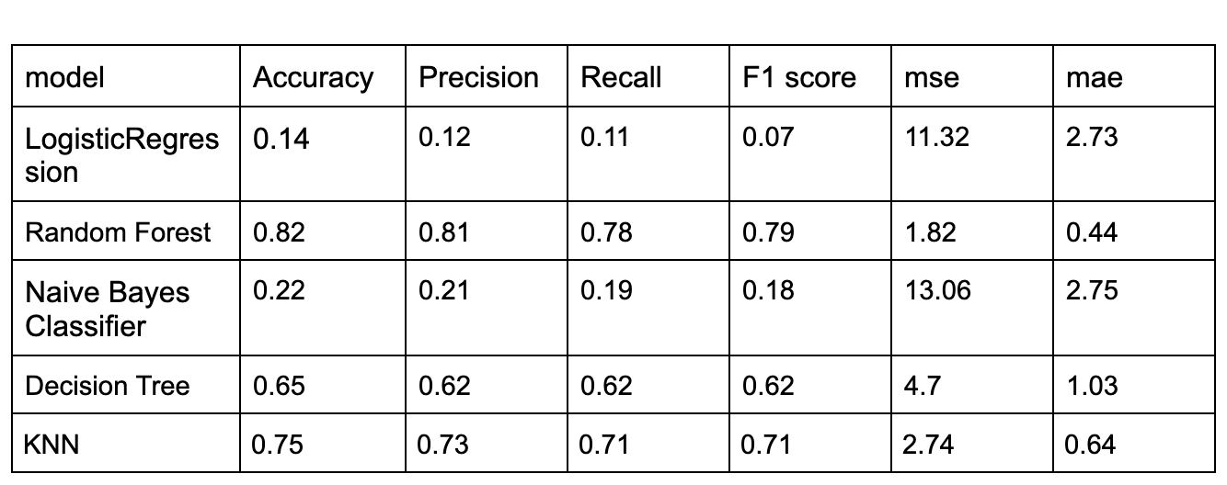
HAR using Wi-Fi Signals

Slide 4
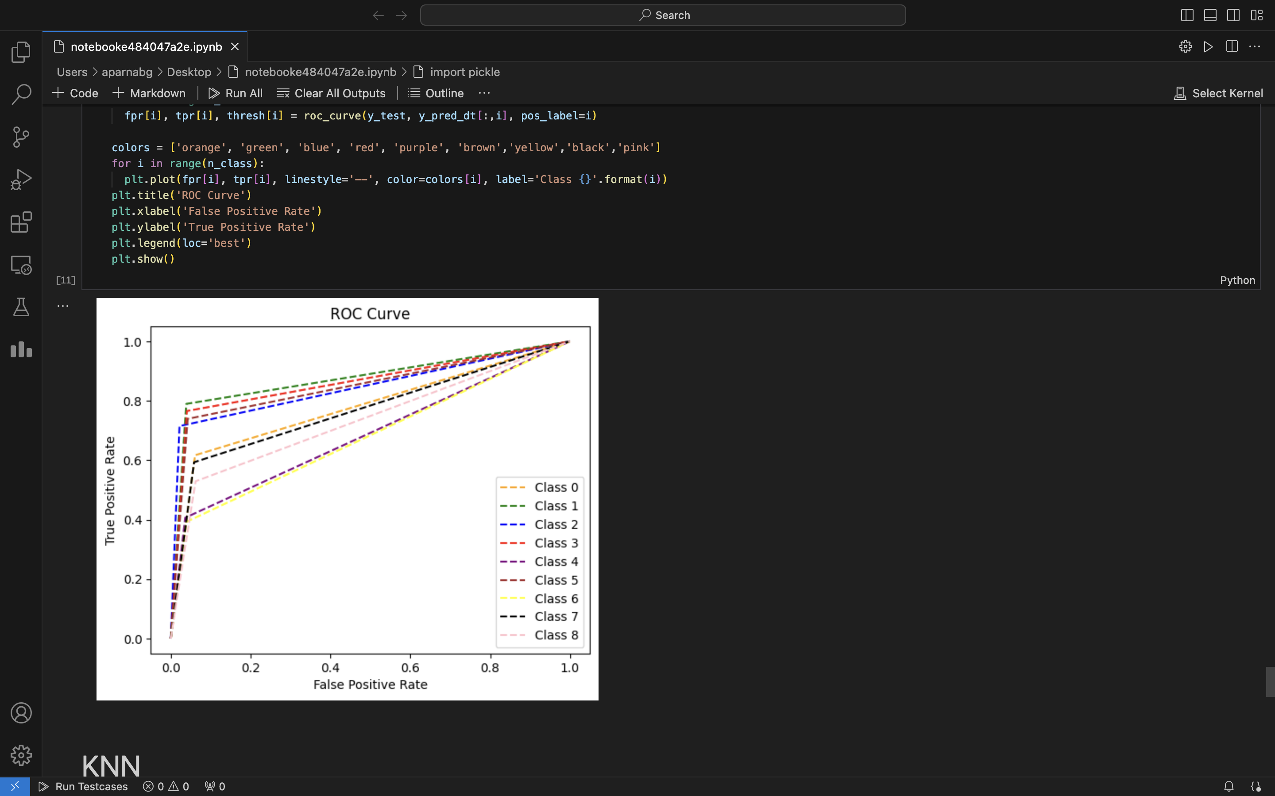
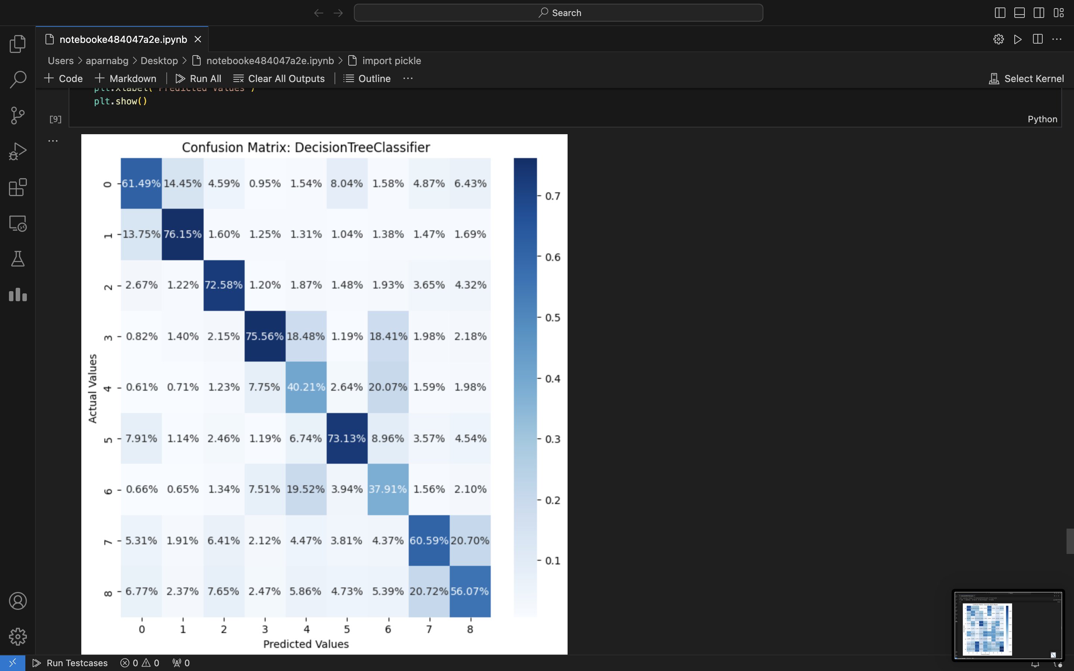
HAR using Wi-Fi Signals
Decision Tree

Slide 5
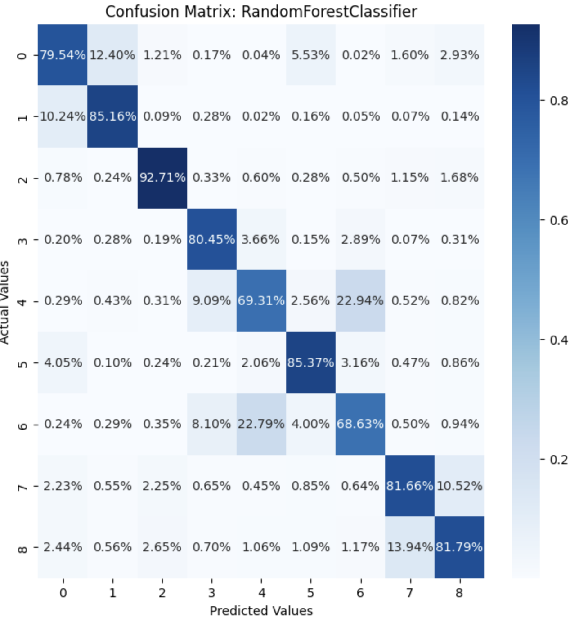
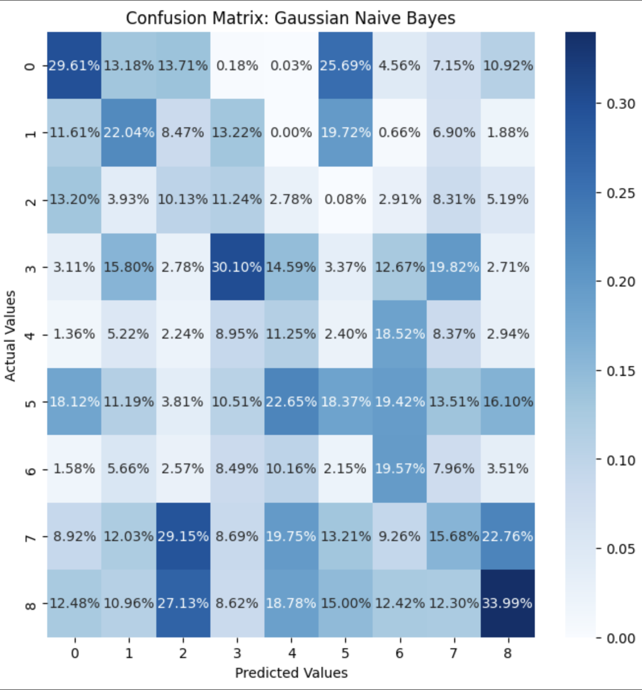
HAR using Wi-Fi Signals
Random Forest
Gaussian Naive Bayes

Slide 6
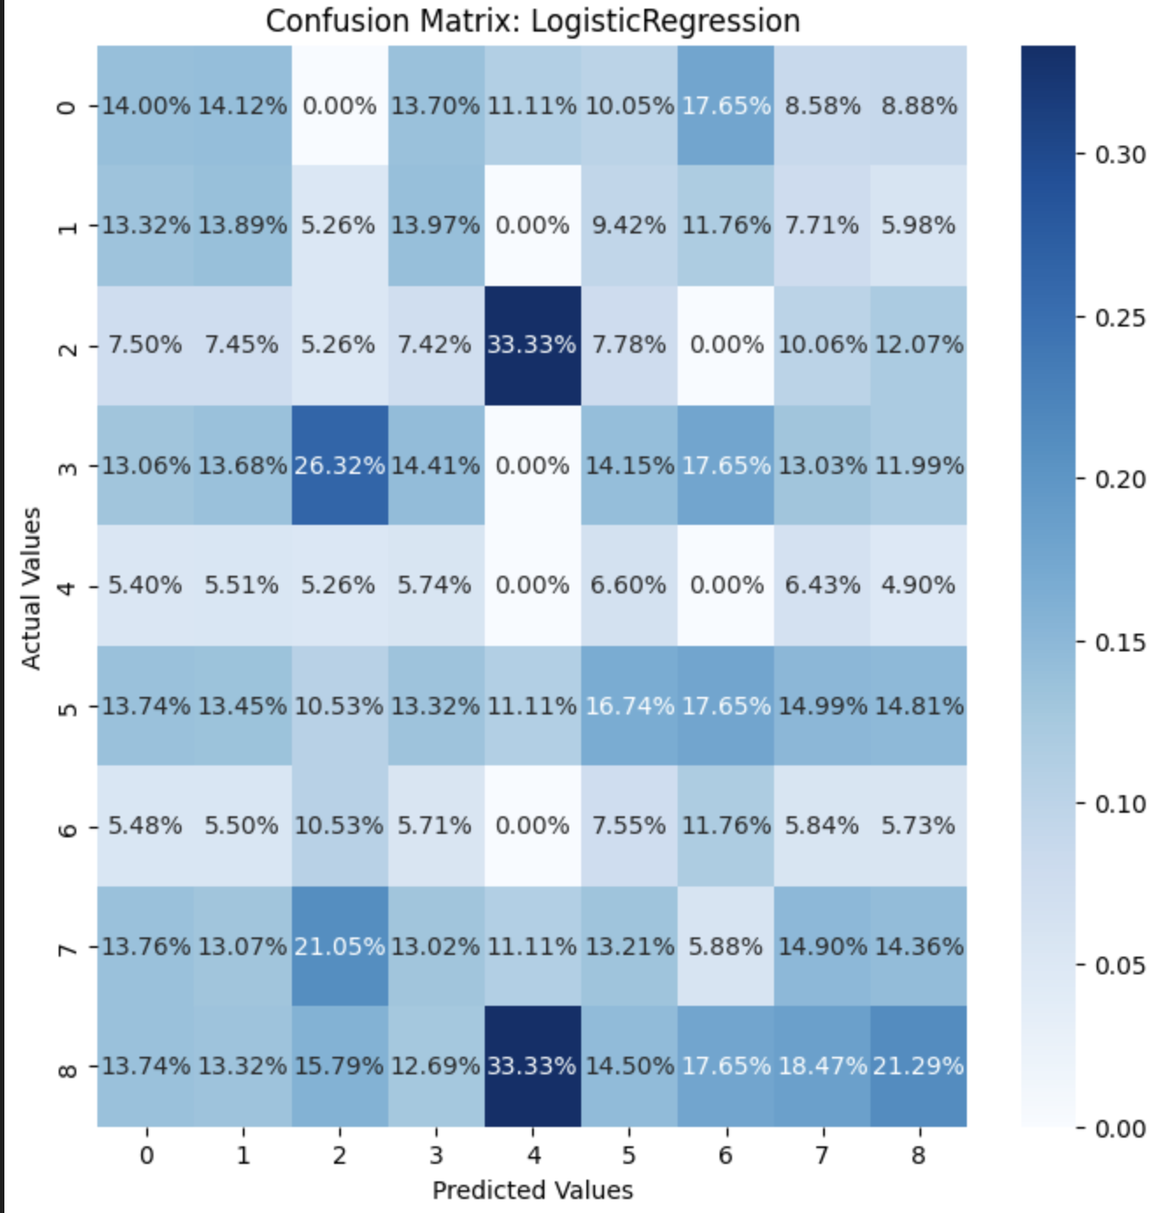
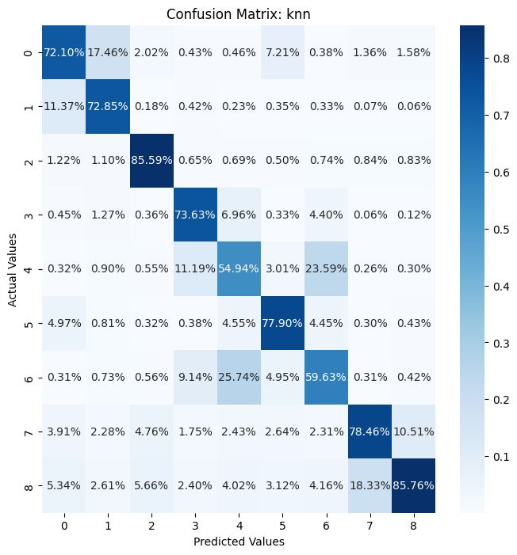
HAR using Wi-Fi Signals
Logistic Regression
KNN

Slide 7
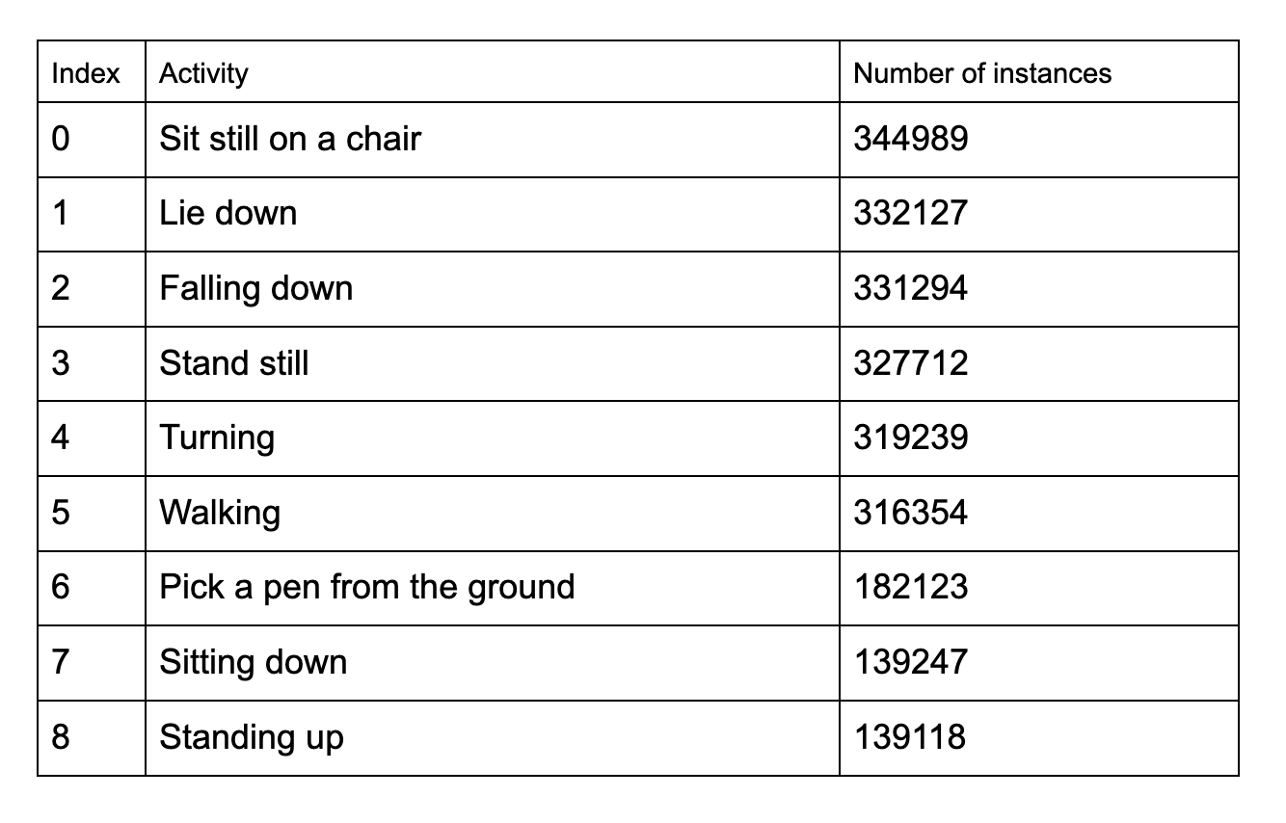
HAR using Wi-Fi Signals
Data set Information

