Slide 1

Warehouse
Inventory and
Reorder System
Name: Aparna Jha
Roll no: 2620030367
Team no: 15
Course: Problem Solving Using Programming (JAVA)
Submitted to: Ms. Swathi

Slide 2
PROJECT SUMMARY
Abstract
A Java application that tracks warehouse stock, values inventory, processes sales, and flags low stock before it runs out.
Product records
Stock value
Stores product details such as ID, name, quantity, and price.
Calculates total stock value across all products.
Sales processing
Low-stock warnings
Reduces stock quantities when sales are recorded.
Warns when a product falls to its reorder level.
Notes:
Introduce the Warehouse Inventory and Reorder System as a Java application that records products, calculates stock value, processes sales, and warns about low stock.

Slide 3
PROBLEM STATEMENT
Understanding the Problem Statement
Manual stock handling creates errors, slow reorders, and weak lookup.
Manual records
Delayed reorder decisions
Paper or scattered records make stock levels hard to trust.
Low stock is noticed late, so reorders happen after shortages begin.
Validation and search
One storage structure
Invalid entries and slow searches make stock data difficult to use.
Products need one structure for fast storage, lookup, and duplicate checks.
Notes:
Explain the four problems the system must solve: manual records, delayed reorder decisions, difficult validation and search, and the need for one product storage and lookup structure.

Slide 4
PROJECT OVERVIEW
Record
Calculate
A Java system for smarter stock decisions
Product ID, name, price, quantity, and reorder level.
Total stock value and remaining quantity after sales.
Warn
Build
Low stock creates an immediate reorder warning.
Foundational Java, classes, strings, and the Collections Framework.
A compact program that turns product records into stock actions.

Slide 5
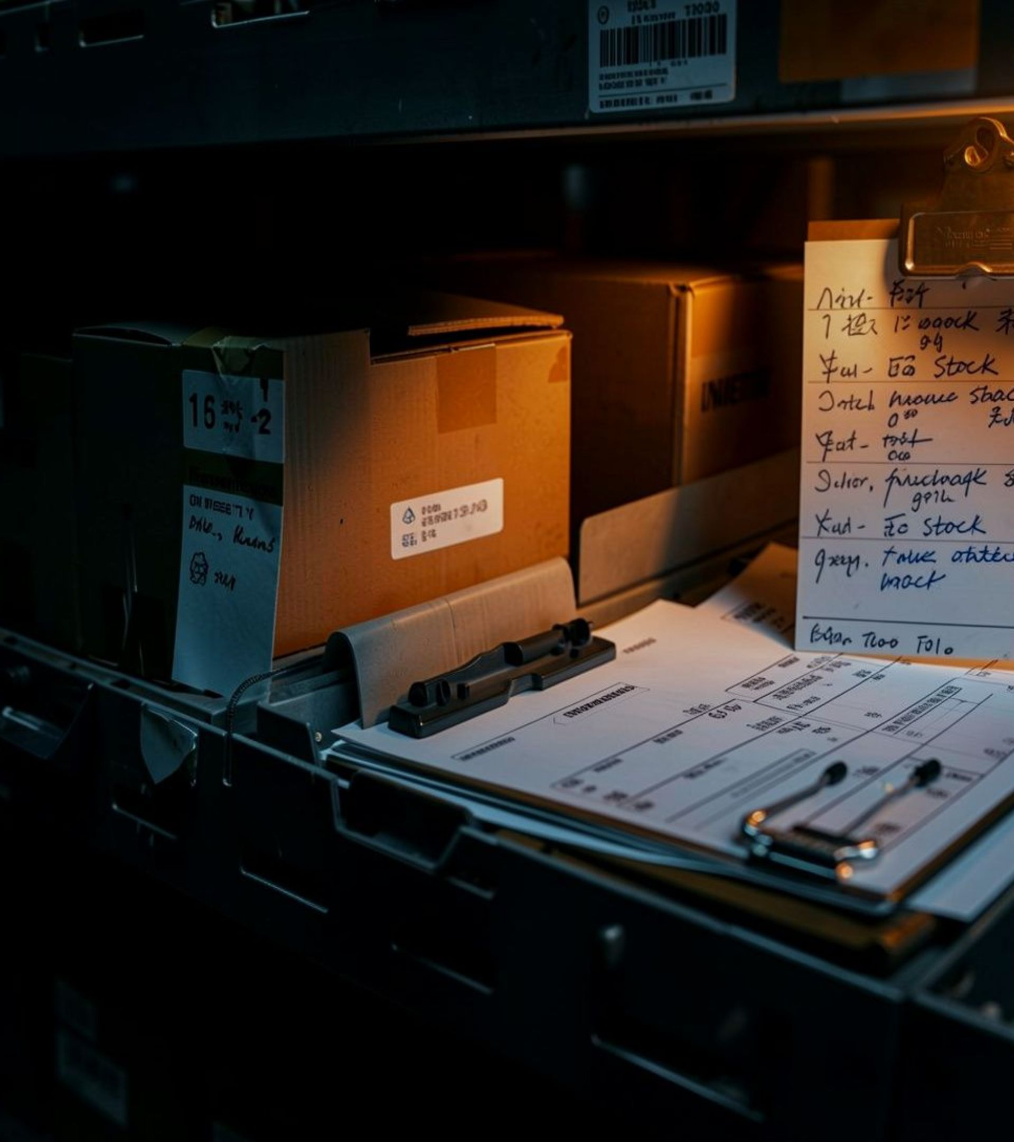
THE OPERATIONAL GAP
The problem is operational, not just computational
Manual records
Stock levels are harder to validate and search.
Late reaction
Low stock needs an immediate reorder warning.
Scattered records
Products need one structure for storage, lookup, and updates.

Slide 6
SYSTEM FLOW
One flow connects input to reorder action
01
02
03
04
05
Collect
Validate
Store
Act
Search
Collect product details through Scanner input.
Reject duplicate IDs, empty names, and negative values.
Store products in a List, unique IDs in a Set, and ID lookups in a Map.
Calculate stock value, process a sale, and compare quantity with reorder level.
Search by product name and display the result.

Slide 7



CO 1 · FOUNDATIONS
CO 1 turns warehouse logic into Java decisions
Variables & data types
Operators
Calculate stock value and remaining quantity.
Hold product details.
Final intREORDERLevel = 10;
Int quantity = scanner.nextInt();
String status = (quantity <REORDERLevel) ?
double totalValue = price * quantity;
boolean reorder = quantity <= reorderLevel;
Loops
Process multiple products.

Slide 8
CO 2 · CONTROL FLOW
CO 2 controls repetition and validation
The program repeats the work while protecting the records.
for
if
while-style flow
Repeats product entry and product display.
Rejects duplicate IDs, empty names, and invalid values.
Supports the input and sales flow through repetition and selection.
if (productIds.contains(id)) { i--; continue; }

Slide 9
CO 3 · DECOMPOSITION
CO 3 decomposes the program into reusable operations
CLASS
METHODS
OBJECT
WarehouseProduct
Reusable operations
One record
Groups fields and related behavior in one class.
Calculate total value, check reorder status, and display details.
Each object represents one product record.
double getTotalValue() { return price * quantity; }

Slide 10
CO 4 · OBJECT MODEL
CONSTRUCTOR
ENCAPSULATION
WarehouseProduct()
Product behavior
Initializes product ID, name, price, quantity, and reorder level.
Keeps product calculations with the product object.
CO 4 – Object-Oriented Modelling, Design & Exception Handling
DECISION METHOD
needsReorder()
Returns true when quantity is at or below the reorder level.
boolean needsReorder() { return quantity <= reorderLevel; }

Slide 11




CO 5 · STRINGS & VALIDATION
CO 5 makes product data searchable and valid
trim()
isEmpty()
Removes surrounding spaces from product names.
Rejects a missing product name.
String name = sc.nextLine().trim();
equalsIgnoreCase()
Current boundary
Finds a product without requiring exact capitalization.
The revised implementation does not yet save records to a file or database.
product.productName.equalsIgnoreCase(searchName)

Slide 12
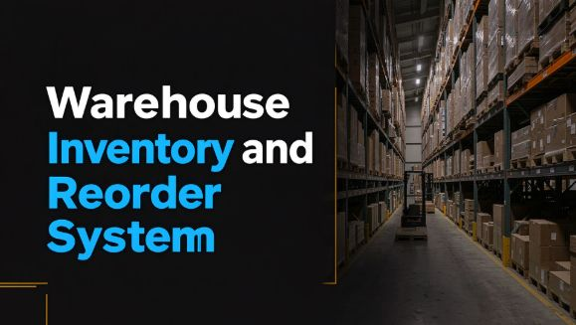
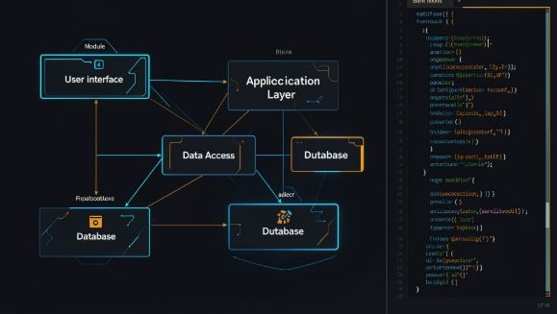
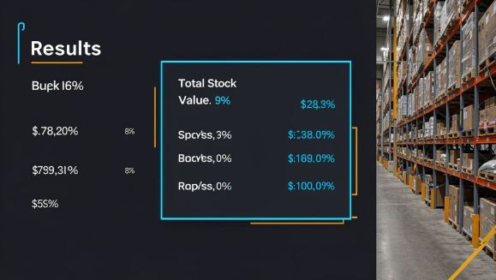
CO 6 · COLLECTIONS FRAMEWORK
CO 6 uses collections for flexible product storage
Three structures, three jobs. Streams and lambda expressions are not part of this version.
System context
Module architecture
Evidence gallery
List
Set
Map
Stores product objects.
Prevents duplicate product IDs.
Connects each ID to its product for fast lookup.
List<WarehouseProduct> products = new ArrayList<>();
Set<Integer> productIds = new HashSet<>();
Map<Integer, WarehouseProduct> productMap = new HashMap<>();

Slide 13
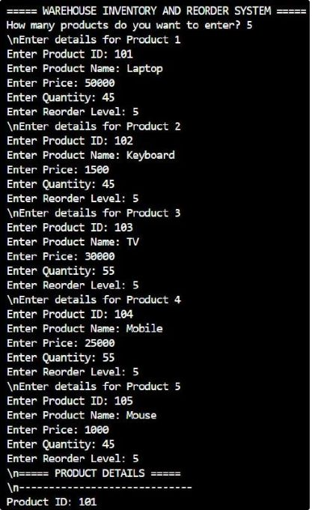
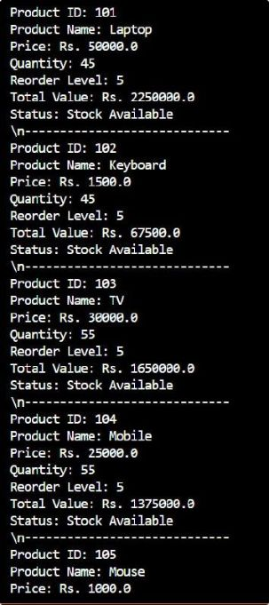
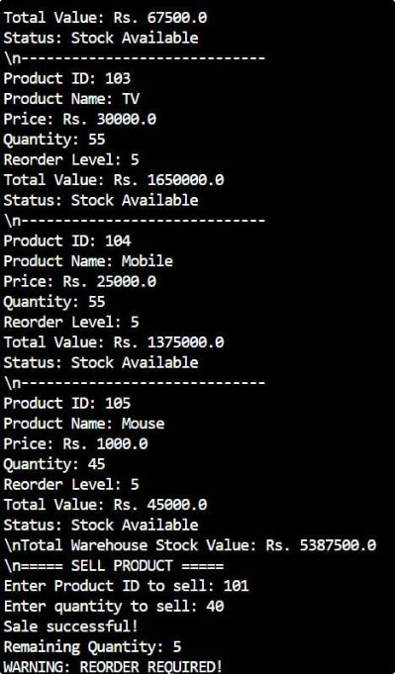
EVIDENCE GALLERY
Output
Screenshots of the running Warehouse Inventory and Reorder System.
Notes:
Walk through the three screenshots as evidence of the system's output before the conclusion.

Slide 14
PROJECT SUMMARY
Conclusion
Java fundamentals, object-oriented modelling, string validation, and the Collections Framework combine into one inventory system.
What the system does
Future improvements
The system stores product details, calculates stock value, processes sales, supports product searching, and identifies low-stock items that need reordering.
In the future, we can improve the project by adding permanent data storage using a file or database, developing a graphical user interface, adding supplier management, generating inventory reports, and introducing role-based access.
Notes:
Summarize how the Java concepts from each CO combine into the Warehouse Inventory and Reorder System, then close with the planned future improvements.

