Slide 1

MentorBot
BYTE WARRIORS
Rahul Venkatesh
Ferran Sulaimann
Aparna Krishnan
Keerthisree Raghu

Slide 2
“I want to learn something new but I don’t know where to start.”

Slide 3

If this sounds familiar, just know that you’re not alone. We get it.
For the thousands of students out there who aspire to achieve greatness, but simply don’t know how to take the first step…
Or the next step…
Or the step after that...
MentorBot has you covered.

Slide 4
MentorBot is an interactive virtual tutor which is designed to help students achieve self-growth as well as global sustainability by guiding them in the right direction on their journey towards learning and subsequent application of knowledge.

Slide 5

THEMES
Sustainable Education
Community Building

Slide 6
Key Features
COURSES
Students who want to learn a subject, language, or framework will be provided with a curated list of courses to select, based on the user-provided ratings of the courses from a variety of online course providers.
INTERNSHIPS
Once the student believes that they have achieved proficiency in the subject of their choice, they can opt to receive guidance on choosing an internship based on its relevance to their subject of study and availability.

Slide 7
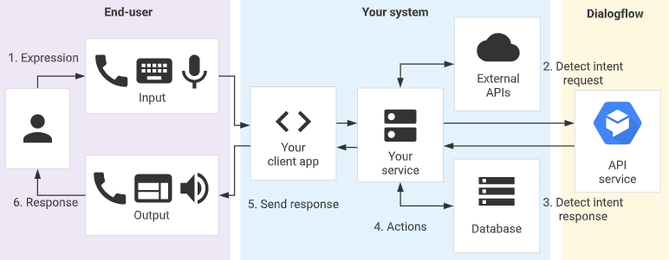




Architecture

Slide 8

Technology Stack
Front-end: Android Application
Chatbot Framework: Dialogflow
Back-end: Node.js
Server: Express
Scraping Tool: Request, Cheerio
Database: MongoDB

Slide 9
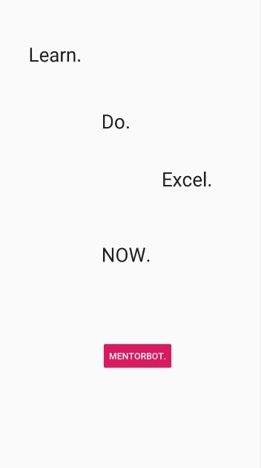
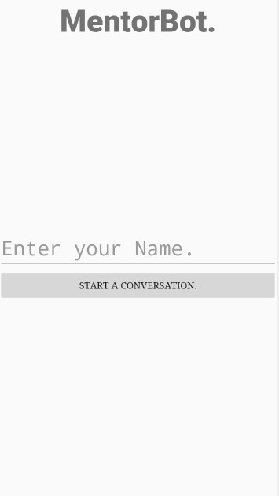
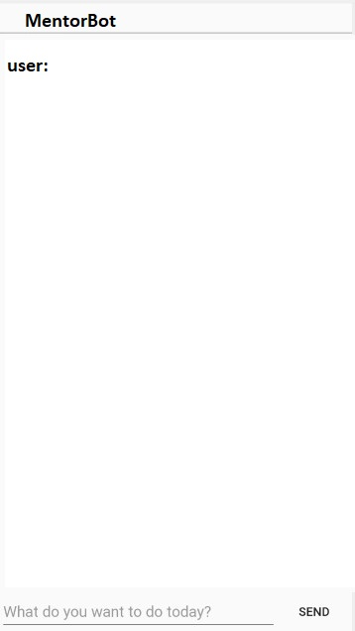

Slide 10

Future Scope
PREMIUM FEATURES
Course Completion Scheduler
Interactive Progress Tracking
Tips, Tricks, and Tests
SCOPE FOR EXPANSION
Real-time suggestion of pertinent technical topics to students as prompts for future study.
Building learning groups with like-minded students studying similar topics.
eal-time suggestion of pertinent technical topics.

