Slide 1
Modeling Uncertainty in Diabetes Incidence by Race in the United States
Aparna Marathe, Beza Delelegn,
Karolina Naranjo-Velasco, Hannah Schmuckler
December 10, 2021
Notes:
Aparna Marathe(am7ad)
Beza Delelegn(bmd5bc)
Hannah Schmuckler(mmc4cv)
Karolina Naranjo-Velasco(kn3cs)

Slide 2
Problem Description
Prevalence: 10% of the US population had diabetes (2018)
Undiagnosed: 34.2 million adults with diabetes, 7.3 million were undiagnosed.
Prediabetes: 88 million Americans age 18 and older had prediabetes (2015)
Why race/ethnicity matters? : 77% higher for African Americans, 66% higher for Latinos/Hispanics, 18% higher for Asian Americans
Approach: Logistic classification tool to predict the incidence of diabetes by race

Slide 3
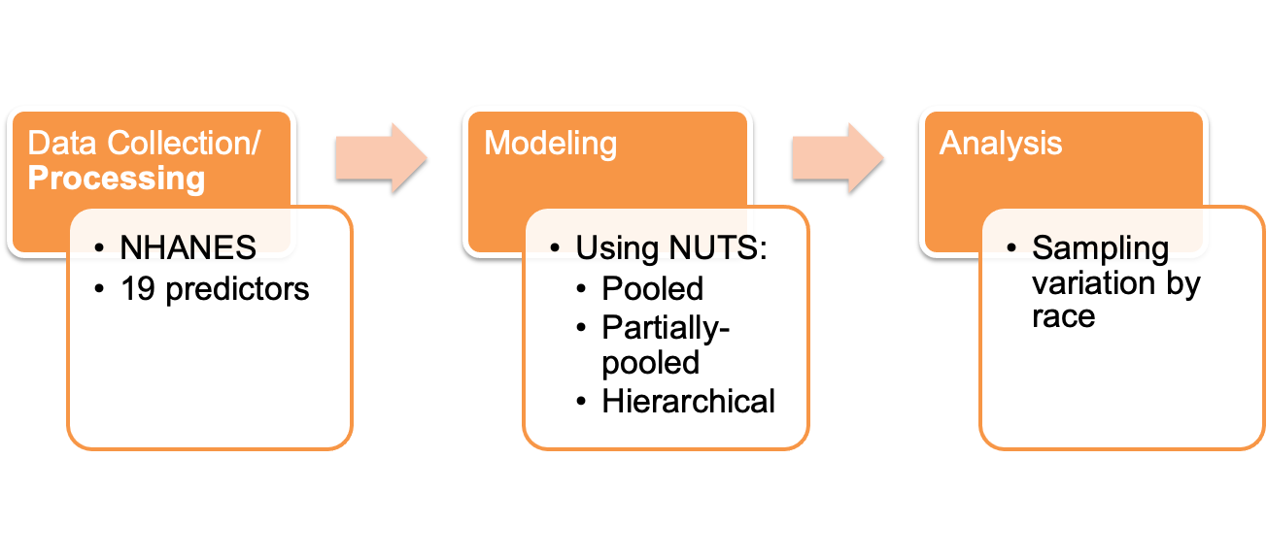
Methodology

Slide 4
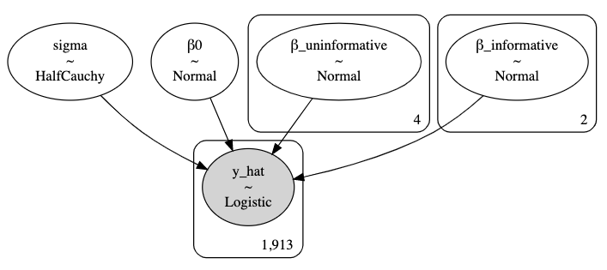
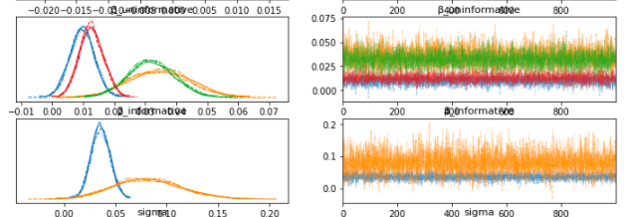
Pooled Model
HC~(5)
N~(0, 1)
N~(0, 100)
N~(1, 2)

Slide 5
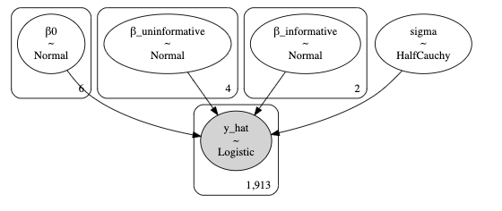
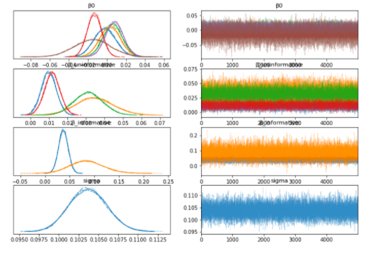
Partially-Pooled Model
Results:
N~(0, 1)
N~(0, 100)
N~(1, 2)
HC~(5)

Slide 6
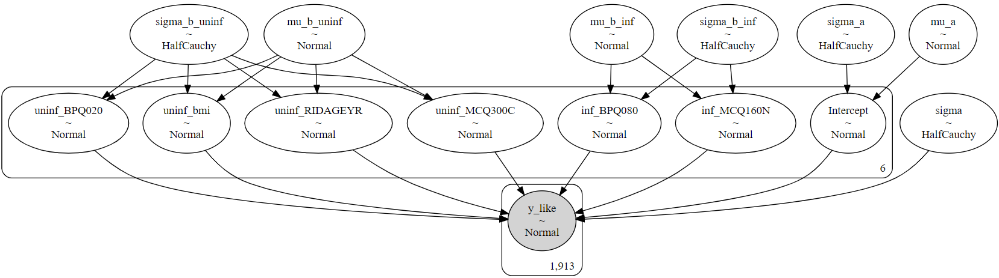
Hierarchical Model
HC~(10e5)
N~(0, 10e5)
N~(1, 2)
HC~(10e5)
HC~(10e5)
N~(1, 2)
N~(0, 10e5)

Slide 7
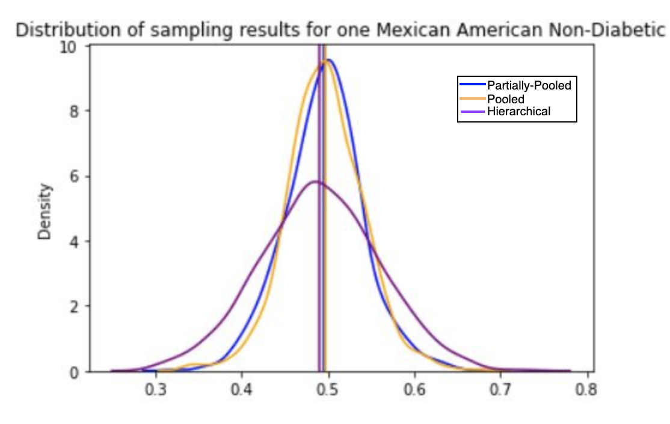
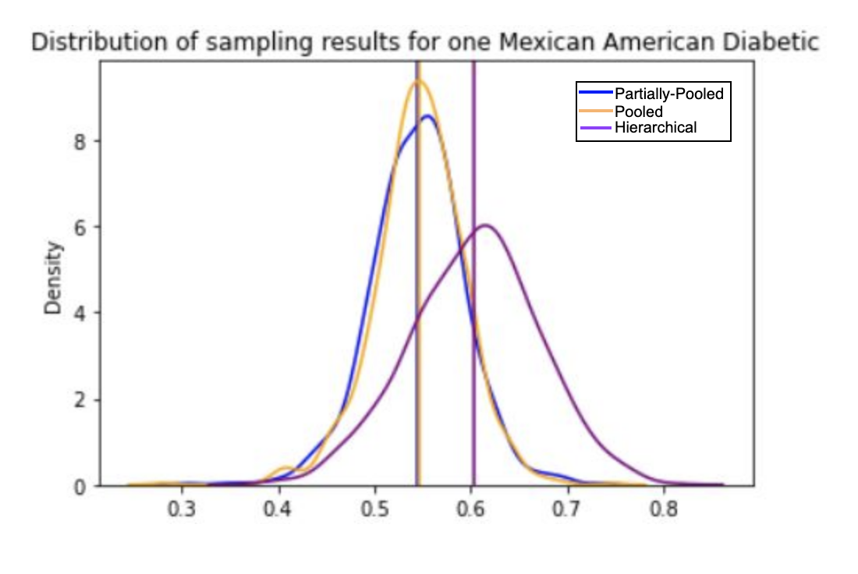
Results by Race: Mexican American
Distribution of Sampling Results for one Mexican American Non-Diabetic individual
Distribution of Sampling Results for one Mexican American Diabetic individual

Slide 8
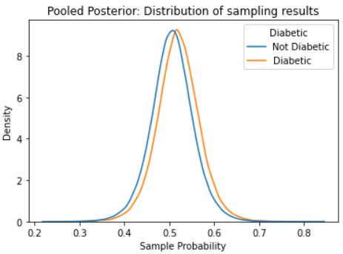
Pooled Predictions

Slide 9
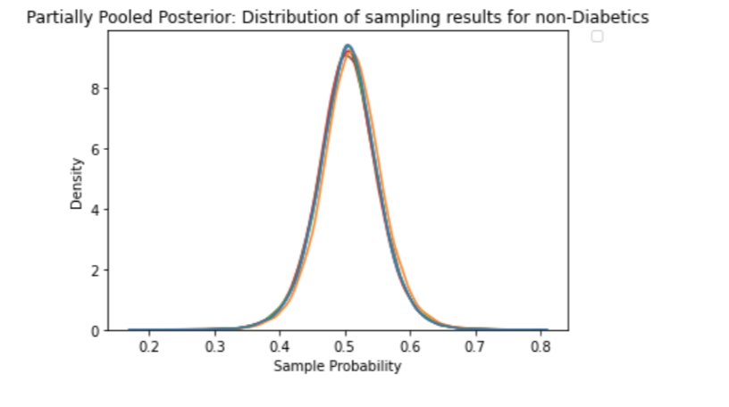
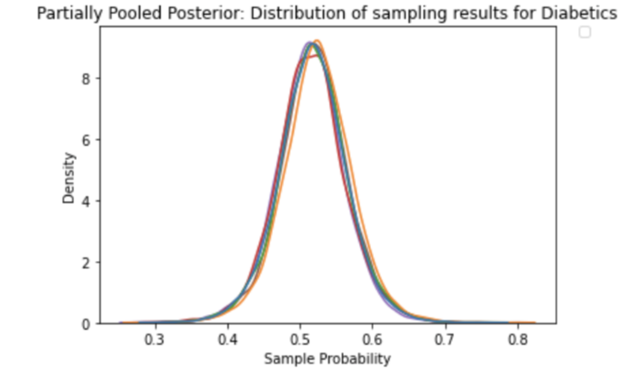
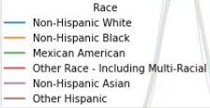
Partially-Pooled Predictions

Slide 10
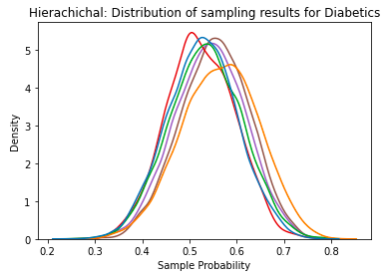
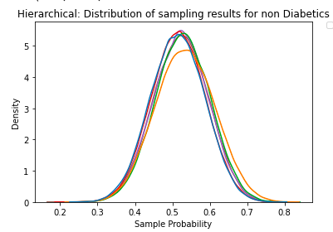
Hierarchical Predictions

Slide 11
Results
Pooled:
False Positive Rate: 67.92%
False Negative Rate: 1.92%
Partially Pooled:
False Positive Rate: 66.04%;
False Negative Rate: 1.92%
Hierarchical:
False Positive Rate: 71.53%;
False Negative Rate: 1.61%

Slide 12
Conclusions
There is significantly more variance in the hierarchical predictions than the pooled or partially pooled models, but this does not significantly negatively impact model performance.
The hierarchical model best captures the increased likelihood of diabetes for minorities.
All of these models would be useful for identifying additional individuals who are at high risk for diabetes in the US.

Slide 13
References
“Statistics About Diabetes | ADA.”American Diabetes Association, https://www.diabetes.org/resources/statistics/statistics-about-diabetes. Accessed 6 December 2021.
Meng, Ying-Ying et al. “Racial and Ethnic Disparities in Diabetes Care and Impact of Vendor-Based Disease Management Programs.” Diabetes Care, vol. 2016;39:743–749, no. 39, 2016, pp. 743–749. American Diabetes Association, https://care.diabetesjournals.org/content/39/5/743.full-text.pdf.
“NHANES 2005-2006: Diabetes Data Documentation, Codebook, and Frequencies.” Centers for Disease Control and Prevention, Centers for Disease Control and Prevention, https://wwwn.cdc.gov/Nchs/Nhanes/2005-2006/DIQ_D.htm.
“Cholesterol and Diabetes.” Www.heart.org, https://www.heart.org/en/health-topics/diabetes/diabetes-complications-and-risks/cholesterol-abnormalities--diabetes.
Tung, Yi-Ching, et al. “Association between Gout and Incident Type 2 Diabetes Mellitus: A Retrospective Cohort Study.” The American Journal of Medicine, vol. 129, no. 11, 2016, https://doi.org/10.1016/j.amjmed.2016.06.041.
Biondi, Bernadette, et al. “Thyroid Dysfunction and Diabetes Mellitus: Two Closely Associated Disorders.” Endocrine Reviews, vol. 40, no. 3, 2019, pp. 789–824., https://doi.org/10.1210/er.2018-00163.

