Slide 1
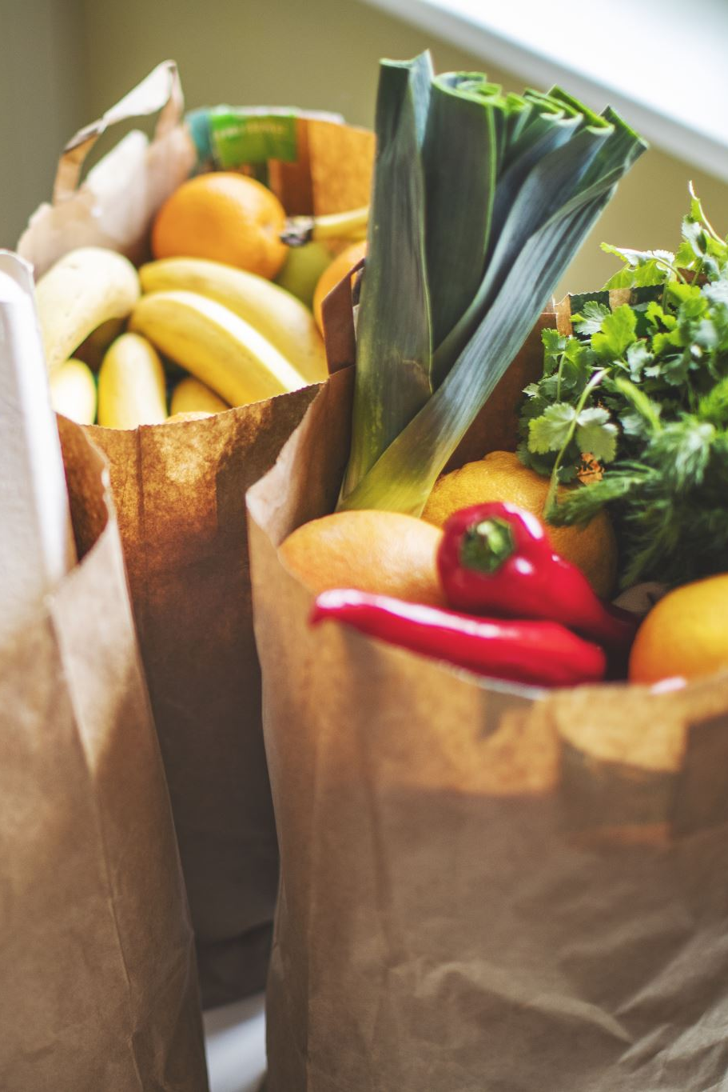
Food Waste Management in Hotels
Reducing Waste, Controlling Costs & Building a Sustainable Future
Presented by Archana M S | Joel Abraham
Grand Hyatt Kochi Bolgatty

Slide 2

Why Food Waste Matters
Food waste is one of the biggest operational challenges in the hospitality industry.
Luxury hotels prepare food in large quantities to maintain guest satisfaction, but inaccurate forecasting, overproduction and inefficient handling result in unnecessary waste.
Impact of Food Waste:
• Hotel profitability
• Food cost percentage
• Environmental sustainability
• Resource utilization
• Brand reputation
2

Slide 3
Where Food Waste Occurs
Receiving
Storage
• Damaged or poor-quality deliveries
• Incorrect ordering
• Short shelf-life products
• Improper temperature control
• Expired inventory
• Poor stock rotation
Preparation
Service
• Excessive trimming
• Poor knife skills
• Incorrect portioning
• Buffet leftovers
• Plate waste
• Overproduction during peak hours
3

Slide 4
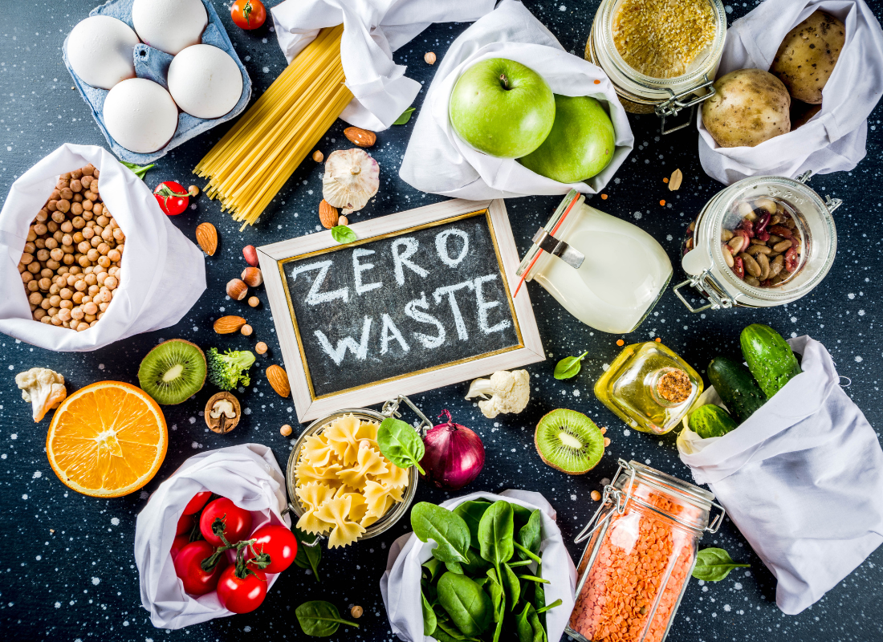
Root Causes of Food Waste
• Inaccurate demand forecasting
• Overstocking of ingredients
• Large buffet displays
• Standard recipes not followed
• Improper inventory management
• Lack of staff awareness
• Poor communication between departments
4

Slide 5
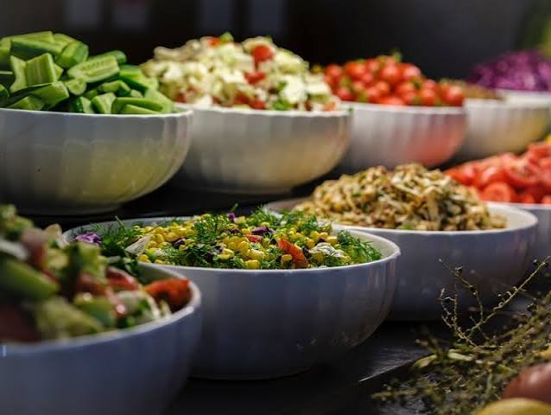
Cost Impact of Food Waste
Hidden Costs Include
• Raw material cost
• Labour in preparation
• Energy & water consumption
• Waste disposal expenses
• Reduced operating profit
Key Insight
Even a small reduction in waste can significantly improve food cost control and overall profitability
5

Slide 6
Food Waste & Pricing
Higher Waste Leads To
• Increased production cost
• Higher menu pricing
• Reduced profit margins
• Lower operational efficiency
Solution
Reducing waste helps hotels maintain competitive pricing while protecting profitability
6

Slide 7
Waste Reduction Techniques
• Accurate demand forecasting
• FIFO (First In, First Out) inventory management
• Standardized recipes and procedures
• Portion control measures
• Proper storage practices
• Daily waste monitoring
• Staff training and awareness programs
7

Slide 8
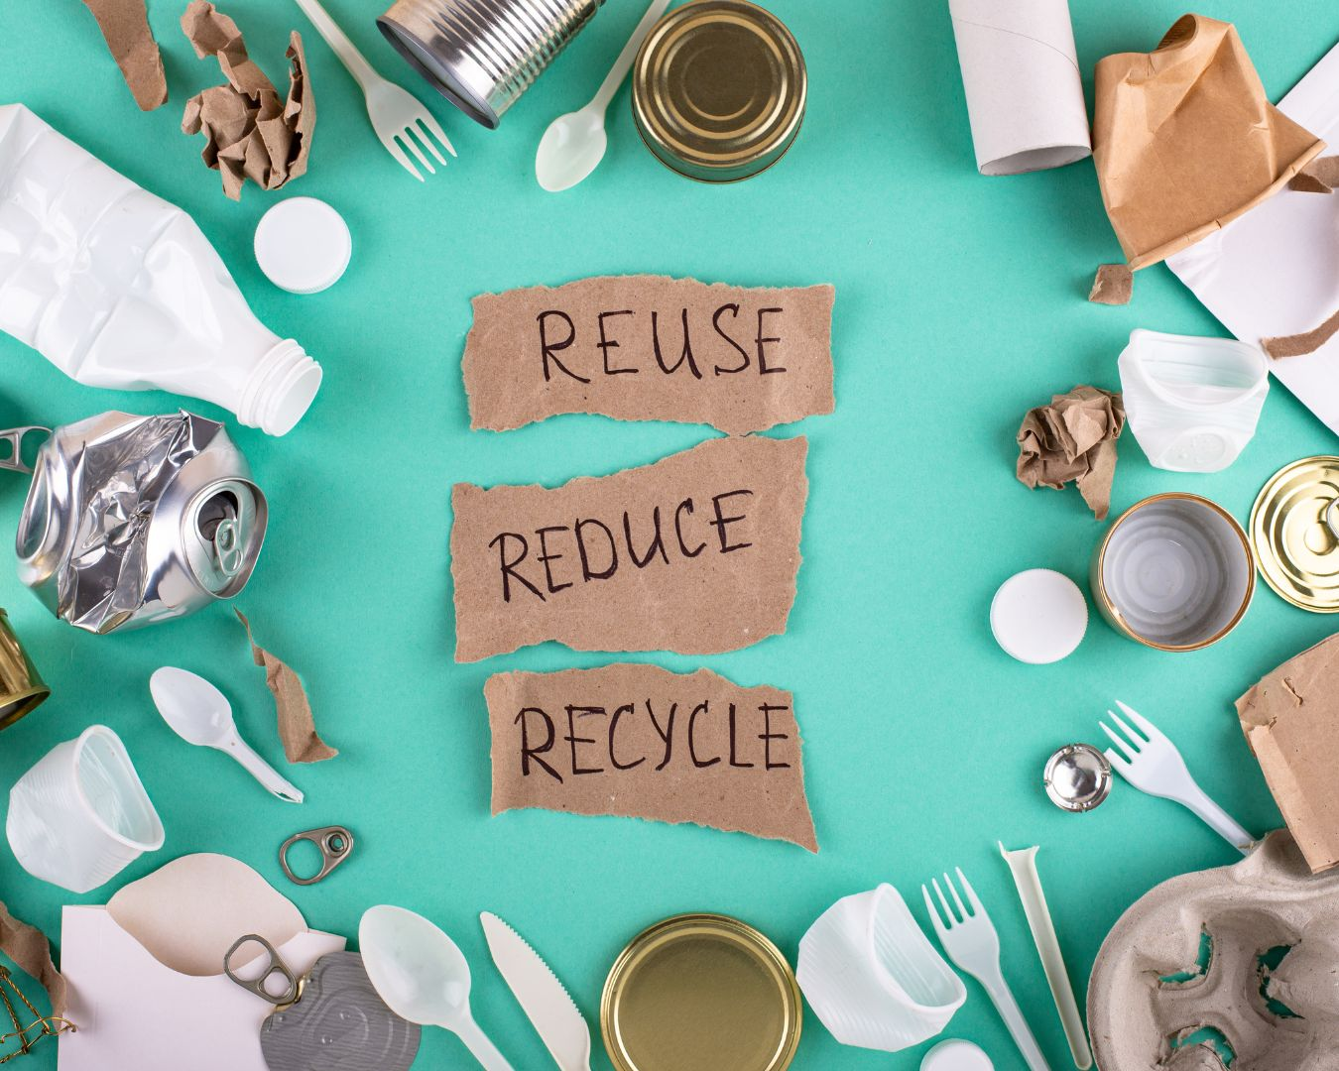
Sustainable Kitchen Practices
Modern hotel kitchens focus on maximizing resource utilization:
• Creative use of vegetable trimmings for stocks
• Repurposing surplus ingredients where food safety permits
• Composting organic waste
• Recycling packaging materials
• Donation of safe surplus food through approved channels
8

Slide 9
Hyatt Sustainability Practices
Hyatt integrates sustainability into daily operations through responsible resource management:
• Monitoring food waste through kitchen audits
• Responsible sourcing of ingredients
• Energy and water conservation
• Waste segregation and recycling
• Staff engagement in sustainability programs
These initiatives support Hyatt's commitment to responsible hospitality
9

Slide 10
Role of Every Hotel Employee
Food waste management is a shared responsibility.
Every team member contributes by:
• Following Standard Operating Procedures
• Maintaining portion consistency
• Reporting avoidable waste
• Practicing careful handling
• Supporting sustainable operations
Small daily actions create a significant long-term impact
10

Slide 11
Benefits of Reducing Food Waste
Business Benefits
• Lower food cost
• Higher profitability
• Better inventory control
• Improved operational efficiency
Environmental Benefits
• Reduced landfill waste
• Lower carbon emissions
• Conservation of water & energy
• Sustainable hospitality
11

Slide 12
Food Waste Management is Prevention
Through effective planning, cost control, responsible production and sustainable practices, hotels can reduce operational losses while delivering exceptional guest experiences.
"The most sustainable meal is the one that never becomes waste."

Slide 13
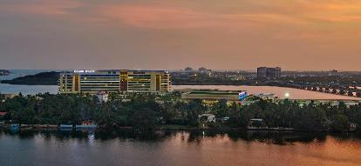
THANK YOU

