Slide 1

House Pricing Prediction

Slide 2

Scenario
Build a machine learning model to predict the selling prices of houses based on a variety of features on which the value of the house is evaluated.
The dataset consists of historic data of houses sold between May 2014 to May 2015.

Slide 3
Key Points when considering House Selling prices
Which locations within the Country area have the highest average house prices?
Which house attributes increase sale price?
Area / Location
Sq ft area of the property
Number of rooms: bedrooms, Bathrooms
When property is built or renovated or condition of property
View from the house
Etc
Does time of the year have an impact on house sales?

Slide 4
Column Names and descriptions for Data Set
id - unique identified for a house
dateDate - house was sold
pricePrice - is prediction target
bedroomsNumber - of Bedrooms/House
bathroomsNumber - of bathrooms/bedrooms
sqft_livingsquare - footage of the home
sqft_lotsquare - footage of the lot
floorsTotal - floors (levels) in house
waterfront - House which has a view to a waterfront
view - Has been viewed
condition - How good the condition is ( Overall )
grade - overall grade given to the housing unit, based on features grading system
sqft_above - square footage of house apart from basement
sqft_basement - square footage of the basement
yr_built - Built Year
yr_renovated - Year when house was renovated
zipcode - zip

Slide 5
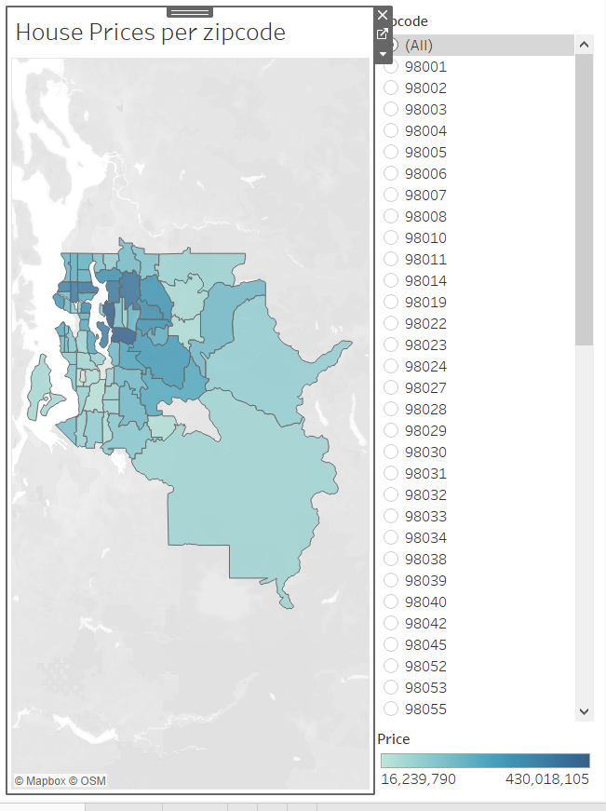
Location

Slide 6
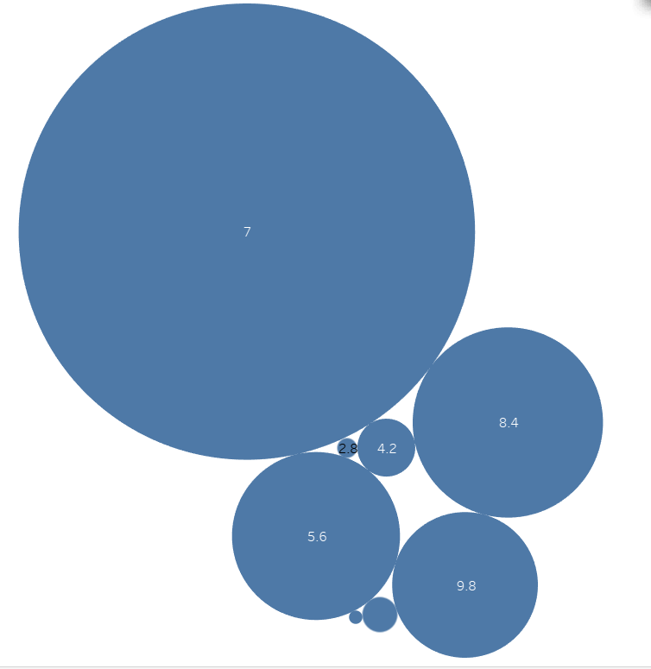
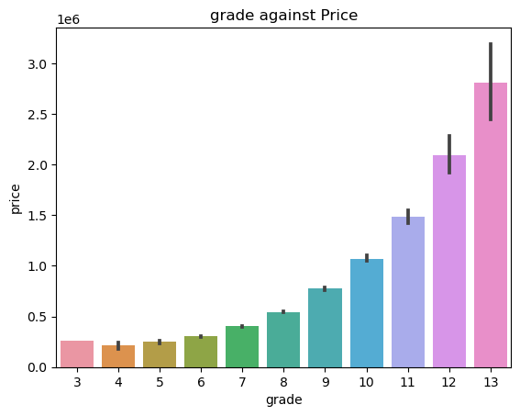
Grade and Prices

Slide 7
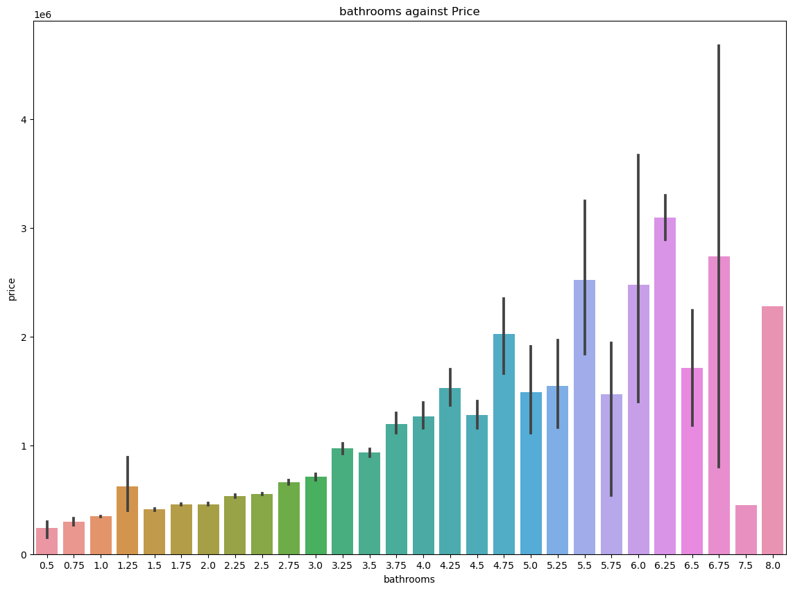
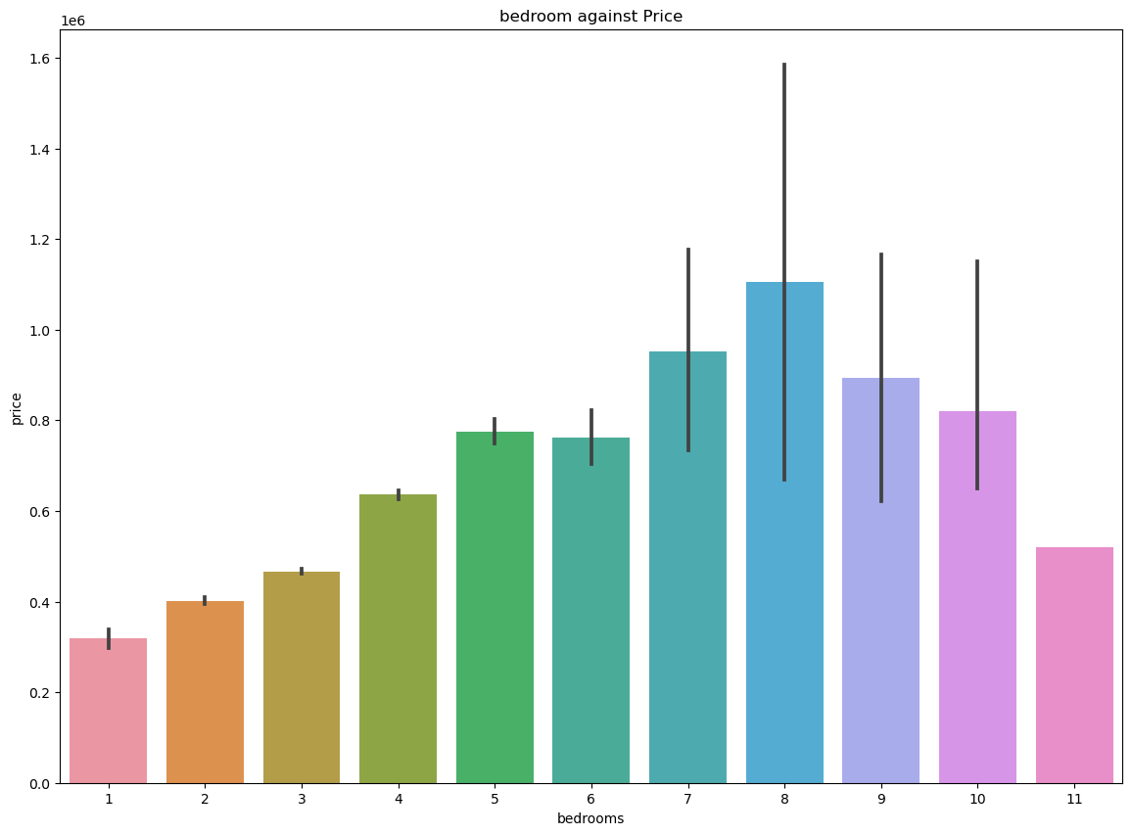

Slide 8
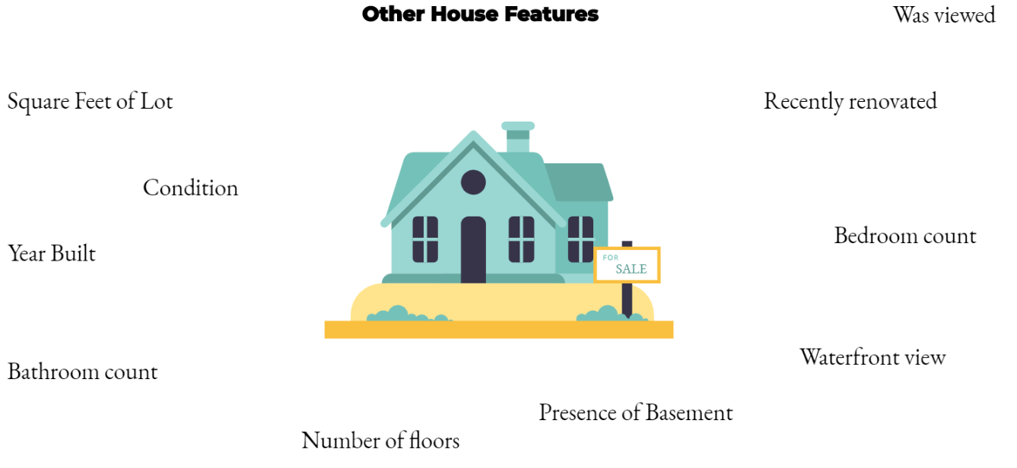

Slide 9
Predicting House Prices
Train Model value : 0.6134590055764721
Test model Value : 0.6213445746378723
Prediction can be more accurate if data location is accurate.

Slide 10
Features in this model best to predict are
Grade
Zip code
Waterfront
View
Number of bathrooms
Number of bedrooms
Sq ft living area

Slide 11
Future Work
In future for predicting dataset precisely following features can be considered
Commute time from center
Schools near by

Slide 12
Thank You

