Slide 1
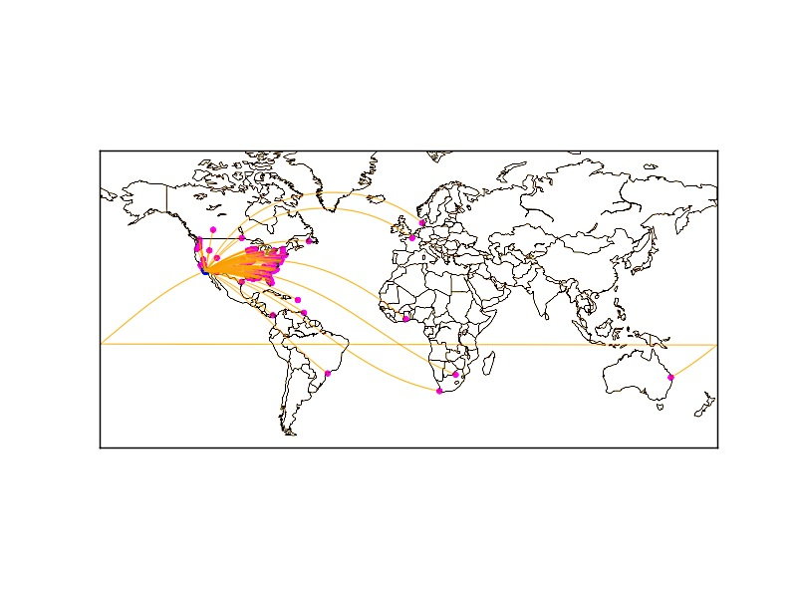
Mining Spatial Relationships from Social Trails

Slide 2
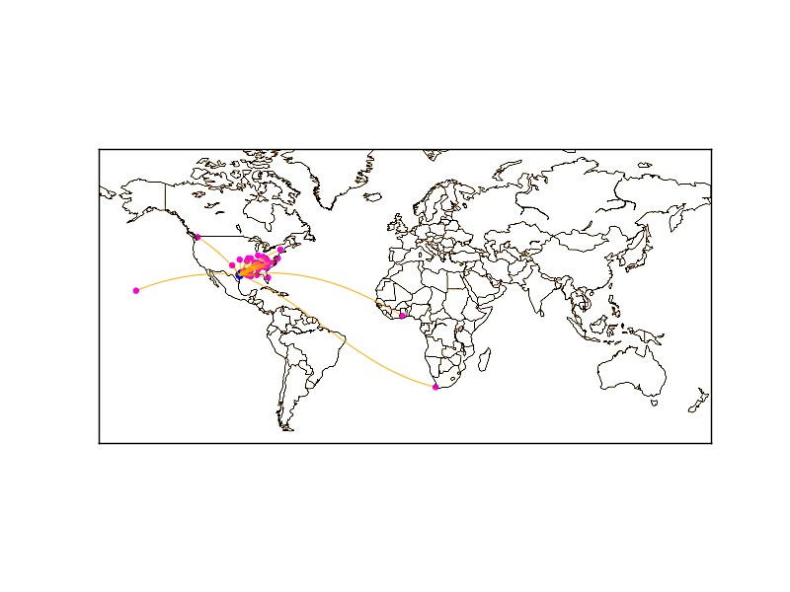
Mining Spatial Relationships from Social Trails

Slide 3
Mining Spatial Relationships from Social Trails

Slide 4
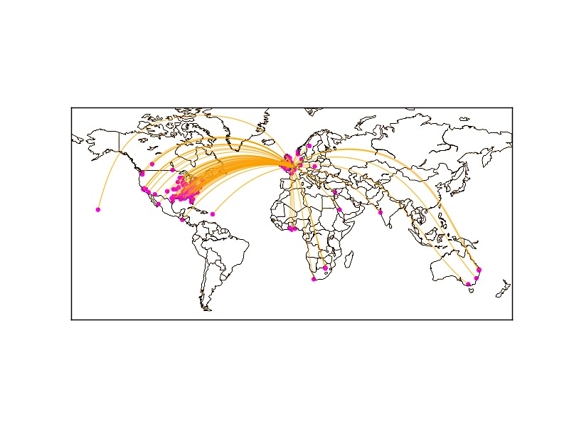
London
Mining Spatial Relationships from Social Trails

Slide 5

New York
Mining Spatial Relationships from Social Trails

Slide 6
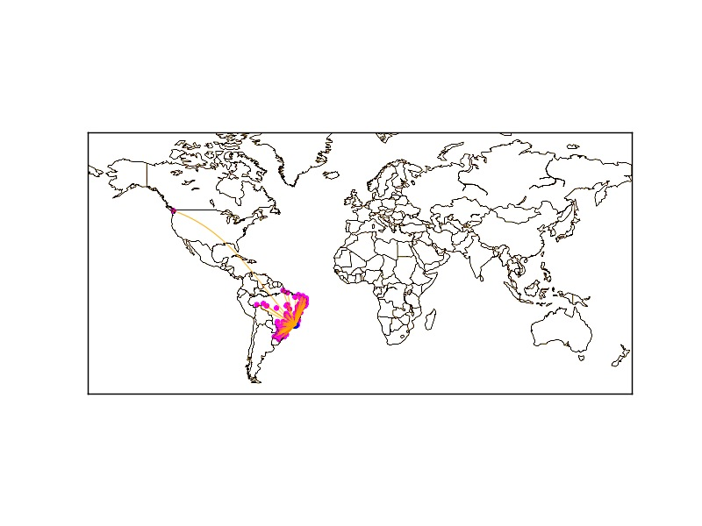
Rio de Janerio
Mining Spatial Relationships from Social Trails

Slide 7
Rio de Janerio
Mining Spatial Relationships from Social Trails

Slide 8
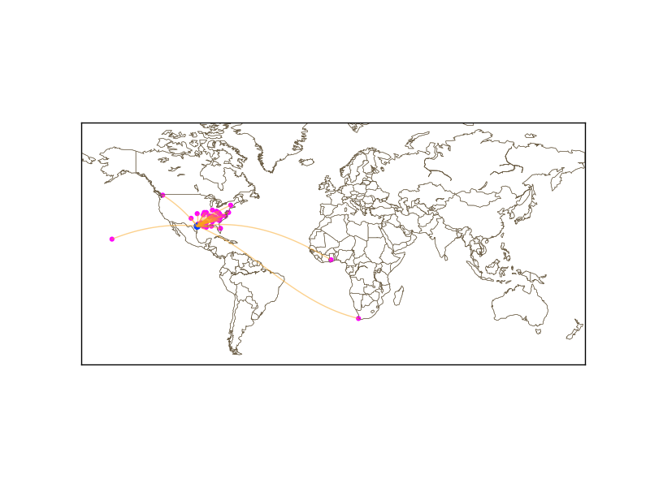

Slide 9
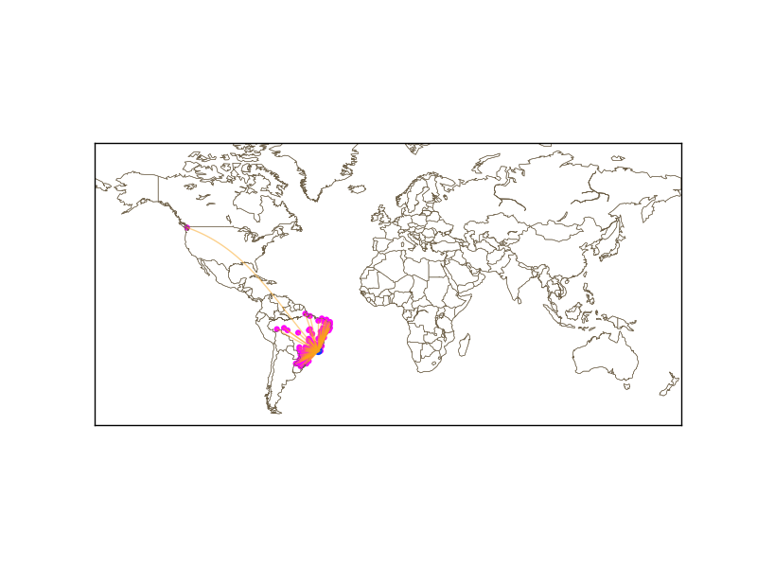
Rio de Janerio

Slide 10
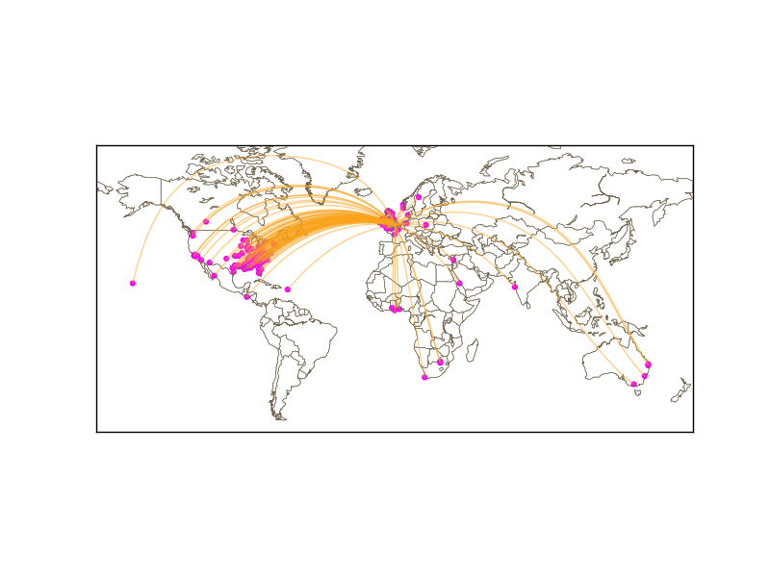
London

