Slide 1

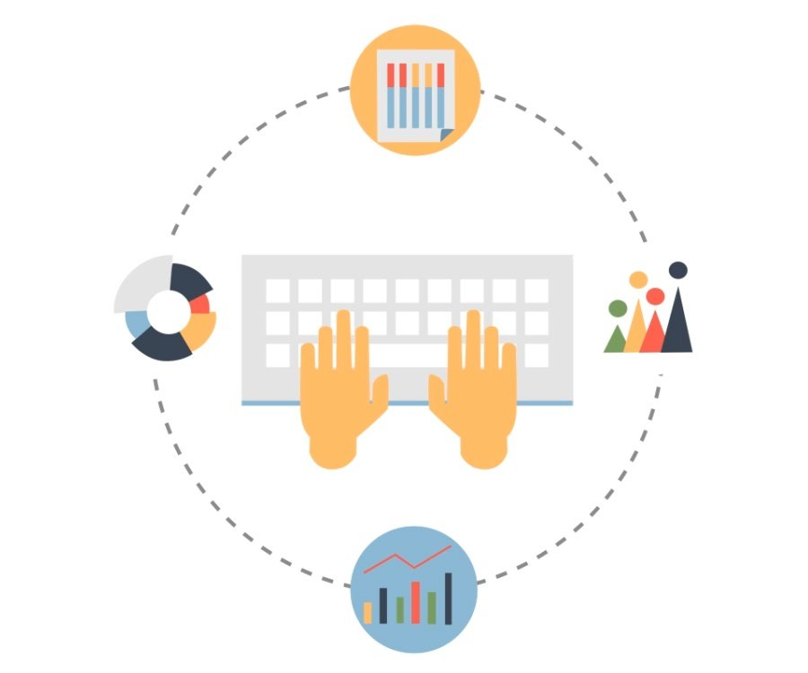
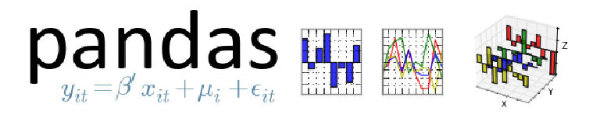
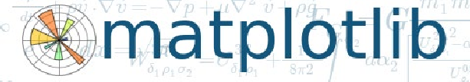




Data Analytics and Python
Python deals with each stage of data analytics efficiently by applying different libraries and packages.
Acquire
Wrangle
Explore
Model
Data
An alytics
Visualize
Bokeh

Slide 2
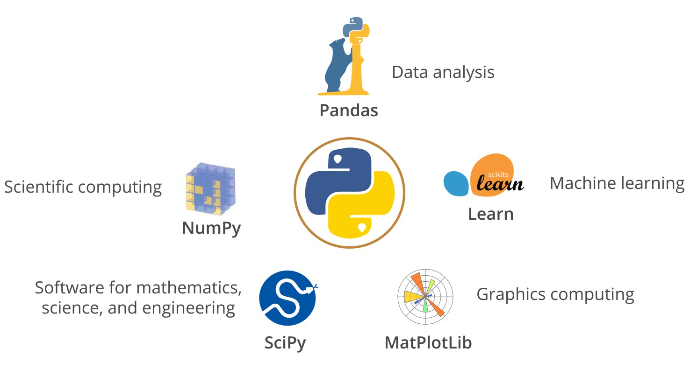
Python Tools and Technologies
Python is a general purpose, open source programming language that lets you work quickly and integrate
system s m ore effective ly.

Slide 3
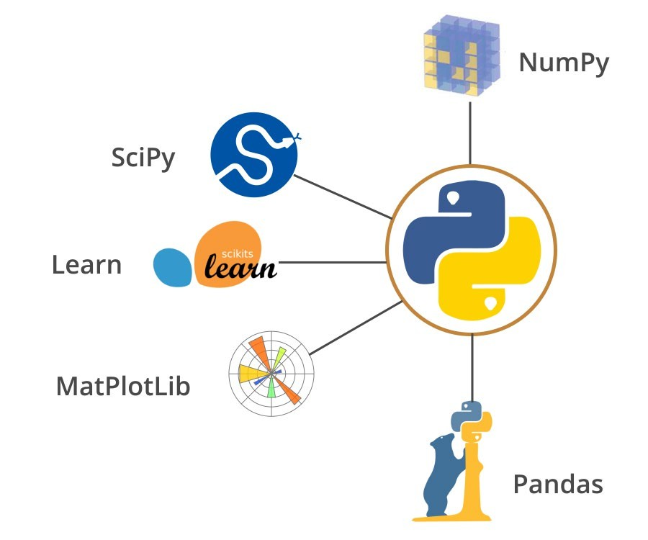
Benefits of Python
Easy to learn
Easy to learn
Open source
Open source
Efficient and multi -platform support
Efficient and multi platform support
Huge collection of libraries, functions, and modules
Huge collection of libraries, functions
and modules
Big open source community
Big open source community
Integrates well with enterprise apps and systems
Integrates well with enterprise apps
and systems
Great vendor and product support
Great vendor and product support

Slide 4
