Slide 1
CS 6240 Final Project
Just reduce it
Aparna Sharma
Ishan Patel
Rahul Motan

Slide 2
GOAL
Suggest relevant groups to the user which the user can join.

Slide 3
Objectives
Task 1
Understanding HBase
Dataset Expansion & Reduce Side Join
Task 2
Performing Join Using HBase
Task 3
Performance Comparison

Slide 4
Understanding HBase
What is HBase?
How HBase works?
Why use HBase?

Slide 5
What : HBase is…
HBase is distributed column-oriented database built on top of the Hadoop file-system. It is modeled like Google’s BigTable.
It is like a sorted map which is distributed, consistent and multidimensional, and has:
Labeled tables of rows.
Row consist of key-value cells.

Slide 6
What HBase is Not...
Not a SQL Database
Not relational
No joins
No transactions out-of-the box
Not a drop-in replacement for your RDBMS

Slide 7
Features of HBase
Linear scalability: capable of storing hundreds of terabytes of data.
Automatic failover support.
Automatic and configurable partitioning of tables.
Strictly consistent reads and writes.

Slide 8
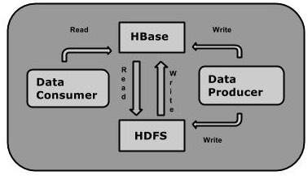
How it works?
Automatic and configurable partitioning of Tables.
Tables partitioned into Regions.
Regions defined by start and end row keys.
Regions are the “atoms” of distribution.
Regions are assigned to Region Servers (HBase cluster slaves)

Slide 9
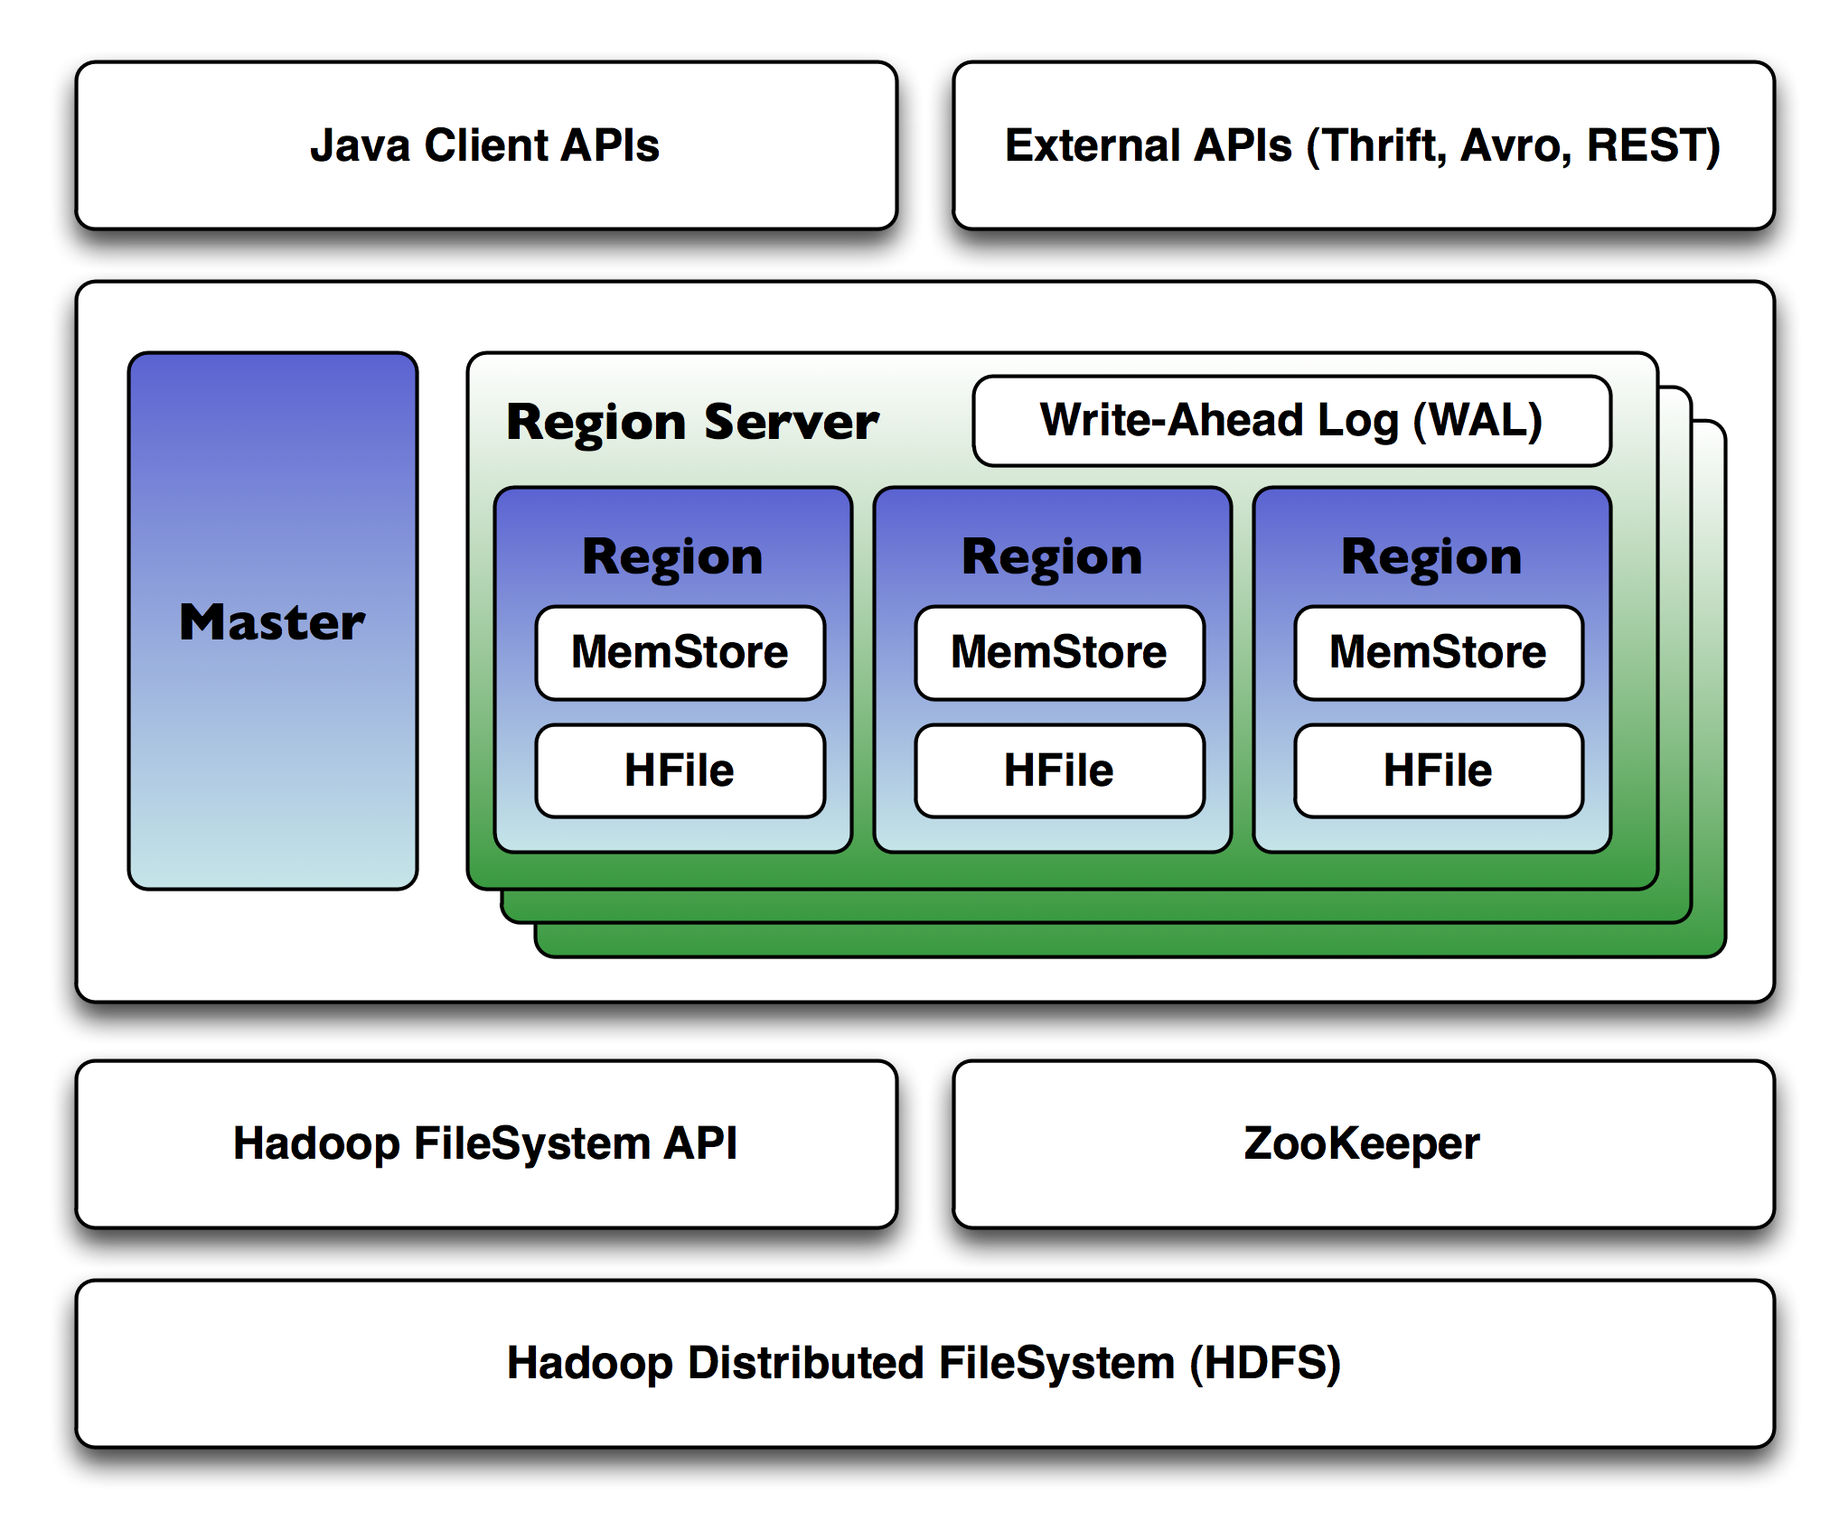
HBase Architecture

Slide 10
The Why
Serving large amount of data: built to scale from the get-go.
Fast random access to the data.
HBase provides “Consistency” and “Partition Tolerance” but is not always “Available.” (CAP Theorem)
HBase provides a high degree of reliability.

Slide 11
Algorithms
Dataset Expansion
Finding groups for users using reduce side join
Finding groups for users using HBase join

Slide 12
Dataset Expansion
Volume of the data insufficient to execute performance comparison.
Preprocessing the data and duplicating the user edges and the group edges data.

Slide 13
Reduce-Side Join
Read user friendship data and emit (user, “friend”+friend). Use the tag “friend” in value to distinguish it in later stages
Read user groups data and emit (user, “group”+group). Use tag “group”.
In the reducer, create 2 list. One for listOfFriends and other ListOfGroups. If the value contains tag “friend” add it to listOfFriends and if it contains tag “group” add it to listOfFriends.
For each friend in listOfFriends emit friend as key and all groups of user or key as value with tag “suggestion”. (friend,”suggestion”+group). Write this in an intermediate file.
Read the intermediate file and the user group data file again and emit them.
In reducer create separate list for suggested groups and existing groups using the value tags.
Emit the suggested groups which are not in existing group with the same key.

Slide 14
Join Using HBase
Create Table
Read group data and populate Hbase table with group data
Read user friendship data and emit user and friend
In the reducer, for key i.e. the user get list of existing groups.
for each friend i.e. values of user get list of existing group of friend and compare it with the group list of user.
Loop through the friend’s list of group and find out which group is not present in the group list of user. Emit them with the user as key.

Slide 15
Setting-up HBase on AWS
Challenges Faced : configuration to choose, versions, single/multiple jar, single/multiple servers, HDFS/S3, SSH Access, DDOS
Program Execution
Other Improvements : Bulk Retrieve, Sharding on Region Servers

Slide 16
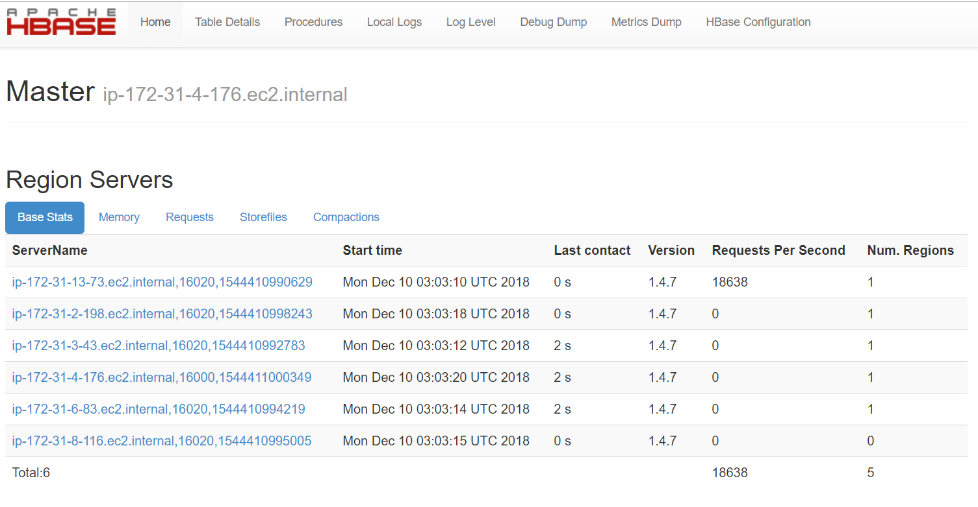
Apache HBase Request Info

Slide 17
Conclusion
As per logs, the time taken to execute the program using Map Reduce job, Spark and HBase with map reduce are as follows:
Machine | Time Taken to execute
MR job on 5 worker | 2 min 50 sec
MR job on 10 worker | 1 min 7 sec
Spark job on 5 worker | 16 min
Spark job on 10 worker | 16 min
HBase+MapReduce job on 5 worker | Not Available
HBase+MapReduce job on 10 worker | 50 min 12 sec

Slide 18
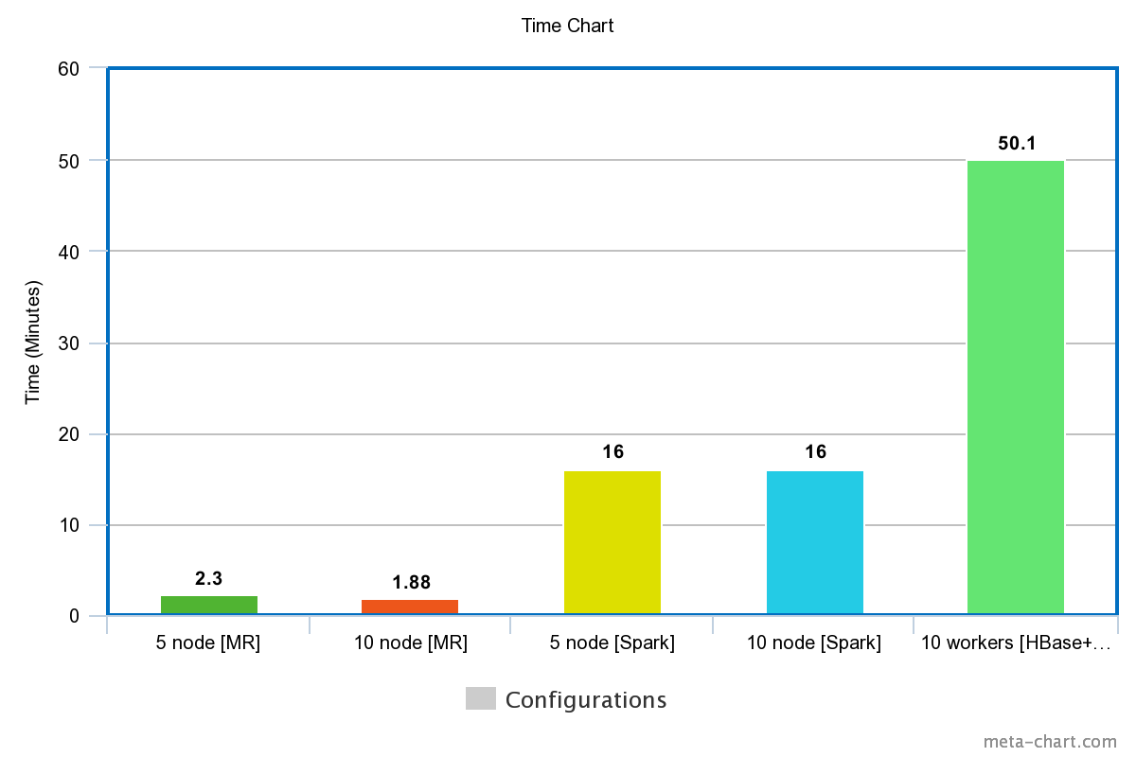

Slide 19
Thank You

