Slide 1
Strings in Python

Slide 2
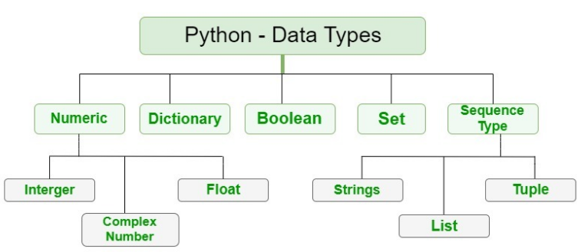
Objects in Python
Every object has these attributes:
Identity – This refers to the address that the object refers to in the computer’s memory.
Type – This refers to the kind of object that is created. For example- integer, list, string etc.

Slide 3
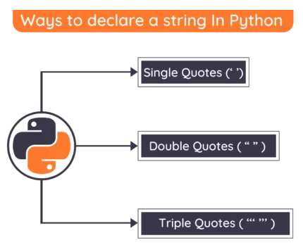
What is a String?
A string is a sequence of characters.
Usually strings are enclosed in single or double quotes
Strings are immutable

Slide 4
Accessing a String?
0 | 1 | 2 | 3 | 4 | 5 | 6 | 7 | 8 | 9
H | E | L | L | O | W | O | R | L | D
-10 | -9 | -8 | -7 | -6 | -5 | -4 | -3 | -2 | -1

Slide 5
List of Mutable and Immutable objects.
Objects of built-in type that are mutable are:
Lists
Sets
Dictionaries
User-Defined Classes (It purely depends upon the user to define the characteristics)
Objects of built-in type that are immutable are:
Numbers (Integer, Rational, Float, Decimal, Complex & Booleans)
Strings
Tuples
Frozen Sets

Slide 6
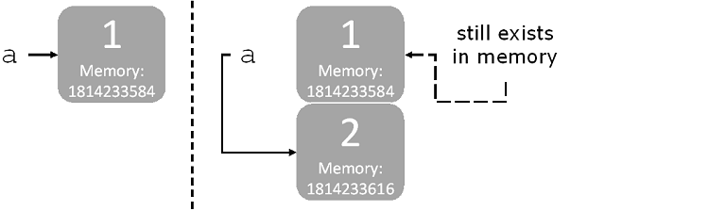
Strings are immutable
Definition: An immutable object is an object cannot change after creation.
id(a)
id(a)

Slide 7
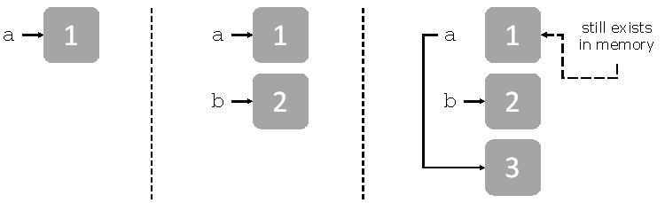
Example
a=1
b=2
c=3

Slide 8
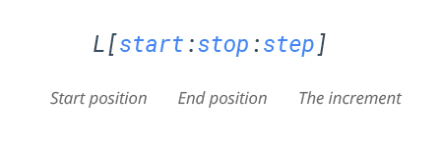
String slicing
It is the creation of a new sub-string from the given string on the basis of the user-defined starting and ending indices.
Mandatory parameters
Optional parameters
Allows you to select nth item within the range start to stop.
The index of the string where slicing starts.
Default index-0
The index of the string where slicing end.
Default value- len(string)-1

Slide 9
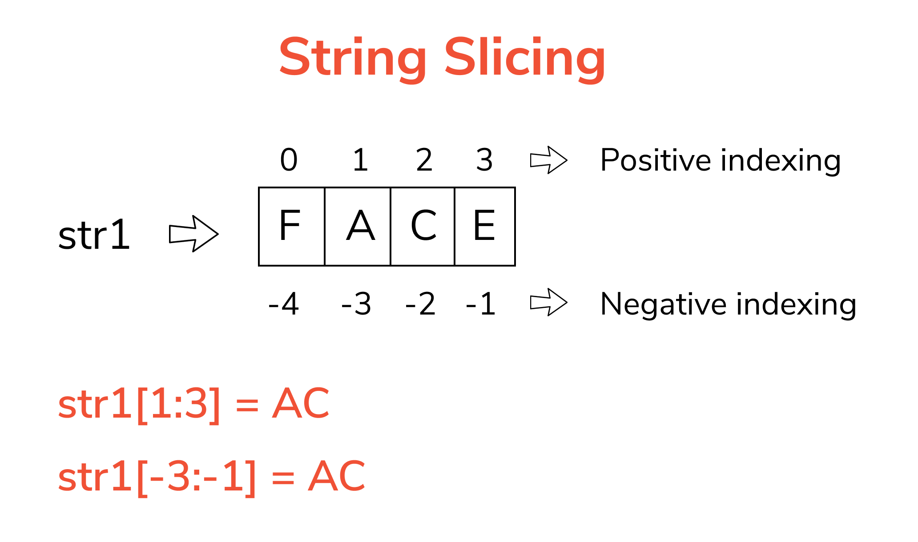
String Slicing

Slide 10
Quick Check
Does slicing change the existing string?
Given string: Hello World (Slice the string from 2nd to 8 th position)
Given String: Charlie (Slice the string from 2nd to last index)

Slide 11
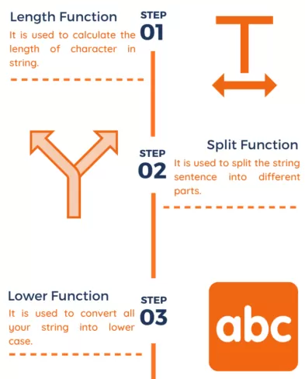
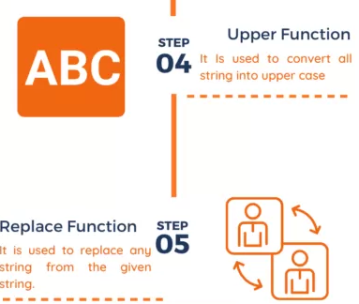
Python built-in functions

Slide 12
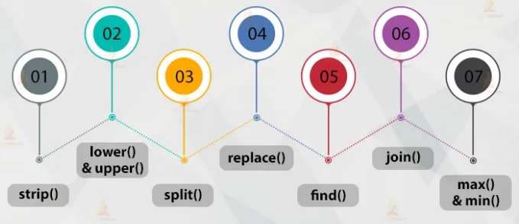
Python built-in functions

Slide 13
Thank you.

Slide 14
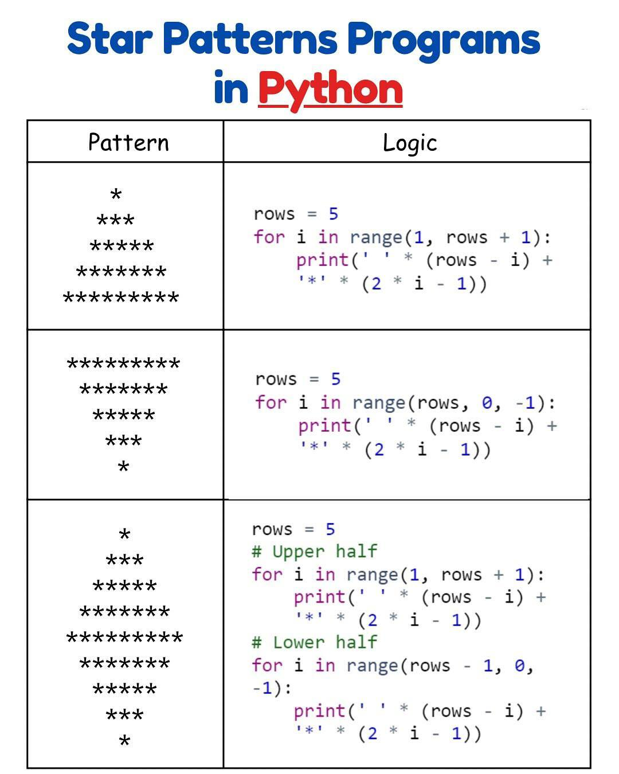

Slide 15
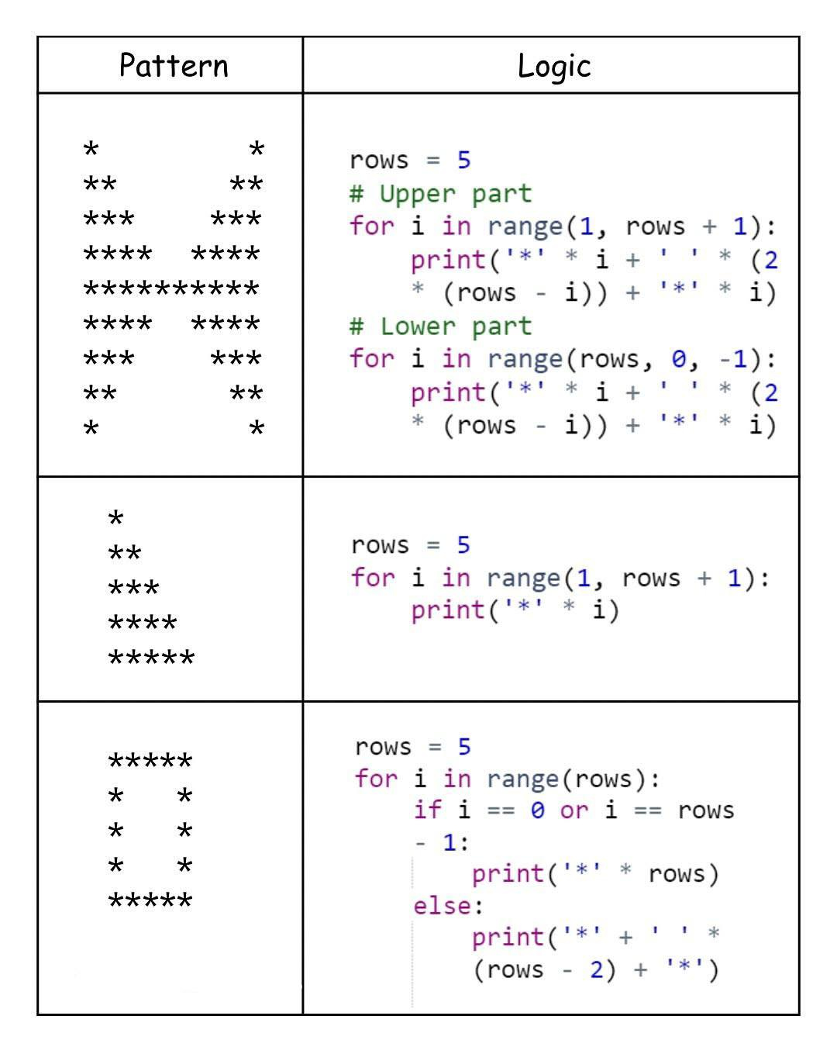

Slide 16
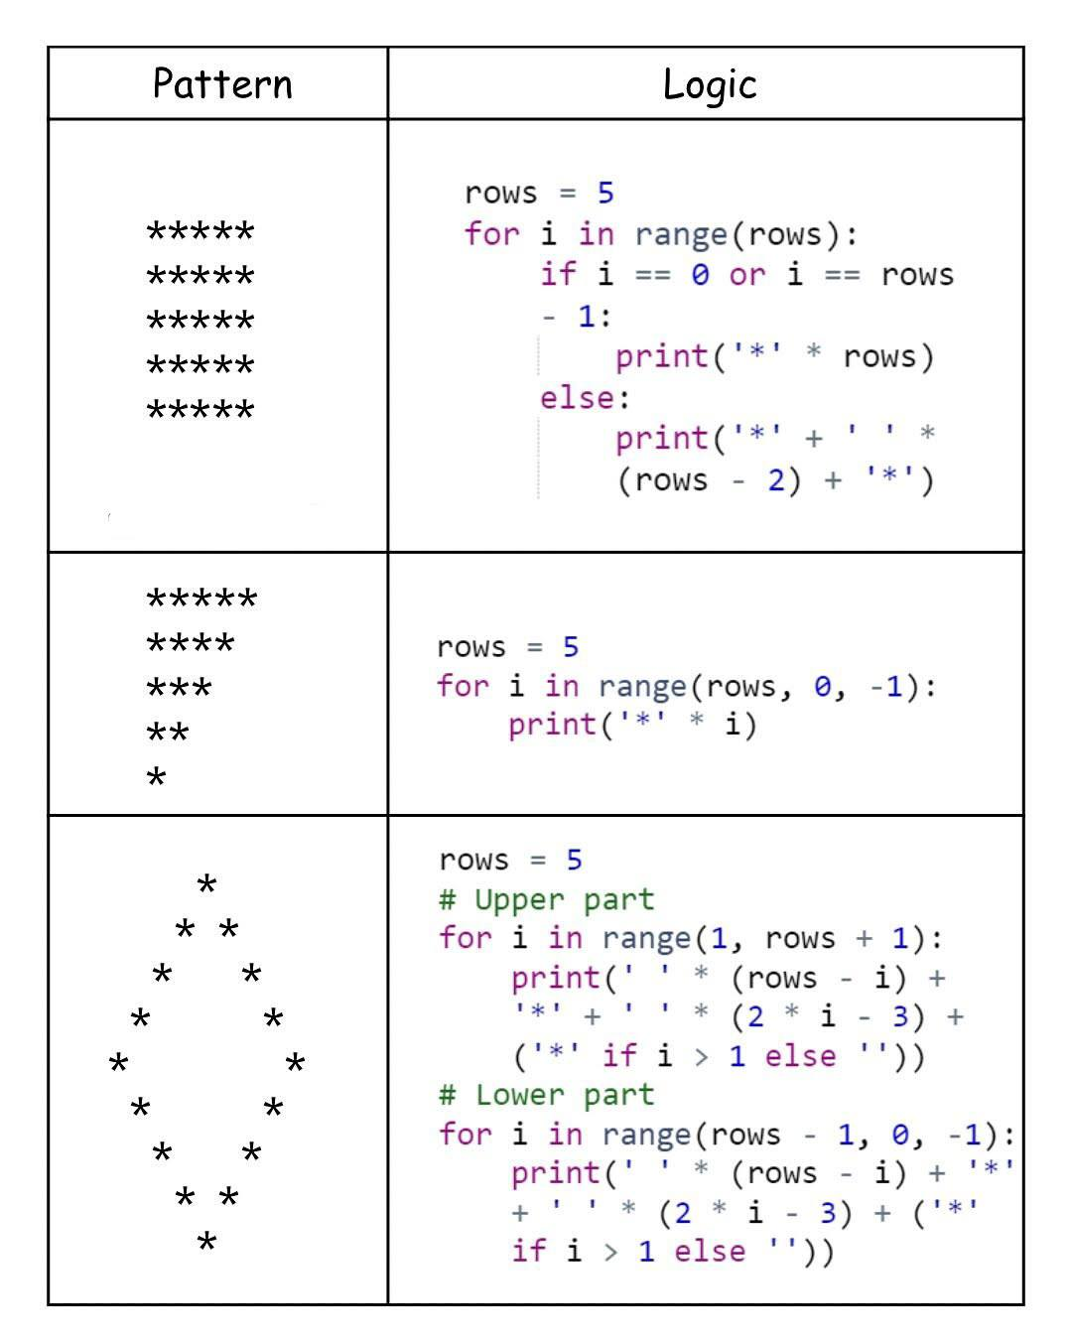

Slide 17
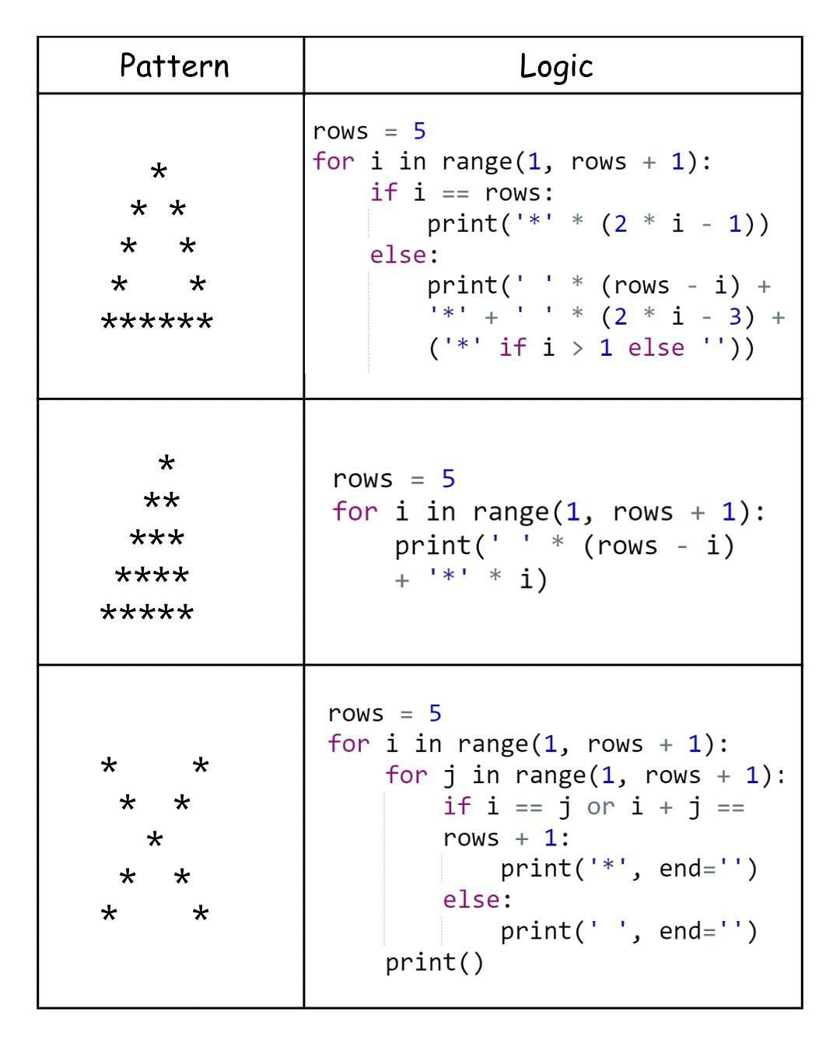

Slide 18
