Slide 1
LISTS IN PYTHON

Slide 2
What is a List?
A List is a compound data type, you can group values together.
A list contains items separated by commas and enclosed with in square brackets – [ ]
The items belonging to the list can be heterogeneous type.
Index starts at ‘0’.
A list in Python can grow and shrink in size

Slide 3
List Functions
append(x) → Add an element at the end
insert(i, x) → Insert element at index i
extend(iterable) → Add multiple elements
remove(x) → Remove first occurrence of x
pop(i) → Remove element at index (default: last)
clear() → Remove all elements
index(x) → Return index of x
count(x) → Count occurrences of x
sort() → Sort the list
reverse() → Reverse the list
copy() → Copy the list

Slide 4
Creation of List
Creation of the list
list_str = ["apple", "banana", "cherry"]
list_int = [1,2,3]
list_mixed = [“London”, 12 , 56.78]
List_emp=[ ]
It is also possible to use the list() constructor to make a new list.
List_const = list(("apple", "banana", "cherry"))

Slide 5
Accessing elements of list
Accessing the list:
List indices start at 0.
If an index has a positive value it counts from the beginning
If the index has a negative value it counts from the end.
Example
color_list=["RED", "Blue", "Green", "Black"]
Item | Red | Blue | Green | Black
Index(from left to right) | 0 | 1 | 2 | 3
Index(from right to left) | -4 | -3 | -2 | -1

Slide 6
Accessing elements of list:
markslist=[54,66,89,21]
#print all the elements of the list
print(markslist)
#access first element of list
print(markslist[0])
#access last element
print(markslist[-1])
#access all element one by one
for ele in markslist:
print(ele)
While accessing List elements, if you pass a negative index, python adds the length of the list to the index to get element’s forward index.
markslist[-1+4]=marklist[3]=21

Slide 7
Mutable Object
Simply put, a mutable object can be changed, but an immutable object cannot.
nums = [1, 2, 3]
l = nums
print(id(nums) == id(l))
nums.append(4)
print(id(nums) == id(l))
del nums[0]
print(id(nums) == id(l))

Slide 8
List Operations
Python Expression | Results | Description
len([1, 2, 3]) | 3 | Length
[1, 2, 3] + [4, 5, 6] | [1, 2, 3, 4, 5, 6] | Concatenation
['Hi!'] * 4 | ['Hi!', 'Hi!', 'Hi!', 'Hi!'] | Repetition
3 in [1, 2, 3] | True | Membership
for x in [1, 2, 3]: print(x) | 1 2 3 | Iteration

Slide 9
List Methods
Inserting items
append(): Adds an element at the end of the list
insert(): Adds an element at the specified position
Removing items
remove(): removes the specified item
pop(): removes the specified index or the last item if index is not specified
del: deletes the list completely:
Copying a list
copy(): Returns a copy of the list
built-in method list().
Joining two lists
Using operator ‘+’
extend(): Add the elements of a list (or any iterable), to the end of the current list

Slide 10
List Methods
clear(): Removes all the elements from the list
count(): Returns the number of elements with the specified value
index(): Returns the index of the first element with the specified value
reverse(): Reverses the order of the list
sort(): Sorts the list

Slide 11
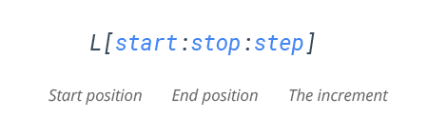
Slicing of a List
Mandatory parameters
Optional parameters
The index of the list where slicing starts.
Default index-0
Allows you to select nth item within the range start to stop.
The index of the list where slicing end.
Default value- len(list)-1

Slide 12
Examples
colors= ['red', 'green', 'blue', 'white', 'yellow']
print(colors[0:2])
['red', 'green']
print(colors[1:2])
['green']
print(colors[1:-2])
['green', 'blue']
print(colors[:3])
['red', 'green', 'blue']
print(colors[:])

Slide 13
List Comprehension
List comprehensions is a pythonic way of expressing a ‘for-loop’ that appends to a list in a single line of code.
list comprehensions hail from functional programming.
less verbose, clearer and more readable.

Slide 14
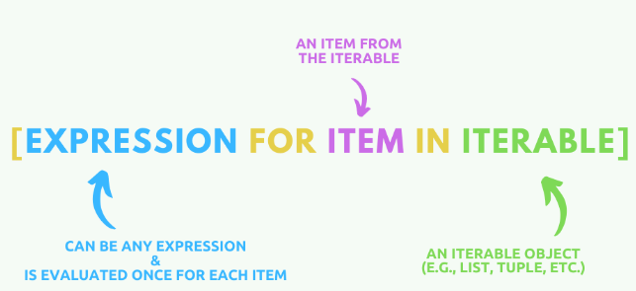
List Comprehension
Syntax
my_new_list = [ expression for item in list ]

Slide 15
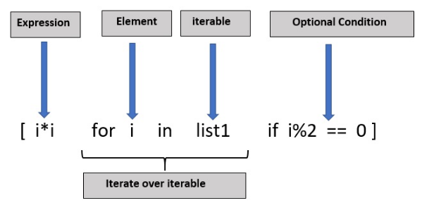

Python List Comprehension (Conditionals)
Conditionals can enhance Python list comprehensions significantly.
They server the following purposes:
To filter a list, and
To modify items in a list.
1. Finding Common Items in Two Lists Using List Comprehensions

Slide 16
Thank you.

