Slide 1
PYTHON
Tuples in python

Slide 2
Introduction to Tuples
A Tuple is a collection of Python objects separated by commas.
Tuple is similar to a list in terms of indexing, nested objects and repetition but
Tuple is immutable unlike lists which are mutable.

Slide 3
Tuple Creation
# Different types of tuples
# Empty tuple
my_tuple = ()
print(my_tuple)
# Tuple having integers
my_tuple = (1, 2, 3)
print(my_tuple)
# tuple with mixed datatypes
my_tuple = (1, "Hello", 3.4)
print(my_tuple)
# nested tuple
my_tuple = ("mouse", [8, 4, 6], (1, 2, 3))
print(my_tuple)

Slide 4
Tuple packing & unpacking
1. What is the Output?
my_tuple = 3, 4.6, "dog"
print(my_tuple)
Tuple packaging
2. What is the Output?
a, b, c = my_tuple
print(a)
print(b)
print(c)
Tuple unpackaging

Slide 5
Create a tuple with single item ‘hello’
my_tuple = ("hello")
print(type(my_tuple))
class <‘str’>
# Creating a tuple having one element
my_tuple = ("hello",)
print(type(my_tuple))
my_tuple = "hello",
print(type(my_tuple))
class <‘tuple’>

Slide 6
Tuples are immutable
Unlike a list, once you create a tuple, we cannot alter its content – similar to a string
Immutable (cannot be modified) i.e., we cannot change elements of the tuple.
We cannot perform item-assignment in immutable types.

Slide 7
Accessing Tuples
In Python, the process of tuple accessing is same as with list.
Like a list, we can access each and every element of a tuple.
Similarity with list, tuple also has index.
All functionality of a list and a tuple is same except mutability.

Slide 8
Accessing a tuple
# create a tuple
sample_tuple = tuple((1, 2, 3, "Hello", [4, 8, 16]))
# iterate a tuple
for item in sample_tuple:
print(item)
Tuple can be accessed through indexing and slicing.

Slide 9
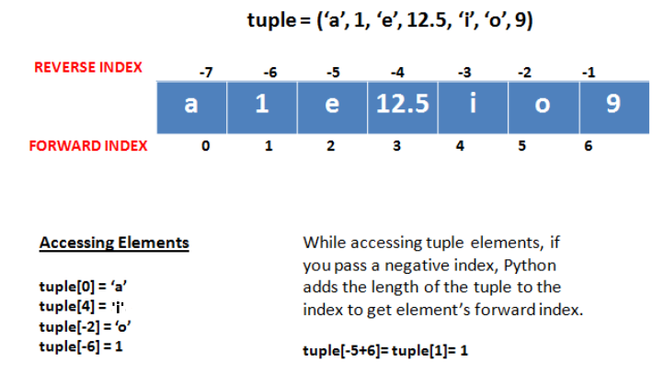
Indexing

Slide 10
Methods in Tuples
Function | Description
len(tuple) | Gives the total length of the tuple.
count() | Returns the number of times a specified value occurs in a tuple
index() | Searches the tuple for a specified value and returns the position of where it was found
tuple(seq) | Converts a list into tuple.

Slide 11
Slicing
We can use indexing to call out a few items from the tuple.
Slices allow us to call multiple values by creating a range of index numbers separated by a colon [x:y].

Slide 12
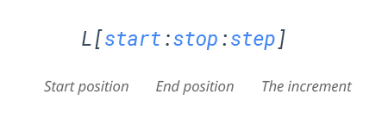
Slicing
Mandatory parameters
Optional parameters
The index of the tuple where slicing starts.
Default index-0
The index of the tuple where slicing ends.
Default value- len(tuple)-1
Allows you to select nth item within the range start to stop.

Slide 13
Slicing
2 | 4 | 3 | 5 | 4 | 6 | 7 | 8 | 6
my_tuple= (2, 4, 3, 5, 4, 6, 7, 8, 6)
after_slice=my_tuple[3:5]
Slice elements 4th and 5th from tuple my_tuple
2 | 4 | 3 | 5 | 4 | 6 | 7 | 8 | 6
my_tuple[3:5], that means 4th to 5th
5 | 4

Slide 14
Zip()
The zip() function returns a zip object, which is an iterator of tuples where the first item in each passed iterator is paired together, and then the second item in each passed iterator are paired together etc.
If the passed iterators have different lengths, the iterator with the least items decides the length of the new iterator.
Syntax
zip(iterator1, iterator2, iterator3 ...)

Slide 15
Sets in Python
SETS IN PYTHON

Slide 16
Introduction
Sets are used to store multiple items in a single variable.
Set items are unordered, unchangeable (but you can remove items and add new items), and do not allow duplicate values.
set() constructor is used to make a set

Slide 17
Methods
add(x) → Add an element
update(iterable) → Add multiple elements
remove(x) → Remove element (error if not found)
discard(x) → Remove element (no error if not found)
pop() → Remove random element
clear() → Remove all elements
union(other_set) → Combine sets
intersection(other_set) → Common elements
difference(other_set) → Elements only in first set
symmetric_difference(other_set) → Non-common elements
issubset(other_set) → Check subset
issuperset(other_set) → Check superset
isdisjoint(other_set) → Check if no common elements
copy() → Copy the set

Slide 18
Creation
Example 1
thisset = {"apple", "banana", "cherry"}
print(thisset)
Output:
{'cherry', 'apple', 'banana'}
Example 2
thisset = set(("apple", "banana", "cherry“))
print(thisset)
Output:
{'cherry', 'apple', 'banana'}

Slide 19
Access Items
We cannot access items in a set by referring to an index or a key.
But we can loop through the set items using a for loop, or ask if a specified value is present in a set, by using the 'in' keyword.
Example
thisset = {"apple", "banana", "cherry"}
for x in thisset:
print(x)

Slide 20
Thank you.

