Slide 1
Python
Dictionaries in Python

Slide 2
What is a Dictionary?
Python provides another composite data structure called a dictionary, which are used to store data values in key:value pairs.
A dictionary is a collection which is
Ordered (Python version 3.7, dictionaries are ordered. Python 3.6 and earlier, dictionaries are unordered)
Changeable
Does not allow duplicates (cannot have two items with the same key)

Slide 3
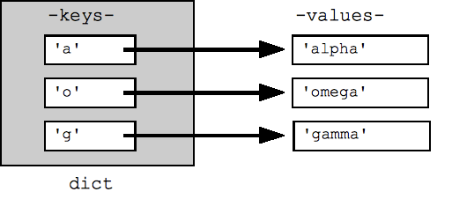
Dictionary

Slide 4
More….
A dictionary in Python is a one to one mapping.
Dictionary holds a pair of values, one being the Key and the other corresponding pair element being its Value
Values in a dictionary can be of any data type and can be duplicated, whereas Keys of a Dictionary must be unique and can’t be repeated and must be immutable.
Dictionary keys are case sensitive, same name but different cases of Key will be treated distinctly.
Dictionaries are indexed using their keys.

Slide 5
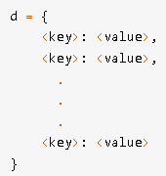
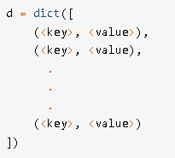
How to create a dictionary

Slide 6
Accessing Dictionary elements
Access the items of a dictionary by referring to its key name, inside square brackets.
get() method gives us the same result
The keys() method will return a list of all the keys in the dictionary.
The items() method will return each item in a dictionary, as tuples in a list.
if a specified key is present in a dictionary use the in keyword.
Can iterate through dictionary using for loop

Slide 7
Built-in Methods
Method | Description
clear() | Removes all the elements from the dictionary
copy() | Returns a copy of the dictionary
fromkeys() | Returns a dictionary with the specified keys and values
get() | Returns the value of the specified key
items() | Returns a list containing a tuple for each key value pair
keys() | Returns a list containing the dictionary's keys
pop() | Removes the element with the specified key
popitem() | Removes the last inserted key-value pair
setdefault() | Returns the value of the specified key. If the key does not exist: insert the key, with the specified value
update() | Updates the dictionary with the specified key-value pairs
values() | Returns a list of all the values in the dictionary

Slide 8
Removing items from dictionary
Remove all items: clear()
Remove an item by a key and return a value: pop()
Remove an item and return a key and value: popitem()
Remove an item by a key: del
Remove items that meet the condition: Dictionary comprehensions

Slide 9
Using Del keyword
a_dictionary = {"one": 1, "two" : 2, "three": 3}
desired_value = 2
for key, value in a_dictionary.items():
if value == desired_value:
del a_dictionary[key]
break
print(a_dictionary)

Slide 10
Dictionary Comprehension
myDict = {"one": 1, "two" : 2, "three": 3}
myDict = {key:val for key, val in myDict.items() if val != 3}
print(myDict)

Slide 11
setdefault()
setdefault(): returns the value of a key (if the key is in dictionary). If not, it inserts key with a value to the dictionary.
Syntax: dict.setdefault(key, default_value) Parameters: It takes two parameters: key – Key to be searched in the dictionary. default_value (optional) – Key with a value. default_value is inserted to the dictionary if key is not in the dictionary. If not provided, the default_value will be None.
Returns: Value of the key if it is in the dictionary. None if key is not in the dictionary and default_value is not specified. default_value if key is not in the dictionary and default_value is specified.

Slide 12
Dictionary vs Lists
Dictionary
Defined with a curly brace({}) enclosing one or more comma-separated key-value pairs where a key and its associated value is separated by a colon(:).
Elements are accessed using keys.
Are unordered sets.
Belongs to the built-in mapping type.
List
Defined with a square bracket([]) where each item in the list is separated by a comma(,), with the first item at index 0.
Elements are accessed by their position in the list, using indexing.
Are ordered sequence of objects.
Belongs to the built-in sequence type.

Slide 13
Thank you.

