Slide 1
Data Visualization
with
matplotlib

Slide 2
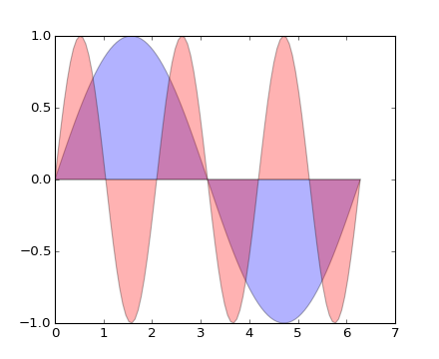
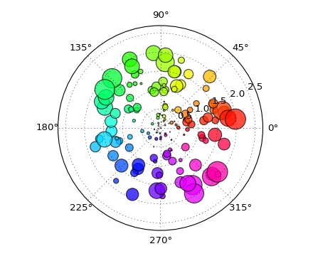
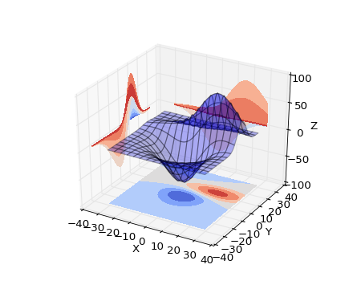
What is data visualization?
Data visualization is the graphical representation of information and data.
Can be achieved using visual elements like figures, charts, graphs, maps, and more.
Data visualization tools provide a way to present these figures and graphs.
Often, it is essential to analyze massive amounts of information and make data-driven decisions.
converting complex data into an easy to understand representation.

Slide 3
Matplotlib
Matplotlib is one of the most powerful tools for data visualization in Python.
Matplotlib is an incredibly powerful (and beautiful!) 2-D plotting library.
It is easy to use and provides a huge number of examples for tackling unique problems
In order to get matplotlib into your script,
first you need to import it, for example:
import matplotlib.pyplot as plt
However, if it is not installed, you may need to install it:
Easiest way to install matplotlib is using pip.
Type the following command in the command prompt (cmd) or your Linux shell;
pip install matplotlib
Note that you may need to run the above cmd as an administrator

Slide 4
matplotlib
Strives to emulate MATLAB
matplotlib.pyplot is a collection of command style functions that make matplotlib work like MATLAB.
Each pyplot function makes some change to the figure:
e.g.,
creates a figure,
creates a plotting area in the figure,
plots some lines in the plotting area,
decorates the plot with labels, etc.
Note that various states are preserved across function calls
Whenever you plot with matplotlib, the two main code lines should be considered:
Type of graph
this is where you define a bar chart, line chart, etc.
Show the graph
this is to display the graph

Slide 5
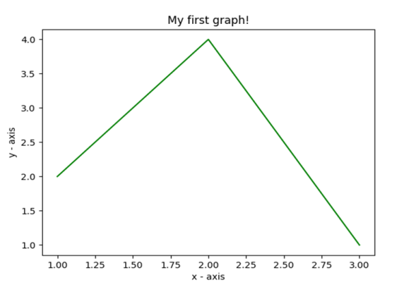
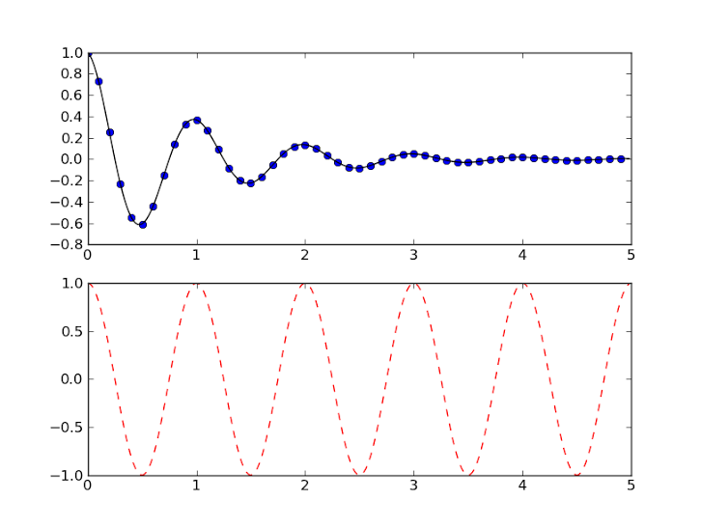
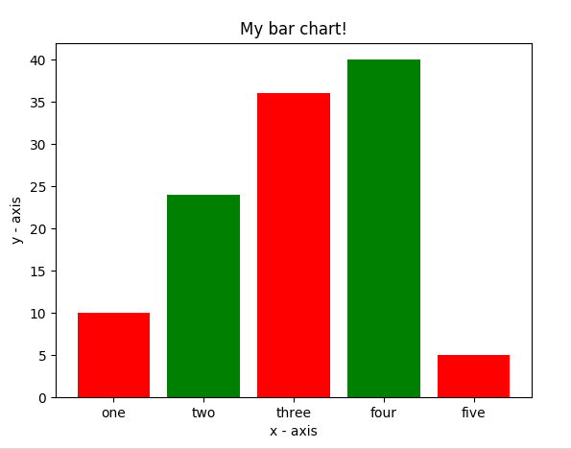
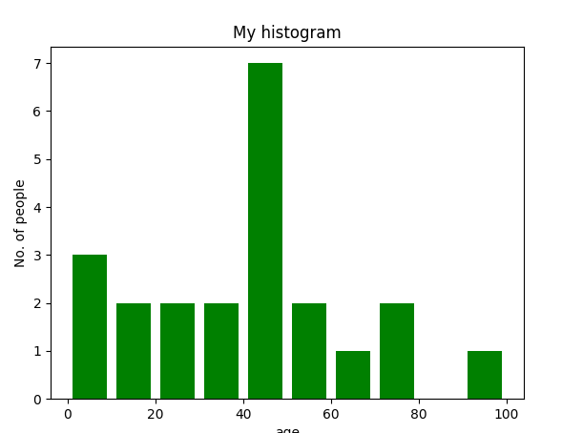
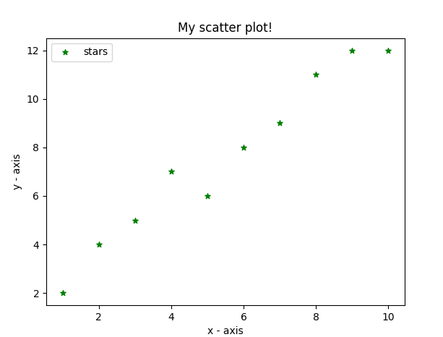
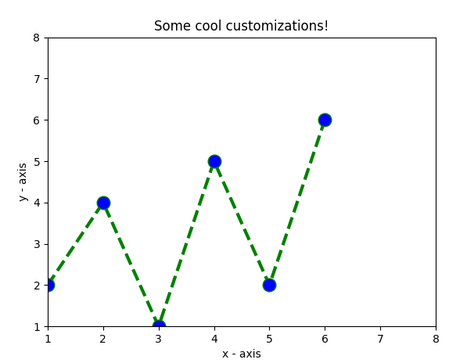
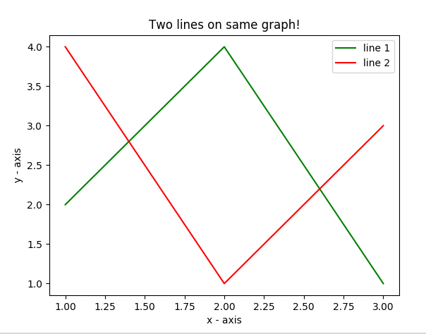
E.g. Matplotlib
Matplotlib allows you to make easy things
You can generate plots, histograms, power spectra, bar charts, errorcharts, scatterplots, etc., with just a few lines of code.

Slide 6
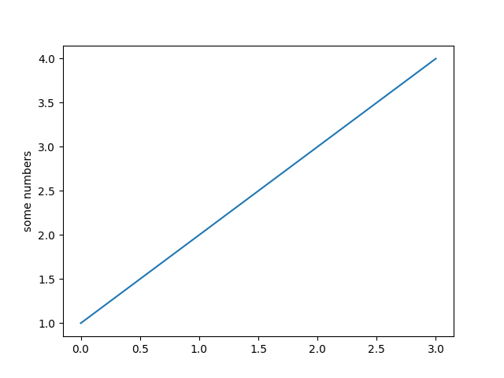
Simple Line Plots
Note: if you provide a single list or array to the plot() command,
then matplotlib assumes it is a sequence of y values, and
automatically generates the x values for you.
Since python ranges start with 0, the default x vector has the same length as y but starts with 0.
Hence the x data are[0, 1, 2, 3].
import matplotlib.pyplot as plt
plt.plot([1, 2, 3, 4])
plt.ylabel('some numbers')
plt.show()

Slide 7
pyplot
text() : adds text in an arbitrary location
xlabel(): adds text to the x-axis
ylabel(): adds text to the y-axis
title() : adds title to the plot
clear() : removes all plots from the axes.
savefig(): saves your figure to a file
legend() : shows a legend on the plot
All methods are available on pyplot and on the axes instance generally.

Slide 8
Plot
import matplotlib.pyplot as plt
x = [1, 2, 3, 4]
y = [1, 4, 9, 16]
plt.plot(x, y)
no return value?

Slide 9
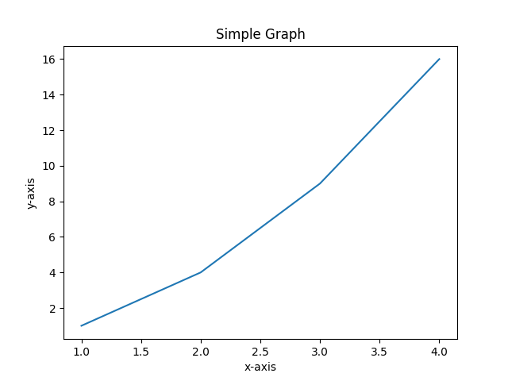
import matplotlib.pyplot as plt
plt.plot([1, 2, 3, 4], [1, 4, 9, 16])
plt.xlabel('x-axis')
plt.ylabel('y-axis')
plt.title('Simple Graph')
plt.show()

Slide 10
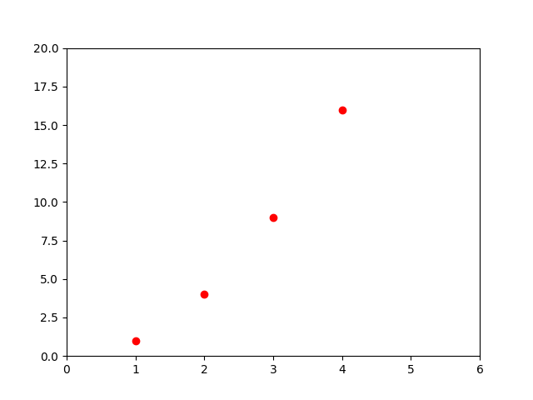
Customization of Plots
import matplotlib.pyplot as plt
plt.plot([1, 2, 3, 4], [1, 4, 9, 16], 'ro')
plt.axis([0, 6, 0, 20])
plt.show()

Slide 11
import matplotlib.pyplot as plt
# x axis values
x = [1,2,3,4,5,6]
# corresponding y axis values
y = [2,4,1,5,2,6]
# plotting the points
plt.plot(x, y, color='green', linestyle='dashed', linewidth = 3,
marker='o', markerfacecolor='blue', markersize=12)
# setting x and y axis range
plt.ylim(1,8)
plt.xlim(1,8)
# naming the x axis
plt.xlabel('x - axis')
# naming the y axis
plt.ylabel('y - axis')
# giving a title to my graph
plt.title('Some cool customizations!')
# function to show the plot
plt.show()
Customization of Plots

Slide 12
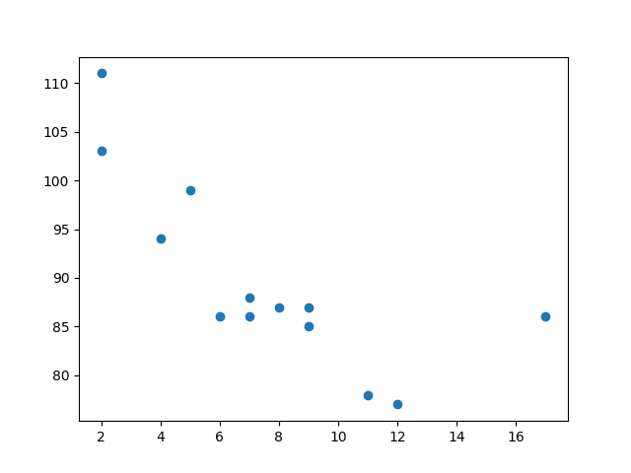
Creating Scatter Plots
With Pyplot, you can use the scatter() function to draw a scatter plot.
The scatter() function plots one dot for each observation. It needs two arrays of the same length,
one for the values of the x-axis, and one for values on the y-axis:
import matplotlib.pyplot as plt
import numpy as np
x = np.array([5,7,8,7,2,17,2,9,4,11,12,9,6])
y = np.array([99,86,87,88,111,86,103,87,94,78,77,85,86])
plt.scatter(x, y)
plt.show()

Slide 13
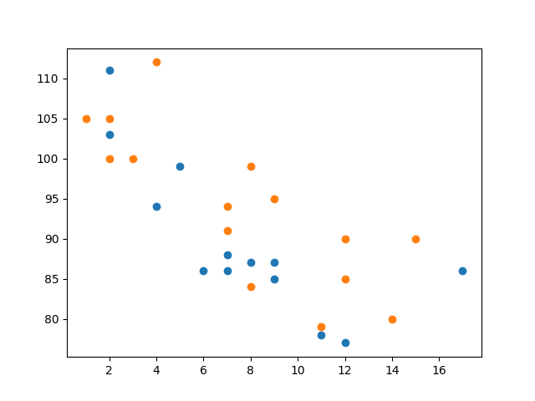
Compare Plots
Draw two plots on the same figure:
import matplotlib.pyplot as plt import numpy as np x = np.array([5,7,8,7,2,17,2,9,4,11,12,9,6]) y = np.array([99,86,87,88,111,86,103,87,94,78,77,85,86]) plt.scatter(x, y) x = np.array([2,2,8,1,15,8,12,9,7,3,11,4,7,14,12]) y=np.array([100,105,84,105,90,99,90,95,94,100,79,
112,91,80,85]) plt.scatter(x, y) plt.show()

Slide 14
Scatter plot
import matplotlib.pyplot as plt
# x-axis values
x = [1,2,3,4,5,6,7,8,9,10]
# y-axis values
y = [2,4,5,7,6,8,9,11,12,12]
# plotting points as a scatter plot
plt.scatter(x, y, label= "stars", color="green", marker="*", s=30)
# x-axis label
plt.xlabel('x - axis')
# frequency label
plt.ylabel('y - axis')
# plot title
plt.title('My scatter plot!')
# showing legend
plt.legend()
# function to show the plot
plt.show()

Slide 15
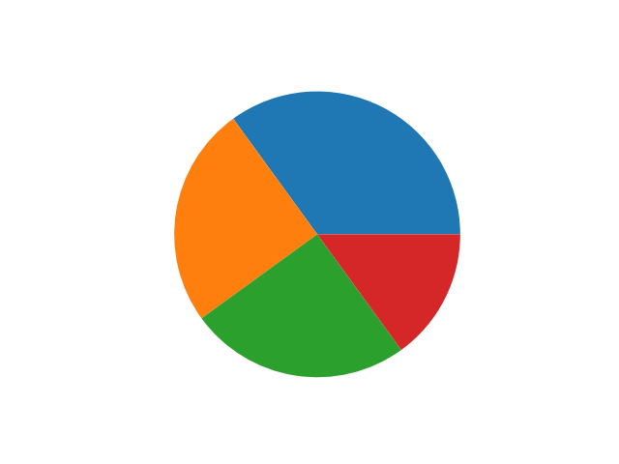
Pie-chart
With Pyplot, you can use the pie() function to draw pie charts
import matplotlib.pyplot as plt
import numpy as np
y = np.array([35, 25, 25, 15])
plt.pie(y)
plt.show()

Slide 16
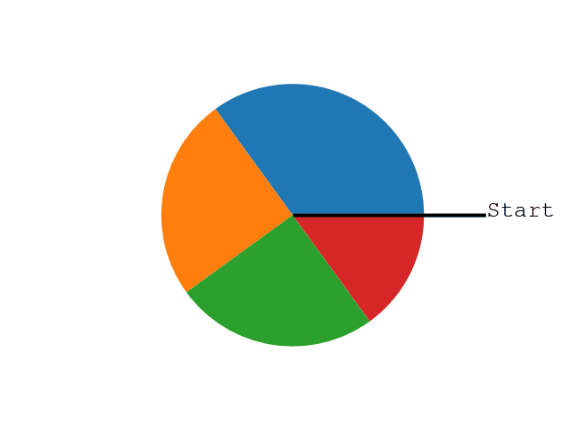
As you can see the pie chart draws one piece (called a wedge) for each value in the array (in this case [35, 25, 25, 15]).
By default the plotting of the first wedge starts from the x-axis and move counterclockwise:

Slide 17
Labels
Add labels to the pie chart with the label parameter.
The label parameter must be an array with one label for each wedge:
Start Angle
The default start angle is at the x-axis, but you can change the start angle by specifying a startangle parameter.
The startangle parameter is defined with an angle in degrees, default angle is 0
Explode
The explode parameter, if specified, and not None, must be an array with one value for each wedge.
Each value represents how far from the center each wedge is displayed

Slide 18
Shadow
Add a shadow to the pie chart by setting the shadows parameter to True
Colors
You can set the color of each wedge with the colors parameter.
The colors parameter, if specified, must be an array with one value for each wedge
You can use Hexadecimal color values, any of the 140 supported color names, or one of these shortcuts:
'r' - Red 'g' - Green 'b' - Blue 'c' - Cyan 'm' - Magenta 'y' - Yellow 'k' - Black 'w' - White

Slide 19
Legend
To add a list of explanation for each wedge, use the legend() function
Legend With Header
To add a header to the legend, add the title parameter to the legend function.

Slide 20
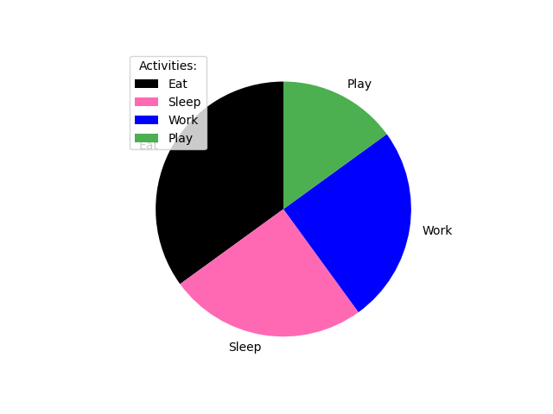
import matplotlib.pyplot as plt
import numpy as np
y = np.array([35, 25, 25, 15])
mylabels = ["Eat", "Sleep", "Work", "Play"]
mycolors = ["black", "hotpink", "b", "#4CAF50"]
plt.pie(y, labels = mylabels, startangle = 90,colors=mycolors)
#plt.legend()
plt.legend(title = "Activities:")
plt.show()

Slide 21
Box Plot
A Box Plot is also known as Whisker plot is created to display the summary of the set of data values having properties like minimum, first quartile, median, third quartile and maximum. In the box plot, a box is created from the first quartile to the third quartile, a vertical line is also there which goes through the box at the median. Here x-axis denotes the data to be plotted while the y-axis shows the frequency distribution.
Syntax:
matplotlib.pyplot.boxplot(data, notch=None, vert=None, patch_artist=None, widths=None)

Slide 22
Parameters:
Attribute | Value
data | array or sequence of array to be plotted
notch | optional parameter accepts boolean values
vert | optional parameter accepts boolean values false and true for horizontal and vertical plot respectively
bootstrap | optional parameter accepts int specifies intervals around notched boxplots
usermedians | optional parameter accepts array or sequence of array dimension compatible with data
positions | optional parameter accepts array and sets the position of boxes
widths | optional parameter accepts array and sets the width of boxes
patch_artist | optional parameter having boolean values
labels | sequence of strings sets label for each dataset
meanline | optional having boolean value try to render meanline as full width of box
order | optional parameter sets the order of the boxplot

Slide 23
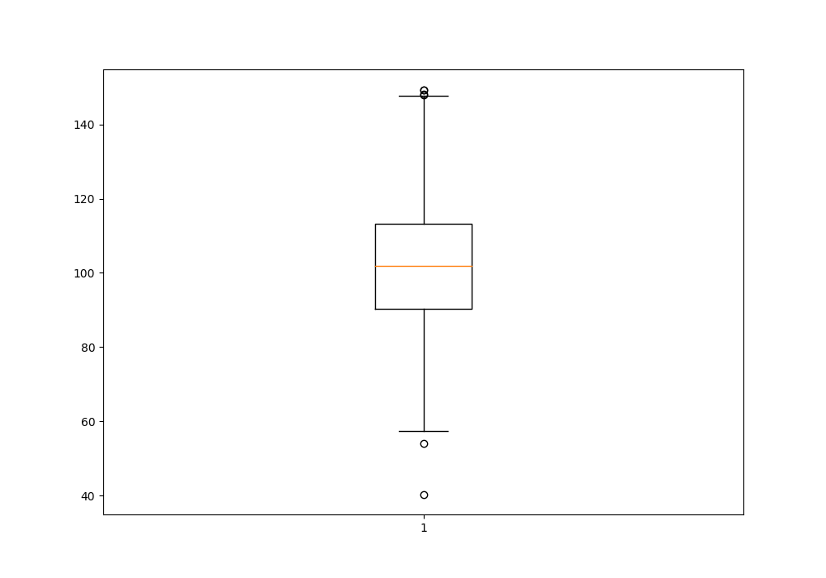
# Import libraries
import matplotlib.pyplot as plt
import numpy as np
# Creating dataset
np.random.seed(10)
data = np.random.normal(100, 20, 200)
fig = plt.figure(figsize =(10, 7))
# Creating plot
plt.boxplot(data)
# show plot
plt.show()

Slide 24
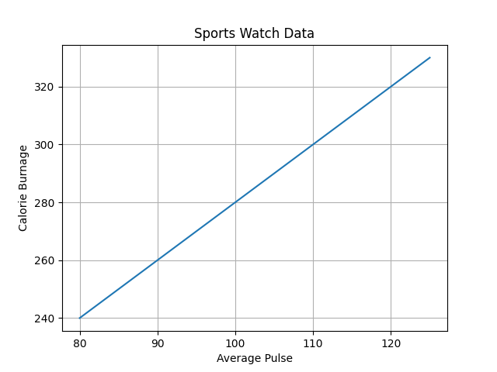
Matplotlib Grid
With Pyplot, you can use the grid() function to add grid lines to the plot.
import numpy as np import matplotlib.pyplot as plt x = np.array([80, 85, 90, 95, 100, 105, 110, 115, 120, 125]) y = np.array([240, 250, 260, 270, 280, 290, 300, 310, 320, 330]) plt.title("Sports Watch Data") plt.xlabel("Average Pulse") plt.ylabel("Calorie Burnage") plt.plot(x, y) plt.grid() plt.show()

Slide 25

Display only grid lines for the x-axis:
import numpy as np import matplotlib.pyplot as plt x = np.array([80, 85, 90, 95, 100, 105, 110, 115, 120, 125]) y = np.array([240, 250, 260, 270, 280, 290, 300, 310, 320, 330]) plt.title("Sports Watch Data") plt.xlabel("Average Pulse") plt.ylabel("Calorie Burnage") plt.plot(x, y) plt.grid(axis = 'x') plt.show()

Slide 26
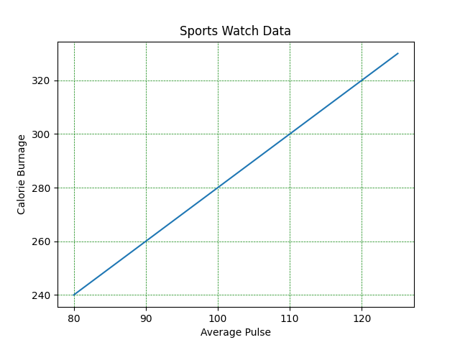
Set Line Properties for the Grid
You can also set the line properties of the grid, like this: grid(color = 'color', linestyle = 'linestyle', linewidth = number).
import numpy as np
import matplotlib.pyplot as plt
x = np.array([80, 85, 90, 95, 100, 105, 110, 115, 120, 125])
y = np.array([240, 250, 260, 270, 280, 290, 300, 310, 320, 330])
plt.title("Sports Watch Data")
plt.xlabel("Average Pulse")
plt.ylabel("Calorie Burnage")
plt.plot(x, y)
plt.grid(color = 'green', linestyle = '--', linewidth = 0.5)
plt.show()

Slide 27
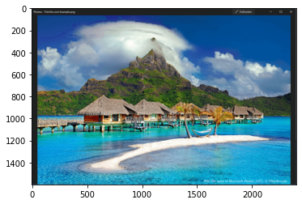
<matplotlib.image.AxesImage at 0x7f3855d4f750>
Display images using matplotlib
The image module in matplotlib library is used for working with images in Python. The image module also includes two useful methods which are imread which is used to read images and imshow which is used to display the image.
# importing required libraries
import matplotlib.pyplot as plt
import matplotlib.image as img
# reading the image
testImage = img.imread('/content/drive/MyDrive/colab_data/png_79.webp')
# displaying the image
plt.imshow(testImage)

Slide 28
Create a Table with Matplotlib
Matplotlib Table in Python is a particular function that allows you to plot a table.
By using matplotlib.pyplot.table(), we can add a table to Axes. This table is then plotted with columns as an x-axis and values as the y-axis.
Syntax of Matplotlib Table:
matplotlib.pyplot.table(cellText=None, cellColours=None, cellLoc='right', colWidths=None, rowLabels=None, rowColours=None, rowLoc='left', colLabels=None, colColours=None, colLoc='center', loc='bottom', bbox=None, edges='closed', **kwargs)

Slide 29
Parameters:
cellText: The texts to place into the table cells.
cellColours: The background colors of the cells.
cellLoc: The alignment of the text within the cells. (default: ‘right’)
colWidths (optional): The column widths in units of the axes.
rowLabels (optional): The text of the row header cells.
rowColours (optional): The colors of the row header cells.
rowLoc (optional): The text alignment of the row header cells. (default: ‘left’)
colLabels (optional): The text of the column header cells.
colColours (optional): The colors of the column header cells.
colLoc (optional): The text alignment of the column header cells.(default: ‘left’)
Loc (optional): This parameter is the position of the cell with respect to ax.
bbox (optional): This parameter is the bounding box to draw the table into.
edges (optional): This parameter is the cell edges to be drawn with a line.
**kwargs: Used to control table properties.

Slide 30
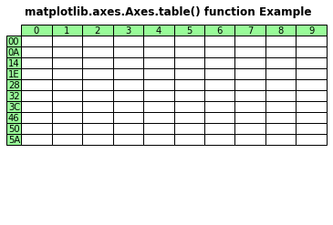
import matplotlib.pyplot as plt
val1 = ["{:X}".format(i) for i in range(10)]
val2 = ["{:02X}".format(10 * i) for i in range(10)]
val3 = [["" for c in range(10)] for r in range(10)]
fig, ax = plt.subplots()
ax.set_axis_off()
table = ax.table(
cellText = val3,
rowLabels = val2,
colLabels = val1,
rowColours =["palegreen"] * 10,
colColours =["palegreen"] * 10,
cellLoc ='center',
loc ='upper left')
ax.set_title('matplotlib.axes.Axes.table() function Example',
fontweight ="bold")
plt.show()

Slide 31
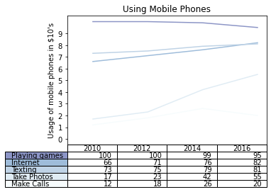
import numpy as np
import matplotlib.pyplot as plt
data = [[ 100, 100, 99, 95],
[ 66, 71, 76, 82],
[ 73, 75, 79, 81],
[ 17, 23, 42, 55],
[ 12, 18, 26, 20]]
columns = ('2010', '2012', '2014', '2016')
rows = ("Make Calls", "Take Photos", "Texting", "Internet", "Playing games")[::-1]
values = np.arange(0, 10, 1)
value_increment = 10
# Get some pastel shades for the colors
colors = plt.cm.BuPu(np.linspace(0, 0.5, len(rows)))
colors = colors[::-1]
index = np.arange(len(columns)) + 0.3
bar_width = 0.4
n_rows = len(data)
for row in range(n_rows):
plt.plot(index, data[row], bar_width, color=colors[row])
plt.table(cellText=data, rowLabels=rows, rowColours=colors, colLabels=columns, loc='bottom')
plt.subplots_adjust(left=0.25, bottom=0.25)
plt.ylabel("Usage of mobile phones in ${0}'s".format(value_increment))
plt.yticks(values * value_increment, ['%d' % val for val in values])
plt.xticks([])
plt.title('Using Mobile Phones')
plt.show()
Matplotlib Table Example As Line Graph

Slide 32
Matplotlib.pyplot.plot_date ()
This function used to add dates to the plot
Syntax:
matplotlib.pyplot.plot_date(x, y, fmt=’o’, tz=None, xdate=True, ydate=False, data=None, **kwargs)
parameters
S.no. | Parameter/Arguments | Description
1. | x, y | x and y both are the coordinates of the data i.e. x-axis horizontally and y-axis vertically.
2. | fmt | It is a optional string parameter that contains the corresponding plot details like color, style etc.

Slide 33
3. | tz | tz stands for timezone used to label dates, default(UTC).
4. | xdate | xdate parameter contains boolean value. If xdate is true then x-axis is interpreted as date in matplotlib. By default xdate is true.
5. | ydate | If ydate is true then y-axis is interpreted as date in matplotlib. By default ydate is false.
6. | data | The data which is going to be used in plot.

Slide 34
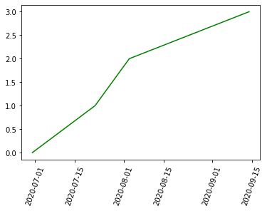
# importing libraries
import matplotlib.pyplot as plt
from datetime import datetime
# creating array of dates for x axis
dates = [
datetime(2020, 6, 30),
datetime(2020, 7, 22),
datetime(2020, 8, 3),
datetime(2020, 9, 14)
]
# for y axis
x = [0, 1, 2, 3]
plt.plot_date(dates, x, 'g')
plt.xticks(rotation=70)
plt.show()

Slide 35
Plotting polar curves
A point in polar co-ordinates is represented as (r, theta). Here, r is its distance from the origin and theta is the angle at which r has to be measured from origin.
Syntax :
matplotlib.pyplot.polar(theta, r, **kwargs)

Slide 36
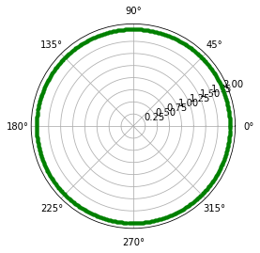
import numpy as np
import matplotlib.pyplot as plt
# setting the axes projection as polar
plt.axes(projection = 'polar')
# setting the radius
r = 2
# creating an array containing the
# radian values
rads = np.arange(0, (2 * np.pi), 0.01)
# plotting the circle
for rad in rads:
plt.polar(rad, r, 'g.')
# display the Polar plot
plt.show()

Slide 37
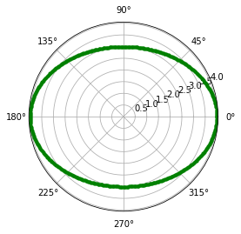
Ellipse : An ellipse is the locus of a point moving in a plane such that the sum of its distances from two other points (the foci) is constant.
import numpy as np
import matplotlib.pyplot as plt
import math
# setting the axes
# projection as polar
plt.axes(projection = 'polar')
# setting the values of
# semi-major and
# semi-minor axes
a = 4
b = 3
# creating an array
# containing the radian values
rads = np.arange(0, (2 * np.pi), 0.01)
# plotting the ellipse
for rad in rads:
r = (a*b)/math.sqrt((a*np.sin(rad))**2 + (b*np.cos(rad))**2)
plt.polar(rad, r, 'g.')
# display the polar plot
plt.show()

Slide 38
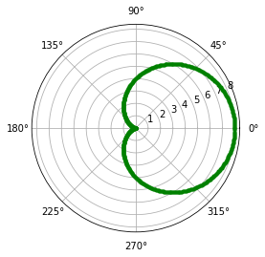
Cardioid : A cardioid is the locus of a point on the circumference of a circle as it rolls around another identical circle.
import numpy as np
import matplotlib.pyplot as plt
import math
# setting the axes
# projection as polar
plt.axes(projection = 'polar')
# setting the length of
# axis of cardioid
a=4
# creating an array
# containing the radian values
rads = np.arange(0, (2 * np.pi), 0.01)
# plotting the cardioid
for rad in rads:
r = a + (a*np.cos(rad))
plt.polar(rad,r,'g.')
# display the polar plot
plt.show()

Slide 39
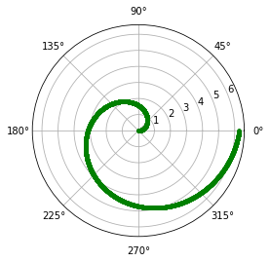
Archimedean spiral : An Archimedean spiral is the locus of a point moving uniformly on a straight line, which itself is turning uniformly about one of its end points.
import numpy as np
import matplotlib.pyplot as plt
# setting the axes
# projection as polar
plt.axes(projection = 'polar')
# creating an array
# containing the radian values
rads = np.arange(0, 2 * np.pi, 0.001)
# plotting the spiral
for rad in rads:
r = rad
plt.polar(rad, r, 'g.')
# display the polar plot
plt.show()

Slide 40
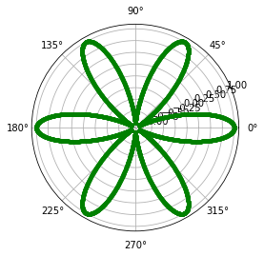
Rhodonea : A Rhodonea or Rose curve is a rose-shaped sinusoid plotted in polar coordinates.
Where,
a = length of petals
n = number of petals
import numpy as np
import matplotlib.pyplot as plt
# setting the axes
# projection as polar
plt.axes(projection='polar')
# setting the length
# and number of petals
a = 1
n = 6
# creating an array
# containing the radian values
rads = np.arange(0, 2 * np.pi, 0.001)
# plotting the rose
for rad in rads:
r = a * np.cos(n*rad)
plt.polar(rad, r, 'g.')
# display the polar plot
plt.show()

Slide 41
Visualisation Errors
For any scientific measurement, accurate accounting for errors is nearly as important, if not more important, than accurate reporting of the number itself. For example, imagine that I am using some astrophysical observations to estimate the Hubble Constant, the local measurement of the expansion rate of the Universe. I know that the current literature suggests a value of around 71 (km/s)/Mpc, and I measure a value of 74 (km/s)/Mpc with my method. Are the values consistent? The only correct answer, given this information, is this: there is no way to know.
Suppose I augment this information with reported uncertainties: the current literature suggests a value of around 71 ±± 2.5 (km/s)/Mpc, and my method has measured a value of 74 ±± 5 (km/s)/Mpc. Now are the values consistent? That is a question that can be quantitatively answered.
In visualization of data and results, showing these errors effectively can make a plot convey much more complete information.

Slide 42
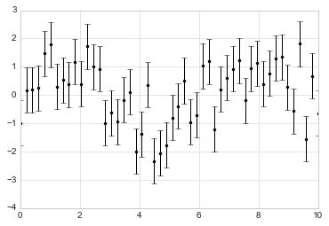
Types And Description Of Visualisation Errors
1. Basic Errorbars
A basic errorbar can be created with a single Matplotlib function call:
%matplotlib inline
import matplotlib.pyplot as plt
plt.style.use('seaborn-whitegrid')
import numpy as np
x = np.linspace(0, 10, 50)
dy = 0.8
y = np.sin(x) + dy * np.random.randn(50)
plt.errorbar(x, y, yerr=dy, fmt='.k');

Slide 43
2 . Continuous Error
In some situations it is desirable to show errorbars on continuous quantities. Though Matplotlib does not have a built-in convenience routine for this type of application, it's relatively easy to combine primitives like plt.plot and plt.fill_between for a useful result.
Here we'll perform a simple Gaussian process regression, using the Scikit-Learn API (see Introducing Scikit-Learn for details). This is a method of fitting a very flexible non-parametric function to data with a continuous measure of the uncertainty. We won't delve into the details of Gaussian process regression at this point.

Slide 44
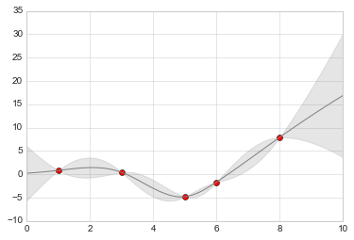
model = lambda x: x * np.sin(x)
xdata = np.array([1, 3, 5, 6, 8])
ydata = model(xdata) # Compute the Gaussian process fit
gp = GaussianProcess(corr='cubic', theta0=1e-2, thetaL=1e-4, thetaU=1E-1, random_start=100)
gp.fit(xdata[:, np.newaxis], ydata) xfit = np.linspace(0, 10, 1000) yfit, MSE = gp.predict(xfit[:, np.newaxis], eval_MSE=True)
dyfit = 2 * np.sqrt(MSE)
model = lambda x: x * np.sin(x)
xdata = np.array([1, 3, 5, 6, 8])
ydata = model(xdata) # Compute the Gaussian process fit
gp = GaussianProcess(corr='cubic', theta0=1e-2, thetaL=1e-4, thetaU=1E-1, random_start=100)
gp.fit(xdata[:, np.newaxis], ydata) xfit = np.linspace(0, 10, 1000) yfit, MSE = gp.predict(xfit[:, np.newaxis], eval_MSE=True)
dyfit = 2 * np.sqrt(MSE)

Slide 45
Contour Plot using Matplotlib
Contour plots also called level plots are a tool for doing multivariate analysis and visualizing 3-D plots in 2-D space.
Contour plots are widely used to visualize density, altitudes or heights of the mountain as well as in the meteorological department.
matplotlib.pyplot.contour
The matplotlib.pyplot.contour() are usually useful when Z = f(X, Y) i.e Z changes as a function of input X and Y. A contourf() is also available which allows us to draw filled contours.
Syntax: matplotlib.pyplot.contour([X, Y, ] Z, [levels], **kwargs)

Slide 46
Parameters:
X, Y: 2-D numpy arrays with same shape as Z or 1-D arrays such that len(X)==M and len(Y)==N (where M and N are rows and columns of Z)
Z: The height values over which the contour is drawn. Shape is (M, N)
levels: Determines the number and positions of the contour lines / regions.
Returns: QuadContourSet

Slide 47
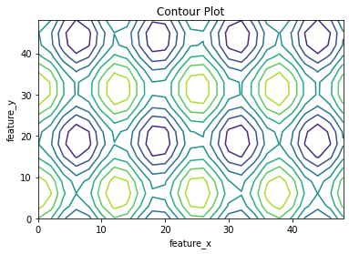
# Implementation of matplotlib function
import matplotlib.pyplot as plt
import numpy as np
feature_x = np.arange(0, 50, 2)
feature_y = np.arange(0, 50, 3)
# Creating 2-D grid of features
[X, Y] = np.meshgrid(feature_x, feature_y)
fig, ax = plt.subplots(1, 1)
Z = np.cos(X / 2) + np.sin(Y / 4)
# plots contour lines
ax.contour(X, Y, Z)
ax.set_title('Contour Plot')
ax.set_xlabel('feature_x')
ax.set_ylabel('feature_y')
plt.show()

Slide 48
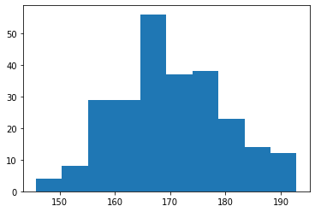
Histogram
A histogram is a graph showing frequency distributions.
It is a graph showing the number of observations within each given interval.
import matplotlib.pyplot as plt import numpy as np x = np.random.normal(170, 10, 250) plt.hist(x) plt.show()

Slide 49
The following table shows the parameters accepted by matplotlib.pyplot.hist() function :
Attribute | parameter
x | array or sequence of array
bins | optional parameter contains integer or sequence or strings
density | optional parameter contains boolean values
range | optional parameter represents upper and lower range of bins
histtype | optional parameter used to create type of histogram [bar, barstacked, step, stepfilled], default is “bar”
align | optional parameter controls the plotting of histogram [left, right, mid]
weights | optional parameter contains array of weights having same dimensions as x
bottom | location of the baseline of each bin
rwidth | optional parameter which is relative width of the bars with respect to bin width
color | optional parameter used to set color or sequence of color specs
label | optional parameter string or sequence of string to match with multiple datasets
log | optional parameter used to set histogram axis on log scale

Slide 50
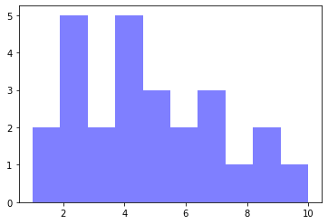
Bins — is an argument specific to a histogram and allows the user to customize how many bins they want.
Alpha — is an argument that displays the level of transparency of the data points.
import matplotlib.pyplot as plt
#generate fake data
x = [2,1,6,4,2,4,8,9,4,2,4,10,6,4,5,7,7,3,2,7,5,3,5,9,2,1]
#plot for a histogram
plt.hist(x, bins = 10, color='blue', alpha=0.5)
plt.show()

Slide 51
import matplotlib.pyplot as plt
# frequencies
ages=[2,5,70,40,30,45,50,45,43,40,44,60,7,13,57,18,90,77,32,21,20,40]
# setting the ranges and no. of intervals
range = (0, 100)
bins = 10
# plotting a histogram
plt.hist(ages, bins, range, color='green',histtype='bar',rwidth=0.8)
# x-axis label
plt.xlabel('age')
# frequency label
plt.ylabel('No. of people')
# plot title
plt.title('My histogram')
# function to show the plot
plt.show()

Slide 52
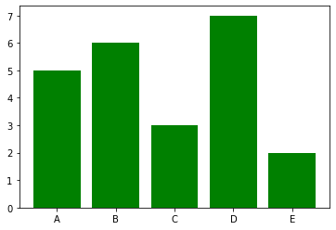
Bar graphs
import matplotlib.pyplot as plt
#Create data for plotting
values = [5, 6, 3, 7, 2]
names = ["A", "B", "C", "D", "E"]
plt.bar(names, values, color="green")
plt.show()
When using a bar graph, the change in code will be from plt.plot() to plt.bar() changes it into a bar chart.

Slide 53
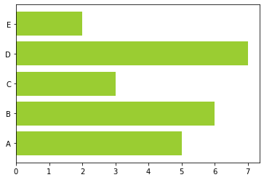
We can also flip the bar graph horizontally with the following
import matplotlib.pyplot as plt
#Create data for plotting values = [5,6,3,7,2] names = ["A", "B", "C", "D", "E"]
# Adding an "h" after bar will flip the graph plt.barh(names, values, color="yellowgreen") plt.show()

Slide 54
Customizing Plot Legends
Legends
Legend is an area of the graph describing each part of the graph. A graph can be simple as it is. But adding the title, X label, Y label and legend will be more clear. By seeing the names we can easily guess what the graph is representing and what type of data it is representing.
It can be described by the following terms:
legend(): legend() automatically determines the elements to display. It accomplishes this by showing every plot that has been marked with the keyword argument "label.
legend(labels): The name of the X and the name of Y, which is shown in the legend
legend(handles and labels): The list of line numbers to add to the legend. Combining labels and handles gives you complete control over what information should be included within the legend. It is recommended that the lengths of both legend as well as handles should be equal.

Slide 55
Customizing Plot Legends
Location:
Syntax:
legend(loc = ")
It is possible to pass it by following the steps:
"upper left", "upper right", "lower left", "lower right": It is located in the appropriate area of the plot.
"upper-center", "lower center", "center left", "center right": It is located at the edge that is in the middle of it.
"center": It is situated in the exact middle of the map.
"Best": It is not placed with the cross-over of artists.

Slide 56
Font Size:
Syntax:
legend(fontsize = ")
This can be passed as, 'xx-small', 'x-small', 'small', 'medium', 'large', 'x-large', 'xx-large'
Colour of the Legend:
Syntax:
legend(labelcolor = ")
labelcolor: is used for changing the colour of the text.
legend(facecolor = ")
facecolor: is used for changing the background colour of the legend
legend(edgecolor=")
edgecolor: is used for changing the edge colour of the legend

Slide 57
Marker Properties:
Syntax:
legend(markerfirst = bool, default: True)
The markerfirst parameter allows us to alter the location of the marker. If we set it to False, the positions of the marker and labels are swapped.
Changing the Looks:
shadow: This argument creates shadows to the legend.
frameon: Gives the frame to the legend.
fancybox: Gives smooth edges for the title.
framealpha: Provides transparency to the background of the legend.

Slide 58
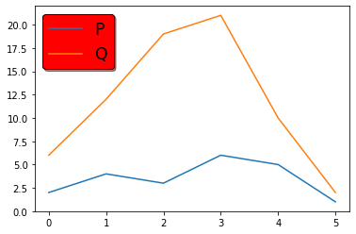
# First, we will import the required modules
import matplotlib.pyplot as mplot
# Here, we will plot values
P = [2, 4, 3, 6, 5, 1]
Q = [6, 12, 19, 21, 10, 2]
# Now, we will plot using matplotlib
mplot.plot(P, label = "P")
mplot.plot(Q, label = "Q")
# Here, we will create the legend and add the colour to it:
mplot.legend(loc='upper left',facecolor='red',edgecolor='black',fontsize='xx-large',shadow=True)

Slide 59
Customizing Colorbars
Colorbars are a visualization of the mapping from scalar values to colors. In Matplotlib they are drawn into a dedicated axis.
Note: Colorbars are typically created through Figure.colorbar or its pyplot wrapper
matplotlib.pyplot.colorbar() in python
The colorbar() function in pyplot module of matplotlib adds a colorbar to a plot indicating the color scale.
Syntax:matplotlib.pyplot.colorbar(mappable=None, cax=None, ax=None, **kwarg)

Slide 60
Parameters:
ax: This parameter is an optional parameter and it contains Axes or list of Axes.
**kwarg(keyword arguments): This parameter is an optional parameter and are of two kinds:
colorbar properties:
extend:{‘neither’, ‘both’, ‘min’, ‘max’} makes pointed end(s) for out-of-range values.
label:The label on the colorbar’s long axis.
ticks:None or list of ticks or Locator.
Returns:colorbar which is an instance of the class ‘matplotlib.colorbar.Colorbar’.

Slide 61
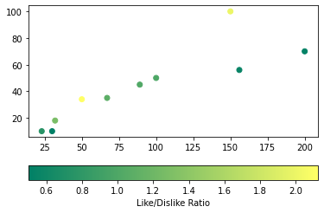
To Add a horizontal colorbar to a scatterplot
import numpy as np
import matplotlib.pyplot as plt
# Dataset
# List of total number of items purchased
# from each products
purchaseCount = [100, 200, 150, 23, 30, 50,
156, 32, 67, 89]
# List of total likes of 10 products
likes = [50, 70, 100, 10, 10, 34, 56, 18, 35, 45]
# List of Like/Dislike ratio of 10 products
ratio = [1, 0.53, 2, 0.76, 0.5, 2.125, 0.56,
1.28, 1.09, 1.02]
# scatterplot
plt.scatter(x=purchaseCount, y=likes, c=ratio, cmap="summer")
plt.colorbar(label="Like/Dislike Ratio", orientation="horizontal")
plt.show()

Slide 62
Multiple Subplots
To create multiple plots in one figure, we use matplotlib.pyplot.subplots method.
The subplot() Function
The subplot() function takes three arguments that describes the layout of the figure.
The layout is organized in rows and columns, which are represented by the first and second argument.
The third argument represents the index of the current plot.

Slide 63
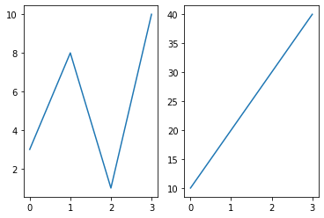
import matplotlib.pyplot as plt
import numpy as np
#plot 1:
x = np.array([0, 1, 2, 3])
y = np.array([3, 8, 1, 10])
plt.subplot(1, 2, 1) #the figure has 1 row, 2 columns, and this plot is the first plot.
plt.plot(x,y)
#plot 2:
x = np.array([0, 1, 2, 3])
y = np.array([10, 20, 30, 40])
plt.subplot(1, 2, 2) #the figure has 1 row, 2 columns, and this plot is the second plot.
plt.plot(x,y)
plt.show()

Slide 64
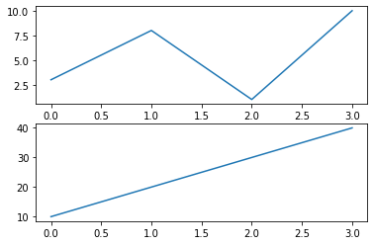
Draw 2 plots on top of each other:
import matplotlib.pyplot as plt import numpy as np #plot 1: x = np.array([0, 1, 2, 3]) y = np.array([3, 8, 1, 10]) plt.subplot(2, 1, 1) plt.plot(x,y) #plot 2: x = np.array([0, 1, 2, 3]) y = np.array([10, 20, 30, 40]) plt.subplot(2, 1, 2) plt.plot(x,y) plt.show()

Slide 65
Customizing Ticks
Ticks are the markers denoting data points on axes.
Matplotlib's default tick locators and formatters are designed to be generally sufficient in many common situations. Position and labels of ticks can be explicitly mentioned to suit specific requirements.
The xticks() and yticks() function takes a list object as argument. The elements in the list denote the positions on corresponding action where ticks will be displayed.
Eg: ax.set_xticks([2,4,6,8,10])
Similarly, labels corresponding to tick marks can be set by set_xlabels() and set_ylabels() functions respectively.
Eg: ax.set_xlabels([‘two’, ‘four’,’six’, ‘eight’, ‘ten’])

Slide 66
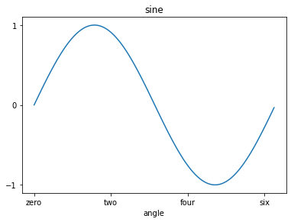
import matplotlib.pyplot as plt
import numpy as np
import math
x = np.arange(0, math.pi*2, 0.05)
fig = plt.figure()
ax = fig.add_axes([0.1, 0.1, 0.8, 0.8]) # main axes
y = np.sin(x)
ax.plot(x, y)
ax.set_xlabel('angle')
ax.set_title('sine')
ax.set_xticks([0,2,4,6])
ax.set_xticklabels(['zero','two','four','six'])
ax.set_yticks([-1,0,1])
plt.show()

Slide 67
Customizing Matplotlib: Configurations and Stylesheets
There are three ways to customize Matplotlib:
Setting rcParams at runtime.
Using style sheets.
Changing your matplotlibrc file.
Runtime rc settings
You can dynamically change the default rc (runtime configuration) settings in a python script or interactively from the python shell. All rc settings are stored in a dictionary-like variable called matplotlib.rcParams, which is global to the matplotlib package.

Slide 68
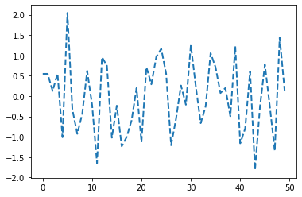
import numpy as np
import matplotlib.pyplot as plt
import matplotlib as mpl
from cycler import cycler
mpl.rcParams['lines.linewidth'] = 2
mpl.rcParams['lines.linestyle'] = '--'
data = np.random.randn(50)
plt.plot(data)

Slide 69
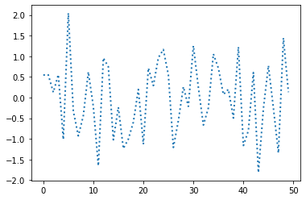
Temporary rc settings
with mpl.rc_context({'lines.linewidth': 2, 'lines.linestyle': ':'}):
plt.plot(data)

Slide 70
Using style sheets
Another way to change the visual appearance of plots is to set the rcParams in a so-called style sheet and import that style sheet with matplotlib.style.use.
Syntax:plt.style.use(“Name of the style”)
To list all available styles, use:
print(plt.style.available)
['Solarize_Light2', '_classic_test_patch', 'bmh', 'classic', 'dark_background', 'fast', 'fivethirtyeight', 'ggplot', 'grayscale', 'seaborn', 'seaborn-bright', 'seaborn-colorblind', 'seaborn-dark', 'seaborn-dark-palette', 'seaborn-darkgrid', 'seaborn-deep', 'seaborn-muted', 'seaborn-notebook', 'seaborn-paper', 'seaborn-pastel', 'seaborn-poster', 'seaborn-talk', 'seaborn-ticks', 'seaborn-white', 'seaborn-whitegrid', 'tableau-colorblind10']

