Slide 1
Predicting the Home Prices in Ames, Iowa
Aparna SUndaram

Slide 2
Data Types
Continuous:
All area variables such as basement square footage and 1st floor square footage
Year
Counts:
Variables including numbers of bathrooms, bedrooms, and kitchens
Ordinal categorial
Nominal categorial:
Variables including zoning, subclass, heating type, lot shape, and quality of items
Notes:
Issues with data types: several counts data showed up as numerical or continuous data, and additional care was needed to sift through these carefully, check them carefully, and assign them to the correct data type.

Slide 3
Selecting Variables – Round 1
Correlations on all true continuous variables with outcome
Relaxed rule: included variables correlated at 0.50 or higher
Also examined scatter plots against outcome
T-Tests and ANOVAs on all ordinal categorical and nominal categorial
Variables with significant difference on outcome selected
Also examined box-plots and bar plots against outcome
A total of 50 explanatory variables prior to recoding were selected
Notes:
50 is already too many, but I wanted to be conservative.

Slide 4
Variable Recodes – Continuous Variables
Outcome variable -- Sale price of home:
Right skewed variable with a long tail
Natural logged to reduce elasticity
All selected continuous variables (except year) were logged.
All were right skewed
Year was converted to duration
Examined the outliers on all continuous variables
Instead of dropping, they were reset to the mean of the variable
Notes:
Checked this with Aiko.

Slide 5
Variable Recodes – Categorical Variables
Frequency distribution of all categorical variables examined
Low cell frequencies cause problems with variance estimation
Cell size of 1 is particularly problematic
Variable with one category dominating the others were binary coded
Especially important when other cell frequencies are small
Rationale that either the market or the building codes dictated strong cell frequencies
The residual category was treated as ‘other’
Variables with large numbers of missing values such as pool or fence were binary coded (present Y/N)
Variables with enough cell counts were coded as multi-category
Notes:
Variance estimation is not the focus of this project, but the rules learned through work in that area were applied here as well.

Slide 6
Missing Values
Data reasonably clean, but some issues with missing values
Many missing values indicated absence of a feature
Pool, Fence, Fireplace
They were assigned a value of zero
Issues with inconsistent missings on basement and garage variables
Only observations consistently missing on all basement/garage variables assigned zero
Rest treated as true missing (not many)
All true missings imputed using KNN Impute.

Slide 7
Selecting Variables – Round 2
Forward AIC on all recoded variables
Left with 31 variables to include in final set of models
This does not include the different categories of each variable

Slide 8
Models used
Ordinary Least Squares
Ridge
Lasso
Elastic-Net
Gradient Boosting Regression
Decision Tree Regressor
Random Forest Regressor
All except OLS done using grid-search with 10-fold cross-validation

Slide 9
OLS, Ridge, Lasso, Elastic-Net
OLS:
R-square of .889
MSE of 0.017
RMSE of 0.129
Tuned Ridge:
R-square of .870
MSE of 0.017
RMSE of 0.129
Tuned Lasso:
R-square of .821
MSE of 0.027
RMSE of 0.164
Tuned Elastic-Net:
R-square of .662
MSE of 0.051
RMSE of 0.226
Notes:
The Lasso zeroed out a large chunk of the variables. The training R^2 on OLS and Ridge were very high at close to 90%.

Slide 10
Gradient Boosting, Decision Tree, Random Forest
Gradient Boosting Regression:
R-square of .842
MSE of 0.020
RMSE of 0.141
Decision Tree:
R-square of .764
MSE of 0.017
RMSE of 0.129
Random Forest:
R-square of .779
MSE of 0.026
RMSE of 0.129
Notes:
The GBM curiously retained most all of the variables. The training R^2 on the Decision Tree and Random Forest was close to 99%. The test R^2 were decidedly less impressive indicating serious over-fitting.

Slide 11
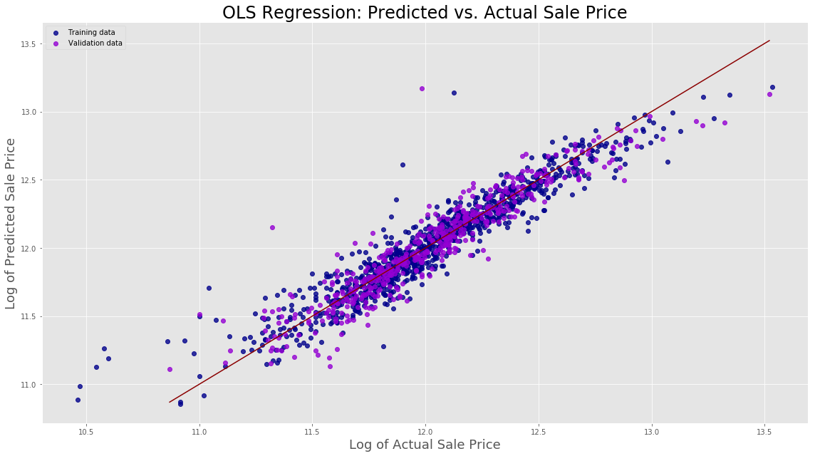
Fit of the OLS
Linear
Some under-estimate at the higher end
Some over-estimate at the lower end

Slide 12
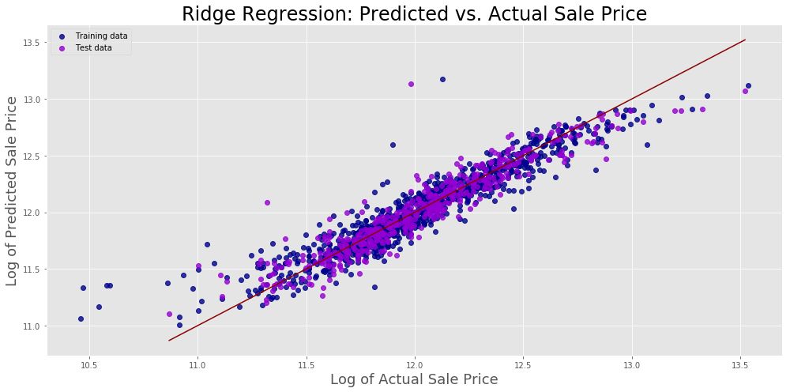
Fit of Ridge
Similar to OLS
Linear
Under/over estimate at extremes

Slide 13
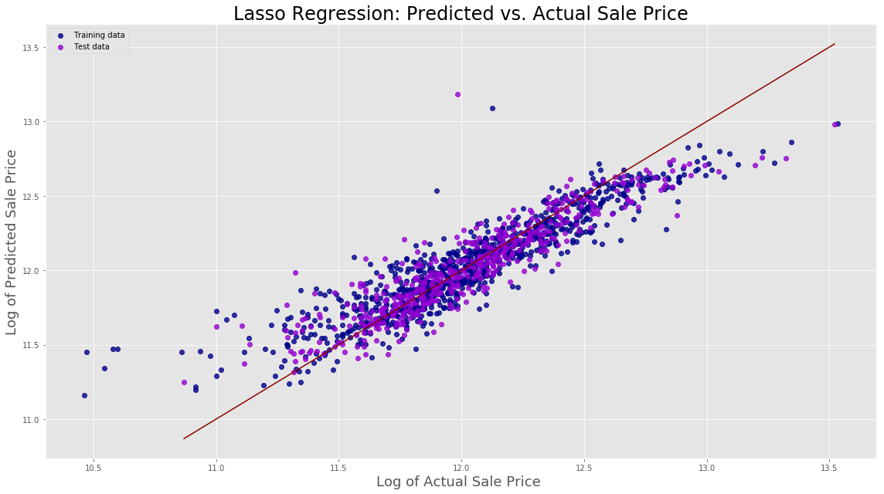
Fit of Lasso
Not as good as the others
A lot of over/under-estimation
Not just at extremes

Slide 14
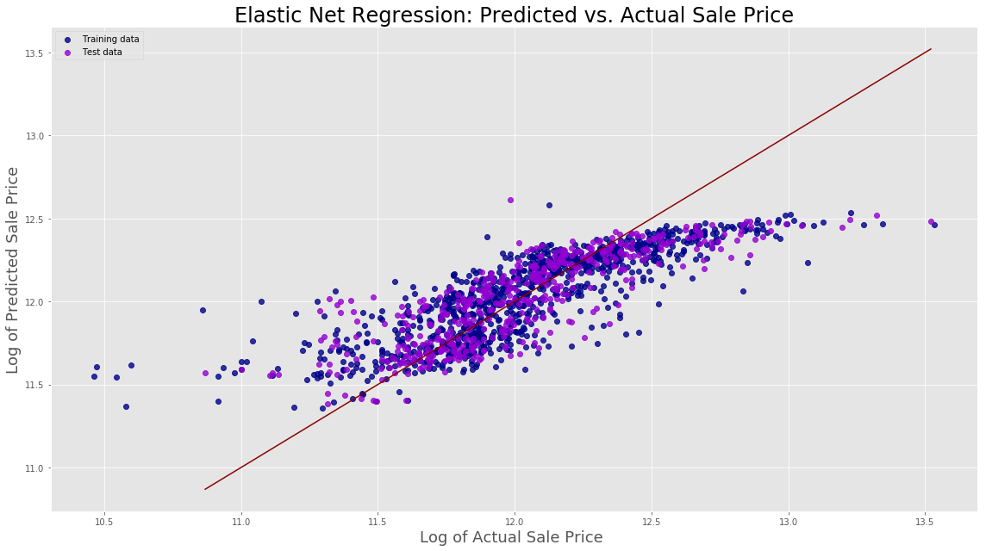
Fit of Elastic-Net
Very poor fit
The regression line does not fit the data at all well
A lot of over/under-estimation

Slide 15
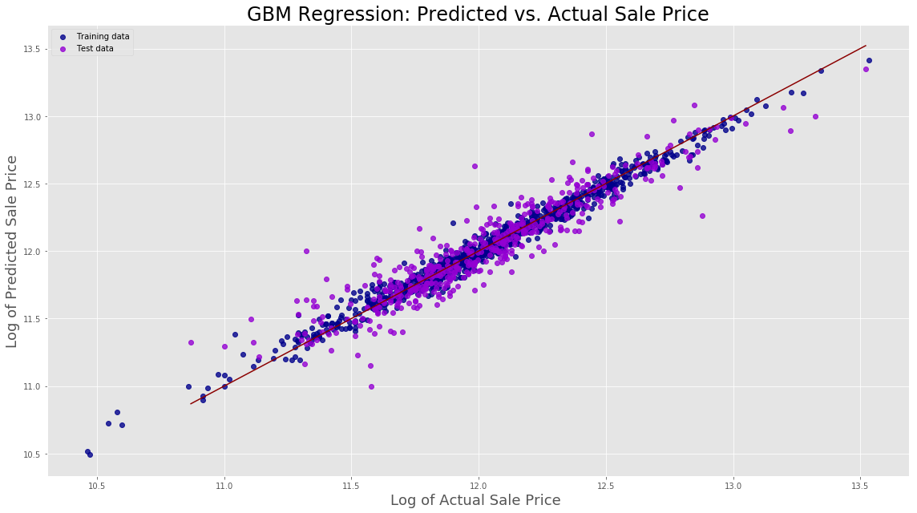
Fit of GBM
A very good fit
Reasonably even around the regression line
Looks best fit so far
Notes:
Rather curious since the R^2 wasn’t higher than OLS or Ridge.

Slide 16
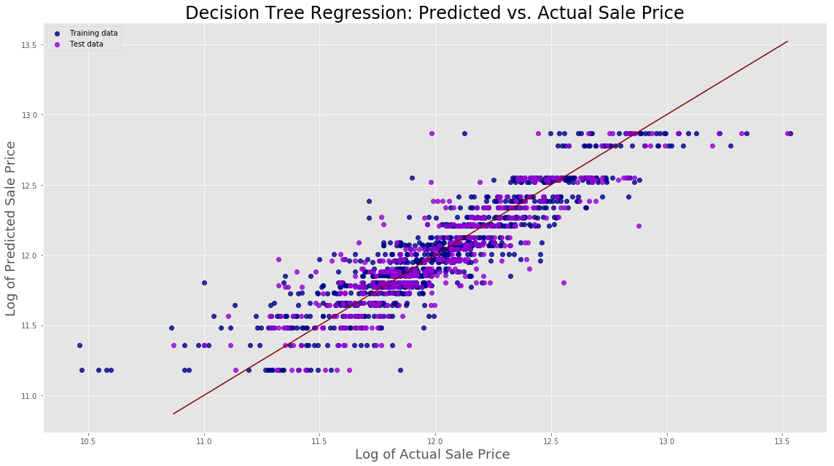
Fit of Decision Tree
Poor fit
A lot of dispersion around regression line
Data appear clustered at certain values

Slide 17
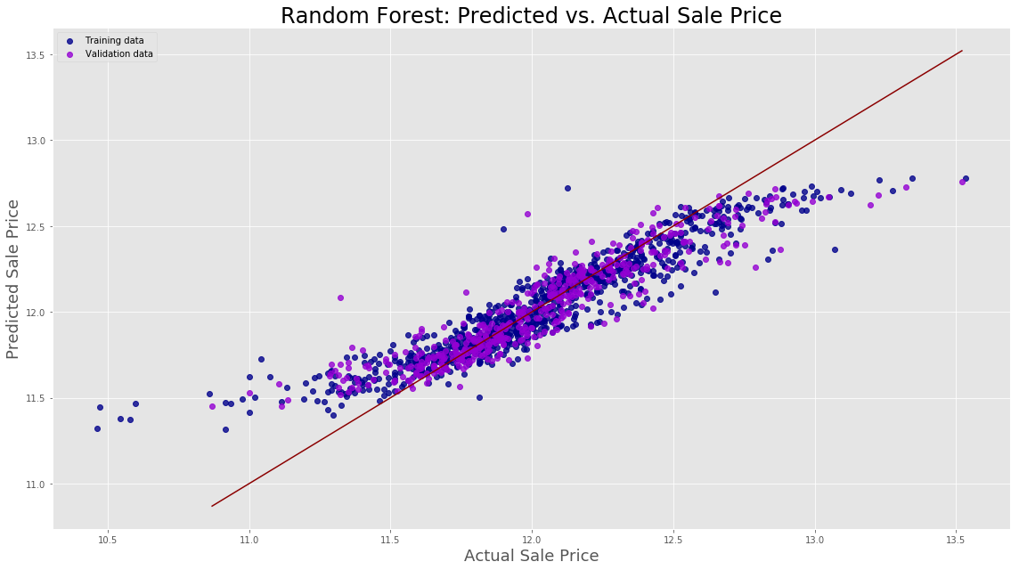
Fit of Random Forest
Poor fit
Not as bas as E-Net
Regression line does not predict the data well
A lot of over and under-estimation

Slide 18
Models selected
Gradient Boosting Regression
Ridge
OLS
Submitted on Kaggle for a score

Slide 19
Concerns
The data are very clustered
Serious problems with spatial auto-correlation
Violates assumptions of OLS
Managing autocorrelation requires use of design effects
Beyond the scope of this project
Very large standard errors associated with estimates

Slide 20
Thank You for Listening!

