Slide 1
iot.schema.org
Alignment with Brick Schema and Haystack Vocabulary,
Update on Feature of Interest
June 28, 2018

Slide 2
Alignment with Brick Schema
Haystack vocabulary in iot.schema.org

Slide 3
Project Haystack
Background:
Aims to standardize semantic data models to unlock the value of data generated by building equipment.
It is an open source initiative to enable Internet of Things applications.
Applications include automation, control, energy, HVAC, lighting, and other environmental systems.
Goal:
propose a concept to integration Haystack model with iot.schema.org
Review of existing schemas, which provide an RDF/OWL model for Haystack, and a proposal for the integration

Slide 4
Berkeley-IBM-UVA Model for Haystack
An RDF representation of Haystack tags and tagsets
No schema available
Example:
:ahu rdfs:subClassOf :HaystackMarker;
rdfs:label "AHU"@en;
rdfs:seeAlso <http://project-haystack.org/tag/ahu>;
:usedWith :equip;
:usedWith :rooftop.
:ahu_set rdfs:subClassOf :HaystackMarkerSet;
rdfs:label "AHU set"@en.
:ahu_discharge_air_temp_sensor rdfs:subClassOf :ahu_set;
owl:equivalentClass [ rdf:type owl:Class ; owl:intersectionOf (
[ rdf:type owl:Restriction; owl:onProperty :hasMarker; owl:someValuesFrom :ahu ]
[ rdf:type owl:Restriction; owl:onProperty :hasMarker; owl:someValuesFrom :discharge ]
[ rdf:type owl:Restriction; owl:onProperty :hasMarker; owl:someValuesFrom :air ]
[ rdf:type owl:Restriction; owl:onProperty :hasMarker; owl:someValuesFrom :temp ]
[ rdf:type owl:Restriction; owl:onProperty :hasMarker; owl:someValuesFrom :sensor ]
) ].
Source: https://github.com/arkaaloke/Berkeley-IBM-UVA

Slide 5
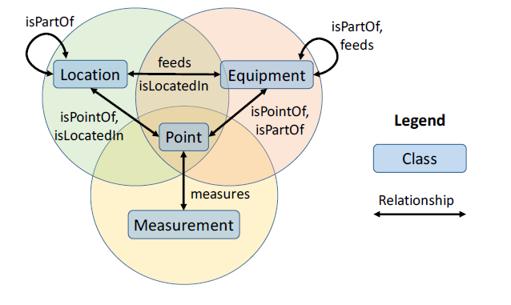
Brick Schema
RDF representation of Haystack tags and tagsets
Brick has additional tags and tagsets
Example:
brick:AHU_Discharge_Air_Temperature_Sensor
bf:usesTag
:AHU,
:Air,
:Discharge,
:Sensor,
:Supply,
:Temperature .
Source: http://brickschema.org/

Slide 6
Brick iot.schema.org Integration
iot:Capability,
iot:FeatureOfInterest
Equipment aligns to iot:FeatureOfInterest and iot:Capability
Example: Boiler equip →Boiler as a Capability and FeatureOfInterest

Slide 7
Brick iot.schema.org Integration
Quantity
iot:InteractionPattern
Quantity is missing in Brick schema. A quantity is a measure of an observable phenomenon, that, when associated with something, becomes a property of that thing.
Quantity is missing in Brick.
Point, Measurement, and Quantity align to iot:InteractionPattern
Example: chilled water delta temp sensor → InteractionPattern: ChilledWaterDeltaTemperature (Property)

Slide 8
Brick iot.schema.org Integration
iot:DataSchema
Kind
Kind in Haystack defines a tag value type using a predefined string constant.
Kind (DataSchema) is missing in Brick.
For some points kind is missing in Haystack as well.
Kind and Measurement align to iot:DataSchema

Slide 9
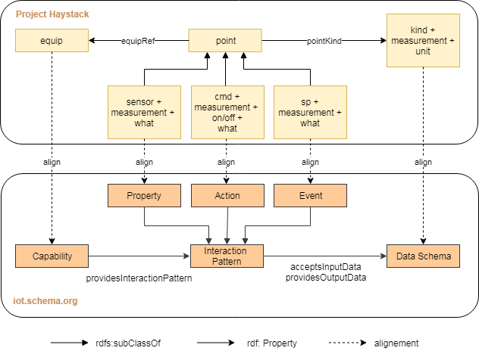
Old: Integration of Haystack vocabulary in iot.schema.org

Slide 10
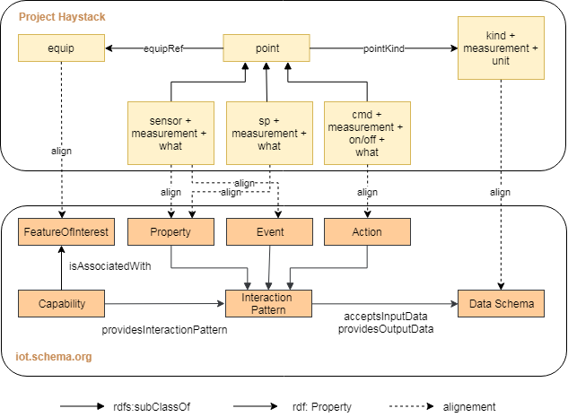
New: Integration of Haystack vocabulary in iot.schema.org

Slide 11
Example
iot:Capability: iot:Boiler
subclasses: iot:HotWaterBoiler, iot:SteamBoiler, iot:OilBoiler etc
iot:InteractionPattern:
iot:Action: iot:TurnOn, iot:TurnOff (run cmd)
iot:Property: iot:RunStatus (run sensor)
iot:Action: iot:CirculatePumpOn, iot:CirculatePumpOff (circ pump cmd)
iot:Property: iot:CirculatePumpStatus (circ pump sensor)
iot:Action: iot:CondensatePumpOn, iot:CondensatePumpOff (condensate pump cmd)
iot:Property: iot:CondensatePumpStatus (condensate pump sensor)

Slide 12
Example
:Boiler a owl:Class ;
rdfs:label "Boiler"@en ;
rdfs:subClassOf bf:Tag ;
skos:definition ""@en ;
bf:usedBy brick:Boiler,
brick:Boiler_On_Off_Status,
brick:Boiler_Run_Time_Sensor,
brick:Boiler_Start_Stop_Status .
brick:Boiler_Run_Time_Sensor bf:usesTag :Boiler, :Run, :Sensor, :Time .
Haystack defines more points for a Boiler than present in Brick, e.g. Brick does not define:
circ pump cmd, circ pump sensor, condensate pump cmd, condensate pump sensor

Slide 13
Feature of Interest
Update on the meta-model

Slide 14
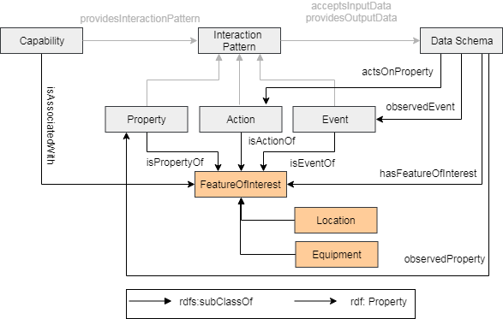
Feature Of Interest Pattern

Slide 15
Thing Description Example
{ "@context": [{"iot": "http://iotschema.org/",
"festoPA":"http://example.com/FestoPA/"} ],
"@type": [ "Thing", "iot:Pump", "iot:Valve", "iot:FloatSwitch", "iot:UltrasonicSensing“ ],
"iot:isAssociatedWith" : {"@id": "festoPA:FESTO-1", "@type": "iot:LiquidMixingSystem"},
"name": "FestoLive",
"id": "urn:dev:wot:siemens:festolive",
"security": [{"scheme": "basic"}],
"properties": {
"PumpStatus": {
"@type": "iot:OperationStatus",
"isPropertyOf": {"@id": "festoPA:Pipe2", "@type": "iot:LiquidPipe"},
"type": "object",
"properties": {"PumpStatus": {"type": "boolean"}},
"writable": false, "observable": false,
"forms": [{ "href": "https://129.144.182.85/iot/api/devices/Festo/PumpStatus",
"mediaType": "application/json“ }] }

Slide 16
Thank You!
Questions please…

