Slide 1
iot.schema.org
Feature of Interest
Haystack Vocabulary Alignment
May 17, 2018

Slide 2
Feature of Interest
Update on the meta-model

Slide 3
Motivation for Feature Of Interest Pattern
Binds Capability and Interaction Patterns to real-world objects
This provides information about the environment in which sensing/actuating is applied
PlugFest use cases prove that the Feature of Interest (FoI) pattern is needed in iot.schema.org

Slide 4
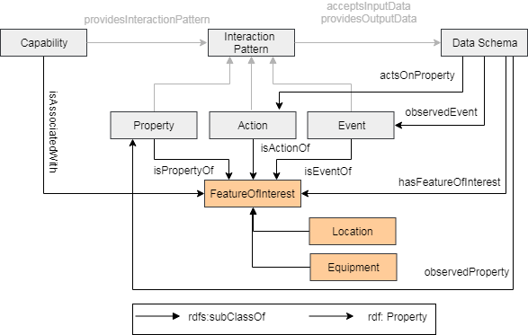
Feature Of Interest Pattern

Slide 5
Feature of Interest Example
{
"@id": "iot:TemperatureSensing",
"rdfs:subClassOf": { "@id": "iot:Capability" },
"iot:providesInteractionPattern": [ { "@id": "iot:Temperature“ }]
}, {
"@id": "iot:Temperature",
"rdfs:subClassOf": { "@id": "iot:Property" },
"iot:isPropertyOf": {"@type": "iot:Room"},
"iot:providesOutputData": { "@id": "iot:TemperatureData“ }
}, {
"@id": "iot:TemperatureData",
"rdfs:subClassOf": { "@id": "iot:DataSchema" },
"iot:hasFeatureOfInterest": {"@type": "iot:Room"},
"iot:observedProperty": "iot:Temperature",
"schema:propertyType": { "@id": "schema:Float" },
"schema:unitCode": { "@id": "iot:TemperatureUnit" },
"schema:minValue": "schema:Float",
"schema:maxValue": "schema:Float"
}

Slide 6
Haystack vocabulary in iot.schema.org
Extension of iot.schema.org

Slide 7
Project Haystack
Aims to standardize semantic data models to unlock the value of data generated by building equipment.
It is an open source initiative to enable Internet of Things applications.
Applications include automation, control, energy, HVAC, lighting, and other environmental systems.

Slide 8
Haystack Model
entity: is an abstraction for some physical object in the real world, e.g.
sites, equipment, sensor points, etc.
tag: is a name/value pair applied to an entity.
equip: is a physical asset, e.g. AHU, boiler, or chiller. Can also be used
to model a logical grouping, e.g. chiller plant.
point: is typically a digital or analog sensor or actuator
sensor: input, AI/BI, sensor
cmd: output, AO/BO, actuator, command
sp: setpoint, internal control variable, schedule
kind: Defines a tag value type, e.g., number, bool, str
Multiple tags are used to model the role of a point:
where: discharge, return, exhaust, outside
what: air, water, steam
measurement: temp, humidity, flow, pressure

Slide 9
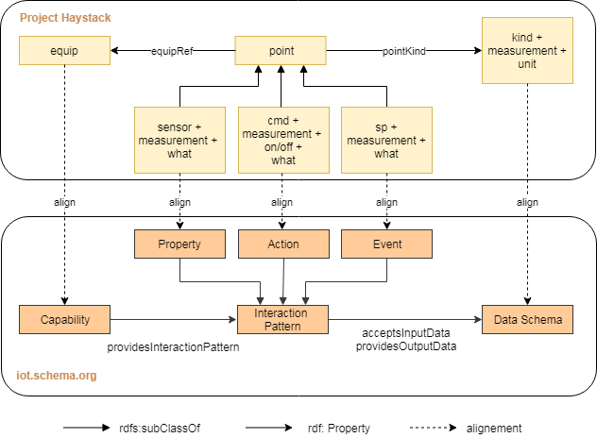
Integration of Haystack vocabulary in iot.schema.org

Slide 10
Example: Boiler in Haystack
equip: boiler
It is used to generate hot water or steam for heating.
Equip level tags:
where: equipRef must reference parent plant if associated with a plant
what: hot water or steam or oil or gas
Points associated with the boiler equip:
run cmd
run sensor
circ pump cmd
circ pump sensor
condensate pump cmd
condensate pump sensor

Slide 11
Example: Boiler mapped to iot.schema.org
iot:Capability: iot:Boiler
subclasses: iot:HotWaterBoiler, iot:SteamBoiler, iot:OilBoiler etc
iot:InteractionPattern:
iot:Action: iot:TurnOn, iot:TurnOff (run cmd)
iot:Property: iot:RunStatus (run sensor)
iot:Action: iot:CirculatePumpOn, iot:CirculatePumpOff (circ pump cmd)
iot:Property: iot:CirculatePumpStatus (circ pump sensor)
iot:Action: iot:CondensatePumpOn, iot:CondensatePumpOff (condensate pump cmd)
iot:Property: iot:CondensatePumpStatus (condensate pump sensor)
What should be the result of mapping the Haystack vocabulary into iot.schema.org?

Slide 12
Thank You!
Questions please…

