Slide 1

Event-Driven Serverless MLOp's Pipeline for Transaction Anomaly Detection and Data Drift Identification Using AWS
SettleNet
Aparna . V | E0124048
Guide: Prof. Ms. Rhevathai M
AIM23CL302 – ML Models on Cloud (ML Ops)

Slide 2
Problem Statement & Objective
• Financial institutions must identify unusual transactions that may indicate fraud, operational errors, or customer-risk events.
• A static anomaly model trained on historical transactions fails when new transaction amounts differ from the training distribution, causing missed anomalies or false alarms.
• SettleNet provides an automated AWS MLOps pipeline for data validation, anomaly-model training, inference, performance evaluation, data-drift identification, and real-time SNS alerting.

Slide 3
Literature Review & Research Gap
Recent Work | Approach | Limitation | How SettleNet Fills the Gap
Machine-learning fraud-detection surveys (2024) | Review ML models and evaluation methods for fraud detection | Focus on model accuracy rather than cloud deployment and monitoring | Provides an end-to-end AWS MLOps workflow with validation, inference, alerting, and metrics
Deep-learning fraud-detection reviews (2024) | Review neural approaches for fraud detection | Complex models require operational pipelines for reproducibility and monitoring | Uses lightweight serverless Lambda inference with measurable latency and drift detection
AWS MLOps reference architectures | Use cloud services for ML lifecycle automation | Often depend on managed training or always-on infrastructure | Uses cost-effective S3 + Lambda serverless design with SNS alerting and CloudWatch monitoring

Slide 4
System Architecture
• Amazon S3 stores incoming CSV files, validation reports, trained model artifacts, experiment metadata, prediction reports, and evaluation metrics.
• AWS Lambda performs CSV validation, anomaly-model training, inference, model evaluation, and SNS alert publication.
• The anomaly model uses median, Median Absolute Deviation (MAD), and modified z-score to identify transactions that drift from the learned normal amount distribution.
• Amazon SNS sends email alerts when anomalies are detected; Amazon CloudWatch records Lambda execution logs and inference activity.
Pipeline: S3 incoming/ → Lambda Validator → Lambda Trainer → S3 models/ → Lambda Inference → S3 predictions/ → SNS Alert → CloudWatch Logs

Slide 5
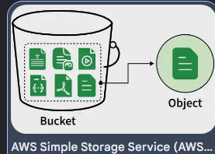
Data Storage & Component Setup
• Amazon S3 bucket: settlenet-dev-apar-7
• incoming/ — raw transaction CSV files uploaded for validation and inference.
• validation-reports/ — stores data-quality and schema-validation results.
• models/ — stores trained anomaly-model artifacts, including median, MAD, and threshold parameters.
• experiments/ — stores training-run metadata and model version information.
• predictions/ — stores inference results, anomaly scores, and inference time.
• evaluation/ — stores labelled test data and model-performance metrics.

Slide 6
Model Deployment Mechanism
• SettleNet uses a serverless deployment model based on AWS Lambda instead of a local server or always-on EC2 instance.
• AWS Lambda automatically scales with incoming CSV-processing and inference requests; no server provisioning or capacity planning is required.
• The inference Lambda loads the latest trained model artifact from Amazon S3, scores each transaction, and writes a prediction report back to S3.
• The model uses a modified z-score: Modified Z = 0.6745 × (amount − median) / MAD.
• Transactions outside the learned normal range are classified as ANOMALY; all other transactions are classified as NORMAL.

Slide 7
Infrastructure Monitoring & Drift Loop
• Amazon CloudWatch captures Lambda invocation logs, errors, execution duration, and inference activity.
• The inference Lambda compares each transaction amount with the median and MAD-based normal range learned during training.
• When an amount exceeds the upper or lower threshold, it is classified as ANOMALY, representing data drift from the training distribution.
• Amazon SNS immediately publishes an email alert containing the source file, anomaly count, transaction ID, amount, and modified z-score.
• Future enhancement: AWS Step Functions can orchestrate validation → training → evaluation → model promotion, while preventing retraining during active anomalies.

Slide 8
Experimental Setup & Results
Metric | Result | Interpretation
Total test records | 10 | 8 normal, 2 anomalous
Accuracy | 1.00 | All records correctly classified
Precision | 1.00 | No false anomaly alerts
Recall | 1.00 | All anomalous transactions detected
F1-score | 1.00 | Strong balance of precision and recall
Confusion matrix | TN = 8, FP = 0, FN = 0, TP = 2 | Perfect classification on test set
Inference latency | Measured in milliseconds per run | Displayed as inference_time_ms in Lambda response and S3 prediction report
• Inference test: TXN403 with amount ₹5,000 was correctly detected as ANOMALY.
• Inference time is automatically calculated and stored in both the Lambda response and S3 prediction report.

Slide 9
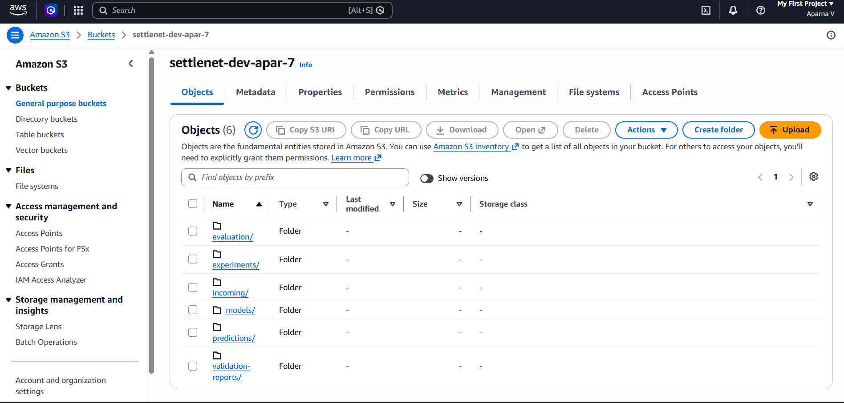
Demo Screenshots & Code Link
1: Amazon S3 bucket showing incoming/, models/, predictions/, and evaluation/ folders.

Slide 10
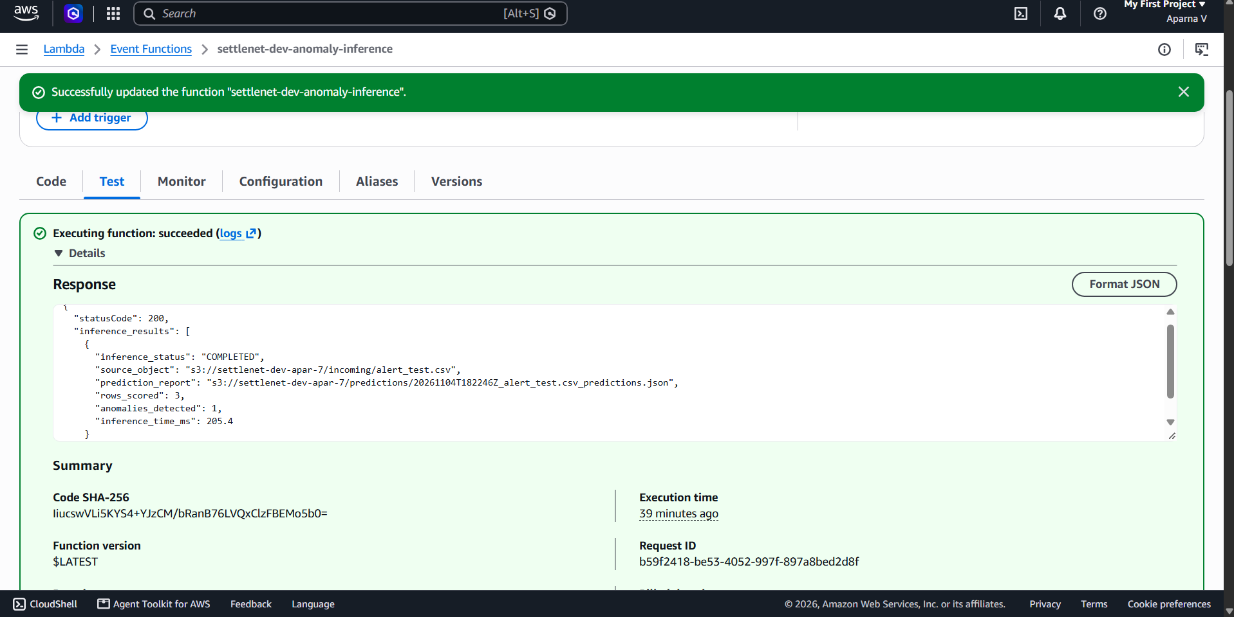
2: Successful AWS Lambda inference test showing inference_time_ms and anomalies_detected.

Slide 11
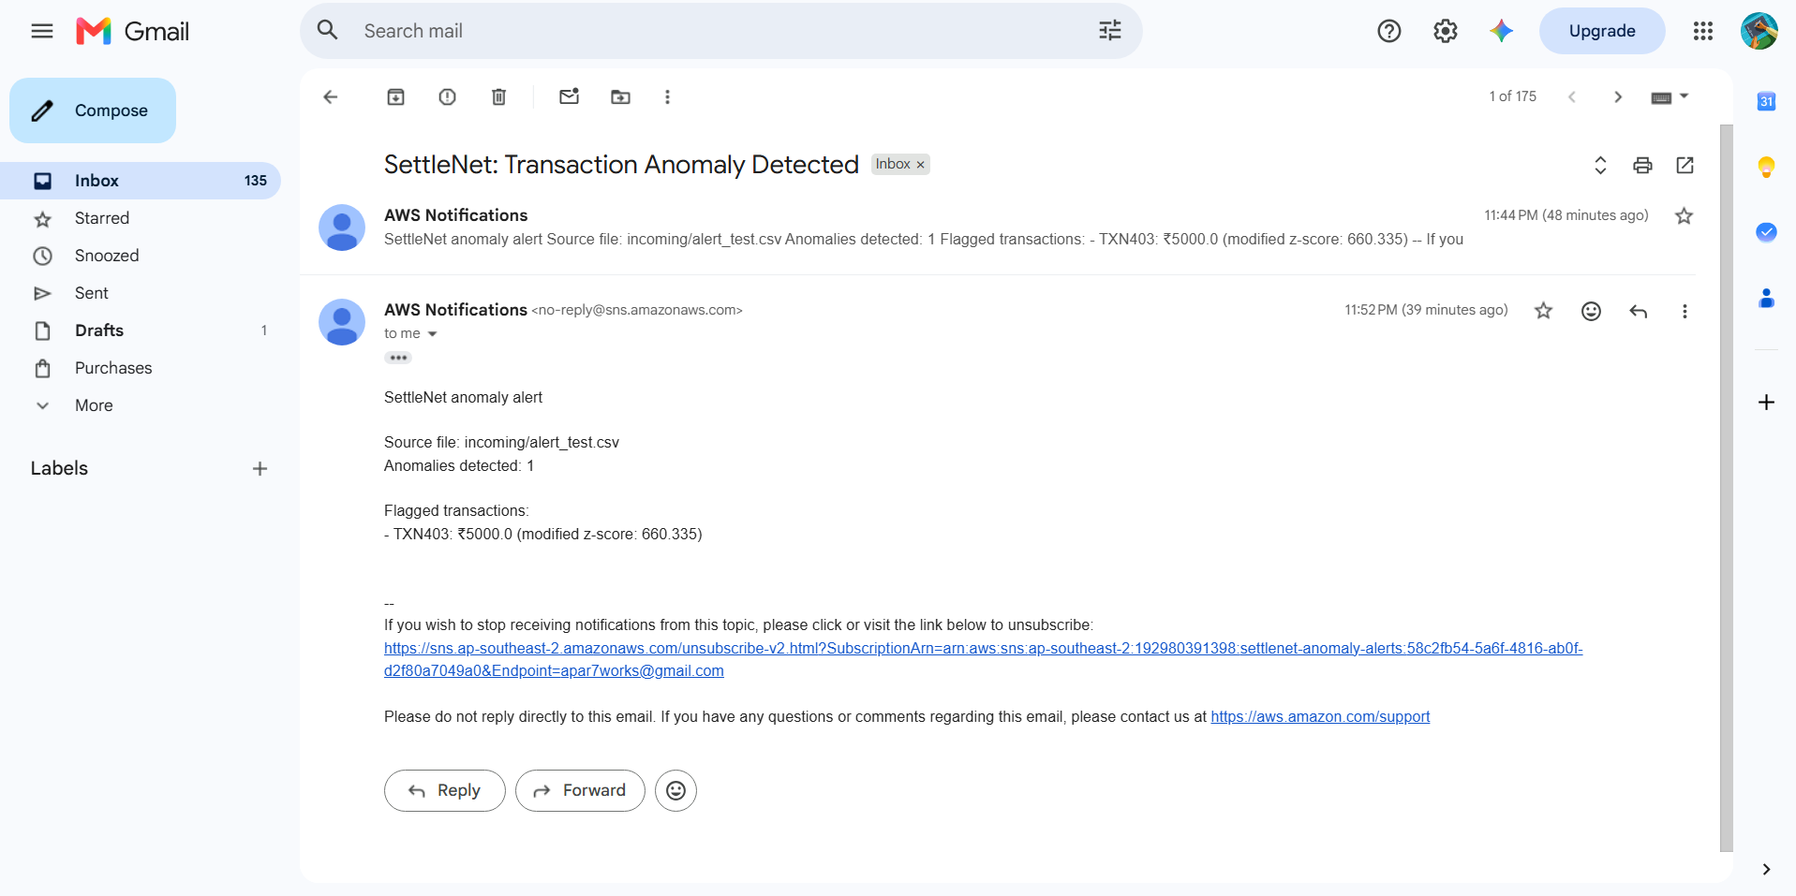
3: SNS anomaly-alert email received in Gmail for TXN403 / ₹5,000.

Slide 12
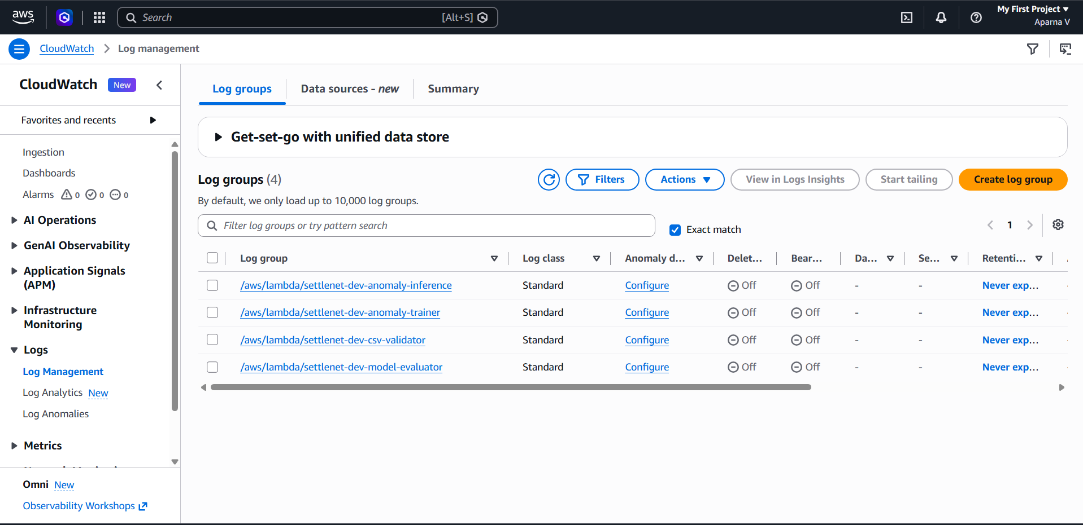
4: CloudWatch log showing successful Lambda invocation.
• GitHub repository : “https://github.com/aparnavenkat-7/Settlenet-mlops-aws”

Slide 13
Conclusion & Future Scope
• SettleNet demonstrates a fully functional serverless MLOps workflow for transaction anomaly detection on AWS.
• The system integrates S3 storage, Lambda-based validation, training, inference, evaluation, SNS alerting, and CloudWatch monitoring.
• The anomaly model achieved accuracy, precision, recall, and F1-score of 1.0 on the labelled evaluation dataset.
• Data drift was demonstrated by detecting high-value transactions that deviated from the learned normal transaction distribution.
• Future scope: Add Amazon API Gateway for real-time scoring, Amazon DynamoDB for prediction history, and AWS Step Functions for automated retraining and model promotion.

