Slide 1
Constraint Satisfaction Problems
Russell and Norvig:
Chapter 5
CMSC 421 – Fall 2006

Slide 2
Outline
Constraint Satisfaction Problems (CSPs)
Backtracking for CSP
Local search for CSPs
Problem structure and decomposition

Slide 3
Exercise #2: Sudoku
But, before we get into all that, let’s do a puzzle…
http://www.websudoku.com/
Each Sudoku has a unique solution that can be reached logically without guessing. Enter digits from 1 to 9 into the blank spaces. Every row must contain one of each digit. So must every column, as must every 3x3 square.

Slide 4
Puzzle
 |  |  |  | 9 |  | 3
 | 2 |  | 6 |  | 1 | 5 | 9
3 |  |  | 5 |  | 8 |  | 2 | 4
 | 9 |  |  |  |  | 4 | 8
6 |  |  | 2 |  | 9 |  |  | 1
 | 5 | 2 |  |  |  |  | 3
9 | 7 |  | 1 |  | 5 |  |  | 3
 | 3 | 8 | 7 |  | 4 |  | 1
 |  | 5 |  | 8

Slide 5
Problem Formulation
What is the state space?
What is the initial state?
What is the successor function?
What is the goal test?
What is the path cost?

Slide 6
Points
Large search space
commutativity
what about using bfs or dfs?
  fixed depth

Slide 7
CSP as a Search Problem
Initial state: empty assignment
Successor function: a value is assigned to any unassigned variable, which does not conflict with the currently assigned variables
Goal test: the assignment is complete
Path cost: irrelevant
Branching factor b at the top level is nd.
b=(n-l)d at depth l, hence n!d^{n} leaves (only d^{n} complete assignments).
We can do better…….

Slide 8
What else is needed?
Not just a successor function and goal test
But also a means to propagate the constraints imposed by one move on the others and an early failure test
→ Explicit representation of constraints and constraint manipulation algorithms

Slide 9
Constraint Satisfaction Problem
Set of variables {X₁, X₂, …, X_{n}}
Each variable Xi has a domain D_{i} of possible values
  Usually D_{i} is discrete and finite
Set of constraints {C₁, C₂, …, C_{p}}
  Each constraint C_{k} involves a subset of variables and specifies the allowable combinations of values of these variables
Goal: Assign a value to every variable such that all constraints are satisfied

Slide 10
Example: Sudoku CSP
variables:
domains:
constraints:
Goal: Assign a value to every variable such that all constraints are satisfied

Slide 11
Example: Sudoku CSP
variables: X₁₁, …, X₉₉
domains: {1,…,9}
constraints:
  row constraint: X₁₁ ≠ X₁₂, …, X₁₁ ≠ X₁₉
  col constraint: X₁₁ ≠ X₁₂, …, X₁₁ ≠ X₁₉
  block constraint: X₁₁ ≠ X₁₂, …, X₁₁ ≠ X₃₃
Goal: Assign a value to every variable such that all constraints are satisfied

Slide 12
Example: Map Coloring
NT
NT
Q
Q
WA
WA
SA
SA
NSW
NSW
V
V
T
T
7 variables {WA,NT,SA,Q,NSW,V,T}
Each variable has the same domain {red, green, blue}
No two adjacent variables have the same value:
WA≠NT, WA≠SA, NT≠SA, NT≠Q, SA≠Q, SA≠NSW, SA≠V,Q≠NSW, NSW≠V

Slide 13
Example: Task Scheduling
T1
T2
T4
T3
T1 must be done during T3
T2 must be achieved before T1 starts
T2 must overlap with T3
T4 must start after T1 is complete
Are the constraints compatible?
Find the temporal relation between every two tasks

Slide 14
Varieties of constraints
Unary constraints involve a single variable.
  e.g. SA ≠ green
Binary constraints involve pairs of variables.
  e.g. SA ≠ WA
Higher-order constraints involve 3 or more variables.
  e.g. cryptharithmetic column constraints.
Preference (soft constraints) e.g. red is better than green often representable by a cost for each variable assignment → constrained optimization problems.

Slide 15
Constraint Graph
Binary constraints
NT
What is the constraint graph for sudoku?
Q
WA
SA
NSW
V
T
Two variables are adjacent or neighbors if they
are connected by an edge or an arc

Slide 16
Remark
Finite CSP include 3SAT as a special case (see class on logic)
3SAT is known to be NP-complete
So, in the worst-case, we cannot expect to solve a finite CSP in less than exponential time

Slide 17
Commutativity of CSP
The order in which values are assigned
to variables is irrelevant to the final
assignment, hence:
Generate successors of a node by
considering assignments for only one
variable
Do not store the path to node

Slide 18
Backtracking Algorithm
partial assignment
of variables
CSP-BACKTRACKING({})
CSP-BACKTRACKING(a)
  If a is complete then return a
  X ← select unassigned variable
  D ← select an ordering for the domain of X
  For each value v in D do
    If v is consistent with a then
      Add (X= v) to a
      result ← CSP-BACKTRACKING(a)
      If result ≠ failure then return result
  Return failure

Slide 19
→ Backtracking Search
empty assignment
1st variable
2nd variable
3rd variable
Assignment = {}

Slide 20
→ Backtracking Search
empty assignment
1st variable
2nd variable
3rd variable
Assignment = {(var1=v11)}

Slide 21
→ Backtracking Search
empty assignment
1st variable
2nd variable
3rd variable
Assignment = {(var1=v11),(var2=v21)}

Slide 22
→ Backtracking Search
empty assignment
1st variable
2nd variable
3rd variable
Assignment = {(var1=v11),(var2=v21),(var3=v31)}

Slide 23
→ Backtracking Search
empty assignment
1st variable
2nd variable
3rd variable
Assignment = {(var1=v11),(var2=v21),(var3=v32)}

Slide 24
→ Backtracking Search
empty assignment
1st variable
2nd variable
3rd variable
Assignment = {(var1=v11),(var2=v22)}

Slide 25
→ Backtracking Search
empty assignment
1st variable
2nd variable
3rd variable
Assignment = {(var1=v11),(var2=v22),(var3=v31)}

Slide 26
Map Coloring
{}
WA=red
WA=green
WA=blue
WA=red
NT=green
WA=red
NT=blue
NT
Q
WA
WA=red
NT=green
Q=red
WA=red
NT=green
Q=blue
SA
NSW
V
T

Slide 27
Questions
Which variable X should be assigned a value next?
In which order should its domain D be sorted?

Slide 28
Questions
Which variable X should be assigned a value next?
In which order should its domain D be sorted?
What are the implications of a partial assignment for yet unassigned variables? (→ Constraint Propagation)

Slide 29
Choice of Variable
Map coloring
NT
NT
Q
WA
WA
SA
SA
NSW
V
T

Slide 30
Choice of Variable
#1: Minimum Remaining Values (aka Most-constrained-variable heuristic or Fail First):
Select a variable with the fewest remaining values

Slide 31
Choice of Variable
NT
Q
WA
SA
SA
NSW
#2: Degree Heuristic:
Select the variable that is involved in the largest number of constraints on other unassigned variables
V
T

Slide 32
Choice of Value
NT
NT
Q
WA
WA
SA
NSW
V
{}
T

Slide 33
Choice of Value
NT
NT
Q
WA
WA
SA
NSW
V
{blue}
T
#3: Least-constraining-value heuristic:
Prefer the value that leaves the largest subset of legal values for other unassigned variables

Slide 34
Sudoku
Variable Selection:
  Minimum Remaining Values?
  Degree
Value Selection:
  Least constraining value?
Others?

Slide 35
Constraint Propagation …
… is the process of determining how the possible values of one variable affect the possible values of other variables

Slide 36
Forward Checking
After a variable X is assigned a value v, look at each unassigned variable Y that is connected to X by a constraint and deletes from Y’s domain any value that is inconsistent with v

Slide 37
Map Coloring: FC
NT
Q
WA
NSW
T
SA
V
WA | NT | Q | NSW | V | SA | T
RGB | RGB | RGB | RGB | RGB | RGB | RGB

Slide 38
Map Coloring: FC
NT
Q
WA
NSW
T
SA
V
WA | NT | Q | NSW | V | SA | T
RGB | RGB | RGB | RGB | RGB | RGB | RGB
1: R | RGB | RGB | RGB | RGB | RGB | RGB

Slide 39
Map Coloring: FC
NT
Q
WA
NSW
T
SA
V
WA | NT | Q | NSW | V | SA | T
RGB | RGB | RGB | RGB | RGB | RGB | RGB
1: R | RGB | RGB | RGB | RGB | RGB | RGB

Slide 40
Map Coloring: FC
NT
Q
WA
NSW
T
SA
V
WA | NT | Q | NSW | V | SA | T
RGB | RGB | RGB | RGB | RGB | RGB | RGB
R | RGB | RGB | RGB | RGB | RGB | RGB
R | RGB | 2: G | RGB | RGB | RGB | RGB

Slide 41
Map Coloring:FC
NT
Q
WA
NSW
T
SA
V
WA | NT | Q | NSW | V | SA | T
RGB | RGB | RGB | RGB | RGB | RGB | RGB
R | RGB | RGB | RGB | RGB | RGB | RGB
R | RGB | 2: G | RGB | RGB | RGB | RGB

Slide 42
Map Coloring: FC
NT
Q
WA
NSW
T
SA
V
WA | NT | Q | NSW | V | SA | T
RGB | RGB | RGB | RGB | RGB | RGB | RGB
R | RGB | RGB | RGB | RGB | RGB | RGB
R | RGB | G | RGB | RGB | RGB | RGB
R | RGB | G | RGB | 3:B | RGB | RGB

Slide 43
Map Coloring: FC
NT
Q
WA
NSW
T
SA
V
WA | NT | Q | NSW | V | SA | T
RGB | RGB | RGB | RGB | RGB | RGB | RGB
R | RGB | RGB | RGB | RGB | RGB | RGB
R | RGB | G | RGB | RGB | RGB | RGB
R | RGB | G | RGB | 3:B | RGB | RGB

Slide 44
Other inconsistencies?
NT
Q
WA
NSW
T
SA
V
Impossible assignments that forward
checking do not detect
WA | NT | Q | NSW | V | SA | T
RGB | RGB | RGB | RGB | RGB | RGB | RGB
R | RGB | RGB | RGB | RGB | RGB | RGB
R | RGB | G | RGB | RGB | RGB | RGB
R | RGB | G | RGB | 3:B | RGB | RGB

Slide 45
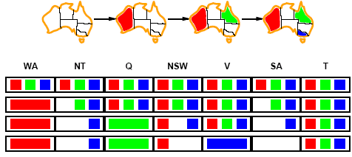
Constraint propagation
Solving CSPs with combination of heuristics plus forward checking is more efficient than either approach alone.
FC checking propagates information from assigned to unassigned variables but does not provide detection for all failures.
    More advanced constraint propagation methods repeatedly enforces constraints locally

Slide 46
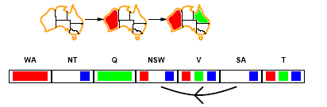
Arc consistency
NT
Q
WA
NSW
T
SA
V
X → Y is consistent iff
for every value x of X there is some allowed y
SA → NSW is consistent iff
SA=blue and NSW=red

Slide 47
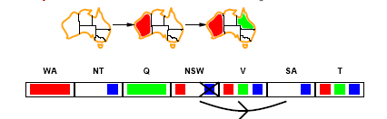
Arc consistency
NT
Q
WA
NSW
T
SA
V
X → Y is consistent iff
for every value x of X there is some allowed y
NSW → SA is consistent iff
NSW=red and SA=blue
NSW=blue and SA=???
Arc can be made consistent by removing blue from NSW

Slide 48
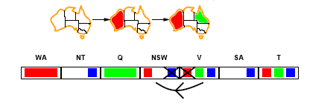
Arc consistency
NT
Q
WA
NSW
T
SA
V
Arc can be made consistent by removing blue from NSW
RECHECK neighbors of NSW!!
  Remove red from V

Slide 49
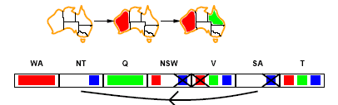
Arc consistency
NT
Q
WA
NSW
T
SA
V
Arc can be made consistent by removing blue from NSW
RECHECK neighbors of NSW!!
  Remove red from V
Arc consistency detects failure earlier than FC
Can be run as a preprocessor or after each assignment.
  Repeated until no inconsistency remains

Slide 50
Arc consistency algorithm
function AC-3(csp) return the CSP, possibly with reduced domains
inputs: csp, a binary csp with variables {X₁, X₂, …, X_{n}}
local variables: queue, a queue of arcs initially the arcs in csp
while queue is not empty do
(X_{i}, X_{j}) ← REMOVE-FIRST(queue)
if REMOVE-INCONSISTENT-VALUES(X_{i}, X_{j}) then
for each X_{k} in NEIGHBORS[X_{i} ] - X_{j} do
add (X_{k}, X_{i}) to queue
function REMOVE-INCONSISTENT-VALUES(X_{i}, X_{j}) return true iff we remove a value
removed ← false
for each x in DOMAIN[X_{i}] do
if no value y in DOMAIN[X_{i}] does (x, y) satisfy constraints between X_{i} and X_{j}
then delete x from DOMAIN[X_{i}];
removed ← true
return removed

Slide 51
K-consistency
Arc consistency does not detect all inconsistencies:
  Partial assignment {WA=red, NSW=red} is inconsistent.
Stronger forms of propagation can be defined using the notion of k-consistency.
A CSP is k-consistent if for any set of k-1 variables and for any consistent assignment to those variables, a consistent value can always be assigned to any kth variable.
  E.g. 1-consistency or node-consistency
  E.g. 2-consistency or arc-consistency
  E.g. 3-consistency or path-consistency

Slide 52
K-consistency
A graph is strongly k-consistent if
  It is k-consistent and
  Is also (k-1) consistent, (k-2) consistent, … all the way down to 1-consistent.
This is ideal since a solution can be found in time O(nd) instead of O(n²d³)
YET no free lunch: any algorithm for establishing n-consistency must take time exponential in n, in the worst case.

Slide 53
Further improvements
Checking special constraints
  Checking Alldif(…) constraint
    E.g. {WA=red, NSW=red}
  Checking Atmost(…) constraint
    Bounds propagation for larger value domains
Intelligent backtracking
  Standard form is chronological backtracking i.e. try different value for preceding variable.
  More intelligent, backtrack to conflict set.
    Set of variables that caused the failure or set of previously assigned variables that are connected to X by constraints.
    Backjumping moves back to most recent element of the conflict set.
    Forward checking can be used to determine conflict set.

Slide 54
Local search for CSP
Use complete-state representation
For CSPs
  allow states with unsatisfied constraints
  operators reassign variable values
Variable selection: randomly select any conflicted variable
Value selection: min-conflicts heuristic
  Select new value that results in a minimum number of conflicts with the other variables

Slide 55
Local Search for CSP
1
2
2
0
3
2
3
2
2
2
2
2
3
2
Pick initial complete assignment (at random)
Repeat
  Pick a conflicted variable var (at random)
  Set the new value of var to minimize the number of conflicts
  If the new assignment is not conflicting then return it
(min-conflicts heuristics)

Slide 56
Local search for CSP
function MIN-CONFLICTS(csp, max_steps) return solution or failure
inputs: csp, a constraint satisfaction problem
max_steps, the number of steps allowed before giving up
current ← an initial complete assignment for csp
for i = 1 to max_steps do
if current is a solution for csp then return current
var ← a randomly chosen, conflicted variable from VARIABLES[csp]
value ← the value v for var that minimize CONFLICTS(var,v,current,csp)
set var = value in current
return failure

Slide 57
Remark
Local search with min-conflict heuristic works extremely well for million-queen problems
The reason: Solutions are densely distributed in the O(n^{n}) space, which means that on the average a solution is a few steps away from a randomly picked assignment

Slide 58
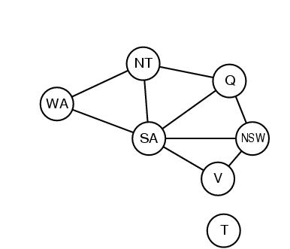
Problem structure
How can the problem structure help to find a solution quickly?
Subproblem identification is important:
  Coloring Tasmania and mainland are independent subproblems
  Identifiable as connected components of constrained graph.
Improves performance

Slide 59
Problem structure
Suppose each problem has c variables out of a total of n.
Worst case solution cost is O(n/c d^{c}), i.e. linear in n
  Instead of O(d ^{n}), exponential in n
E.g. n= 80, c= 20, d=2
  2⁸⁰ = 4 billion years at 1 million nodes/sec.
  4 * 2²⁰= .4 second at 1 million nodes/sec

Slide 60
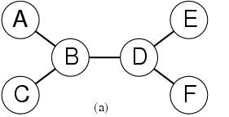
Tree-structured CSPs
Theorem: if the constraint graph has no loops then CSP can be solved in O(nd ²) time
Compare difference with general CSP, where worst case is O(d ^{n})

Slide 61
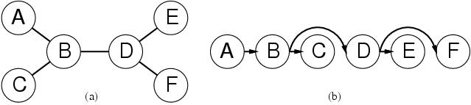
Tree-structured CSPs
In most cases subproblems of a CSP are connected as a tree
Any tree-structured CSP can be solved in time linear in the number of variables.
  Choose a variable as root, order variables from root to leaves such that every node’s parent precedes it in the ordering. (label var from X₁ to X_{n})
  For j from n down to 2, apply REMOVE-INCONSISTENT-VALUES(Parent(X_{j}),X_{j})
  For j from 1 to n assign X_{j} consistently with Parent(X_{j} )

Slide 62
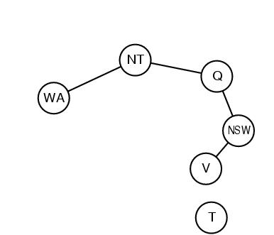
Nearly tree-structured CSPs
Can more general constraint graphs be reduced to trees?
Two approaches:
  Remove certain nodes
  Collapse certain nodes

Slide 63
Nearly tree-structured CSPs
Idea: assign values to some variables so that the remaining variables form a tree.
Assume that we assign {SA=x} ← cycle cutset
  And remove any values from the other variables that are inconsistent.
  The selected value for SA could be the wrong one so we have to try all of them

Slide 64
Nearly tree-structured CSPs
This approach is worthwhile if cycle cutset is small.
Finding the smallest cycle cutset is NP-hard
  Approximation algorithms exist
This approach is called cutset conditioning.

Slide 65
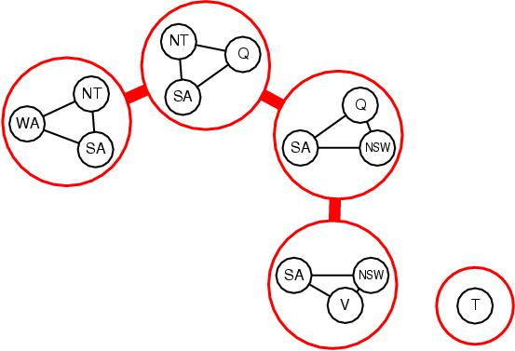
Nearly tree-structured CSPs
Tree decomposition of the constraint graph in a set of connected subproblems.
Each subproblem is solved independently
Resulting solutions are combined.
Necessary requirements:
  Every variable appears in ar least one of the subproblems.
  If two variables are connected in the original problem, they must appear together in at least one subproblem.
  If a variable appears in two subproblems, it must appear in each node on the path.

Slide 66
Applications
CSP techniques allow solving very complex problems
Numerous applications, e.g.:
  Crew assignments to flights
  Management of transportation fleet
  Flight/rail schedules
  Task scheduling in port operations
  Design
  Brain surgery
See www.ilog.com

Slide 67
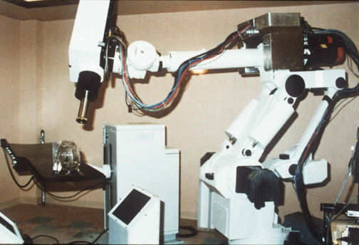
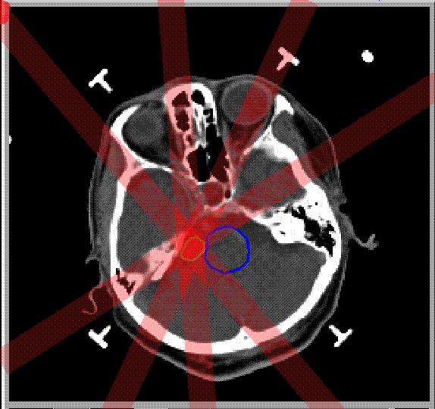
Stereotaxic Brain Surgery

Slide 68
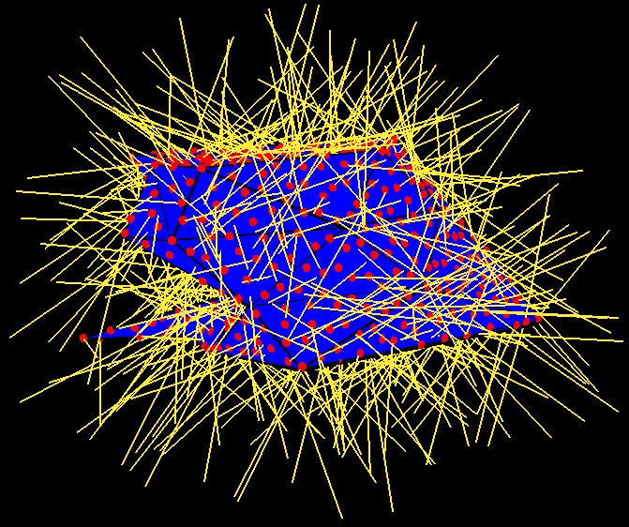
Stereotaxic Brain Surgery
• 2000 < Tumor < 2200
  2000 < B2 + B4 < 2200
  2000 < B4 < 2200
  2000 < B3 + B4 < 2200
  2000 < B3 < 2200
  2000 < B1 + B3 + B4 < 2200
  2000 < B1 + B4 < 2200
  2000 < B1 + B2 + B4 < 2200
  2000 < B1 < 2200
  2000 < B1 + B2 < 2200
T
B1
T
B2
C
B4
B3
• 0 < Critical < 500
  0 < B2 < 500

Slide 69
→ Constraint Programming
“Constraint programming represents one of the closest approaches computer science has yet made to the Holy Grail of programming: the user states the problem, the computer solves it.”
Eugene C. Freuder, Constraints, April 1997

Slide 70
When to Use CSP Techniques?
When the problem can be expressed by a set of variables with constraints on their values
When constraints are relatively simple (e.g., binary)
When constraints propagate well (AC3 eliminates many values)
Local Search: when the solutions are “densely” distributed in the space of possible assignments

Slide 71
Summary
CSPs are a special kind of problem: states defined by values of a fixed set of variables, goal test defined by constraints on variable values
Backtracking=depth-first search with one variable assigned per node
Variable ordering and value selection heuristics help significantly
Forward checking prevents assignments that lead to failure.
Constraint propagation does additional work to constrain values and detect inconsistencies.
The CSP representation allows analysis of problem structure.
Tree structured CSPs can be solved in linear time.
Local Search, e.g., min-conflicts, is often effective in practice.

