Slide 1
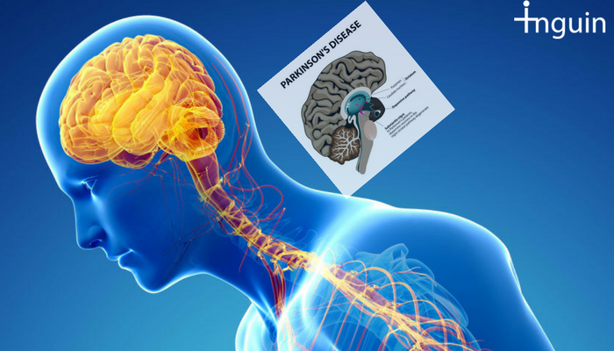

A DIVE INTO...
PARKINSON DISEASE
MODELLING DISEASE PROGRESSION
DATA SCIENCE RETREAT
BATCH # 15
ALICE MARTIN
Sept 2018
Notes:
Good evening everyone. During Data Science Retreat, I decided to apply Data Science to Healthcare, and in particular to PD. I am going to present how we can model Disease Progression with Machine Learning.

Slide 2
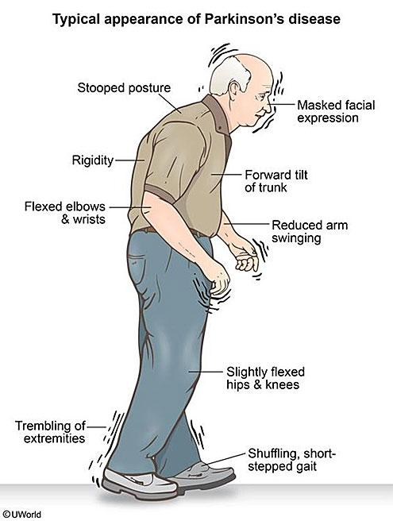
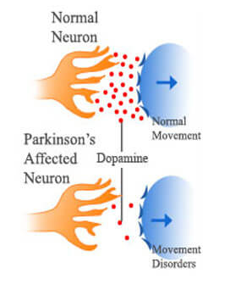
Inside the life of a Parkinson Disease (PD) Subject
Suffers from a motor system disorder resulting from the loss of dopamine-producing brain cells.
Notes:
First, What is Parkinson Disease? PD is a motor system disorder resulting from the loss of the brain cells producing dopamine. It is a neurodegenerative disease.
On the right, the usual symptoms experienced by a PD person: The picture chooses a old man, because men over 60 are the most common person affected by the disease.

Slide 3
Inside the life of a Parkinson Disease (PD) Subject
Diagnosis via Motor symptoms:
Bradykinesia (Slowness of Movements)
Tremor
Rigidity
Postural Instability
But also non-motor symptoms:
Depression,
difficulty swallowing/speaking,
urinary disorders...
Notes:
This is a summary of the 4 main motor symptoms in PD.
But, PD is more than just a motor disorder, and affects all the part of the body and other biological functions: I mention a few other system on this slide.

Slide 4
Parkinson Disease - Global reality...
6.2 Million people affected worldwide in 2015 , with 117,5k deaths.
1% of the worldwide population over 60 is affected.
2nd most common age-related neurodegenerative disorder after Alzheimer's.
source: Global Burden of Disease Study 2015, parkinsondisease.net
Notes:
Now the global reality of Parkinson Disease with a few key figures listed here. Today figure: It is estimated that about 10 million people worldwide are living with PD. The incidence of the disease is higher in industrialized countries.
The 1% means that either you know directly someone affected, or you know someone that knows a parkinsonian. From my side, my grandfather had Parkinson.
To conclude on Parkinson, it is a complex disease impacting the life of millions of people. But because, it is only the 2nd most common neurodegenrative disease, there are much less research being done than Alzheimer’s. That is one of the reason I chose to focus on it.

Slide 5
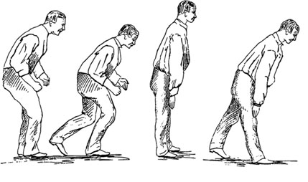
MODELLING PARKINSON PROGRESSION
One step-ahead prediction
Hoehn & Yahr Scale (NHY)
STAGE 0: NO SIGN OF DISEASE
STAGE 1: UNILATERAL DISEASE
STAGE 2: BILATERAL DISEASE, WITHOUT BALANCE IMPAIRMENT
STAGE 3: MILD TO MODERATE BILATERAL DISEASE, SOME POSTURAL INSTABILITY.
STAGE 4: SEVERE DISABILITY, STILL ABLE TO WALK AND STAND UNASSISTED.
STAGE 5: WHEELCHAIR BOUND OR BEDRIDDEN
Last
Visit
Next Visit
Source: theguardian.com
Notes:
So my problem: Modelling Parkinson Progression over time.
So, the first thing to do is to define what is progression? There are a few scale that allows to measure it.
I chose Hoen & Yahr one ranking from 0 to 5: 0 being healthy, 5 being bedridden & dependent.
Now that I chose measure, I chose to tackle the following problem: one-step-ahead prediction: predicting the next visit stage from the previous visit

Slide 6
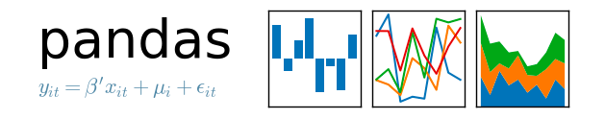
Dataset

Slide 7
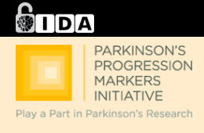
PPMI, THE REFERENCE DATASET FOR PARKINSON RESEARCH
Clinical study with ~2000 subjects enrolled across 3 continents
700 TYPICAL PD
70 SWEDD (PD symptoms with no evidence of dopamine loss)
100 PRODROMAL (Early Phase: patient doesn’t show Motor symptoms yet)
500 HEALTHY CONTROL
Subjects followed for a min of 3 years & max of 5 years (2005-Present)
Multi-modal data: Medical Records, Brain Imaging, Genetic data
Source:http://www.ppmi-info.org/access-data-specimens/download-data/http://www.ppmi-info.ohttp://www.ppmi-info.org/access-data-specimens/download-data/rg/access-data-sphttp://www.ppmi-info.org/access-data-specimens/download-data/ecimens/download-data/
Notes:
Medical Data is usually hard to obtain but I got access to the reference dataset for Parkinson’s Research, PPMI.
On going clinical study of around 2000 subjects with 4 diagnosis types: Typical PD, SWEDD, PRODROMAL, HC.
Multi-modal dataset: for my problem, I am going to focus only on the Medical Records.

Slide 8
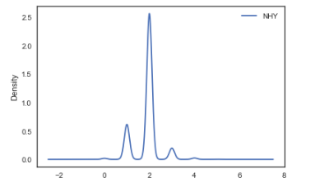

PPMI Medical Records
Datasets
~ 2800 observations stored in 109 csv files:
Personal Information - ex: Gender, Age
General Medical Records - ex: Heart Rate Measurement
PD-Related Medical Records - ex: Is the subject experiencing the typical bradykinesia?
Motor Assessments - ex: Level of rigidity experienced by the subject
Non-Motor Assessments - ex: How depressed the patient is feeling?
Biospecimen Data - ex: Genetic Test
Medication Data - ex: Is the subject taking Levodopa (main PD treatment)?
Tip
Don’t let data stand alone. Always relate it back to a story you’ve already told, in this case, Marco’s shop.
Notes:
Let’s Dive into PPMI Medical Records. I tried to classify all the records in 8 different categories that are listed on this slide. I included an example of one feature for each category.
I selected features from all these datasets category, except the last one Imaging Data Results for various reasons, one being imaging was done on too few patients.
The Non-Motor Assessments are basically all the measurements that are usually looked at to measure disease progression: The Yoehn & Hahr scale was in there.
About my target, I just want to show you its distribtuion in PPMI dataset:

Slide 9

Models & Results

Slide 10
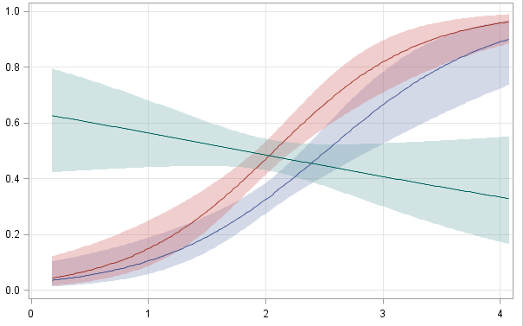

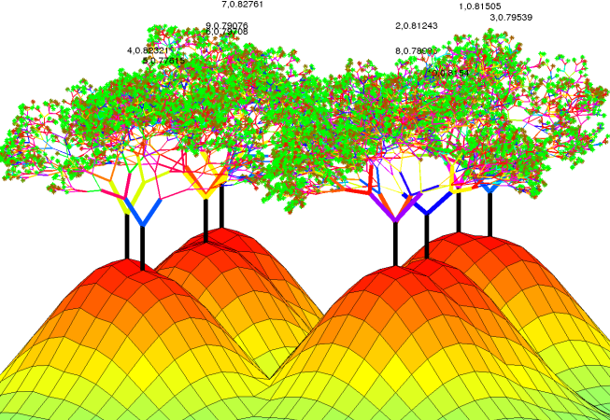

“Off-the-self” classifiers with a 3-fold CV
final dataframe after preprocessing:
3884 samples (for 1003 patients), 373 features
Logistic Regression (LR)
Random Forest (RF)
XGBoost (XGB)
Source: theguardian.com
Notes:
I applied first this different classifiers to my problem. When I say off-the-shelf, this means that I took the default values of sci-kit learn for the hyperparameters.
Here are the results for the training and test accuracy. One thing that stroke me is the 100% of training accuracy for the RF: next step is trying to reduce overfitting.

Slide 11

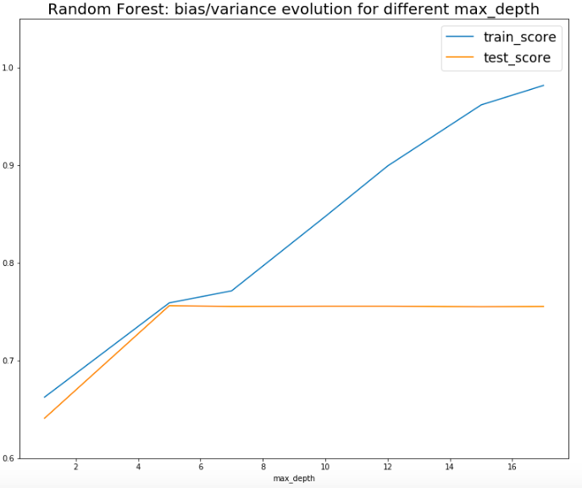
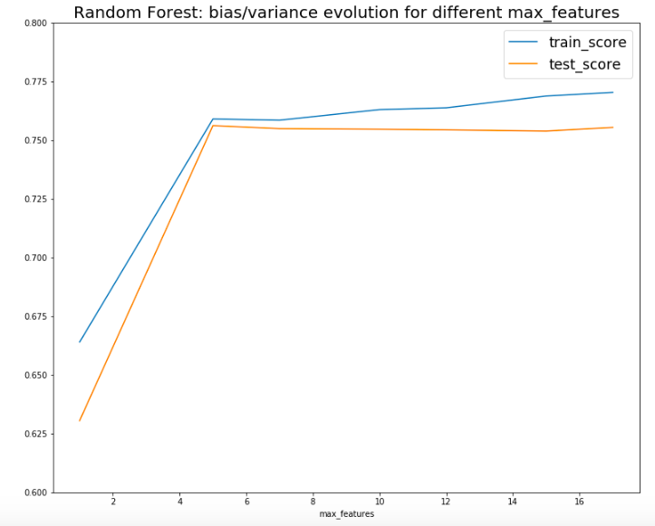
A Gardening lesson: Prun your trees
& control their root size!
Hyperparameters tuning on n_estimators, max_depth, max_features
n_estimators=250
max_features=5
356 features
max_features=5
n_estimators=250
max_depth=5
356 features
Tuned RF=
RandomForestClassifier (n_estimators=250,
Max_depth=5,
max_features=5)
max_depth=5
Source: theguardian.com
Notes:
I did 2 things: First, I did some dimensionality reduction with features importance method of the Random Forest. 356 features instead of 373.
Then, I run several GridSearch on 3 hyperparameters n_estimators, max_depth, max_features of my random Random Forest.
The goal was to try to find the inflexion point between underfitting and overfitting, and see bias/variance evolution. I saw this on the 2 graphs: firs on the right, the influence of max_dept, with the inflexion point occuring around around 5. Then, by looking at the influence of the max_features, with an inflexion point also occuring at max_features=5
Finally, I have the following Tuned RF

Slide 12
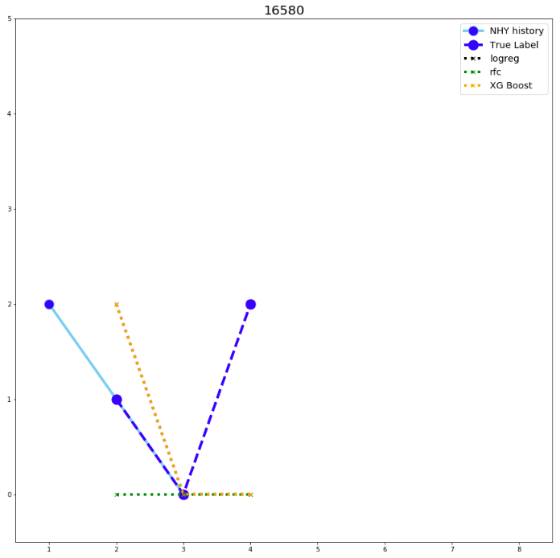
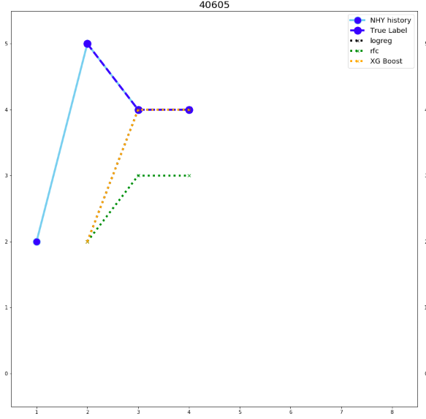
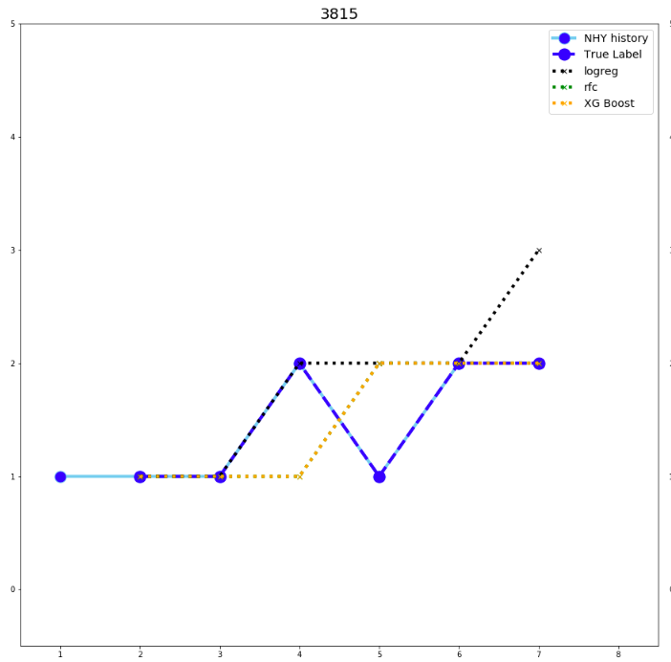
Prediction results at patient level (test set)
Counterintuitive Reality
No-one gets it right
XGB the closest
LogReg right at first
Then XGB right
Light Blue: NHY feat
Dark Blue: Target
Black: Logistic Regression
Green: Random Forest
Orange: XGBoost
Big jump hard to predict…
XGB the closest
Blue: Reality
Orange: XGBoost
Green: Random Forest
Black: Logistic Regression
Best Ensemble Classifier=
[ LogReg, RF_tuned, XGBoost] , (1,2,2) , ‘Soft Voting’
Source: theguardian.com
Tip
Don’t let data stand alone. Always relate it back to a story you’ve already told, in this case, Marco’s shop.
Notes:
Then, I wanted to see my predictions at a patient level: how well the classifiers were doing on the sequence of one-step ahead prediction for each patient?
Here are 3 examples of results (I am showing hard cases).
The fact some classifiers performs best on some patients or some part of the disease stage sequence made me decide to try to ensemble my classifiers.
I tried a few combinaisons and ended-up with this best classifier. I am going to show its accuracy on the next slide.

Slide 13
Final results: in Ensembling you will believe...
Classifier | Training Score | Test Score
Off-the-Shelf Logistic Regression | 89% | 70%
Off-the-Shelf Random Forest | 100% | 78%
Off-the-Shelf XGBoost | 89% | 78%
Tuned Random Forest | 75,9% | 75,6%
Best Ensemble Classifier | 87% | 82%
Notes:
This is the summary of the training and test accuracy I obtained with some of the models I tried.
In red, the 100% training accuracy showing how the untuned RF overfits my dataset.
In Green, the 2 best classifiers: Tuned RF in the sense of that the model has no variance. Ensemble Classifier because it has the highest tes accuracy with not too much variance.

Slide 14
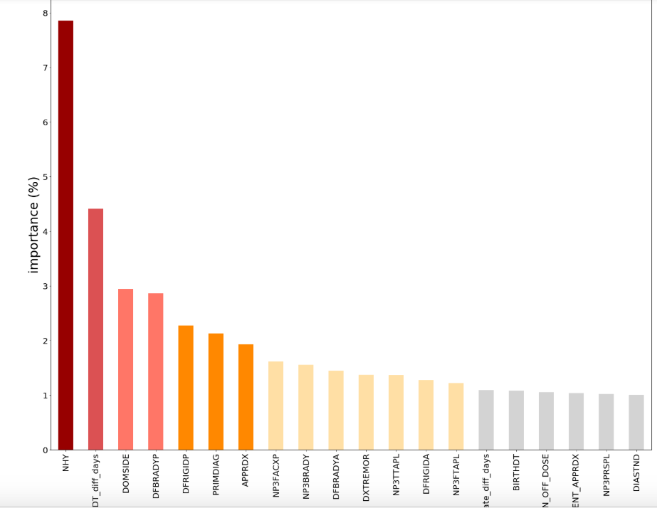
Features importance: which biomarkers matter in PD progression?
Target: Progression scale
20 first features (importance > 1%)
We can order the importance of the motor symptoms
Medication Dose matters
Bradykinesia
Rigidity
Time since
PD diagnosis
Medication
dose
Tremor
Source: theguardian.com
Tip
Don’t let data stand alone. Always relate it back to a story you’ve already told, in this case, Marco’s shop.
Notes:
Finally, I wanted to show some interpretation of my models: I run the features importance method on my RF model, and you see the results for the first 20 features on the slide.
I am going to look at a few features: the first 2 ones makes sense.
Then, these 3 ones are interesting because it is 3 of the main motor symptoms in PD: and we can see that Bradykinesia accounts the most for disease progression, then it is rigidity, then tremor.
Finally, we can see that the medication dose matters; and actually - it seems- more than the actual treatment.

Slide 15
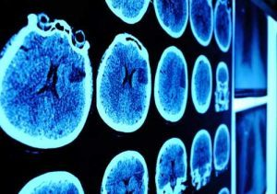


NEXT STEPS
Parkinson Disease Progression:
Prediction of the next Disease State
Important biomarkers
Diagnosis Classification with
Resting state fMRI
Diagnosis Classification with fMRI data
Recommendation of best treatment and dose for each patient
Notes:
Next step: will be discussing my results with a doctor.

Slide 16
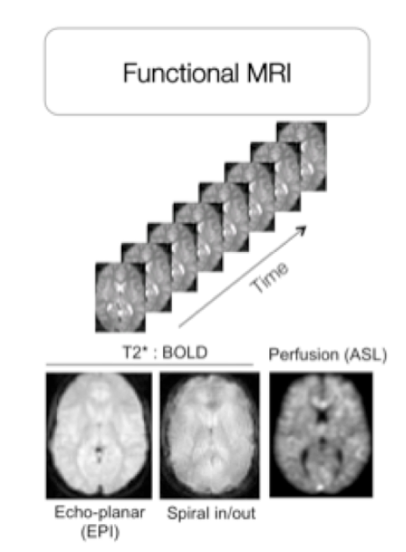
DIAGNOSIS CLASSIFICATION W/
fMRI DATA: THE PROBLEM
Resting state fMRI
Is the Subject:
TYPICAL PD
SWEDD
PRODROMAL
HEALTHY?
Source: theguardian.com

Slide 17
TAKEAWAYS
On applying Machine Learning on small datasets with a large number of features:
Tuning your models like Random Forest matters!
On applying Data Science to Healthcare:
Every data scientist can do it… And you will learn a lot through the process!
On Parkinson Disease:
A complex disease with a lot of challenges that can be tackled with Data Science
Source: theguardian.com
Notes:
Small datasets with a lot of features: off-the-shelf RF overfits > need to control variance with some tuning.

Slide 18
THANK YOU!
Data used in the preparation of this presentation were obtained from the Parkinson’s Progression Markers Initiative (PPMI) database (www.ppmi-info.org/data).
For up-to-date information on the study, visit www.ppmi-info.org.
PPMI – a public-private partnership – is funded by the Michael J. Fox Foundation for Parkinson’s Research
and funding partners, including Abbvie, Allergan, AVid, Biogen, BioLegend, Bristol-Myers Squibb, Jenali, GE Healthcare, Genentech, GlaxoSmithKline, Lilly, Lundbeck, Merck, Meso Scale Discovery, Pfizer,Piramal, Roche,Sanofi Genzyme, Servier, Takeda, Teva, UCB.
Acknowledgements: Adam Greene
Sylvain Lehmann, Tristan Behrens, Chris Ambusher, Jose Quesada, Tiago Oliveira, David Higgins.
Join me to tackle Parkinson Disease:
https://www.linkedin.com/in/alicemartindonati/
alice.martindonati.pro@gmail.com
Project code: https://github.com/AMDonati/parkinson-disease-project
Notes:
Small datasets with a lot of features: off-the-shelf RF overfits > need to control variance with some tuning.

Slide 19
APPENDIX

Slide 20
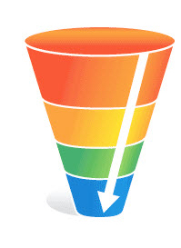
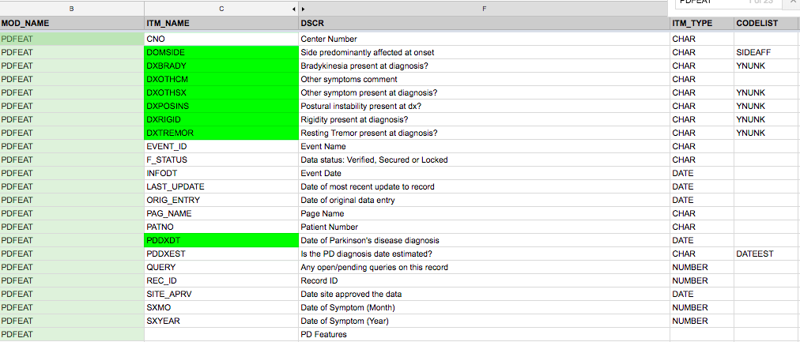
Pre-processing: Through the funnel of
Csv files & features...
From 109 csv files & ~ 2800 features…
Using the well-documented
data dictionary:
Some features engineering on datetime data & some padding
….To a final dataframe: 3884 samples ( for 1003 patients)
373 features
Tip
Don’t let data stand alone. Always relate it back to a story you’ve already told, in this case, Marco’s shop.
Notes:
Format of the medical records: csv files. At first, I thought cool, it will be easy to process but the thing is that there are a lot of them.
I looked at these 109 csv files & first assess quickly if they seems relevant to my problem or not.
Then, on the relevant one, I did some features selection. Luckily for that, I had a well-documented data dictionary. On the slide you can see a screenshot of it: I looked at all the encoded columns name & their definition and selected features: The one in green here are the ones I selected.
Then, I did some features engineering on dates (for example I calculated the time since the first PD diagnosis) and some padding for patients with very few visits.
Final dataframe size, here: small dataset with a lot of features

Slide 21
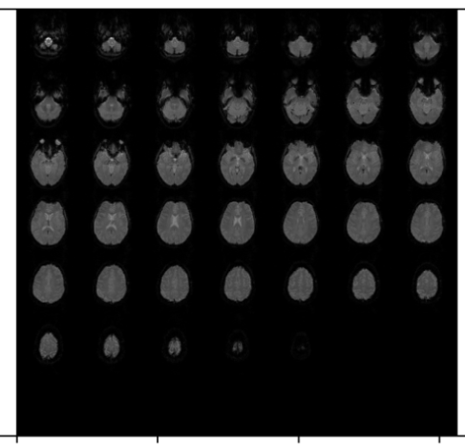
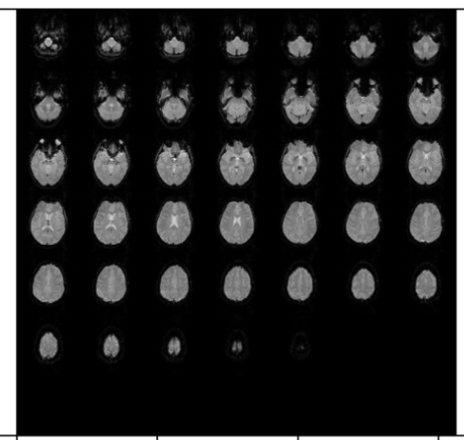
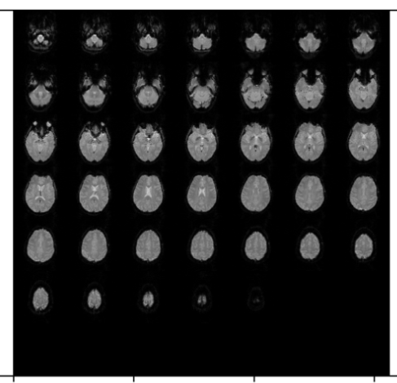
fMRI data structure
np_array.shape for one sample =
(pixel_rows, pixels_cols, slices, time_series)
(68, 64, 40, 210)
time
slice
3D-CNN
+
LSTM
Notes:
Add simple network architecture.

Slide 22
MODELLING PARKINSON PROGRESSION
One step-ahead prediction
Hoehn & Yahr Scale (NHY)
STAGE 0: NO SIGN OF DISEASE
STAGE 1: UNILATERAL DISEASE
STAGE 2: BILATERAL DISEASE, WITHOUT BALANCE IMPAIRMENT
STAGE 3: MILD TO MODERATE BILATERAL DISEASE, SOME POSTURAL INSTABILITY.
STAGE 4: SEVERE DISABILITY, STILL ABLE TO WALK AND STAND UNASSISTED.
STAGE 5: WHEELCHAIR BOUND OR BEDRIDDEN
Last
Visit
Next Visit
> Multi- Class Classification of Time-Series Data
Source: theguardian.com
Notes:
So my problem: Modelling Parkinson Progression over time.
So, the first thing to do is to define what is progression? There are a few scale that allows to measure it.
I chose Hoen & Yahr one ranking from 0 to 5: 0 being healthy, 5 being bedridden & dependent.
Now that I chose measure, I chose to tackle the following problem: one-step-ahead prediction: predicting the next visit stage from the previous visit

Slide 23
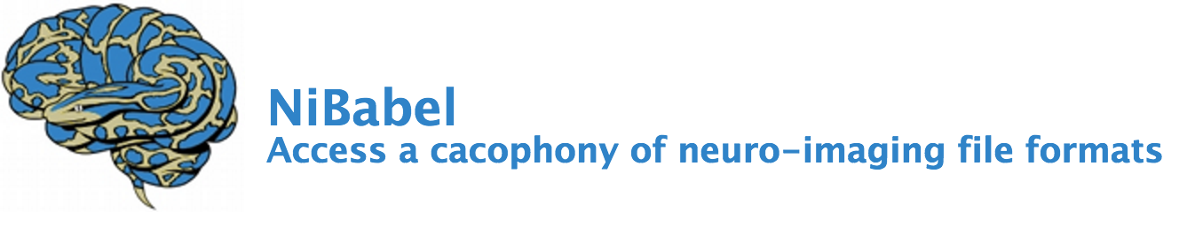


Next Steps

