Slide 1

Note: The data and information in this document is reflective of a hypothetical situation and client. This document is to be used for KPMG Virtual Internship purposes only.
Sprocket Central Pty Ltd
Data analytics approach
[Division Name] - [Engagement Manager], [Senior Consultant], [Junior Consultant]

Slide 2
Note: The data and information in this document is reflective of a hypothetical situation and client. This document is to be used for KPMG Virtual Internship purposes only.
Agenda
Introduction
Data Exploration
Model Development
Interpretation

Slide 3
Note: The data and information in this document is reflective of a hypothetical situation and client. This document is to be used for KPMG Virtual Internship purposes only.
Introduction
Approach for New Customer Analysis
Important Parameters
Job Industry
Wealth Segment
Demographics of State
Product Line

Slide 4
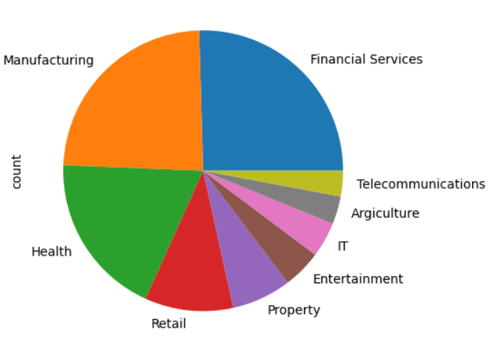
Note: The data and information in this document is reflective of a hypothetical situation and client. This document is to be used for KPMG Virtual Internship purposes only.
Data Exploration
Job Industry
The data shows the Manufacturing, Financial Services and Health industries have the highest amount of customers.
Place any supporting images, graphs, data or extra text here.

Slide 5
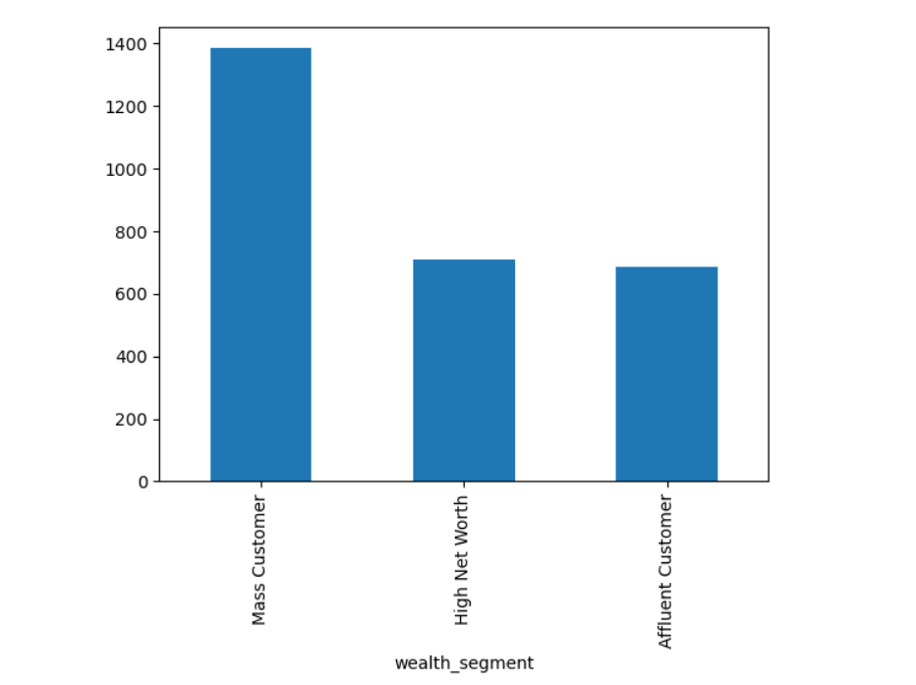
Note: The data and information in this document is reflective of a hypothetical situation and client. This document is to be used for KPMG Virtual Internship purposes only.
Data Exploration
Wealth Segment
The wealth segment ‘mass customer’ is the most important.
The remaining two wealth segments contribute an approximate equal share.
Place any supporting images, graphs, data or extra text here.

Slide 6
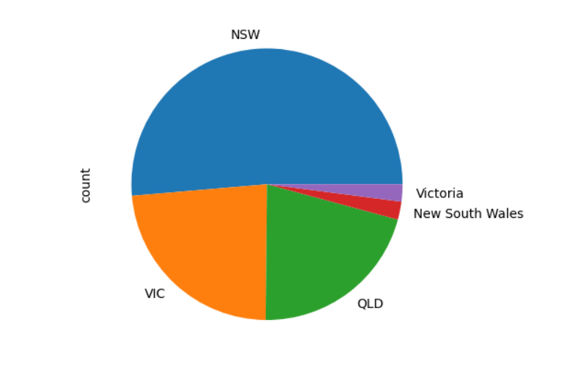
Note: The data and information in this document is reflective of a hypothetical situation and client. This document is to be used for KPMG Virtual Internship purposes only.
Data Exploration
Demographics of State
NSW, VIC and QLD states have the highest contributions.
Most of the customers are saturated in the above mentioned 3 states.

Slide 7
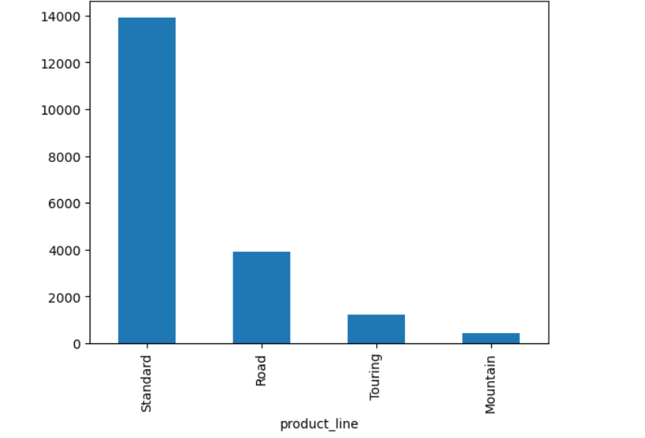
Note: The data and information in this document is reflective of a hypothetical situation and client. This document is to be used for KPMG Virtual Internship purposes only.
Data Exploration
Product Line
Standard product line far outweighs the contribution of other lines.
The primary focus should be on the standard product line.

Slide 8
Note: The data and information in this document is reflective of a hypothetical situation and client. This document is to be used for KPMG Virtual Internship purposes only.
Model Development
Targeting High Value Customers from the NewCustomerList
The model should target the customers living in NSW, QLD and VIC.
It should also take into consideration the age.
The manufacturing, financial and health sectors should be given more importance.

Slide 9
Note: The data and information in this document is reflective of a hypothetical situation and client. This document is to be used for KPMG Virtual Internship purposes only.
Interpretation
The following insights are derived after careful analysis.
Manufacturing, Financial and Health sectors should be targeted.
The 3 states NSW, VIC and QLD hold the potential new customers.
The standard product line should be most focused on.
Although, the mass customer wealth segment has the most importance, however the importance of the other 2 segments should also be taken into consideration.

Slide 10
Note: The data and information in this document is reflective of a hypothetical situation and client. This document is to be used for KPMG Virtual Internship purposes only.
Thank You

