Slide 1
Would I Hire My Own Graduates? Innovation-First Learning for Job-Ready CS Graduates in the AI Era
Dr. Alexander(Sasha) Apartsin
21/07/2026

Slide 2
Motivation
I joined HIT in 2024 to focus on teaching and research
After 30+ years in concurrent academia/industry/teaching tracks
Currently teaching electives
LLM and Agents, Deep Generative Models (for Vision and Audio)
Multiple programs, institutions: CS/Digital Health, HIT/BIU, BSc/MSc, Zoom, and F2F
The syllabus and teaching approach is designed around a simple objective
Would I hire these graduates for my own team?
Would I trust them to contribute to my research?

Slide 3
30+ Years on Parallel Tracks
Watching a Growing Disconnect
Academy: what I studied and how I taught
Technion/Weizmann/TAU: classical CS training
Teaching CS courses: 15+ years of conventional CS syllabus
Student supervision: Dozens of BSc/MSc finals
Industry: what I did and what I was paid for
Roles: From Algo/SW Developer to VP R&D/CTO, AI Head/VP
Companies: startups, medium, corporations
Team building: interviewed hundreds, hired dozens
Real-life hands-on: coding systems, recently vibe-coding
AI has widened the gap.
How can we reconnect without compromising either side?

Slide 4
Software Engineering: Past vs. Future
Past | AI-dominated future
Solving customized standard tasks (textbook tasks with a twist) | Build sophisticated new stuff (offload standard tasks to AI)
Large team with narrow specializations (algo/software separation) | Build complete systems single-handedly (equipped with AI)
Develop deep expertise through complete knowledge of a single tech stack | Perform under uncertainty/partial knowledge (things change fast, the expectations are too high)
Separation between why(business), what (product) and how(engineers) | Integrative engineering, communications and product thinking
How to teach for tomorrow’s skills?

Slide 5
My approach: Innovation-First Learning
Center the course around student projects
Project must have significant novel elements, not a customized standard exercise
Project should be technically deep/sophisticated, with many design choices
Students should start executing and presenting project during the course, not at the course end
Students should perform incremental improvement based on continuous instructor feedback
Course’s final delivery is a demonstratable portfolio project (GitHub repo with detailed README)
Requires significant adaptation of a conventional course syllabus
Introduce many concepts earlier, revisit later for depth
Integrate tools/code with theory at every step
Teach a comprehensive toolbox of state-of-the-art concepts and tools
Multiple in-class student presentations and feedback sessions (proposal, mid, final)
Equip students with tools/references(project examples, up-to-date textbook, AI bot)
Encourage reuse and AI use with clear constraints (novelty + 100% ownership)
Train students for technical communications: reason, explain, and present

Slide 6
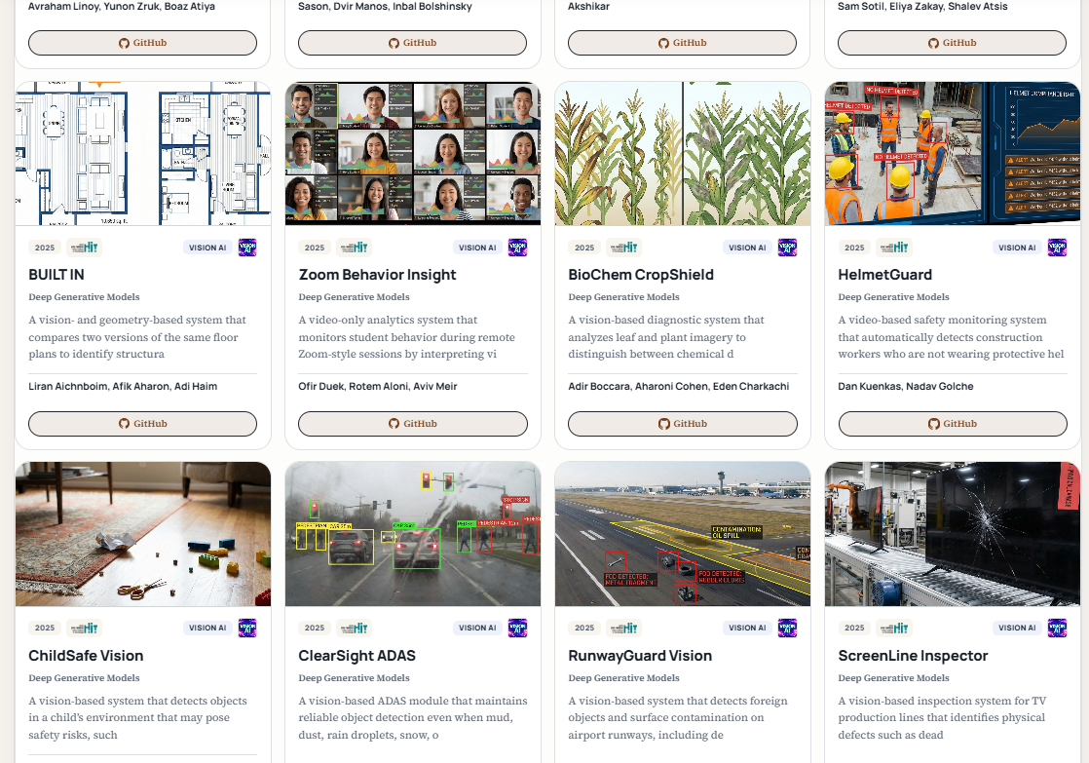
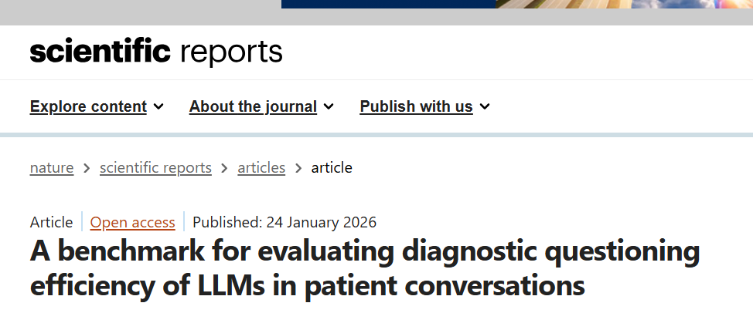

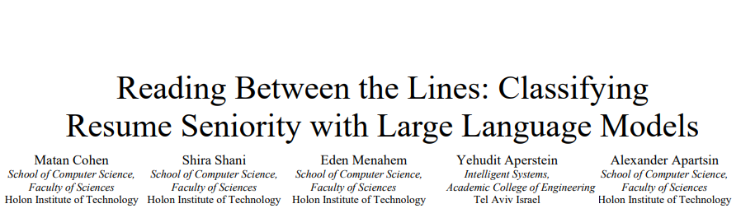
2025-2026: Over 100 student projects

Slide 7
Major Takeaways: Innovation-First Learning
Skills in demand
A one-man army engineer equipped with AI
Perform under uncertainty, partial knowledge, and high expectations
What to teach
Rich toolbox of integrated theoretical concepts and tools/platforms
How to build sophisticated new stuff quickly with reuse and AI-offloading
How to teach
Integrate theory/code/tools/applications during the class
Spiral introduction of complex concepts for early project start
Running student projects with continuous feedback
Require significant value, novelty, and depth of the project
Encouraging AI and reuse while taking 100% ownership

Slide 8
Useful links
Innovation-First Learning Methodology | https://www.apartsin.com/work/innovation-first-learning.html
Student Course Projects | https://www.apartsin.com/teaching/hands-on-ai-science-courses-student-projects.html
Project assistant AI bots | https://www.apartsin.com/teaching/course-bots.html
Online textbooks | https://www.apartsin.com/writing/books-overview.html
Essays on AI in education and AI-driven software engineering | https://www.apartsin.com/writing/blog-posts.html
Graduate Readiness profiles | https://www.apartsin.com/assets/teaching/curriculum-development/grp-ai-engineer.pdf https://www.apartsin.com/assets/teaching/curriculum-development/grp-fullstack-dev.pdf
Student Guides | https://www.apartsin.com/teaching/guides/index.html
Elective design principles | https://www.apartsin.com/teaching/advanced-cs-elective-framework.html

